Slide 1
Comparing Political Democracies: What & Why?
POL1036: Comparative European Politics – Lecture 2 - 19/1/2026

Slide 2
Schedule
Today:
What do we compare?
Problematic?
And why does it matter?

Slide 3
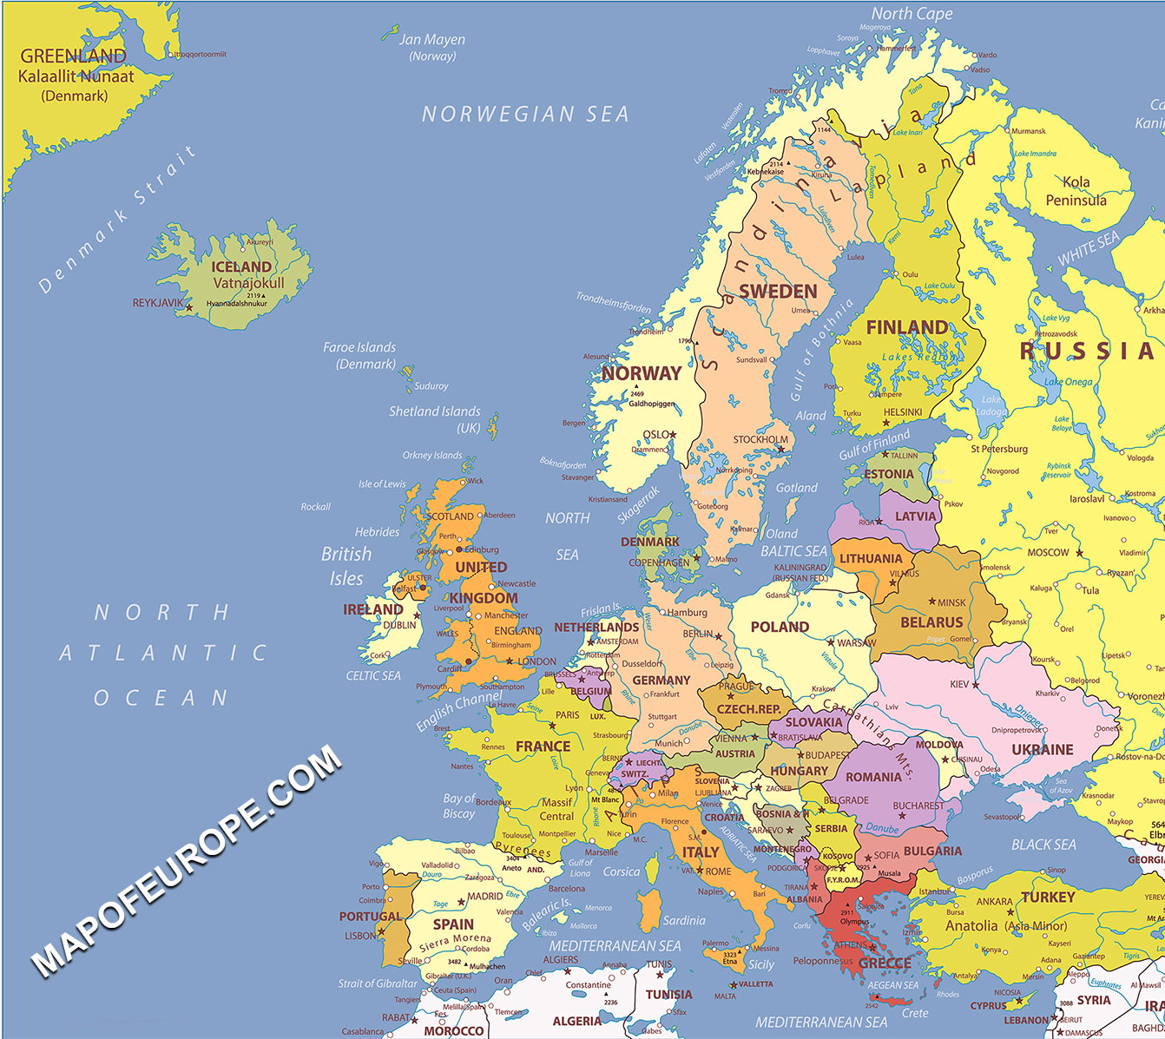
10 building blocks of political democracies
Similarities/differences in pol. systems
Think: people, parties, positions, institutions, …
What criteria did you use?

Slide 4
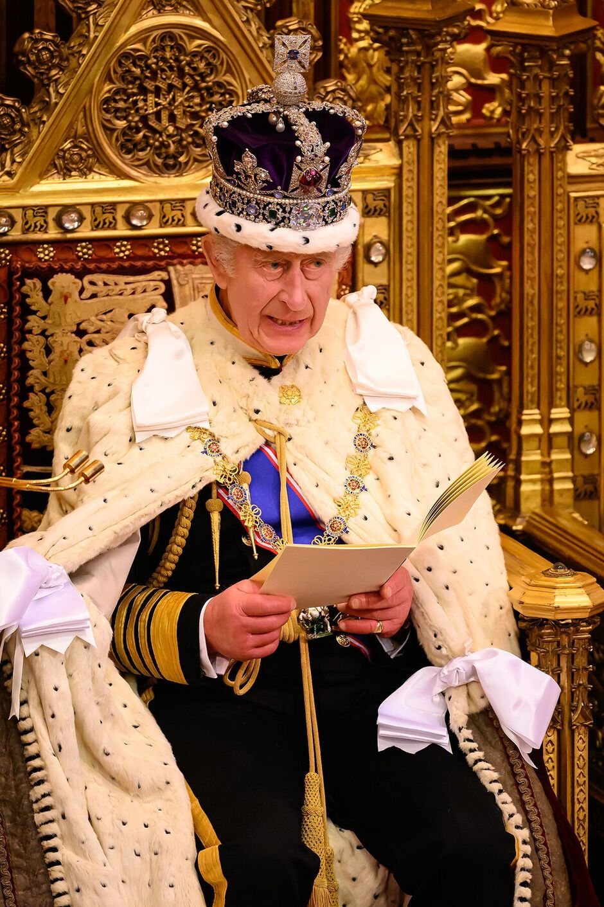
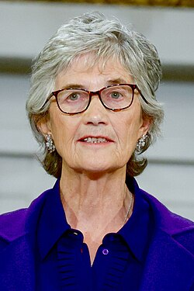
Variety in Europe
Head of state ( Monarchy vs Presidential)

Slide 5
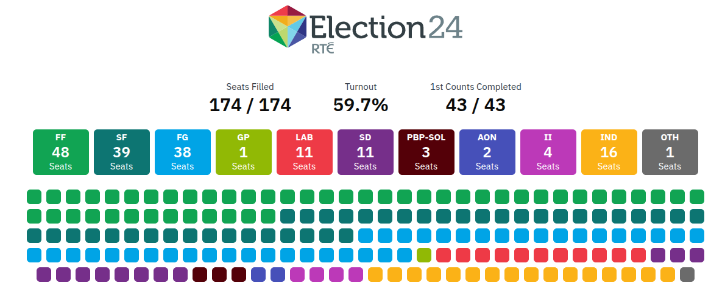
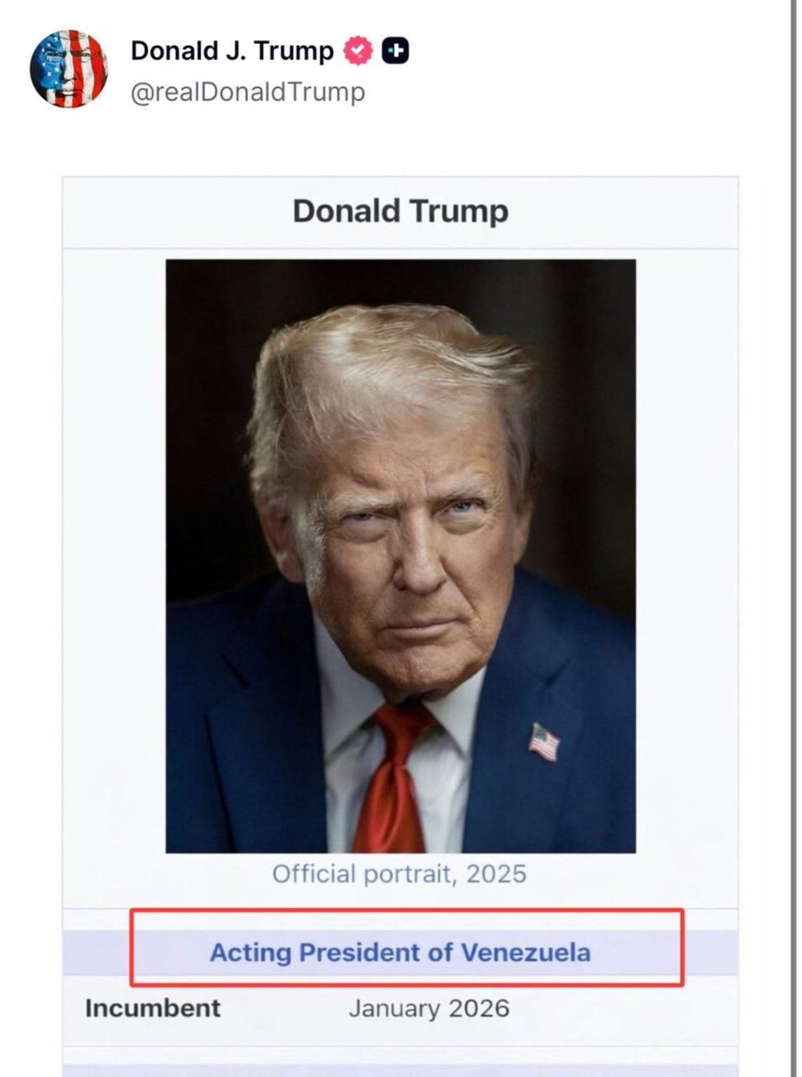
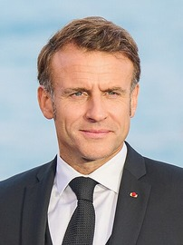
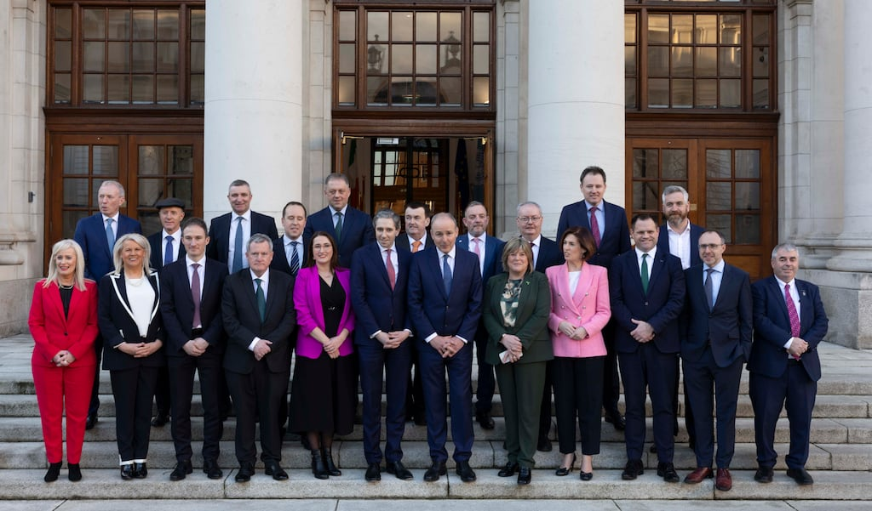
Variety in Europe
Head of state ( Monarchy vs Presidential)
Political System (parliamentary vs presidential)

Slide 6
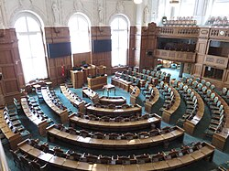
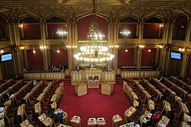
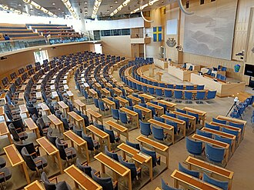
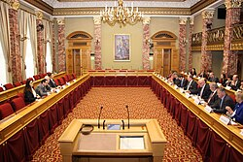
Variety in Europe
Head of state ( Monarchy vs Presidential)
Political System (parliamentary vs presidential)
Parliaments
Unicameral (DK, NO, SW, LU)
Folketing (DK)
Storting (NO)
Riksdag (SW)
Chambre (LU)

Slide 7
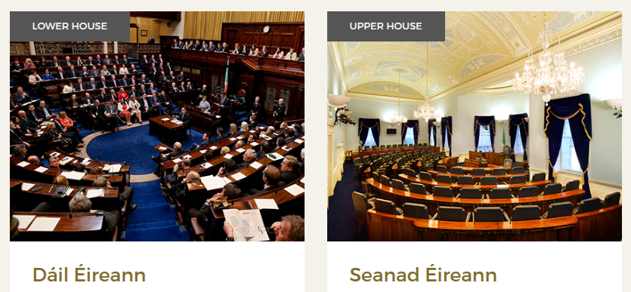
Variety in Europe
Head of state ( Monarchy vs Presidential)
Political System (parliamentary vs presidential),
Parliaments
Unicameral (DK, NO, SW, LU)
Bicameral
Directly elected lower house
Weird upper house

Slide 8
Variety in Europe
Party systems
2 party 2.5 party Multiparty

Slide 9
Variety in Europe
Party systems
Executive Majority
1 party Multiparty
Minority Regular coalition Oversized
(SW, NO, NL 2010, BE 2018)

Slide 10
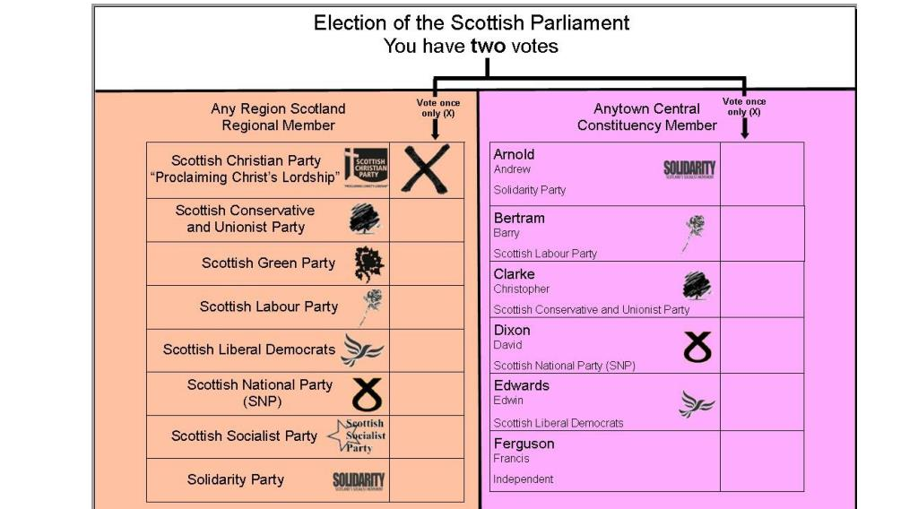
Variety in Europe
Party systems
Executive Majority
Electoral Systems
Majoritarian Mixed System Proportional

Slide 11
Variety in Europe
Party systems
Executive Majority
Party systems
State structure
Federal Quasi-Federal Centralized
DE, BE SP IE, UK (but devolution)
Depends on level and constitutional protection of state autonomy

Slide 12
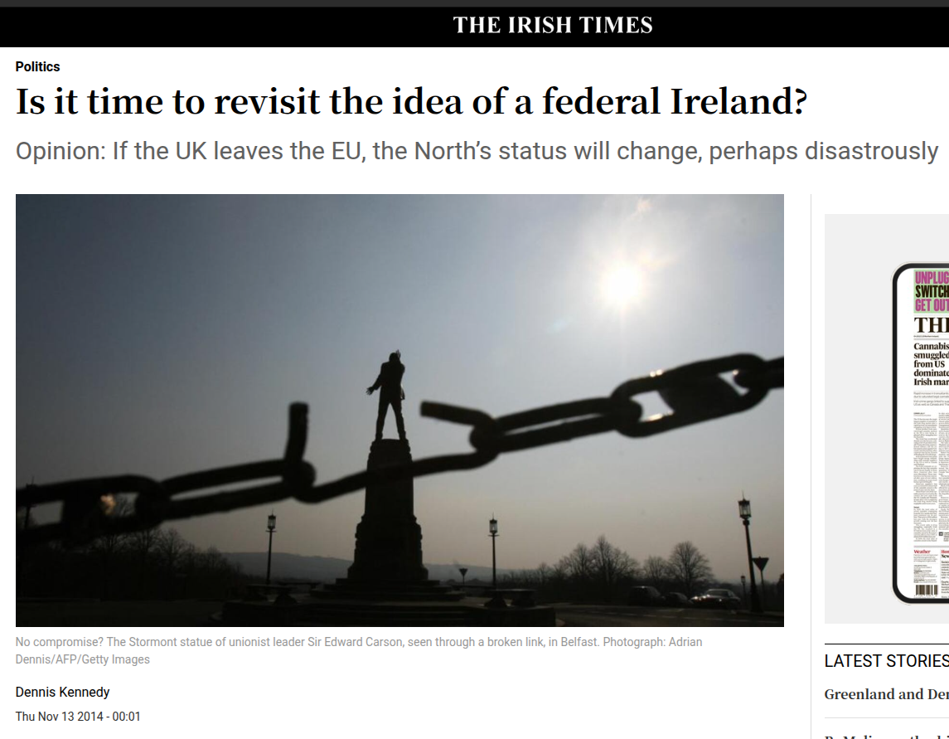
Irish Unification: Towards a Federal State?
https://www.irishtimes.com/news/politics/is-it-time-to-revisit-the-idea-of-a-federal-ireland-1.1998276

Slide 13
The Problems of Comparative Politics

Slide 14
Recap: Classical vs. Modernist Approaches
Classical/Traditional
Normative
No rules
Speculative
Unsystematic
Focused on Polities
Method of Agreement
Modernist
Value-Free
Specific rules
Grounded in facts
Systematic
Focused on Politics & Policies
Method of Difference

Slide 15
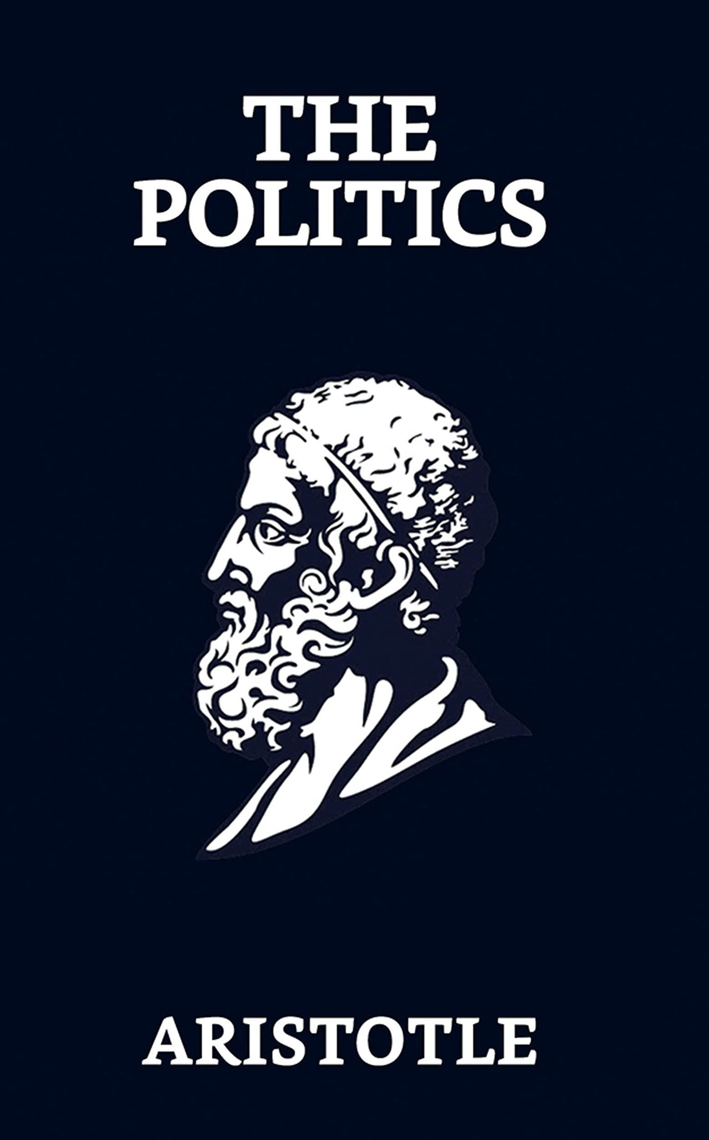
Recap: Inconsistent typologies
The Politics (350 BC)
150 constitutions of Greek city-states
Typology of political systems (#rulers)
#Rulers | Good | Bad/Perverted
1 | Royalty | Tyranny
few | Aristocracy | Oligarchy
many | Polity | Democracy
Normative: "The ideal-state"​
+speculative & ethno-centric

Slide 16
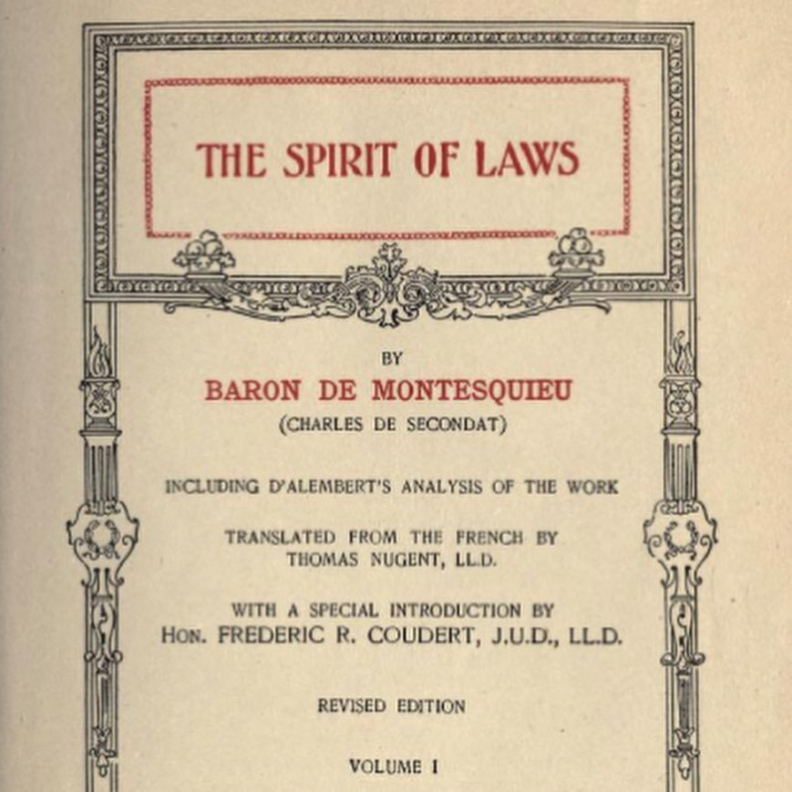
Recap: Inconsistent typologies
Regime Downfall: Did not take into account historical differences
Different, inconsistent and normative typologies
f.i. Montesquieu's Spirit of the Laws (1748):
Monarchy
One ruler, fixed laws
Rule
#Rulers
Despotism
One ruler,
fear
Republic
Many rulers,
fixed laws
#Rulers AND Rule

Slide 17
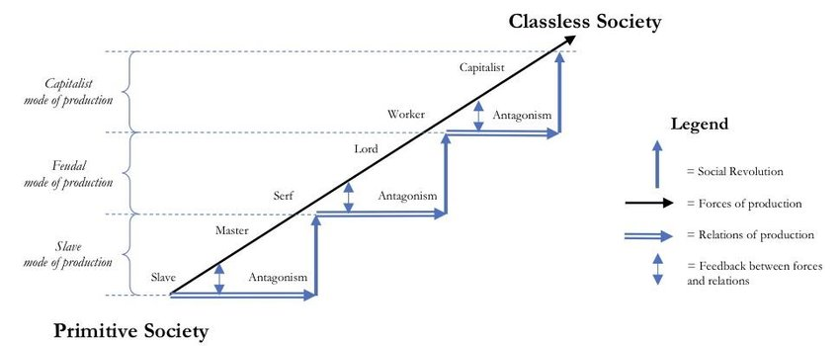
Recap: Evolutionist Models
Capitalist Society
Feudal Society
Ancient Society
Carter, Scott. (2017). Karl Marx and the Marxist School. https://doi.org/10.13140/RG.2.2.27320.03847

Slide 18
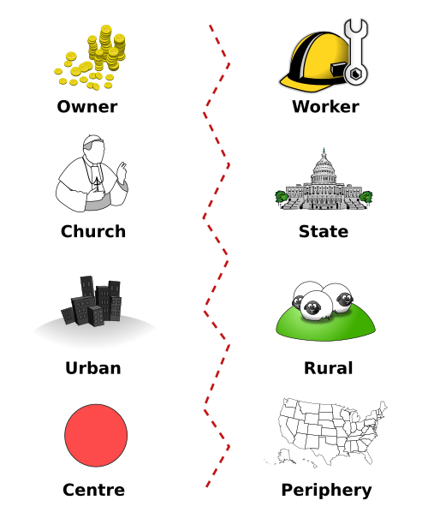
Recap: Frameworks grounded in reality & methodological rigor
Cross-national data on party systems X social divisions to explain voting behavior
Socialist & Communist Parties
Owner
Worker
Religious Parties
Church
State
Conservative & Liberal Parties
Agrarian Parties
Industry
Rural
Ethnic / Linguistic Parties
Centre
Periphery

Slide 19
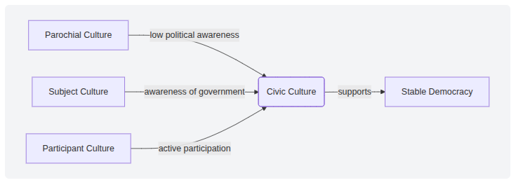
Recap: Frameworks grounded in reality & methodological rigor
What makes a stable and successful democracy?
Cross-national data on attitudes & political behavior

Slide 20

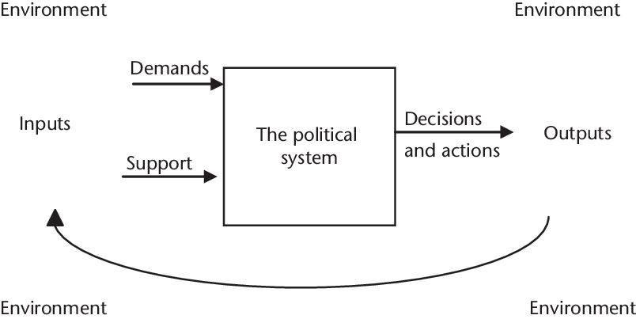
Recap: Frameworks grounded in reality & methodological rigor
Input-Output: Easton's Model of a Political System
(50s-60s)
Black Box
Policies
Feedback

Slide 21
1. Does not tell us who to vote for, or what best form of government is

Slide 22
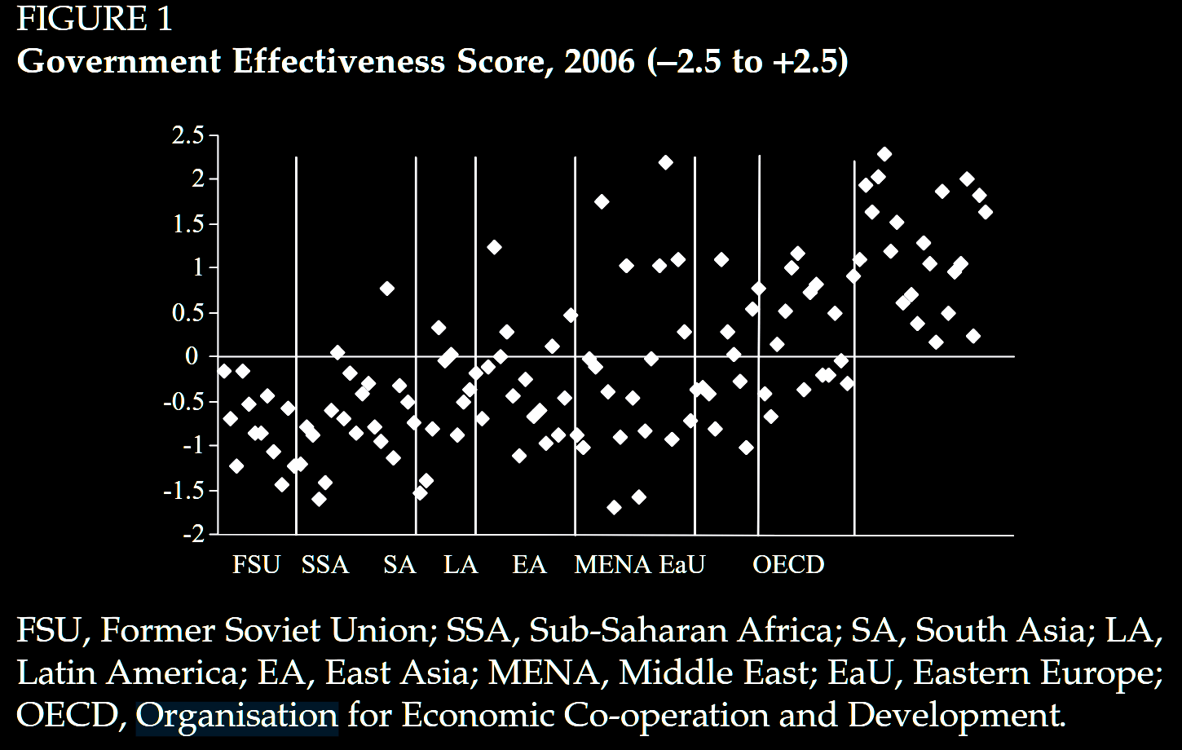
Can only examine specific empirical factors f.i. Government effectiveness (Andrews, 2010)
FSU SSA SA LA EA MENA EaU OECD

Slide 23
But can give evidence to make informed decision

Slide 24
2. CP has a data problem

Slide 25
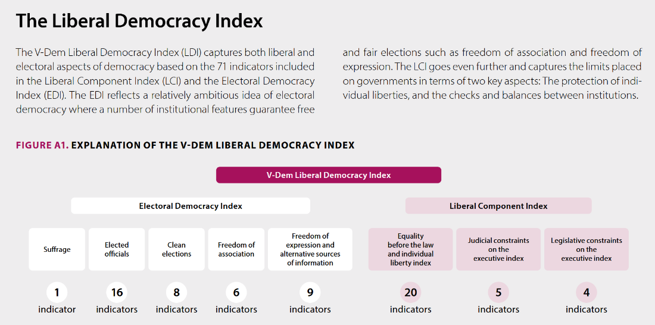
Most phenomena have operationalization issues f.i. V-Dems Liberal Democracy Index
= LATENT VARIABLE
Source: V-Dem Democracy Report 2025. https://www.v-dem.net/documents/61/v-dem-dr__2025_lowres_v2.pdf

Slide 26
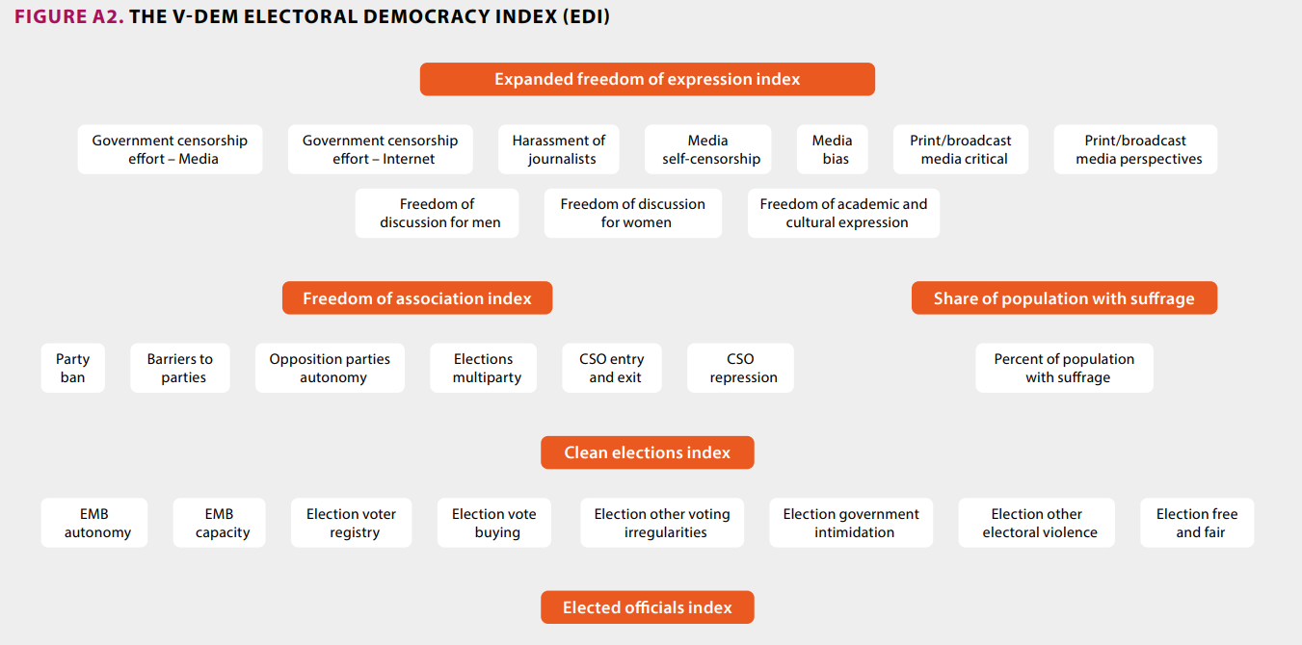
Most phenomena have operationalization issues f.i. V-Dems Liberal Democracy Index
= OPERATIONALIZATION
Source: V-Dem Democracy Report 2025. https://www.v-dem.net/documents/61/v-dem-dr__2025_lowres_v2.pdf

Slide 27
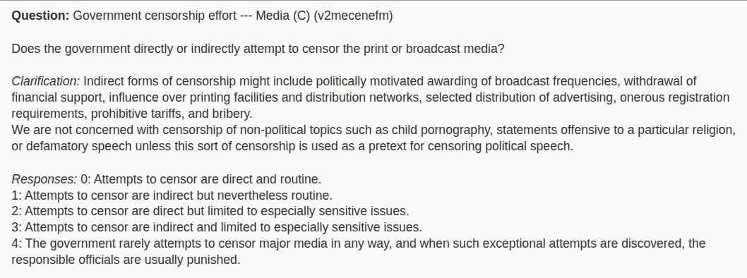
Most phenomena have operationalization issues f.i. V-Dems Liberal Democracy Index
Expert Surveys
Source: V-Dem. https://www.v-dem.net

Slide 28
3. Establishing complete causality is a pipedream

Slide 29
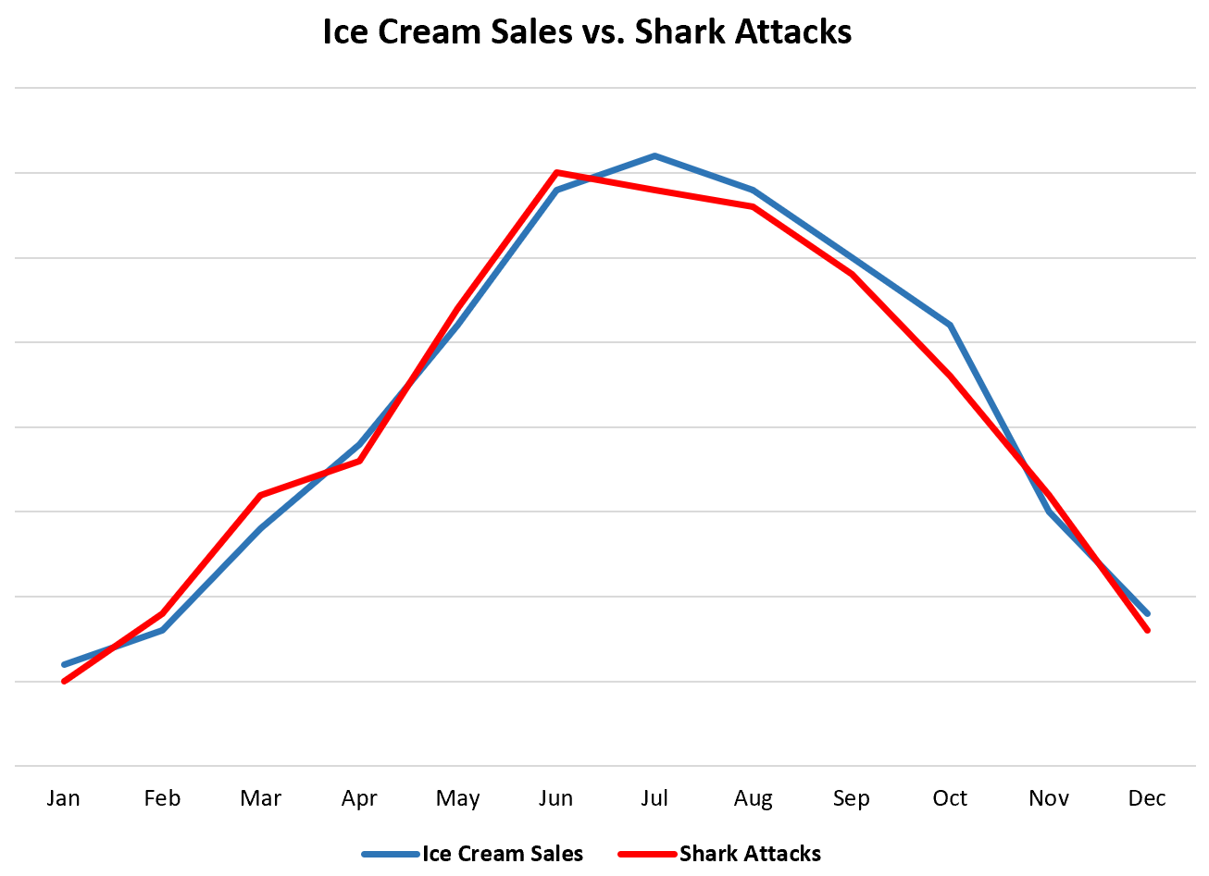
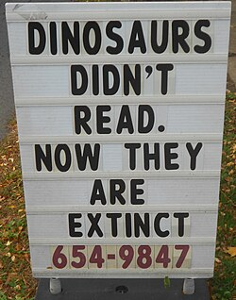
Correlation is not Causation

Slide 30
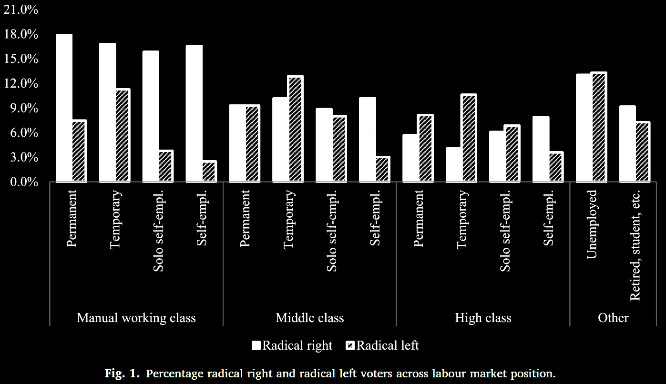
Probabilities, not Laws/Certainties
Other possible factors?
Human factor
Protest vote
Country's history
Party system
…
So never 'for sure', always 'tends to', 'probably', 'likely', ...
Take Sipma, Marcel Lubbers, Niels Spierings, Working class economic insecurity and voting for radical right and radical left parties, Social Science Research, Volume 109, 2023, 102778, ISSN 0049-089X, https://doi.org/10.1016/j.ssresearch.2022.102778.

Slide 31
But all science deals with these issues

Slide 32
4. Every country is unique

Slide 33
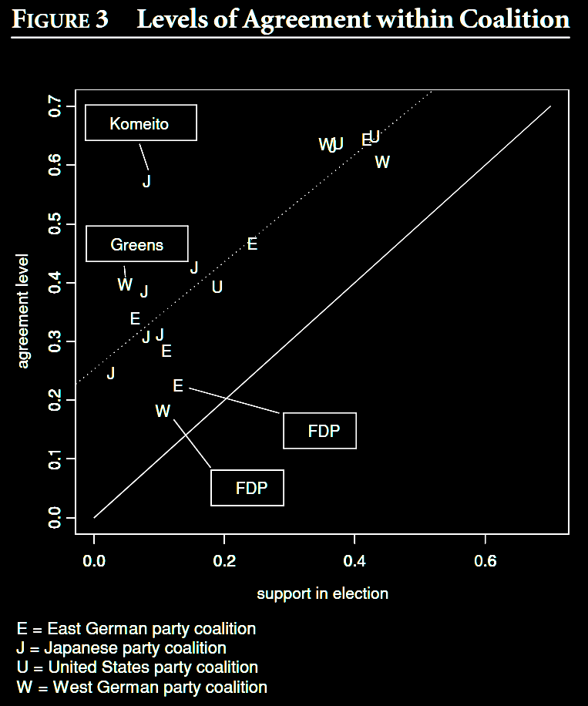
Does it make sense to compare?
Depends on what you want to compare!
Here: effect of amount of party support on levels of agreement within supports of that party
Allows for wide variation in party & electoral systems + other societal factors
Huckfeldt, R., Ikeda, K. and Pappi, F.U. (2005), Patterns of Disagreement in Democratic Politics: Comparing Germany, Japan, and the United States. American Journal of Political Science, 49: 497-514. https://doi.org/10.1111/j.1540-5907.2005.00138.x

Slide 34
So does it matter?

Slide 35
1. Learn more about our own country

Slide 36
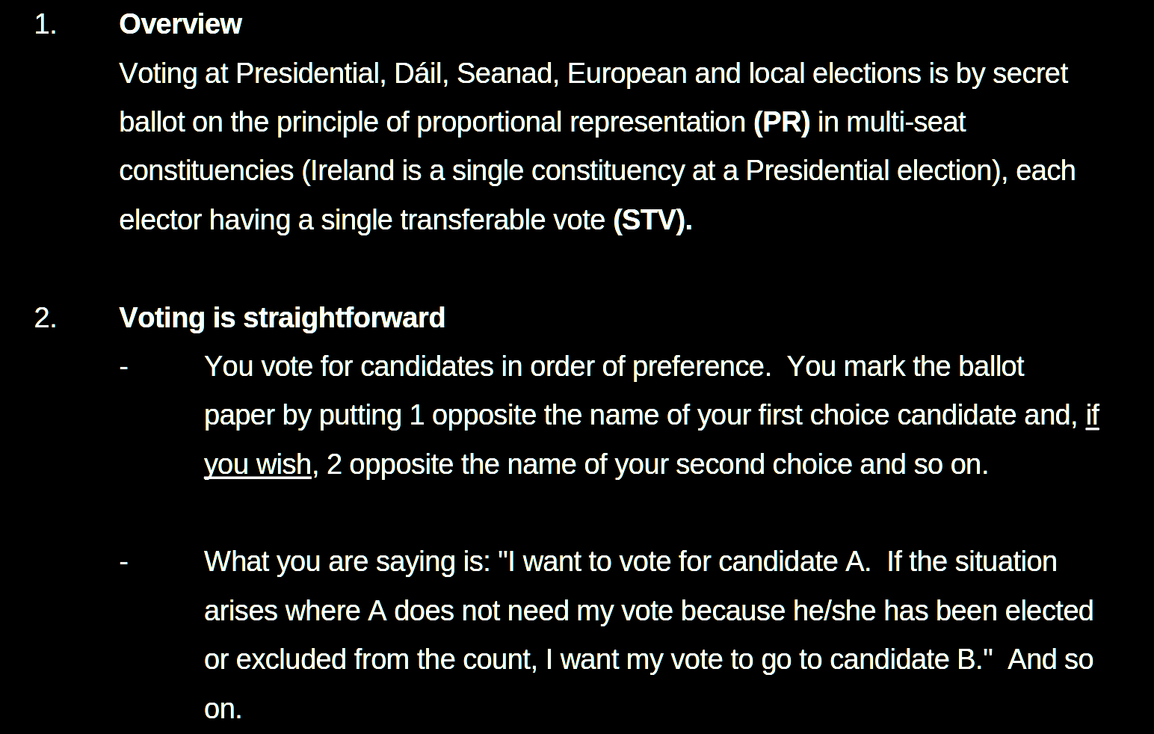
Why does Ireland have such a weird voting system (PR-STV)?
Source: A Guide to Ireland’s PR-STV Voting System. https://assets.gov.ie/static/documents/a-guide-to-irelands-pr-stv-voting-system.pdf

Slide 37
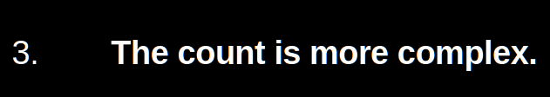

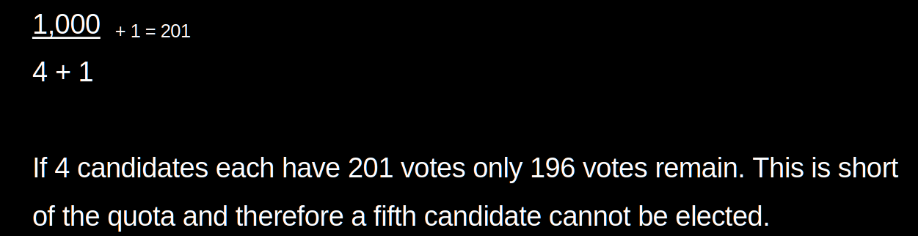
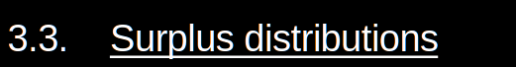
6 pages of explanation!

Slide 38
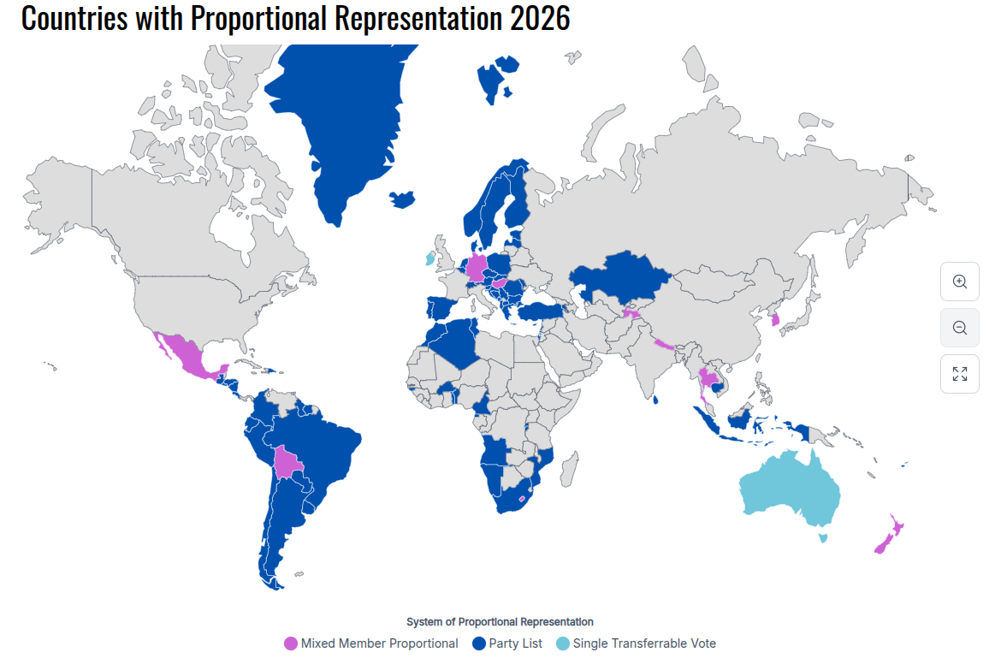
Source: https://worldpopulationreview.com/country-rankings/countries-with-proportional-representation

Slide 39
2. Learn more about other countries

Slide 40
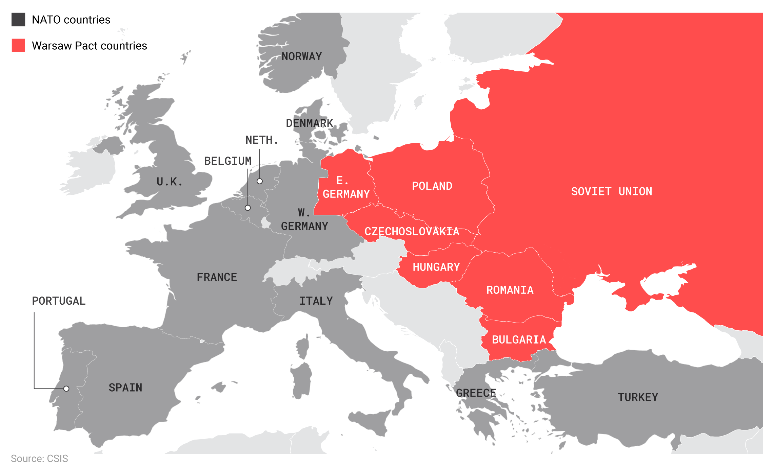
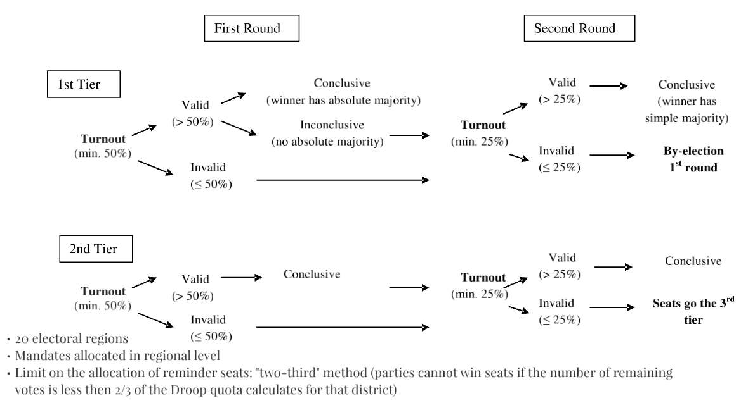
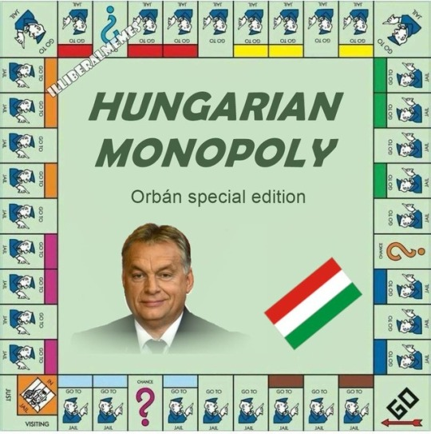
c.f. Democratic Backsliding in Hungary
What explains it?
History?
Institutions?
Actors?

Slide 41
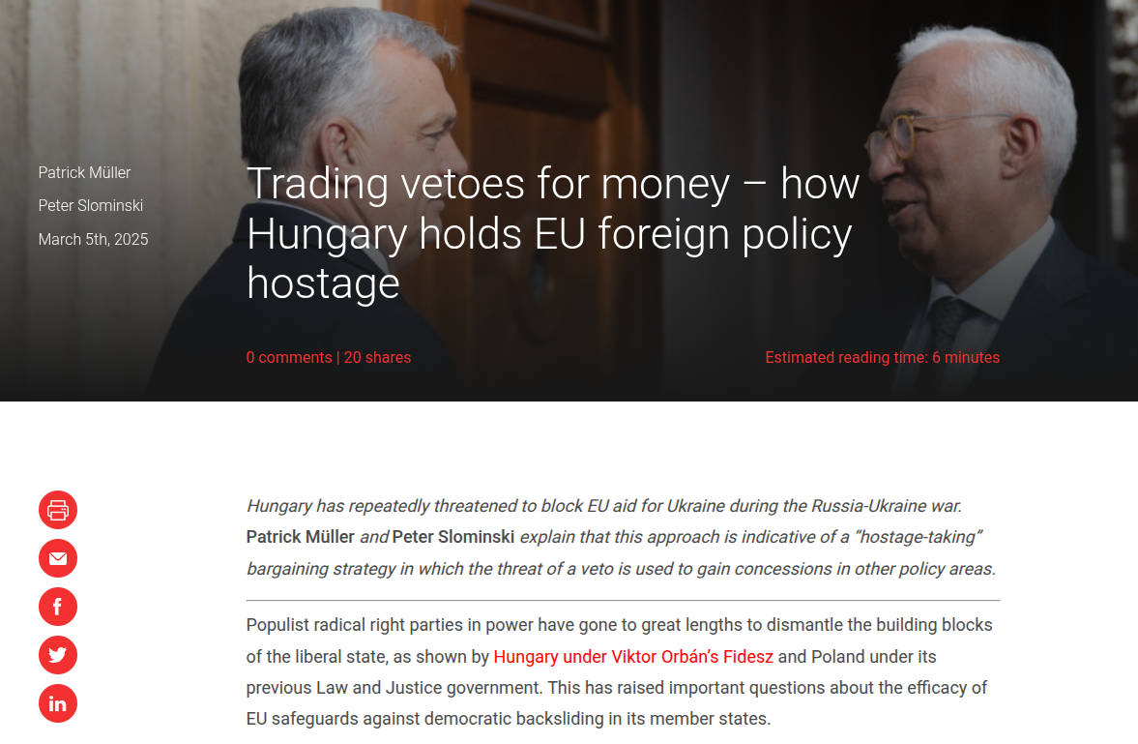
Matters for Ireland: EU Foreign Policy
https://blogs.lse.ac.uk/europpblog/2025/03/05/trading-vetoes-for-money-how-hungary-holds-eu-foreign-policy-hostage/

Slide 42
3. Generalist theories & knowledge on politics & government

Slide 43
If A, then B If X, then Y

Slide 44
More on Thursday!

