Slide 1
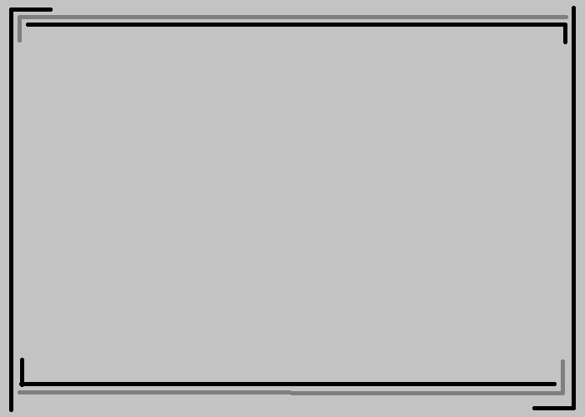
MovieCatcher
Closest distance between movie and movie
U10016023 何怡
U10016027 鍾維聖
U10016033 許顥瀚
U10016043 蕭博文
1

Slide 2
Outline
● What is MovieCatcher ?
● Techniques we will use
● Difficulties we may encounter
2

Slide 3
What is MovieCatcher ?
We're tired of
''what movie you've watched '' ,or
''your friends like which movies''.
So, we dicide to let movies have connected with the other movies by themselves!
3

Slide 4
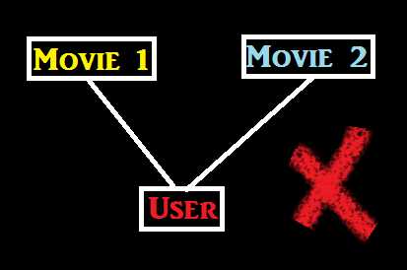
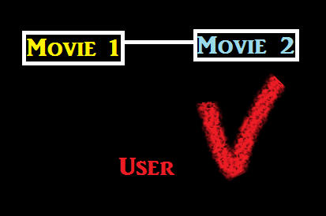
We provide a platform which include a lots of movies, you can chose which movie you have already watched, but what special is ,
for example, you have watched two movie
4

Slide 5
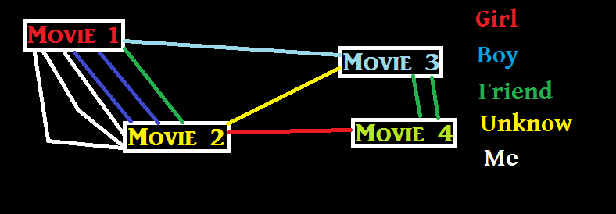
For two movie,
the more people have watched them both
the more line will connected them.
Therefore, user can know what kind of movies they probably like by the MovieCatcher
5

Slide 6
Techniques we will use
(a) Java as our main programming language
(b) Run at Heroku platform
(c) May use FB Graph API, SQLite
Except user chose movie they've watched,
we will get the permission of movies which they like on FB as reference.
6

Slide 7
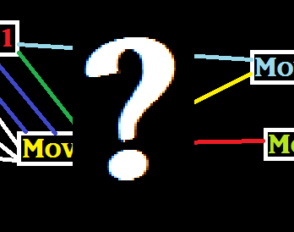
Difficulties we may encounter
1. How to get movies' information ?
2. How to draw a line?
7

Slide 8
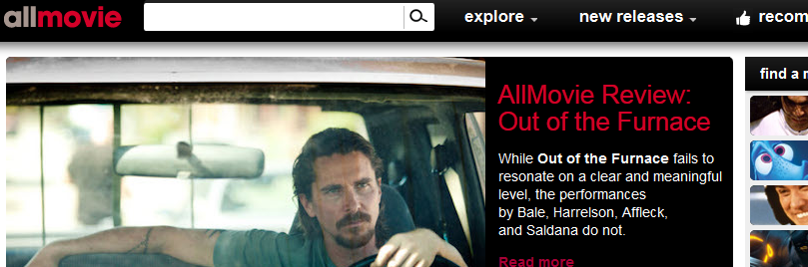
1. How to get movies' information ?
Maybe handmade one by one...
Check information from this web :
http://www.allmovie.com/
AllMovie
7

Slide 9
2. How to draw a line?
This web provide a few way to draw a line or graph
http://www.cnblogs.com/zwl12549/archive/2007/12/21/1009758.html
but it mainly slove histogram,
still get a long way to go.
8

Slide 10
The End
10

