Slide 1

MovieCatcher
Closest distance between movie and movie
U10016023 何怡
U10016027 鍾維聖
U10016033 許顥瀚
U10016043 蕭博文
1

Slide 2
Outline
● What is MovieCatcher ?
●Demonstrate MovieCatcher
●Unfinished part
●GitHub link
2

Slide 3
What is MovieCatcher ?
We're tired of
''what movie you've watched '' ,or
''your friends like which movies''.
So, we dicide to let movies have connected with the other movies by themselves!
3

Slide 4
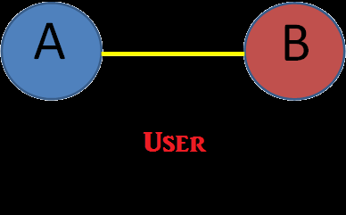
We provide a platform which include a lots of movies, you can watch which movie you have already watched on Facebook
for example, you have watched two movie,
There will line be connected between A and B
4

Slide 5
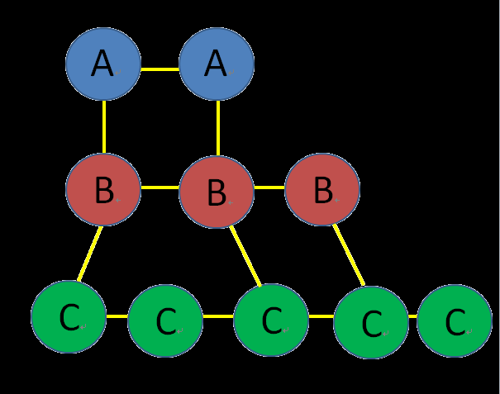
the more movie that your friends have watched them on Facebook,
the more node will connected them.
Movie is ordered by number of viewer
5

Slide 6
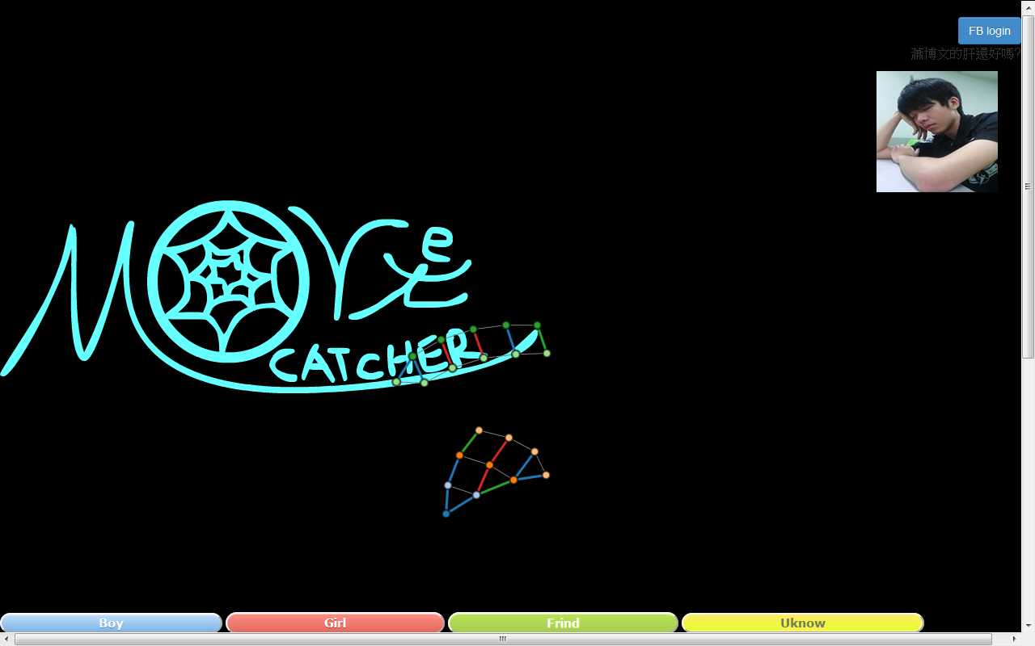
Demonstrate
6

Slide 7
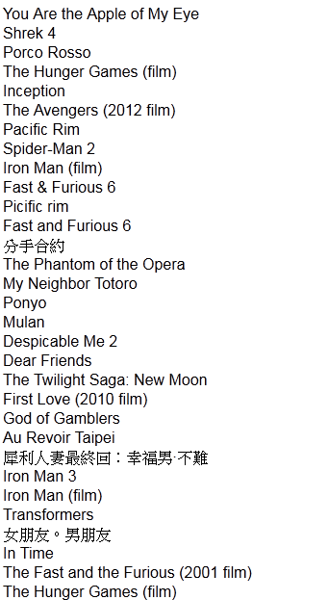
Demonstrate
There are movie data friends and I watched , from Facebook API.
6

Slide 8
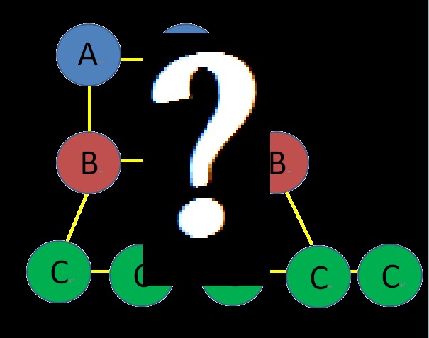
Unfinished Part
1.How to design an algorithm that make node connect node?
2.How to get more movie data?
7

Slide 9
Unfinished Part
2.Maybe we can new an button that is “more..”,
help us to get more movie data preventing
from long time no response.
7

Slide 10
GitHub Link
https://github.com/Twbadkid/MovieCatcher
8

Slide 11
The End
10

