Slide 1
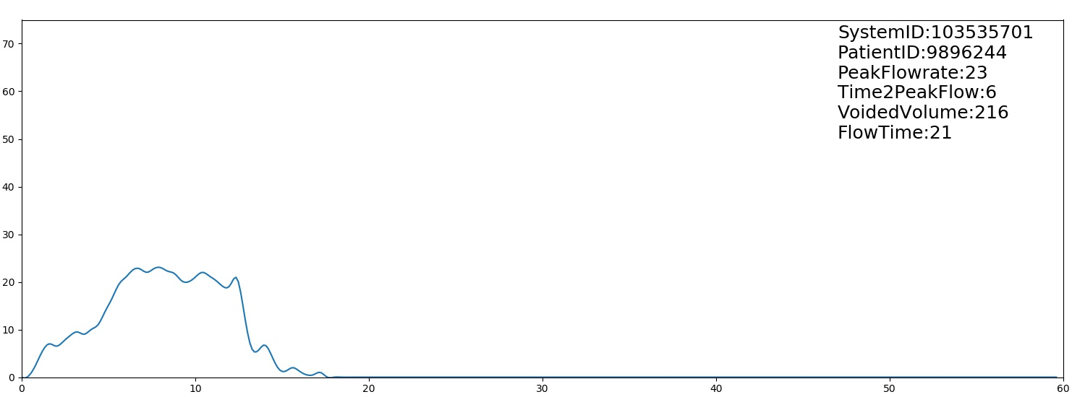
老人泌尿道專案

Slide 2
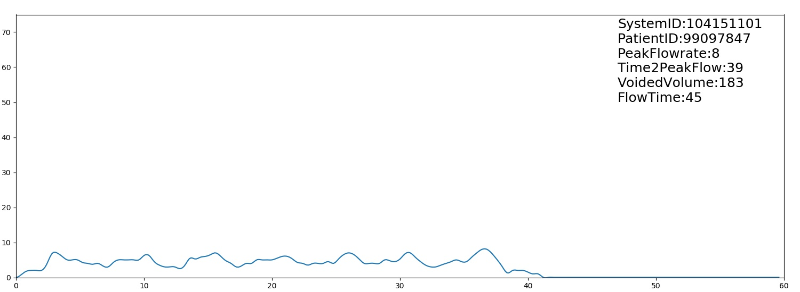

Slide 3
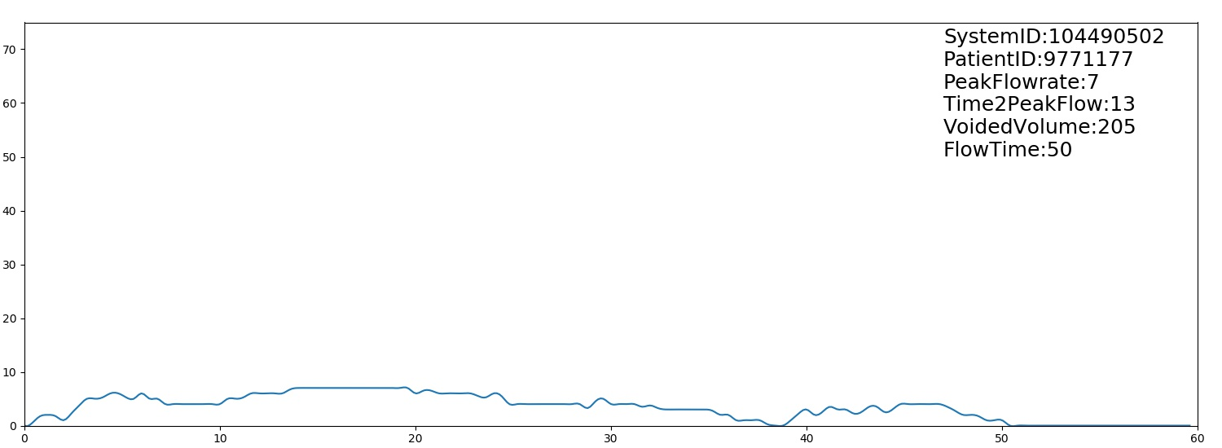

Slide 4
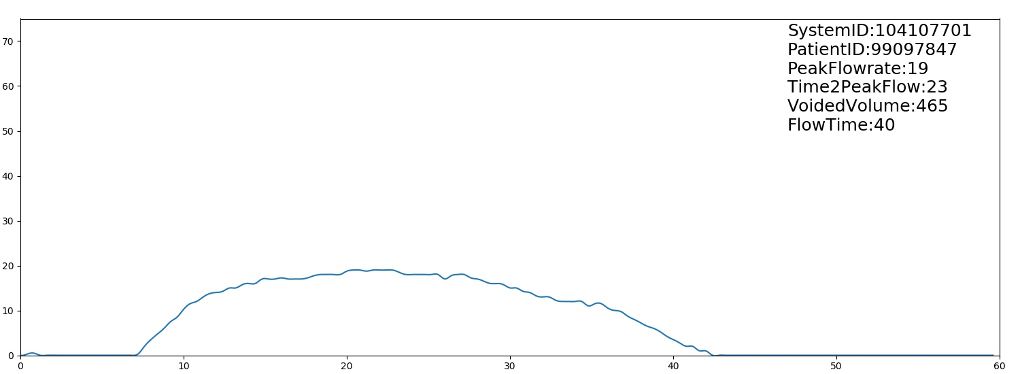

Slide 5
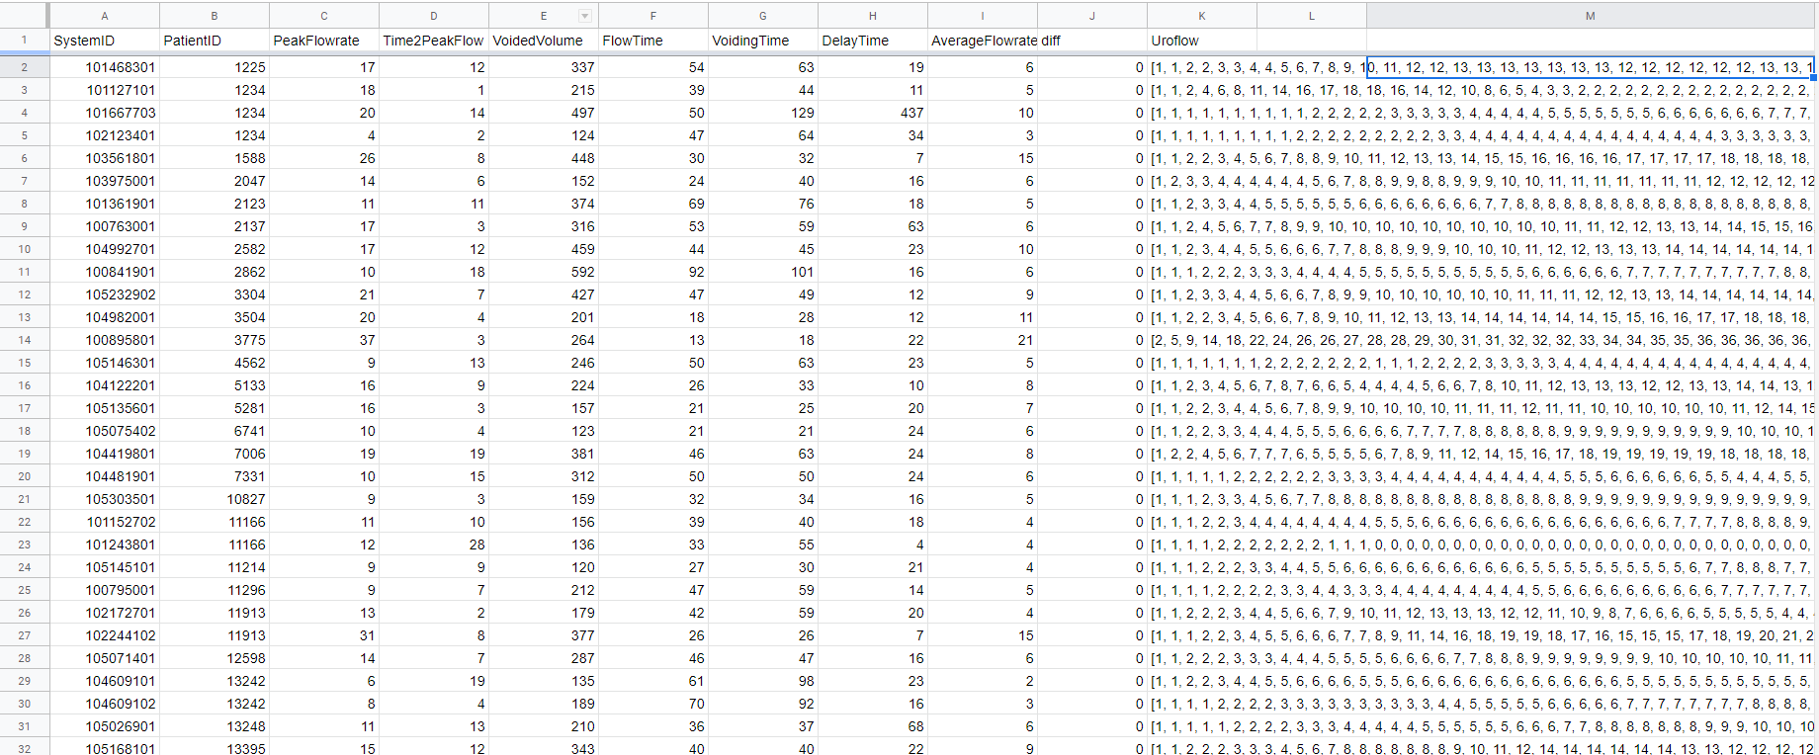
資料預處理 pair up data

Slide 6
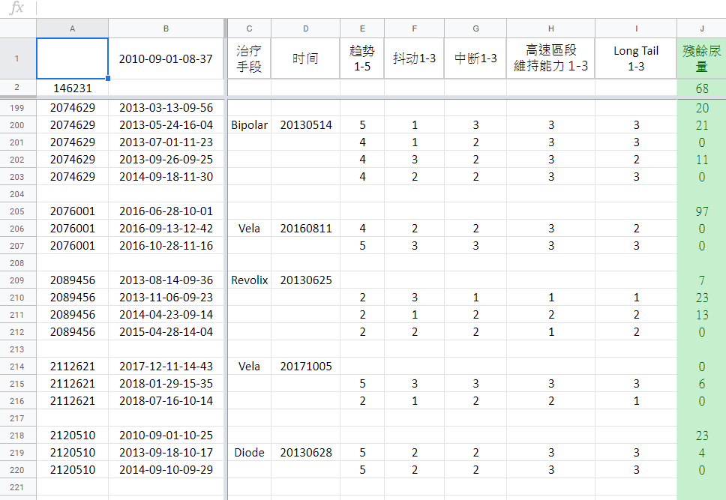

Slide 7
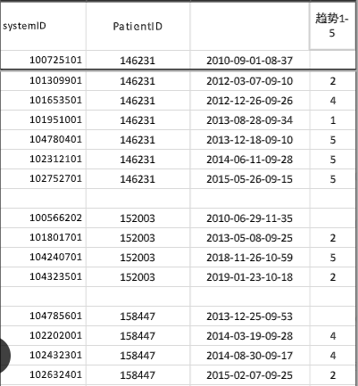
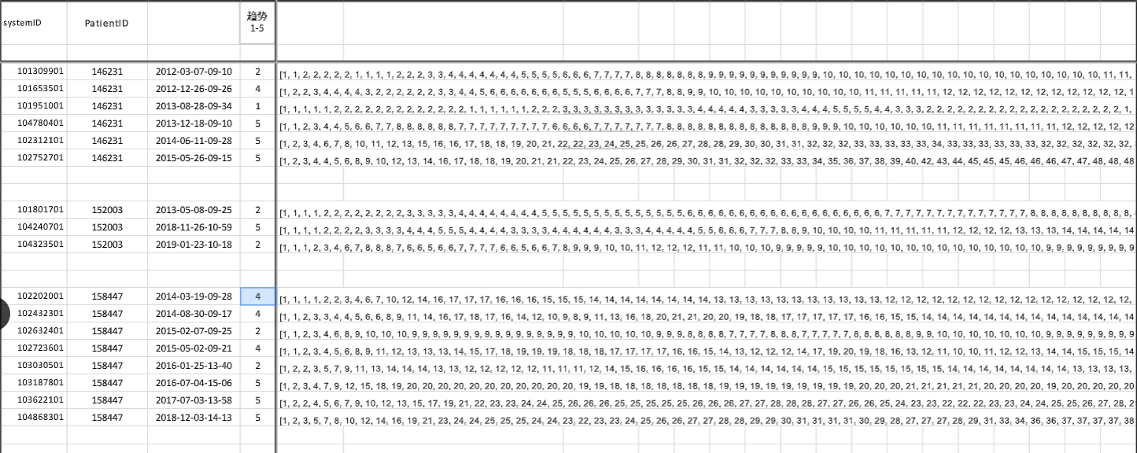

Slide 9
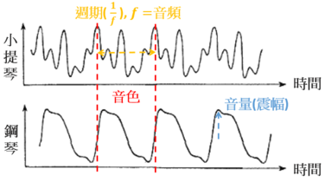
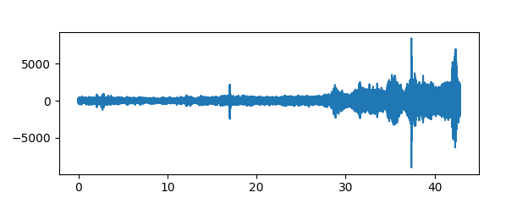
Data for DSP

Slide 10
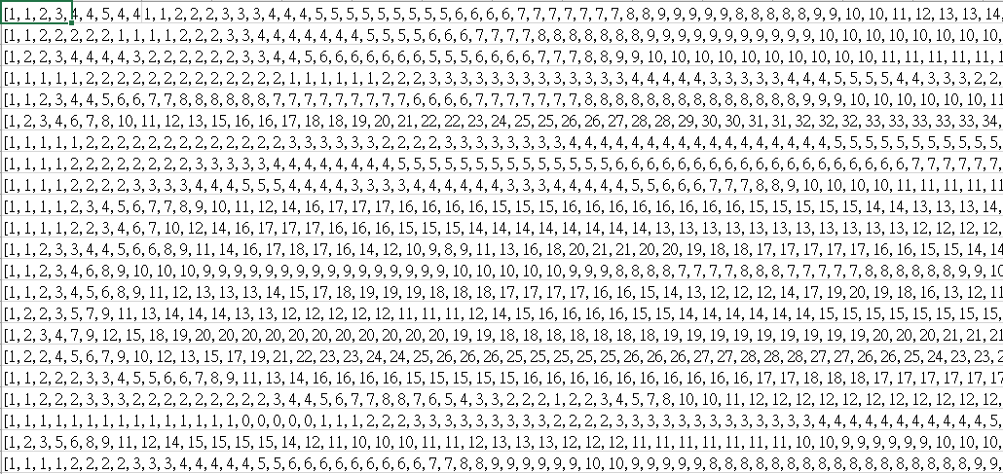

Slide 11
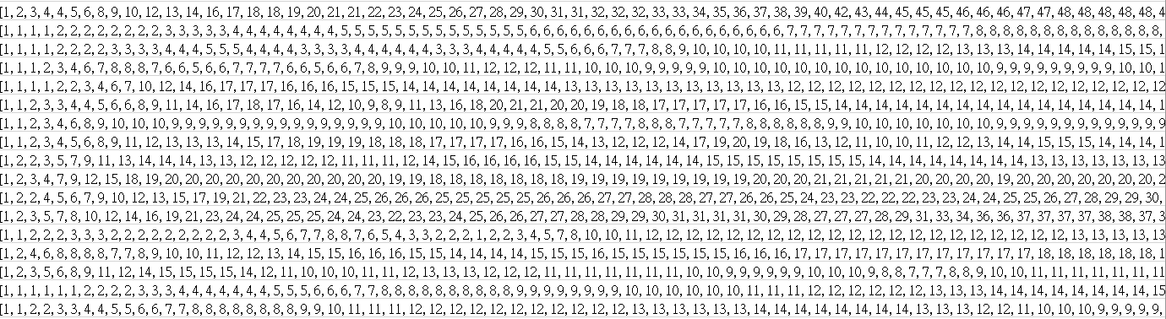

Slide 12
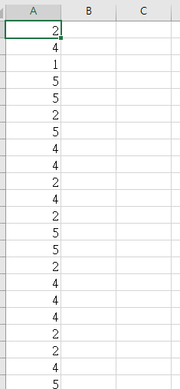

Slide 13
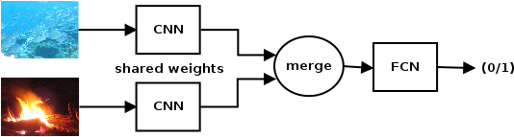
Network
A siamese neural network is an artificial neural network that use the same weights while working in tandem on two different input vectors to compute comparable output vectors.
Uses of similarity measures where a siamese network might be used are such things as recognizing handwritten checks, automatic detection of faces in camera images, and matching queries with indexed documents. The perhaps most well-known application of siamese networks are face recognition, where known images of people are precomputed and compared to an image from a turnstile or similar.

Slide 14
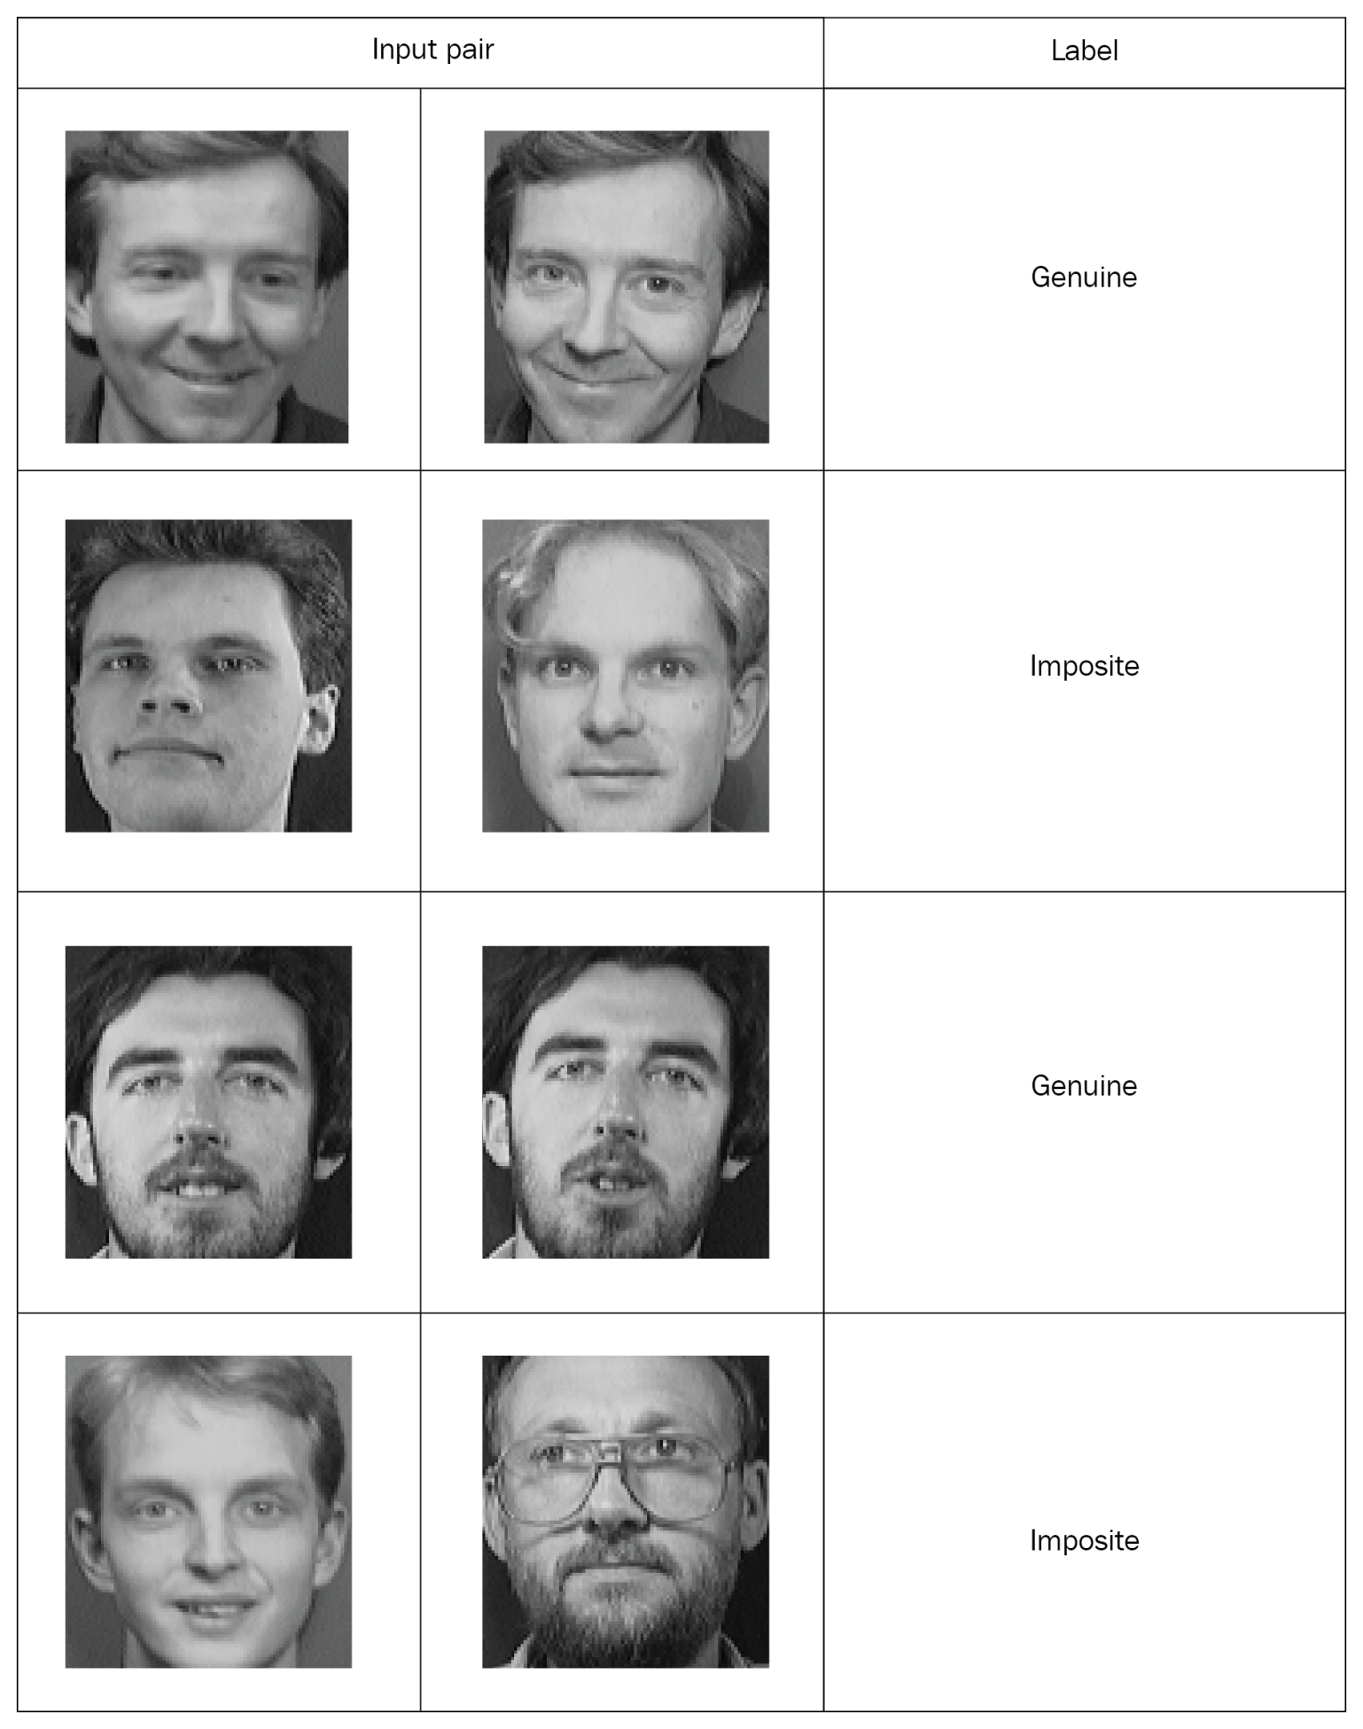

Slide 15
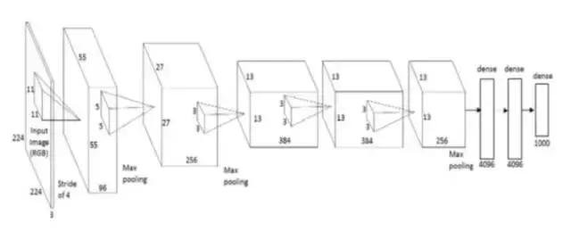
AlexNet 的架構共八層，第一層到第五層是 Convolutional Layers 做卷積操作（Convolution Operation）與池化（Pooling）；第六層到第八層是 Fully Connected

Slide 16
Train a model decide the frequency is high or low
將數據與它們的標籤一起配對，就可以訓練我們的網絡。從圖像對中，我們將一個圖像饋入網絡A，將另一個圖像饋入網絡B。這兩個網絡的作用是提取特徵向量。因此，我們使用具有整流線性單元（ReLU）兩個卷積層來提取特徵。了解了特徵，就將來自兩個網絡的合成特徵向量饋入能量函數，該函數測量相似度；

