Slide 1

AMD Unsloth Studio Fine-tuning
Eddie Zhou
Notes:
Welcome. Today we fine-tune a small open model with Unsloth on an AMD Radeon GPU, and we teach it to play Sudoku using GRPO reinforcement learning. Hands-on: everyone gets a hosted Jupyter notebook on a real AMD GPU.

Slide 2

Workshop access
Studio: localhost:8890 Notebook: localhost:8888
Studio password: RyzenUnslothStudio

Slide 3

Agenda
01
Fine-tuning: what and when
The problem it solves
02
Types of fine-tuning
LoRA, QLoRA, SFT, GRPO
03
The Unsloth advantage
Faster, leaner, no-code
04
Support tickets to JSON
The task we train for
05
AMD Radeon GPU
hipInfo and Task Manager
06
Hands-on in Studio
Train, test and export a model
Notes:
Six blocks. First half is concepts, second half is hands-on on the GPU.

Slide 4
Part 1: The Concepts
What a model is, what fine-tuning changes, and how SFT learns from examples
Notes:
Quick grounding before we touch the GPU.

Slide 5

What is a Large Language Model?
A neural network trained on a huge amount of text so it can predict the next token given what came before.
This ability enables models to chat, summarize, write code and reason.
next-token prediction
prompt > The capital of France is
Paris 0.94
a city 0.03
located 0.01
Base models
Instruct models
Generalists
Raw next-token predictors. Great starting point for training but awkward to chat with.
Further trained to follow instructions and hold a conversation.
Llama, Qwen, Mistral on Hugging Face know a bit of everything, but not something specific to you.
Notes:
An LLM predicts the next token. Base versus instruct matters when you pick a checkpoint: for GRPO from scratch we usually start from a base or a small instruct model.

Slide 6

What is fine-tuning? Why do it?
Take a pre-trained model and keep training it a little more on YOUR data, so it adapts to YOUR task, domain, tone or format.
1
2
3
4
Voice
Domain
Format
Focus
Speak in a specific style or persona: your brand, your support agent.
Know legal, medical, or your own product documentation.
Always return JSON. Always cite sources.
Do one narrow task extremely well, cheaply, on a small model.
Often cheaper and more reliable than stuffing everything into a giant prompt or paying for an even bigger model. It lets a small model punch above its weight.
Notes:
Fine-tuning is not about teaching new facts so much as new behaviour: style, format, and task focus. It is frequently cheaper than prompt engineering at scale.

Slide 7

LoRA and QLoRA
Parameter-efficient fine-tuning: freeze the giant model, train a tiny adapter.
LoRA
Low-Rank Adaptation
QLoRA
Quantized Low-Rank Adaptation
• Inject small low-rank matrices into chosen layers
• Original weights stay frozen, only adapters are trained
• Trainable parameters drop by orders of magnitude
• Everything LoRA does, plus a 4-bit base model
• Cuts VRAM again, so bigger models fit on one GPU
• The usual answer to an out-of-memory error
~1%
4-bit
Comparable
of weights trained today (23M)
base weights under QLoRA
quality to full fine-tuning
Notes:
LoRA freezes the base model and trains small adapter matrices. QLoRA adds 4-bit quantization of the frozen base, which is what lets a workshop-size GPU handle a real model.

Slide 8
Training methodology: SFT and GRPO
Two ways to tell a model it did well. SFT shows the answer, while GRPO scores attempts.
SFT
Supervised Fine-Tuning
GRPO
Group Relative Policy Optimization
• Uses labelled data: prompt in, correct answer out
• The model imitates the answers you supply
• No labelled answer needed, only a way to score one
• Model generates a group of attempts and compares them
{"messages": [
{"role": "user", "content": "<support message>"},
{"role": "assistant", "content": "<ticket JSON>"}]}
1
Generate several candidate answers
2
Score each with a reward function
3
Prefer the ones that scored above the group
Notes:
SFT needs the right answer written down. GRPO only needs a judge. For Sudoku we can check a board programmatically, so a reward function is easy and GRPO is the natural fit.

Slide 9
How SFT learns: one training step
Each step shows the model a few examples and nudges it toward your answers, token by token.
1
2
3
4
Tokenize
Predict
Measure
Update
The chat template turns the message and its ticket into one sequence of tokens.
At every position the model guesses the next token, just as when it chats.
Cross-entropy loss: how unlikely it found the real next token. Lower is better.
Backpropagation adjusts only the LoRA adapter, making the right tokens likelier.
One step is 8 examples. 30 steps show the model 240 tickets, about a quarter of the data. The test tickets are never trained on, which is why the notebook scores on them.

Slide 10
Reading a training run
The settings Studio used today, and what the loss chart tells you.
Knobs
Studio's defaults for this run
Loss
How wrong the next-token guesses are
• Learning rate 2e-4: the size of each update. It warms up for 5 steps, then decays
• Batch of 8: 2 examples at a time, 4 accumulated per update
• LoRA rank 16: how much the adapter can learn
• Falls fast: the model is picking up the format
• Flat near zero: little left to learn from this data
• Only held-out tests show whether it generalizes or memorized
240
~1%
~4 min
examples seen in 30 steps
of the weights trained (23M)
for 30 steps on a Ryzen AI Max+

Slide 11
The fine-tuning pipeline
Same spine either way. The data step is what differs.
SFT: pick data
Hugging Face, public sets, or upload your own
Pick a model
Choose
Train
Evaluate
Start small
LoRA or QLoRA
GRPO: generate data
Define the reward function
Training knobs
learning rate
number of steps
time limit
max sequence length
Notes:
Pick a small model first. SFT path: find or upload data. GRPO path: generate attempts and write a reward function. Then choose LoRA or QLoRA, train, evaluate. The knobs at the bottom are the ones you will actually touch in the notebook.

Slide 12
Unsloth
An open-source, no-code framework and UI for training, running and exporting LLMs locally, tuned for speed, memory efficiency and accessibility.
It sits as an optimized layer on top of Hugging Face Transformers, so your existing workflow still applies.
LoRA and QLoRA
Quantization
Optimized kernels
Consumer hardware
built-in
4-bit and 8-bit paths
faster attention and MLP
one GPU is enough
In this workshop
Unsloth Studio runs the whole process in your browser, from picking a model to exporting the result, without writing code.
Notes:
Unsloth is the accelerator layer. Same Transformers API, materially less memory and time.

Slide 13

Part 2: Hands-On
Support tickets to JSON, an AMD Radeon GPU, and Unsloth Studio you drive yourself
Notes:
Now we switch to the machine.

Slide 14
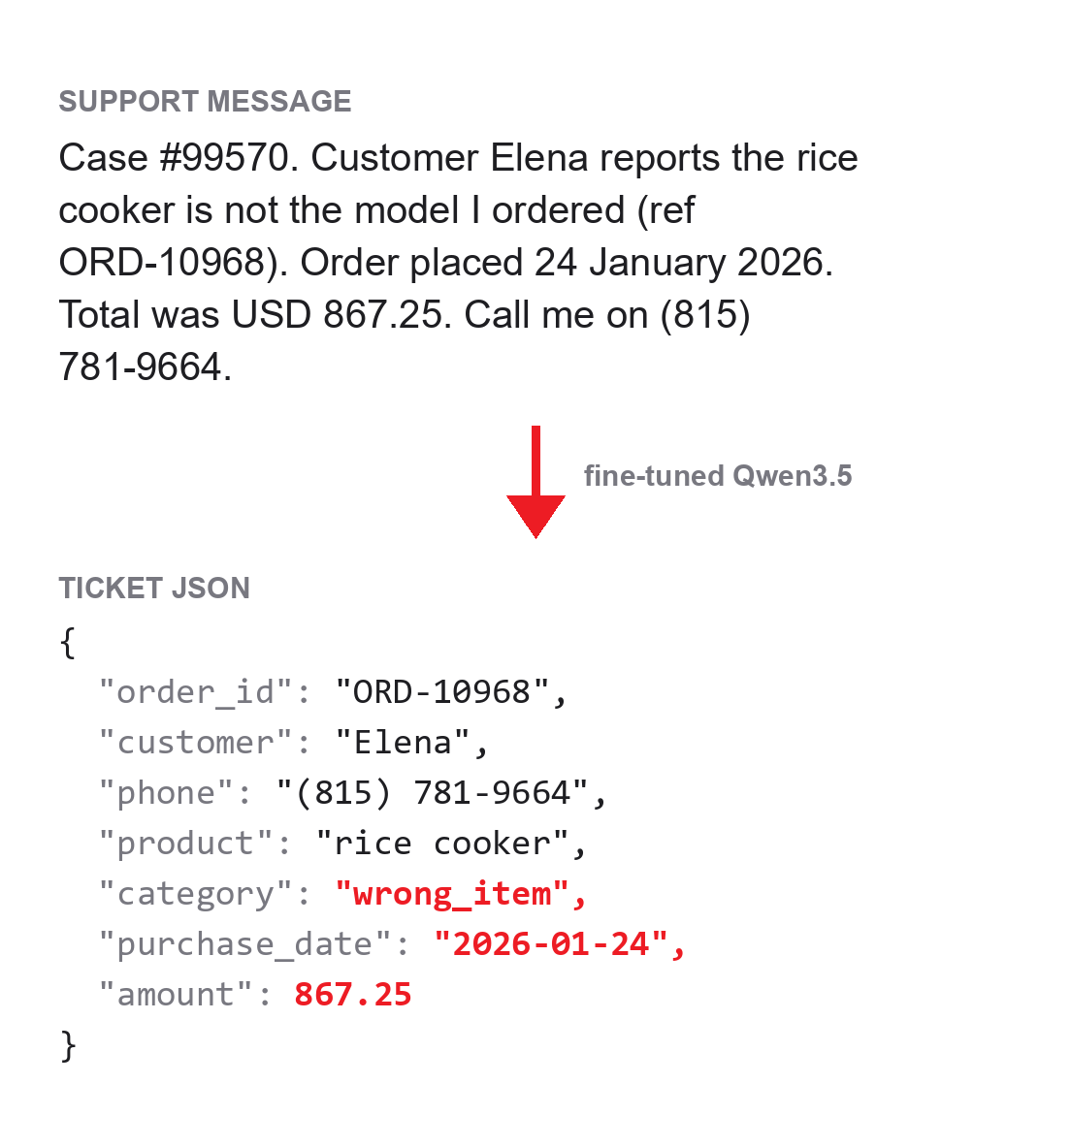
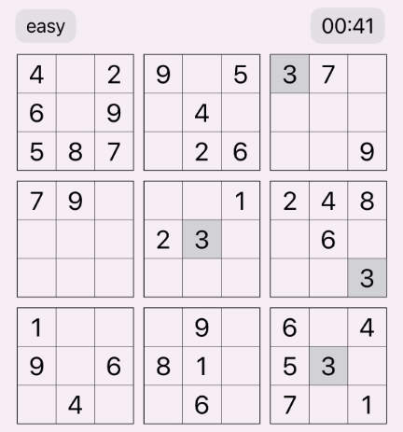
Support tickets to JSON
Turn a customer's message into a ticket record.
Customers write in their own words. The ticket system needs the same seven fields in the same format every time.
Easy to check
Each field is either right or wrong, so a script can grade it.
Learns the format
The prompt is one line. The fields and rules come from the examples.
Needs some judgment
“Not the model I ordered” has to become wrong_item, and dates and prices a standard format.
A test message the model never saw, and its answer after fine-tuning
Notes:
Why Sudoku for GRPO: correctness is checkable in code, so the reward function is a few lines. That is exactly the property GRPO needs.

Slide 15
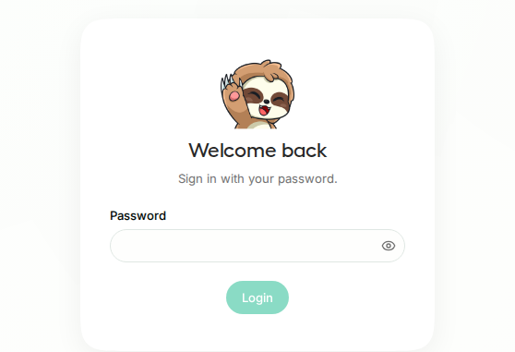
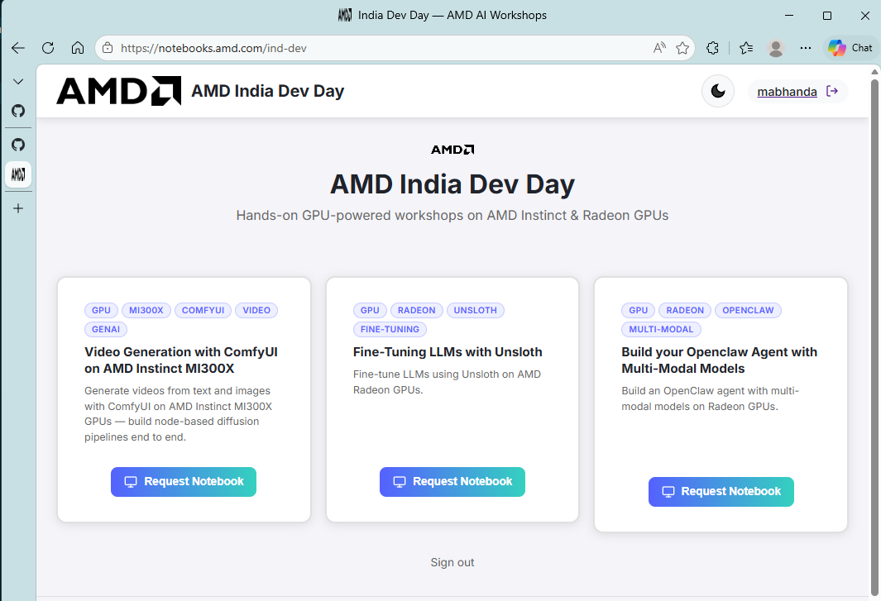
Getting started
1
Open Unsloth Studio
localhost:8890
2
Sign in: RyzenUnslothStudio
3
Open the notebook
localhost:8888, in a second tab
Notes:
Everyone go to notebooks.amd.com/ind-dev now. Password RadeonUnslothTuning. Choose the Fine-Tuning LLMs with Unsloth card.

Slide 16
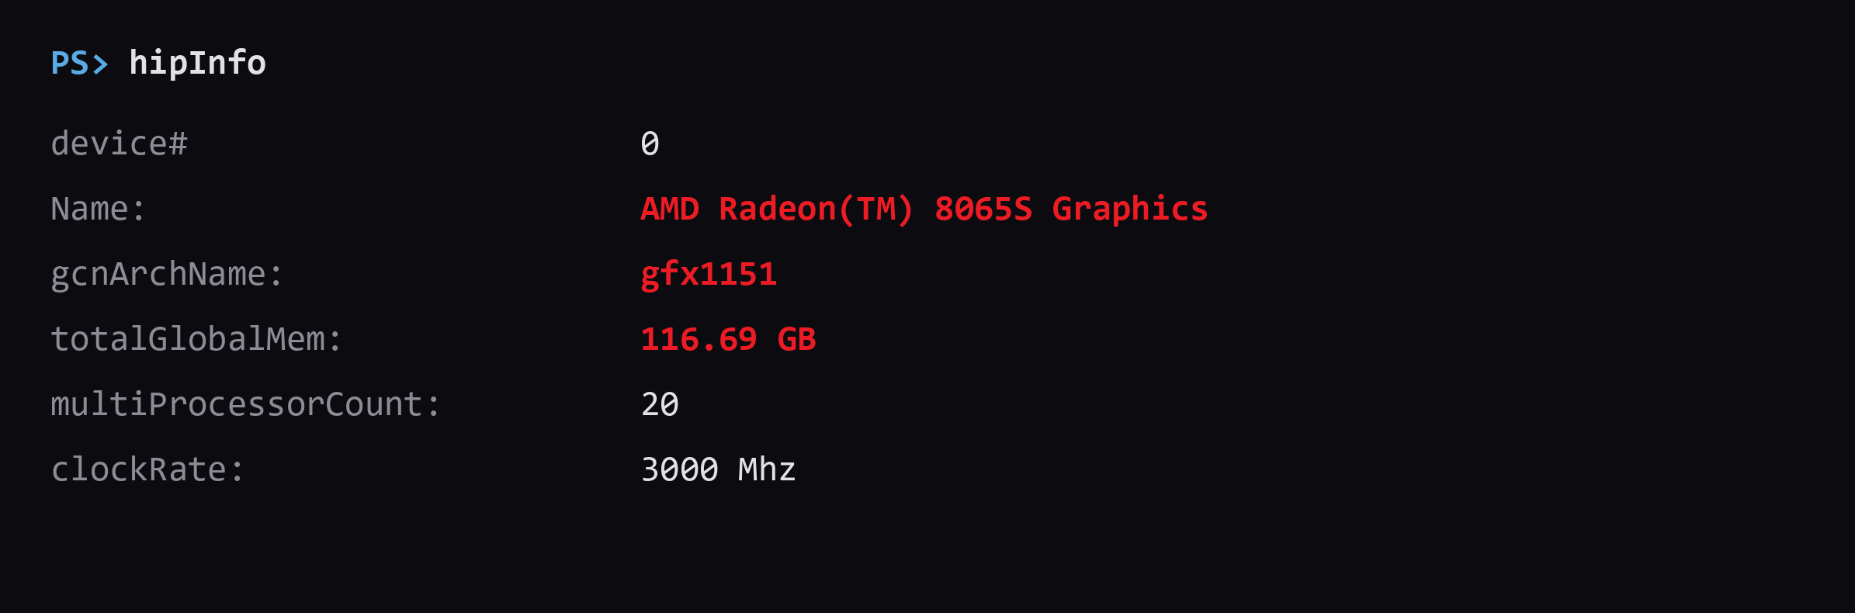
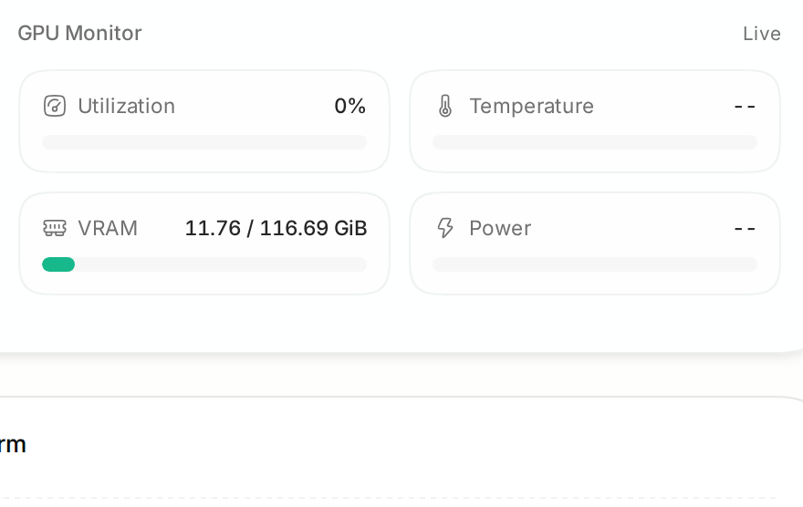
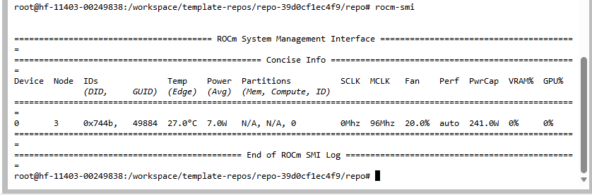
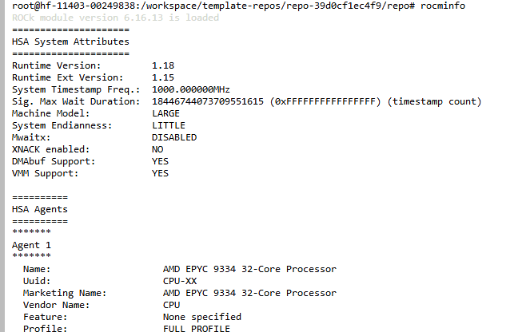
GPU visibility and health
Before you train, check that the GPU is visible.
terminal
> hipInfo
hipInfo
The GPU's name, architecture and memory
Task Manager
Performance, then GPU, then the Compute graph for live load
On Windows, Studio's GPU Monitor shows memory in use (here 11.8 of 116.7 GiB on a Ryzen AI Max+) but not load. Open the terminal in JupyterLab: File, New, Terminal.
Compute graph flat during a run? Training has stopped.
Notes:
rocm-smi is the one you will keep open in a second tab. If utilisation is flat at zero while a cell shows an asterisk, something is running on CPU.

Slide 17
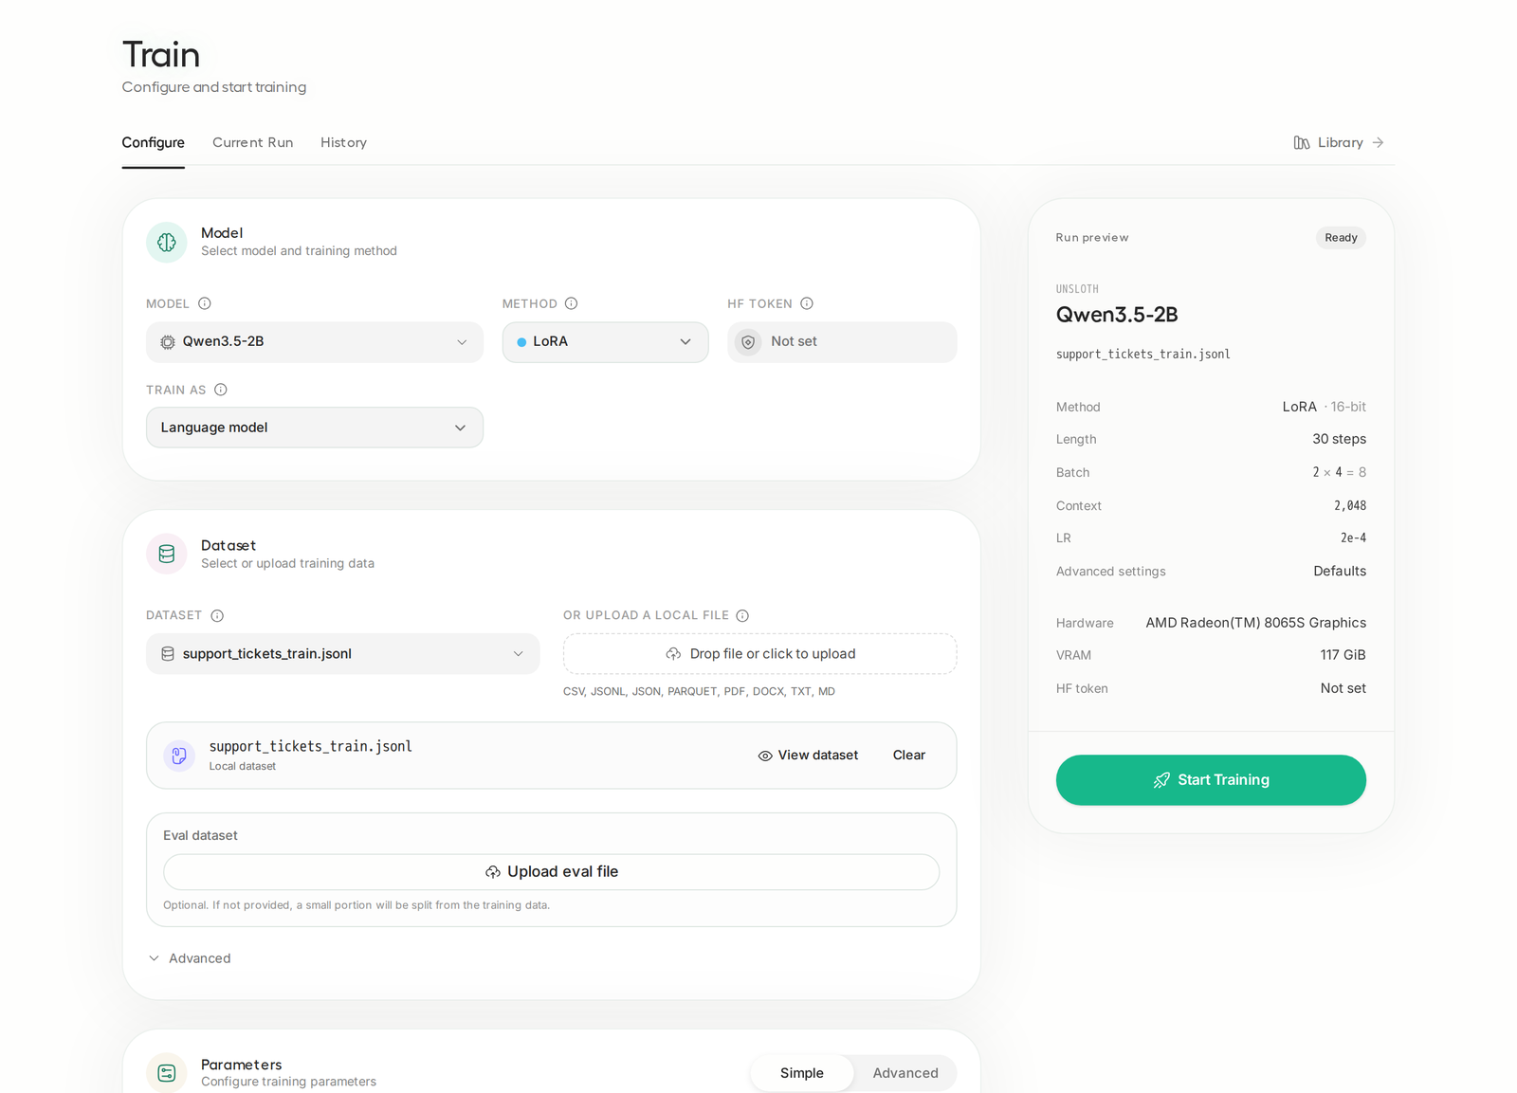
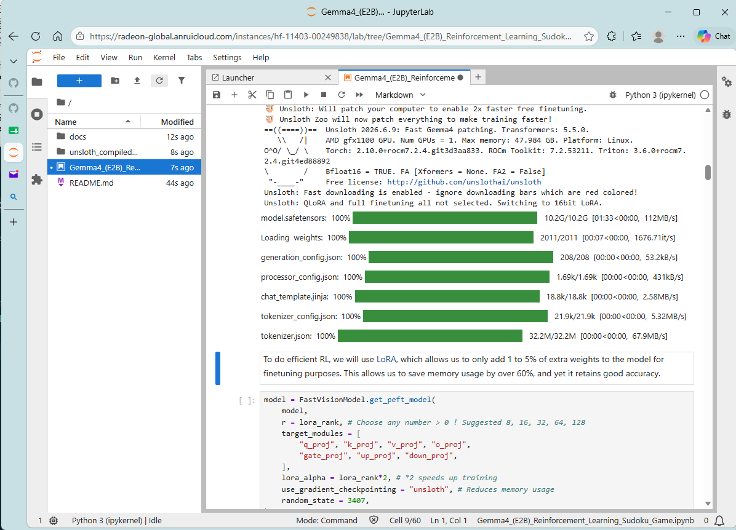
Driving Studio
Everything happens on the Train page. Loading the model the first time takes longest.
Pick the model and method
unsloth/Qwen3.5-2B, method LoRA
Upload the data
support_tickets_train.jsonl. Check that View dataset shows ChatML
Set 30 steps and start training
Watch the loss chart, and the GPU in Task Manager
Compare in Chat
Turn Thinking off, paste a test message, and read both answers side by side
Notes:
Cells run in order. The asterisk means the kernel is busy. Model download happens once.

Slide 18
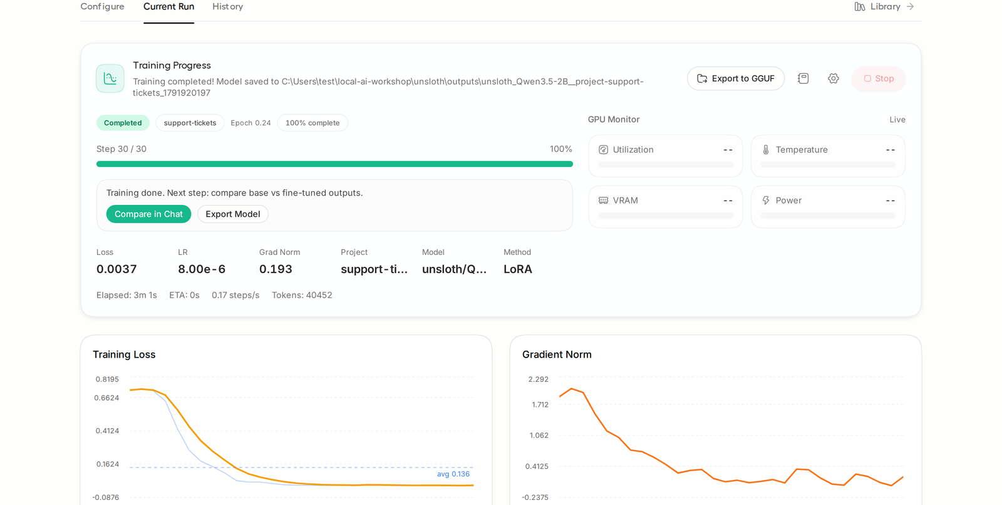
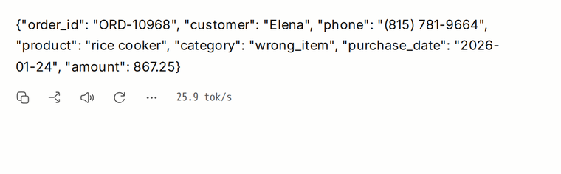
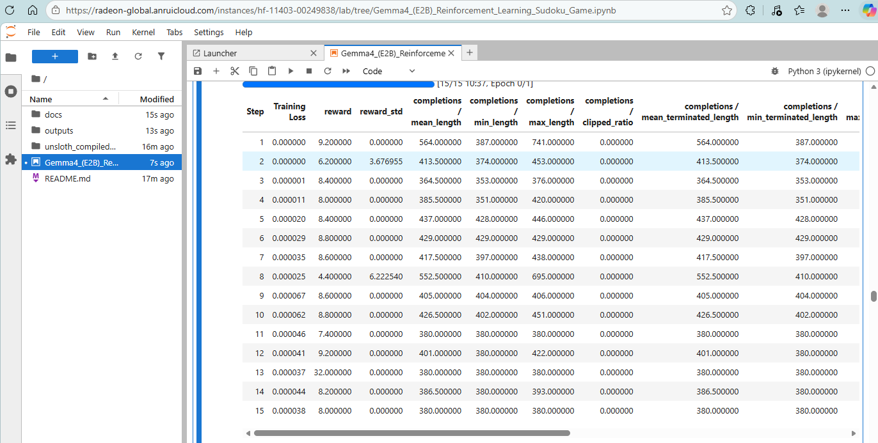
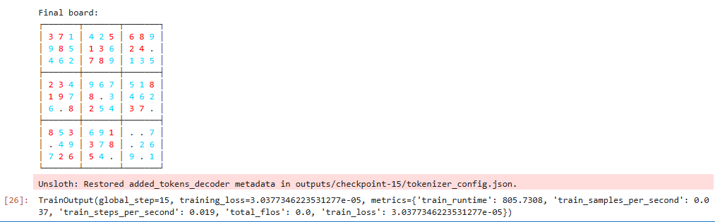
Fine-tuning complete
After 30 training steps, the model answers in the ticket format.
DEMO: 30 STEPS
The fine-tuned model's answer to a test message
What to look for
• Loss falls over the first 15 steps, then levels off
• On a Ryzen AI Max+, 29 of 30 test tickets came out exactly right, against 19 of 30 with a detailed prompt
Loss and gradient norm for each step, from Studio
Notes:
Fifteen steps is a demo, not a converged run. What matters is that the reward is trending and the board output is structurally valid.

Slide 19
Troubleshooting
SYMPTOM
FIX
First chat response times out
Cold model load. Retry, the warm model answers fast.
Dataset not read as chat
Upload the .jsonl from data/ unchanged. View dataset should show ChatML.
Out of memory during training
Smaller model, enable QLoRA 4-bit, lower batch size or sequence length.
Answers run on past the JSON
Turn Thinking off in Chat. If it still happens, train for more steps.
Training fails at step 0
Check the error on the Current Run page. A mismatched Triton install is a common cause.
What to try next
Your own data in the same format, or a larger model such as Qwen3.5-9B.
Notes:
Most workshop issues are one of these six. Out of memory is the most common: QLoRA and a shorter sequence length fix it almost every time.

Slide 20
Finished early? Stretch challenges
CHALLENGE
HOW
Add a field
Add priority (urgent when the message says ASAP) to the data generator and the scorer's FIELDS, then retrain.
Teach it your own task
Write 5 examples by hand, let a bigger model write 50 more, train 30 steps. Ideas on the next slide.
Take it with you
Export as GGUF (Q4_K_M) and run it in llama.cpp, LM Studio, Ollama or Lemonade. Compare answers and speed.

Slide 21
Teach it your own task
Any task with one right answer per input works the same way as today's tickets.
IDEAS
Pick something small
STEPS
Write a few, generate the rest
• One right answer per input, so you can check it
• A short, fixed output, like today's seven fields
• Your hand-written examples set the format and the bar
• A bigger model adds variety: Qwen3.6-35B in Lemonade
meeting notes -> {owner, task, due}
receipt text -> {merchant, date, total}
bug report -> {component, severity}
job ad -> {title, remote, salary}
casual email -> a polite, formal reply
1
Write 5 examples by hand, covering the cases you care about
2
Generate 50 more: paste yours and ask for more like them
3
Check each one, keep 10 back for testing, train 30 steps

Slide 22
Learn more
Unsloth
github.com/unslothai/unsloth
The framework itself
Unsloth docs
docs.unsloth.ai
Guides, notebooks, supported models
LoRA paper
arxiv.org/abs/2106.09685
Low-Rank Adaptation, Hu et al.
QLoRA paper
arxiv.org/abs/2305.14314
4-bit finetuning, Dettmers et al.
Qwen3.5-2B
huggingface.co/unsloth/Qwen3.5-2B
The model used today
This workshop
localhost:8890 and :8888
Studio password: RyzenUnslothStudio
Notes:
All links are on this slide. The notebook stays up after the session.

Slide 23

Notes:
Thank you. Questions.

