Slide 1

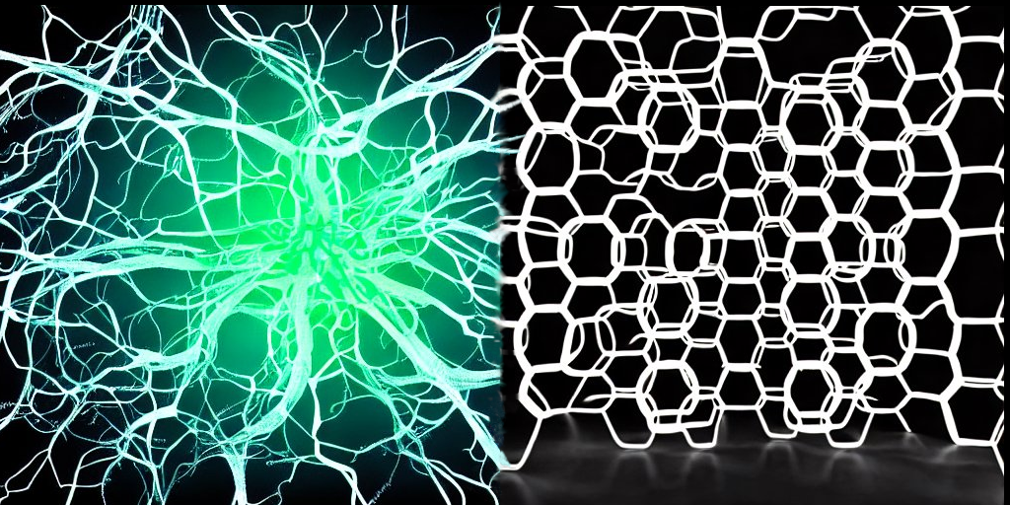

Slide 2
NEURONS & WEEDS

Slide 3
NEURONS & WEEDS
BY
Tosh & CHRONICIDLE

Slide 4
NEURONS & WEEDS
BOARD GAME, ABSTRACT,
SIMULATION, LOGIC, MATHEMATICS,
BIOLOGY, NEUROSCIENCE
EDUCATIONAL (HIGHER)
FUTURE: TURN-BASED AND RT STRATEGY
GENRES

Slide 5

WEEDS

Slide 6
WEEDS

Slide 7
NEURONS
Tosh

Slide 8
CREDITS
SLIDES DESIGN TOSH
LOGO IMAGES STABLE DIFFUSION
GIMP
IRFANVIEW
https://github.com/Twenkid/PlovdivGameJam2023-Neurons-And-Weeds

Slide 9

