Slide 1
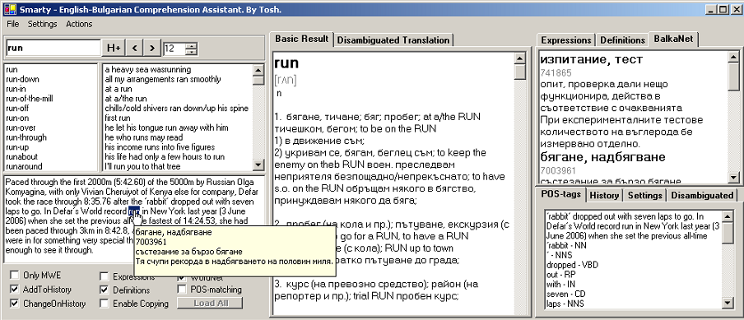
Smarty’s Interface

Slide 2
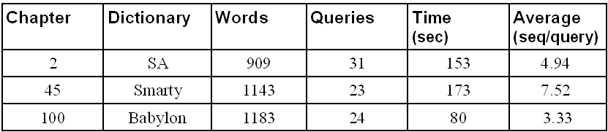
Users Evaluation

Slide 3
Word Sense Disambiguation
User Interface (Input)
Pointing an English word in a context
User Interface (Output)
Bulgarian translation and gloss suggested
Context
Tokenisation
Lemmatisation/Normalisation
Stop words cleaning
POS-tagging
WordNet and BalkaNet
WordNet/BalkaNet alignment
WordNet
WordNet synset for the word found
Glosses extraction
English WSD
The Gloss with the most matches suggested
Glosses
Tokenisation
Lemmatisation/Normalisation
Stop words cleaning
POS-tagging
Context and Glosses
Word Matching
Matches Counted

