Slide 1
Smarty
English-Bulgarian
Comprehension Assistant

Slide 2
Smarty
By
Todor Arnaudov – Tosh
Research Group In Computational Linguistics
at the University of Wolverhampton
June 2007

Slide 3
What we are about to discuss?
Conventional bilingual computer dictionaries and their limitations.
Comprehension assistants.
3. Smarty as an enhanced conventional dictionary.
4. Smarty as a comprehension assistant.
5. Evaluation.
6. Future work.
7. Suggestions?
Notes:
Examples of conventional and intelligent bilingual dictionaries ??
Revise!

Slide 4
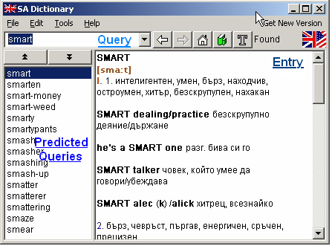
Framework of conventional dictionaries
SA - the most popular English-Bulgarian dictionary

Slide 5
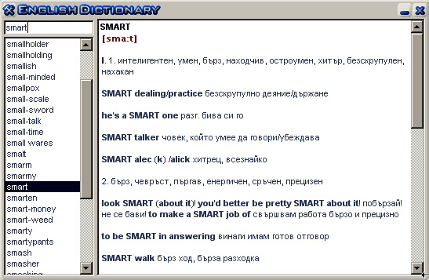
Framework of conventional dictionaries
AEnglish Dictionary

Slide 6
About conventional dictionaries
The most popular quasi-translation tools.
Very simple look-up technology.
Almost no evolution.
No Natural Language Processing.
Developed by programmers without background in computational linguistics.
Not always useful.

Slide 7
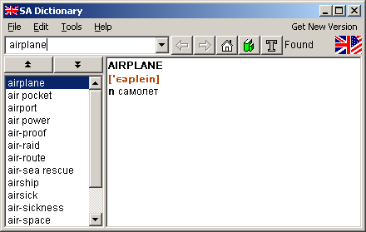
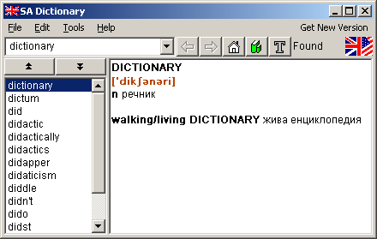
Unambiguous words are OK

Slide 8

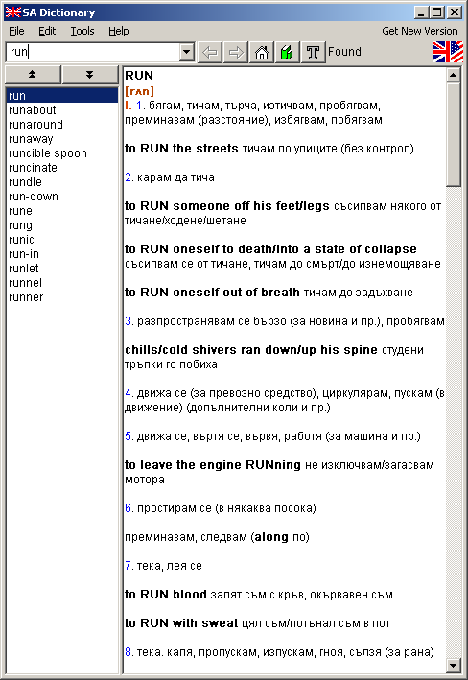
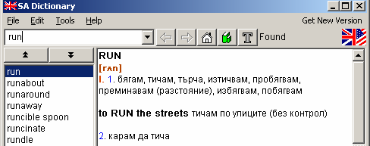
Polysemous words are a problem

Slide 9
Querying numbers of words is not convenient
From texts in electronic form: copy-pasting.
Problem: Switching between windows is distracting.
From texts in a paper form: “typing and retyping”
Problem: Why retype?

Slide 10
Comprehension assistants
Introduced by Xerox LocoLex in 1994.
Use NLP techniques to narrow the number of possible translations:
Part-of-speech tagging, normalization (lemmatization), multi-word expressions recognition
More appropriate point-and-translate graphical user interface and sessions history.

Slide 11
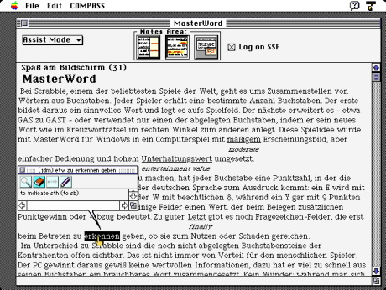
LocoLex
Notes:
Screenshot of a version of LocoLex from 1995

Slide 12
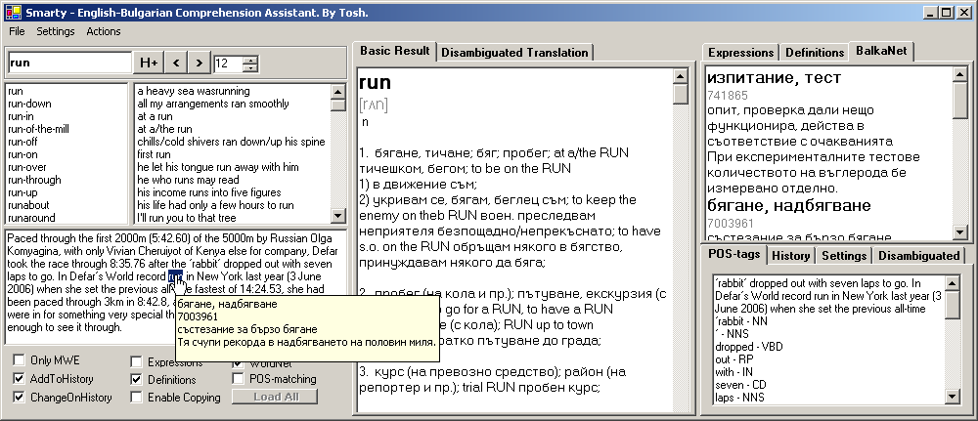
Smarty
Alpha Version of “Smarty”

Slide 13
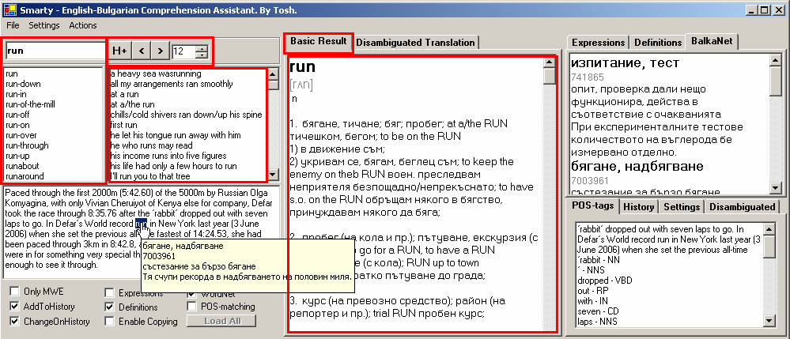
Smarty is a hybrid
Smarty can work as enhanced conventional dictionary
Suffix search, sorted multi-word expressions list
Glosses from WordNet and BalkaNet
Notes:
Demonstration of the program. Input single words, show the entries from the conventional dictionary.
Demonstration: typing words, emphasizing prediction of queries. History list.
The red rectangles show the “soul” of the conventional dictionary. Something not well done well is that the dictionary entry (the right big rectangle) is not neatly formatted. That should be corrected.

Slide 14
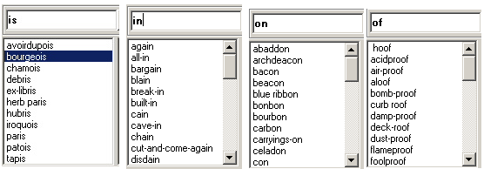
Suffix Search
Search for words with common derivation
Rhyme search

Slide 15
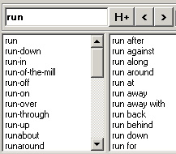
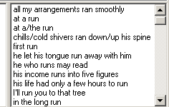
Multi-word expressions list
Unlike the others English-Bulgarian dictionaries, Smarty displays the multi-word expressions sorted.

Slide 16
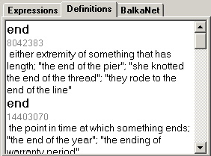
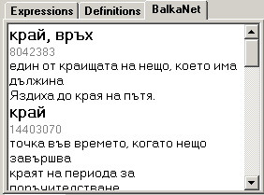
Glosses
The lexical databases WordNet and BalkaNet are used.
Glosses in English are mapped to corresponding glosses in Bulgarian.

Slide 17
Smarty as a Comprehension Assistant
Natural Language Processing:
Part-of-speech tagging
Lemmatization
Multi-word expressions recognition
Word sense disambiguation
2. Point-click-and-translate graphical user interface, and translations in tooltips.

Slide 18
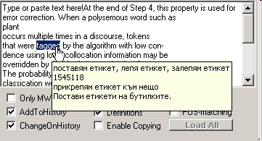
Why point-and-translate?
Selecting and copying word by word is slow.
Switching between text and dictionary entries is distracting.
Translation in tooltips is less distracting.
Word sense disambiguation is impossible without context.

Slide 19
NLP Stages
Part-of-speech tagging
Lemmatization
Multi-word expression recognition
Word sense disambiguation

Slide 20
NLP Stages
Part-of-speech tagging
Assigning part-of-speech tags to the words in the context of the pointed word.
Ivet run every day.
NN VB DT NN
She finished first in that outstanding run.
PRP VBD ADV PP DT ADJ NN
Reduces the number of possible translations by 50% or more.

Slide 21
NLP Stages
Lemmatization
Finding the base form (lemma) of a word:
gone – go
running – run
flies – fly
you, he, she, we, they – I*
your, his, her, our, their – my*
Dictionary databases usually have entries only for base forms.
- Lemmatization improves recognition of multi-word expressions and allows word sense disambiguation, based on words matching.
* Precisely, that is not lemmatization.

Slide 22


NLP Stages
Multi-word expressions recognition
Words matching (strings-matching) and part-of-speech matching
Lemmatization improves words-matching score and reliability.

Slide 23
NLP Stages
Word Sense Disambiguation
If a polysemous word is given in a context, in which sense it is used?
Supposed to solve the main problem of conventional dictionaries.
John works in a bank! He must have a lot of money…
Mary walked to the bank and jumped into the river.
What instrument do you play, Paul?
I play the bass.
Smarty uses bag-of-words method to measure semantic similarity between the context of the word and glosses from a dictionary.

Slide 24
WordNet
A lexical database, consisting of synonym sets of words, structured by part-of-speech.
Different synonym sets are linked by semantic relations, e.g. hypernymy, hyponymy, holonymy.
Plant is hypernym of flower is hypernym of rose.
Rose is hyponym of flower is hyponym of plant.
The synonym sets have glosses with a short definition and/or examples of usage.

Slide 25
NLP Stages
Word Sense Disambiguation in Smarty
John works in a bank! He must have a lot of money…
Bag of words → (work, bank, have, lot, money)
Bank (7909067) - a financial institution that accepts deposits and channels the money into lending activities; "he cashed a check at the bank"; "that bank holds the mortgage on my home"
(financial, institution, accept, deposit, channel, money, lend, activity, cash, check, bank, hold, mortgage, home)
Mary walked to the bank and jumped into the river.
Bag of words → (walk, bank, jump, river)
Bank (8639924) - sloping land (especially the slope beside a body of water); "they pulled the canoe up on the bank"; "he sat on the bank of the river and watched the currents" …
Disambiguated sense is translated to Bulgarian, using BalkaNet.

Slide 26
BalkaNet
Aiming at creation of aligned lexical databases for several languages, mostly from the Balkan peninsula: Bulgarian, Czech, Greek, Romanian, Serbian and Turkish.
All databases are mapped to EuroWordNet and WordNet 2.0

Slide 27
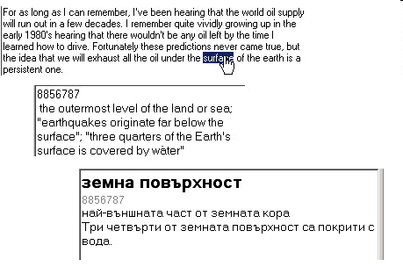
WordNet + BalkaNet

Slide 28
Evaluation
Multi-word expressions recognition is precise for short phrases.
Long multi-word expressions sometimes are mistaken.
Word sense disambiguation in English is successful only if appropriate keywords are found in the context.
Word sense disambiguated translation in Bulgarian often is impossible:
WordNet 2.0 has 115000 synonym sets.
BalkaNet has only 15000 synonym sets.
Overall, Smarty proves the superiority of point-and-translate interface and NLP look-up techniques over the simplicity of conventional dictionaries.

Slide 29
Contributions of “Smarty”
Use of Princeton’s WordNet for word-sense disambiguation.
Use of Bulgarian BalkaNet for word-sense disambiguated translation.
Laying foundations for building multilingual comprehension assistants, by applying other databases from BalkaNet and EuroWordNet.
“Hybridization” – Smarty shares characteristics of both conventional dictionaries and comprehension assistants.

Slide 30
Future work
More flexible interface and better text formatting.
Better multi-word expressions recognition, including expressions not in the head word.
Deeper word sense disambiguation algorithm.
Access to corpora.
Pre-translation and user profiles.
Introducing Bulgarian PoS-tagger and adding Bulgarian-to-English translation direction.
Including other BalkaNet databases in a multilingual comprehension assistant.

Slide 31
Questions and suggestions?
…

