Slide 1
Role-Based Access Control Model as Applied to Object-Oriented Applications
第十四组
谢明旭
徐夏
王润文

Slide 2
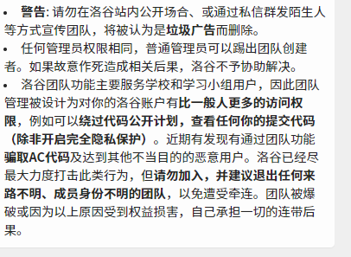
问题描述
？？？

Slide 3
现有系统的权限分配情况
Nagaratnam N., Nadalin A., Hondo M., McIntosh M., Austel P.
Business-driven application security: from modeling to managing secure applications.
IBM Systems Journal, Volume 44 Issue 4, 2005, 847-867 pp.
Xiao L., Peet A., Lewis P., Dashmapatra S., Saez C., Croitoru M., Vicente J., Gonzalez-Velez H.,
Lluch i Ariet M. An Adaptive Security Model for Multi-agent Systems and Application
to a Clinical Trials Environment. 31st Annual International Computer Software and Applications
Conference, COMPSAC 2007, 24-27 July 2007, Beijing, China, 2007, 261-268 pp.
Fengyu Zhao, Xin Peng, Wenyun Zhao. Multi-Tier Security Feature Modeling for Service-Oriented
Application Integration. Eighth IEEE/ACIS International Conference on Computer and Information
Science, ICIS 2009, 1-3 June 2009, Shanghai, China, 2009, 1178-1183 pp.

Slide 4
现有系统的权限分配情况
Saleem M.Q., Jaafar J., Hassan M.F.
Model Driven Security Framework for Definition of Security Requirements for SOA Based Applications.
2010 International Conference on Computer Applications and Industrial Electronics
(ICCAIE), 5-8 Dec. 2010, Kuala Lumpur, 2010, 266-270 pp.
Shiroma Y., Washizaki H., Fukazawa Y., Kubo A., Yoshioka N.
Model-Driven Security Patterns Application Based on Dependences among Patterns.
ARES '10 International Conference on Availability, Reliability, and Security,
15-18 Feb. 2010, Krakow, Poland, 2010, 555-559 pp.
Salini P., Kanmani S. Application of Model Oriented Security Requirements Engineering Framework
for Secure E-Voting. 2012 CSI Sixth International Conference on Software Engineering (CONSEG),
5-7 Sept. 2012, Indore, 2012, 1-6 pp.

Slide 5
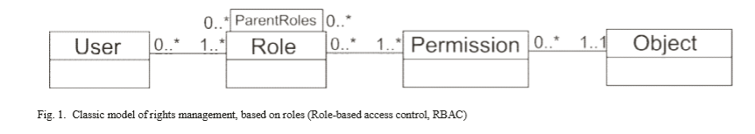
模型

Slide 6
模型
OC
OC1:把权限分配以类的形式表示在面向对象的范式中
OC2:有对不同权限的分配
OC3:将权限分配给对象（实例）

Slide 7
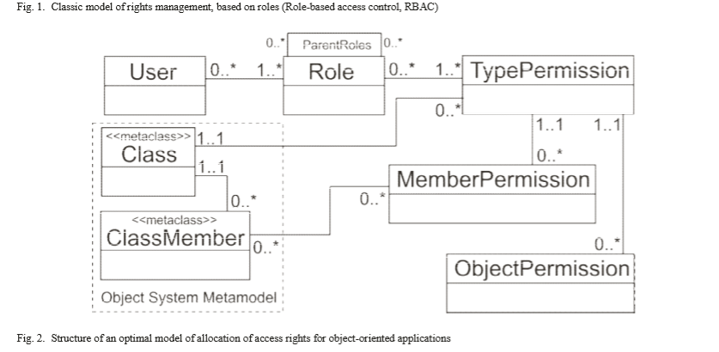
模型

Slide 8
模型
定义的角色：
会议组织者：
是主要用户和管理权限最大的用户
文章作者：
没有作者，就不可能召开会议，
因为他们撰写文章并将其提交给会议。
作者负责根据审稿人对文章的评论对文章进行更正， 并在必要时支付会议费。
权限：
注册用户和录用论文
审稿人
查看和验证更改后的论文
验证是否付款
会议记录
提供证书等其他权限
审稿人：
评估文章的质量

Slide 9
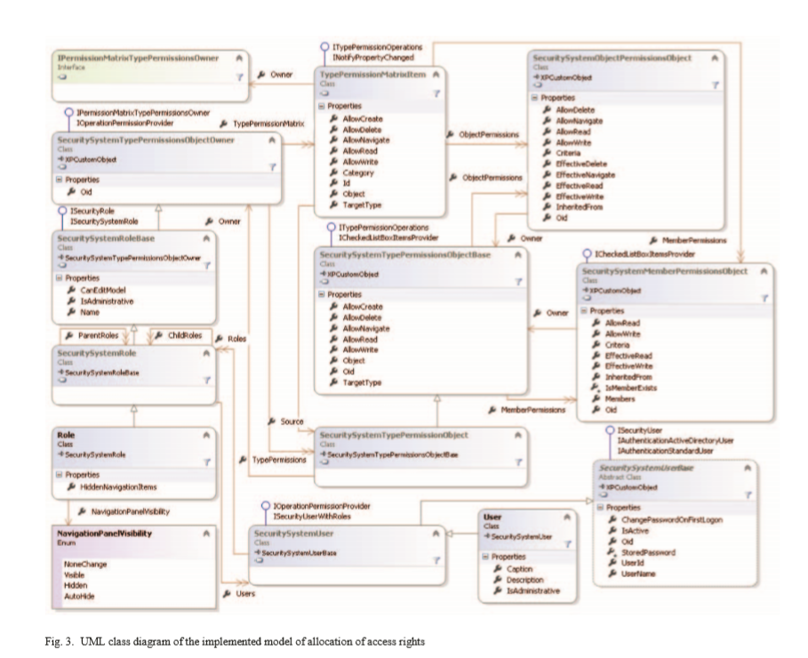
模型

Slide 10
欢迎批评指正
谢谢你的聆听

