Slide 1




Design Patterns Impact on Software Quality:
Where Are the Theories?
IEEE International Conference on Software Analysis
2018-03-01
Chen Hao，Zhi wen Zheng，Zi huan Zuo

Slide 2

INTRODUCTION
When developing software systems, Developers follow the same patterns again
and again and reuse the same solutionsfor similar problems.
“Do Design Patterns Impact Software Quality Positively?”
The Patterns Promotion and Antipatterns Prevention (PPAP) workshop
1
The need for a strong(er) community
2
The need to bridge research activities with industrial practice
3
The need for support in teaching patterns

Slide 3
METHODOLOGY TO IDENTIFY WORKS
reconcile the terminology
1
Identify collections of papers
2
Choose one and download all papers
3
Read all papers and identify term
4
Compile all terms
5
identify synonyms and homonyms
6
Define the retained terms
7
Map all the terms with the retained terms.
Notes:
为了确定各研究团体研究的主题，作者对设计模式进行了领域分析

Slide 4
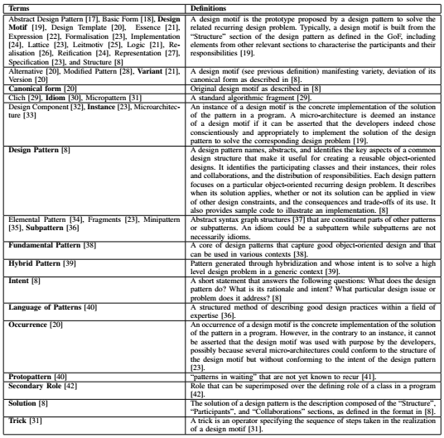
METHODOLOGY TO IDENTIFY WORKS
Notes:
因为它可以帮助社区对每个定义保留的术语做出明智的选择。

Slide 5
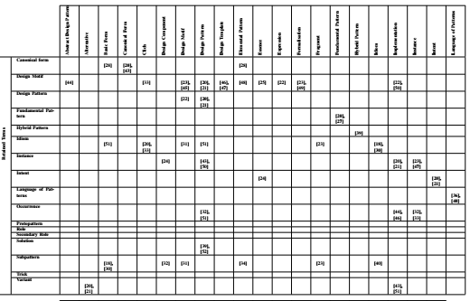
METHODOLOGY TO IDENTIFY WORKS
Notes:
有几个术语是同音词，在文献中重复使用，定义不同 同一定义使用了不同的术语

Slide 6
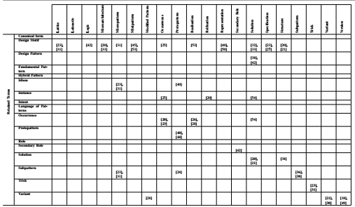
METHODOLOGY TO IDENTIFY WORKS

Slide 7
DESIGN PATTERNS IN SOFTWARE DEVELOPMENT
seven main themes:
1
knowledge sharing
2
development tools
3
formalisation
4
forward engineering
5
reverse engineering
6
documentation
7
quality

Slide 8
DESIGN PATTERNS IN SOFTWARE DEVELOPMENT
knowledge sharing :
1
Design patterns are powerful knowledge-sharing tools
2
tracing problem:
an excessive use of design patterns

Slide 9
DESIGN PATTERNS IN SOFTWARE DEVELOPMENT
tracing problem: :
proposed the idea of a design-pattern library
a vetting process of patterns
alleviate the risks of over-using design patterns
patterns grow in large numbers

Slide 10
Development with Design Patterns
Design patterns used as development tools in different activities:
Design: identify a problem and propose a solution
Implementation: instantiate a design motif
Maintenance: document and suggest refactorings

Slide 11

Formalisation of Design Patterns
propose a specification of and specify design patterns
verify formalisation implementations
specification languages and tools for the
selection and introductionof design patterns
Notes:
提出并指定设计模式的规范
验证形式化实现

Slide 12
Forward Engineering with Design Patterns
1
code generation
bridge between the systems and the code
the loss of the patterns during implementation
large clusters of mutually dependent classes
the lack of a library of concrete reusable patterns
2
Languages
Notes:
相互依赖的大类 缺乏具体的可重用模式库

Slide 13
DESIGN PATTERNS IN SOFTWARE DEVELOPMENT
1
Reverse Engineering with Design Patterns
design pattern detection and pattern-based components recovery
2
Documenting with Design Patterns
documenting patterns helps in understanding and easing maintenance
3
Impact of Design Patterns on Quality

Slide 14
UNIFYING PRINCIPLES AND CHARACTERISTICS
1
introduce new classes and methods to add one or more levels of indirection
Visitor design pattern
Observer design pattern
Composite design patterns
2
two major benefits:
a
The systematic formalisation and categorisation of Current
design patterns based on their underlying principles
b
The systematic combinations of these underlying principles to identify
novel design patterns from first principlesrather than through experiences.
Notes:
通过间接得级别，提供更大的灵活性

Slide 15
SUGGESTED AGENDA
1
Patterns from Developers’ Behaviour
the community pursues research works on the directimpacts of patterns on
developers
2
Patterns of Developers’ Behaviour
works on the analyses of developers’ logs collected through
3
Patterns for Building Systems
raise the levels of abstraction of programming languages with patterns to
promote appropriate patterns as programming-language building blocks
4
Theories of Software Patterns
seizes the opportunities given by its research results to propose a
theory—or competing theories—of patterns

Slide 16
conclusion
followed three research directions
1
further studies of the impacts of design patterns on quality
2
studies of the definition and impact of other types of patterns
3
studies to enhance the identification of occurrencesof patterns

Slide 17



