Slide 1
Reset a password in Admin Portal
4 steps — 2026-06-11

Slide 2
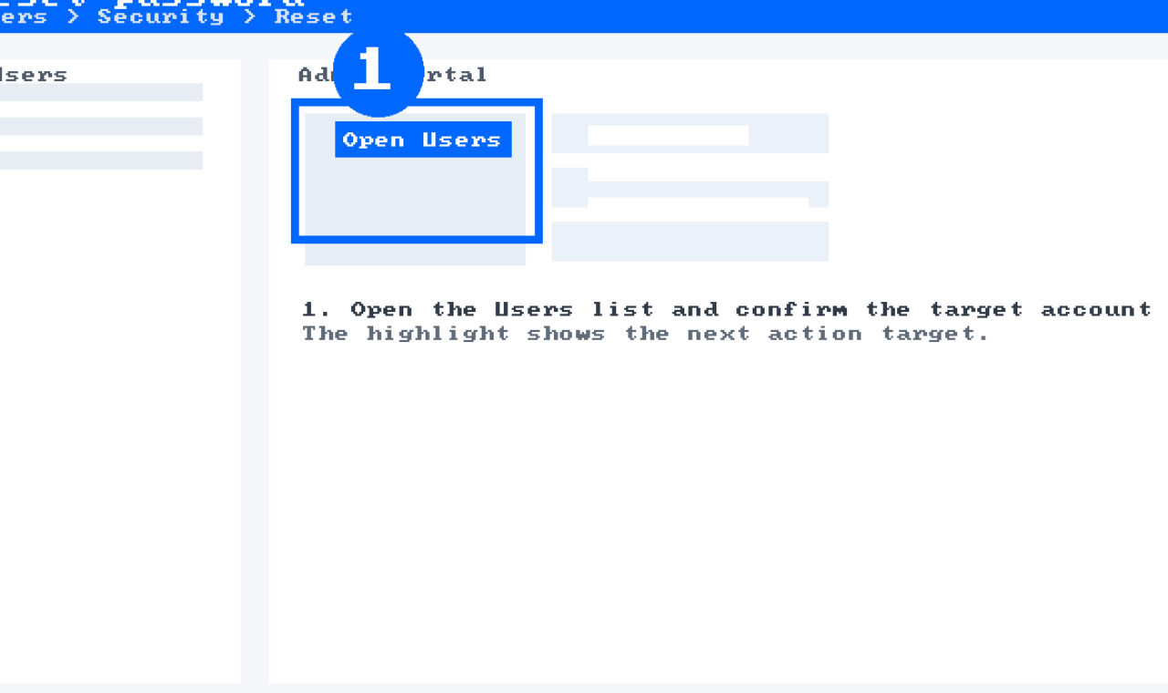
1. Open Admin Portal users
Open the users list and select the target account.

Slide 3
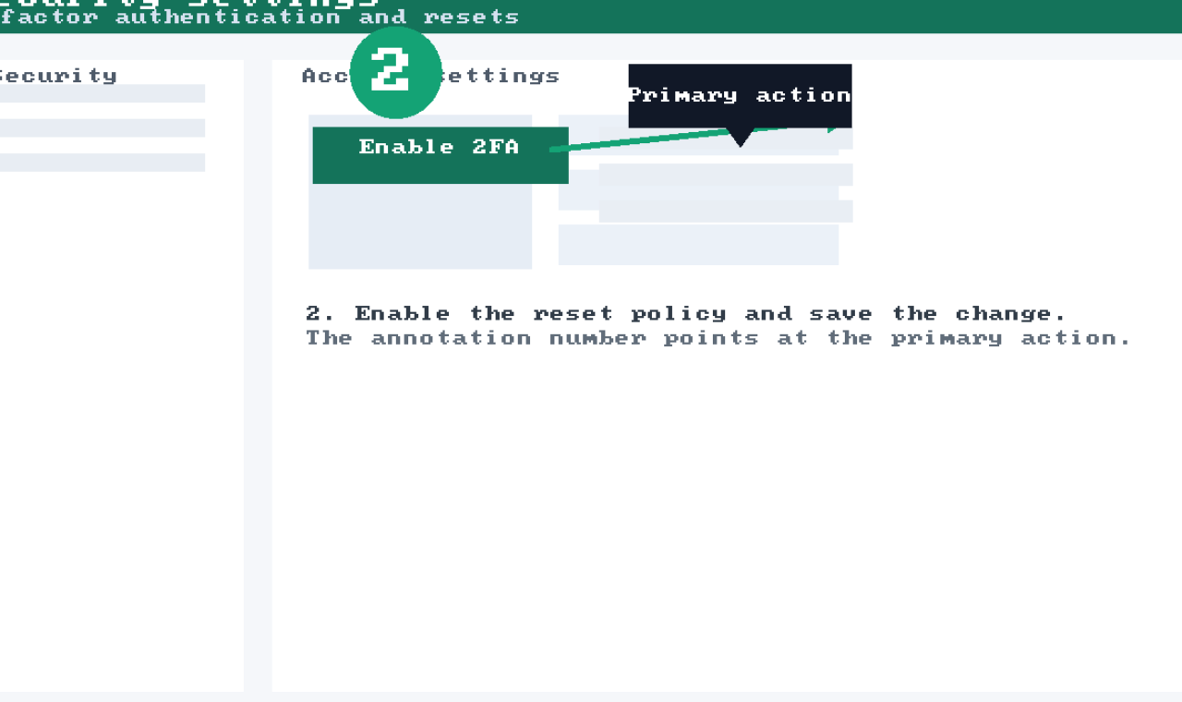
2. Enable the reset policy
Make sure the policy is active before continuing.

Slide 4
2.1. Confirm permission prompt
Only administrators can complete this step.

Slide 5
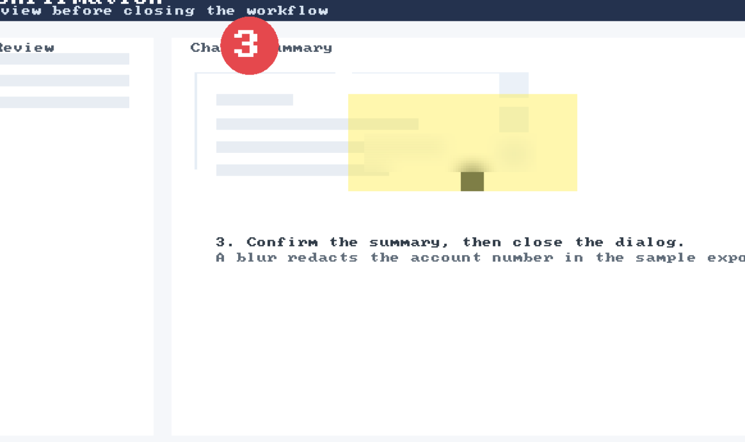
3. Review the confirmation
Confirm the summary and close the modal.

