Slide 1

﻿GMSA: Enhancing Context Compression via Group Merging and Layer Semantic Alignment
Jiwei Tang¹, Zhicheng Zhang¹, Shunlong Wu¹, Jingheng Ye¹, Lichen Bai¹, Zitai Wang¹, Tingwei Lu¹, Lin Hai¹, Yiming Zhao⁴, Hai-Tao Zheng^{1,2,∗}, Hong-Gee Kim³
¹ Shenzhen International Graduate School, Tsinghua University, China ² Pengcheng Laboratory
³ Seoul National University ⁴ Sun Yat-sen University
tangjw24@mails.tsinghua.edu.cn
Presenter：Jingheng Ye
Advised by：Prof. Hai-Tao Zheng
Notes:
Hello everyone. I am Jingheng Ye, a first-year Ph.D. student at Northeastern University. I received my M.S. degree from Tsinghua University. It's my great honor to present our research today. The paper is titled GMSA: Enhancing Context Compression via Group Merging and Layer Semantic Alignment. This work is supervised by Prof. Hai-Tao Zheng.

Slide 2
Content
01
Introduction
02
Method
03
Results and Analysis
Notes:
In this talk, I will cover three main parts:
First, the introduction and motivation of long-context compression.
Second, the detailed methodology of our GMSA framework.
Finally, experimental results, analysis, and key conclusions.

Slide 3

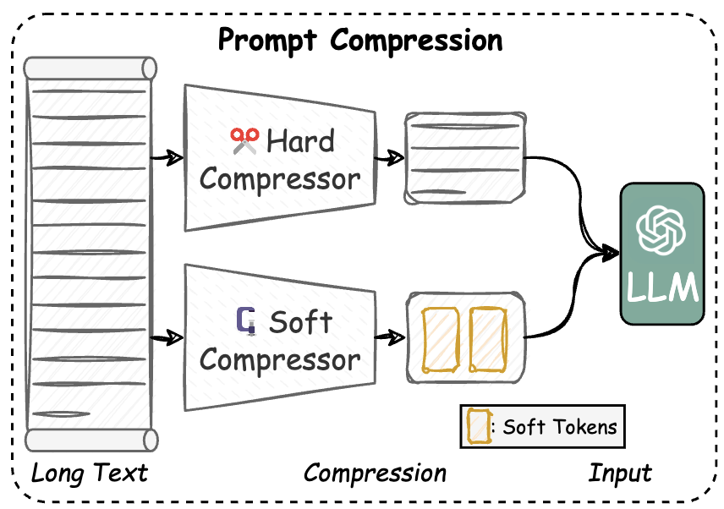
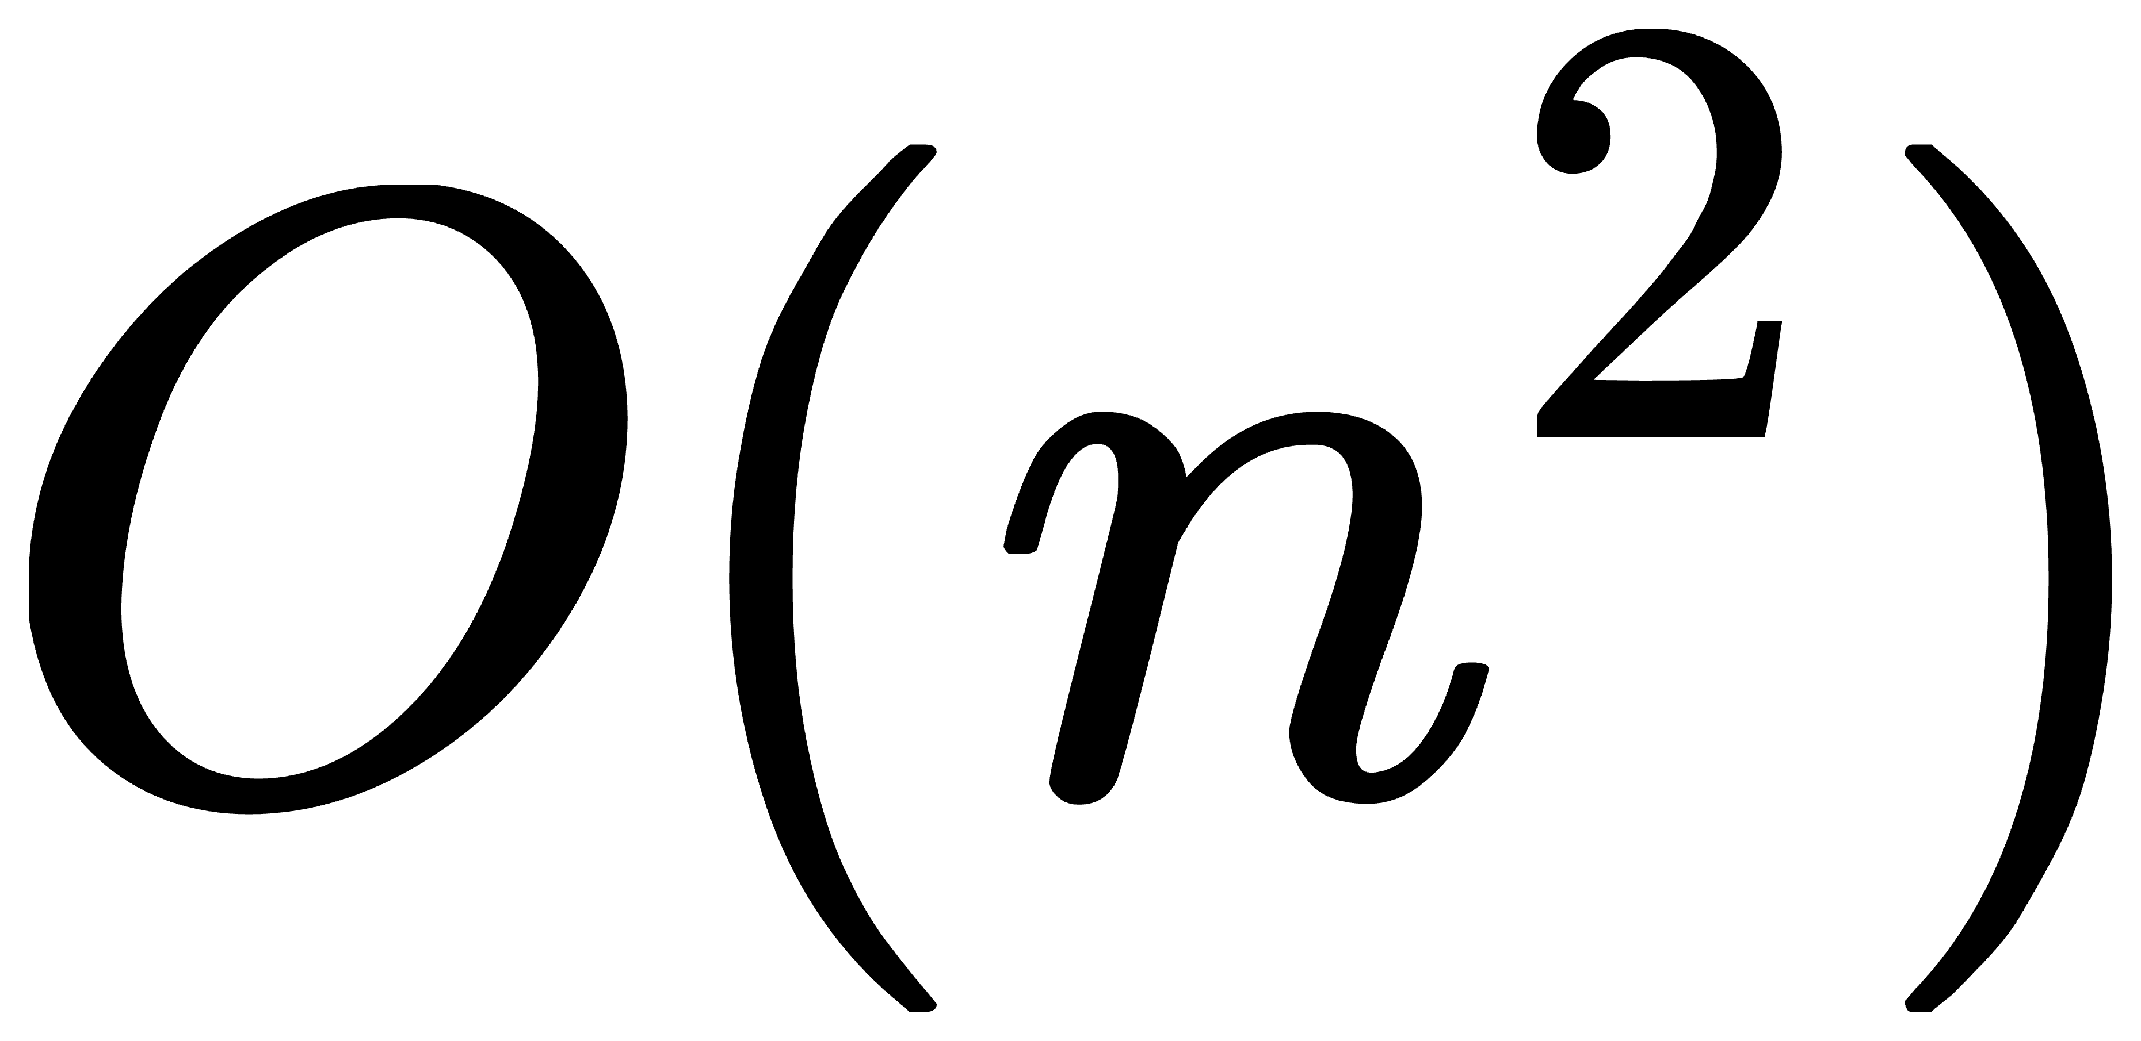
Introduction - Background
Prompt Compression Methods in Long Context Scenarios [1]
Challenge I: High computational overhead ( )
Challenge II: Information redundancy in long context
[1] Liu et al., A comprehensive Survey on Long Context Language Modeling, Arxiv 2025.
Notes:
Large language models have achieved great success, but they suffer from two critical challenges in long-context scenarios:
First, high computational overhead, due to the quadratic complexity of self-attention.
Second, severe information redundancy, which hurts both efficiency and performance.
To solve these problems, prompt compression has become a key solution, which is divided into hard compression and soft compression.

Slide 4
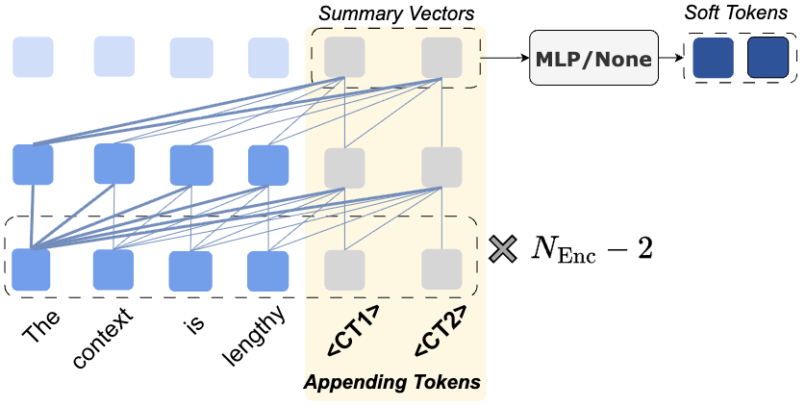
Introduction - Background
Prompt Compression Methods in Long Context Scenarios [1]
Existing Soft Prompt Compression Paradigm
Challenge I: High computational overhead ( )
Challenge II: Information redundancy in long context
Appending learnable tokens for compression
These tokens are emphasized layer by layer
[1] Liu et al., A comprehensive Survey on Long Context Language Modeling, Arxiv 2025.
Notes:
Existing soft prompt compression methods typically work like this:
They append several learnable tokens to the input, then let these tokens summarize the context layer by layer.
Finally, they either directly use these summary vectors as soft tokens, or pass them through a simple MLP.
However, this paradigm has serious limitations.

Slide 5
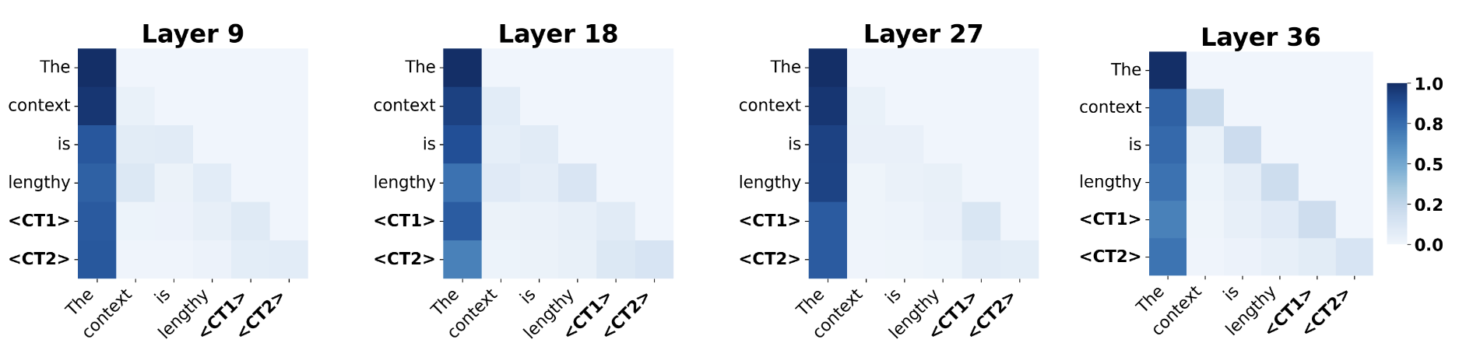
Introduction - Limitations & Motivation
Visualization of the Attention Matrix for Qwen3-4B (Instruct)
Semantic dominance in autoencoder pretraining process.
[2] Liu et al., Fantastic Semantics and Where to Find Them: Investigating Which Layers of Generative LLMs Reflect Lexical Semantics, ACL 2024 Findings.
[3] Jin et al., Exploring Concept Depth: How Large Language Models Acquire Knowledge and Concept at Different Layers? COLING 2025.
Notes:
However, existing soft prompt compression methods have two limitations:
Semantic dominance in autoencoder pretraining process. LLM tends to aggregate information on a few anchor tokens. As shown in Figure, in existing soft prompt compression paradigm, the appending randomly initialized tokens (“<CT1>” and “<CT2>”) learn summary vectors layer by layer. The semantics of anchor token (“The”) is emphasized layer by layer, resulting in the semantics of the summary vectors being dominated by it while the semantics of other tokens (“context”, “is”, and “lengthy”) are diluted. This limits the retention of complete semantics in autoencoder pretraining, which is a common approach in soft prompt compression.

Slide 6
Introduction - Limitations & Motivation
Visualization of the Attention Matrix for Qwen3-4B (Instruct)
Semantic dominance in autoencoder pretraining process.
How to mitigate semantic dominance?
[2] Liu et al., Fantastic Semantics and Where to Find Them: Investigating Which Layers of Generative LLMs Reflect Lexical Semantics, ACL 2024 Findings.
[3] Jin et al., Exploring Concept Depth: How Large Language Models Acquire Knowledge and Concept at Different Layers? COLING 2025.
Notes:
This limitation motivates us a research question: How to mitigate semantic dominance?

Slide 7
Introduction - Limitations & Motivation
Visualization of the Attention Matrix for Qwen3-4B (Instruct)
Semantic dominance in autoencoder pretraining process.
How to mitigate semantic dominance?
Large gap between compressed semantics and input semantics [2][3].
[2] Liu et al., Fantastic Semantics and Where to Find Them: Investigating Which Layers of Generative LLMs Reflect Lexical Semantics, ACL 2024 Findings.
[3] Jin et al., Exploring Concept Depth: How Large Language Models Acquire Knowledge and Concept at Different Layers? COLING 2025.
Notes:
(2) Ignoring the Large gap between compressed semantics and input semantics. The summary vectors, which represent high-level abstract semantics, are directly treated as ordinary tokens (i.e., as low-level semantics) and directly fed into the decoder during training and testing, resulting in a large semantic gap.

Slide 8
Introduction - Limitations & Motivation
Visualization of the Attention Matrix for Qwen3-4B (Instruct)
Semantic dominance in autoencoder pretraining process.
How to mitigate semantic dominance?
Large gap between compressed semantics and input semantics [2][3].
How to bridge the semantic gap?
[2] Liu et al., Fantastic Semantics and Where to Find Them: Investigating Which Layers of Generative LLMs Reflect Lexical Semantics, ACL 2024 Findings.
[3] Jin et al., Exploring Concept Depth: How Large Language Models Acquire Knowledge and Concept at Different Layers? COLING 2025.
Notes:
This limitation motivates us another research question: How to bridge the semantic gap?

Slide 9
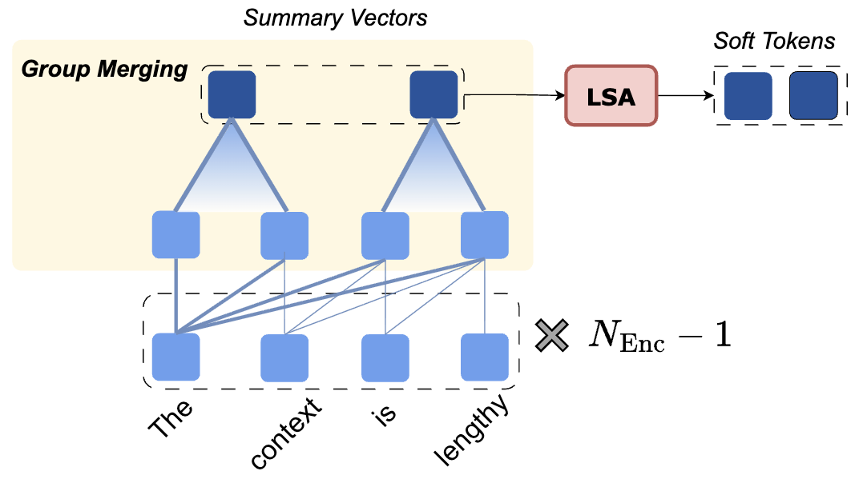
Introduction - GMSA
Group Merging
Equal Sized Split → Average Pooling
Compression by GMSA
Notes:
To address these issues, we propose GMSA.
The first core module is Group Merging.
Instead of appending tokens and letting attention focus on anchors, we split input tokens into equal-sized groups and compress each group using average pooling.

Slide 10
Introduction - GMSA
Group Merging
Equal Sized Split → Average Pooling
Reduce semantic dominance, preserving more complete semantics
Compression by GMSA
Notes:
This uniform aggregation mitigates the dominance of anchor tokens, therefore helping to preserve complete semantics during pretraining.

Slide 11
Introduction - GMSA
Group Merging
Equal Sized Split → Average Pooling
Reduce semantic dominance, preserving more complete semantics
Layer Semantic Alignment (LSA)
Lightweight module inheriting low-level semantics
Compression by GMSA
Notes:
The second core module is Layer Semantic Alignment, short for LSA.
LSA is a lightweight Transformer stack, initialized with the lower-layer weights of the decoder.
In this way, it naturally inherits the low-level semantic space of the model.

Slide 12
Introduction - GMSA
Group Merging
Equal Sized Split → Average Pooling
Reduce semantic dominance, preserving more complete semantics
Layer Semantic Alignment (LSA)
Lightweight module inheriting low-level semantics.
Align compressed semantics and input semantics.
Compression by GMSA
Notes:
By feeding the summary vectors through LSA, we project them from a high-level semantic space into the lower-level space, which alleviates cross-layer semantic gap.

Slide 13
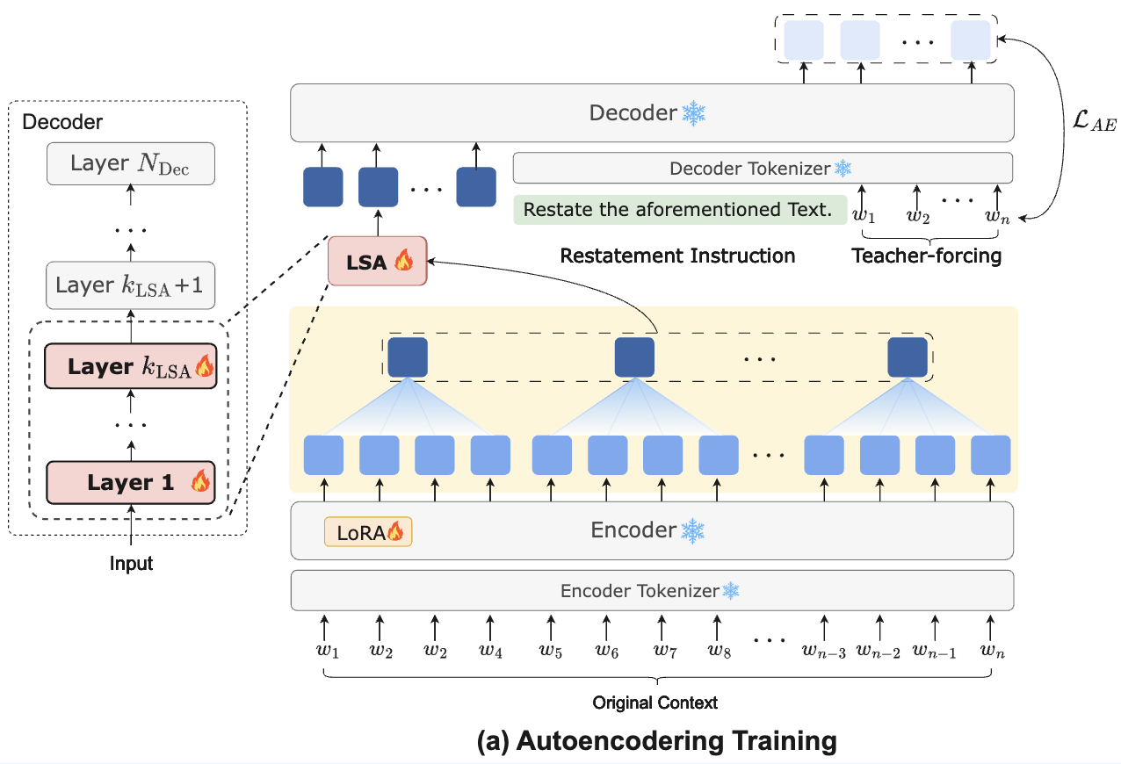
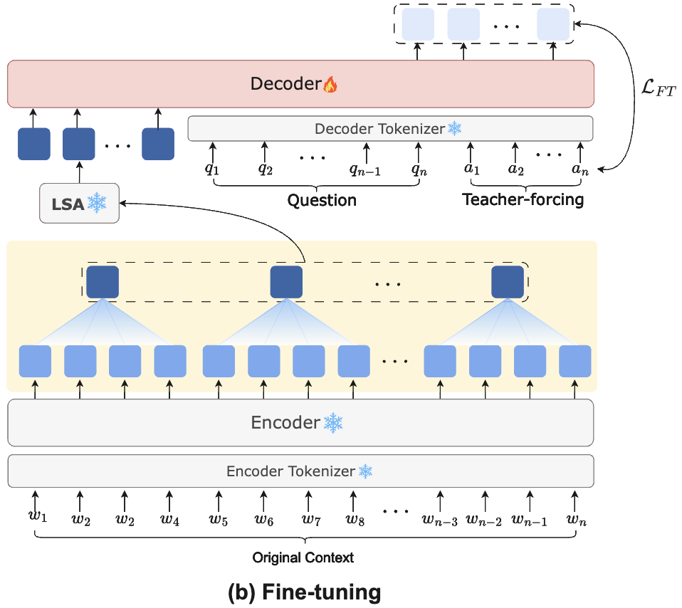
Method - Training Paradigm
Stage I: Autoencoder Training, aimed at preserving comprehensive semantic information.
Stage II: Fine-tuning, designed to adapt the model to downstream tasks.
Notes:
GMSA uses a two-stage training pipeline:
Stage 1: Autoencoder pretraining. We only train the encoder and LSA to reconstruct the original context, ensuring full semantic preservation.
Stage 2: Task-specific fine-tuning. We only train the decoder to adapt compressed representations to downstream tasks like QA and summarization.
Our contributions are threefold: (1) We identify and analyze two limitations in existing soft prompt compression paradigm: (i) semantic dominance in soft prompt compression pretraining process, and (ii) a semantic gap arising from the direct use of high-level summary vectors as decoder inputs. (2) We propose GMSA, a context compression framework that introduces (i) Group Merging to mitigate semantic dominance in soft compression pretraining process, and (ii) a Layer Semantic Alignment (LSA) module bridges semantic gap. (3) We conduct extensive experiments on context reconstruction, diverse benchmarks, demonstrating that GMSA achieves high semantic fidelity and superior downstream performance compared to baselines, while incurring low end-to-end latency.

Slide 14
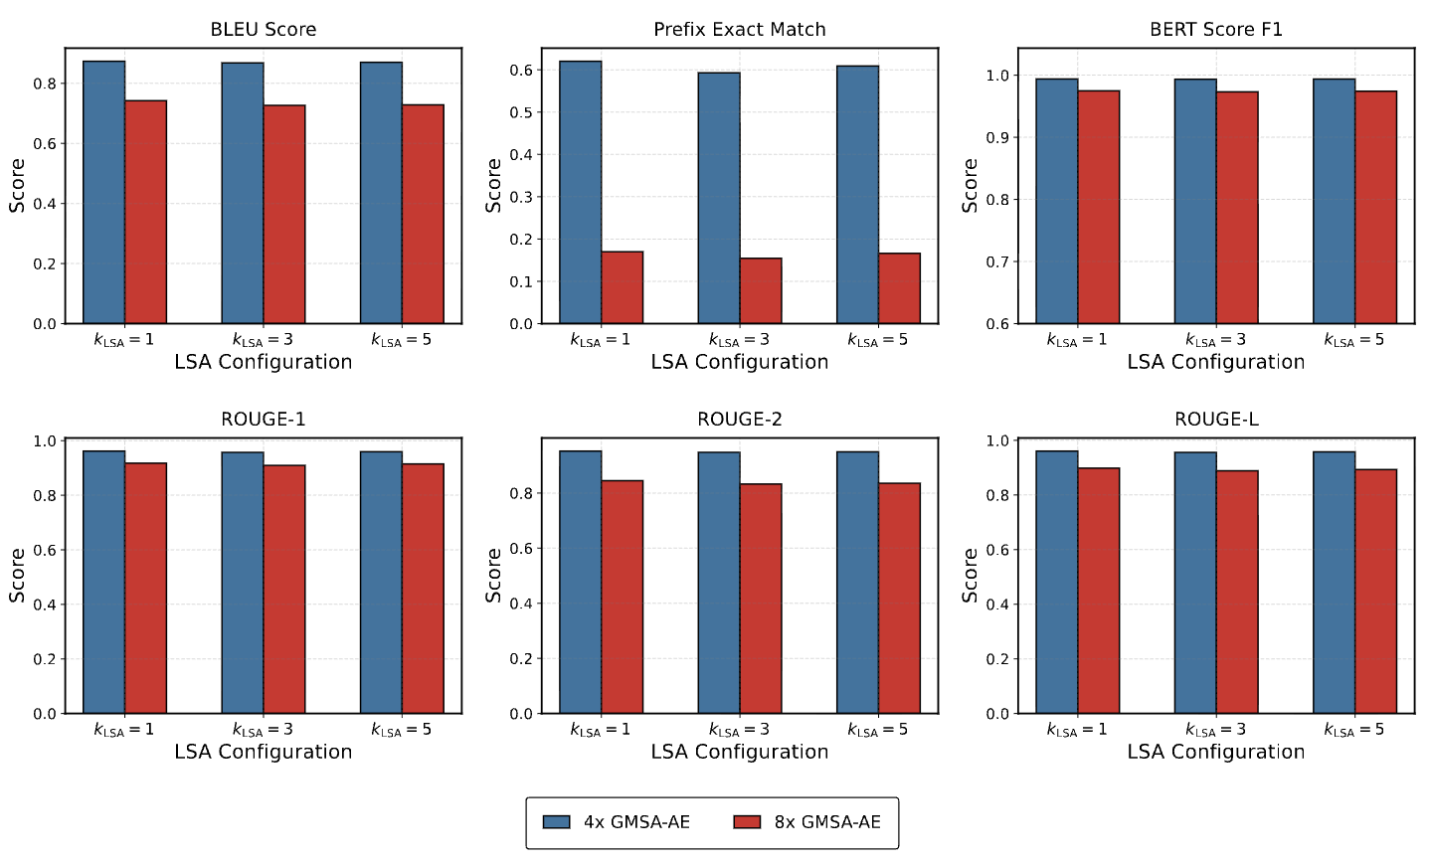
Result and Analysis - Impact of Different Layers of LSA
Surprisingly, only 1 layer of LSA achieves the best performance.
Notes:
We first tested how many LSA layers are needed.
Surprisingly, only 1 layer of LSA achieves the best performance.
Deeper LSA layers introduce more high-level semantics and increase alignment difficulty, leading to performance degradation.
Therefore, we use one layer of LSA as the default setting in the following experiments.

Slide 15
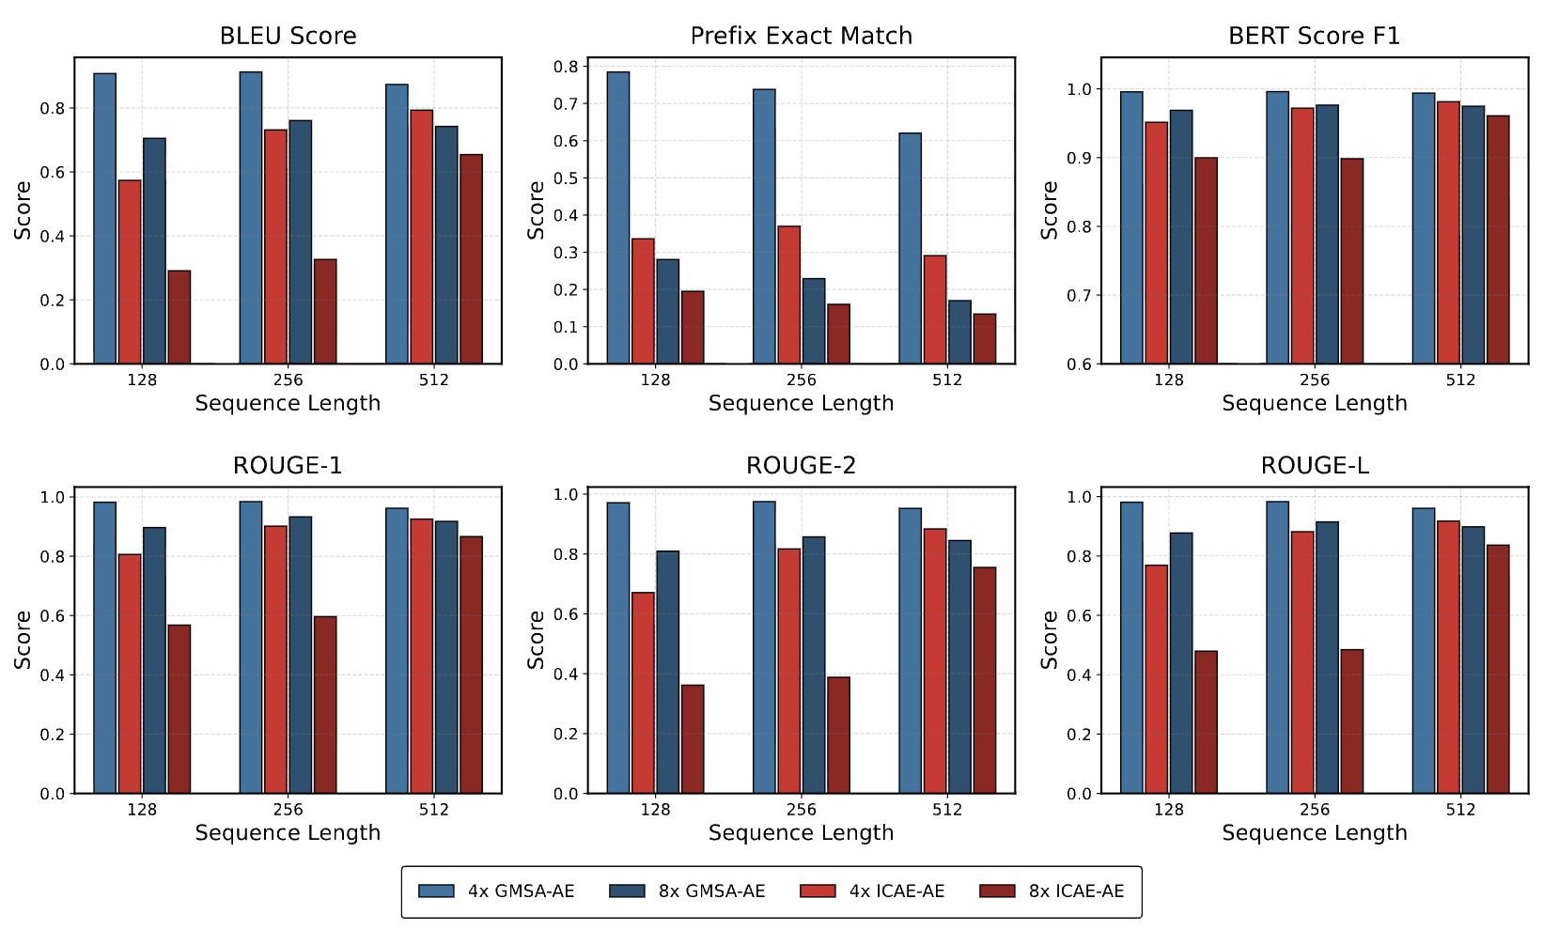
Result and Analysis - Context Restoration
GMSA–AE outperforms the baseline on both token-level and semantic metrics.
Notes:
In the context reconstruction task, GMSA–AE performs better than the baseline on both token-level matching metrics and semantic matching metrics.

Slide 16
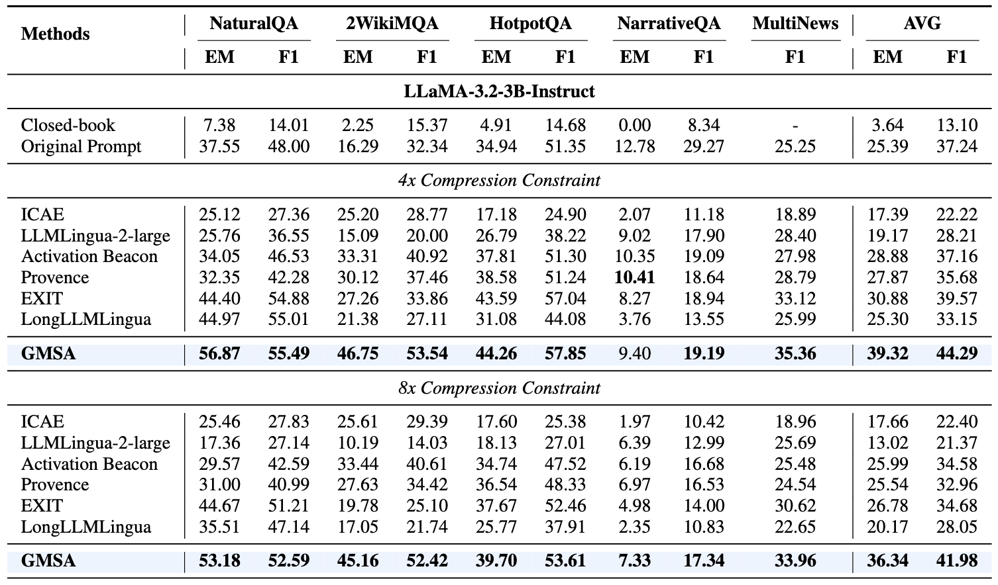
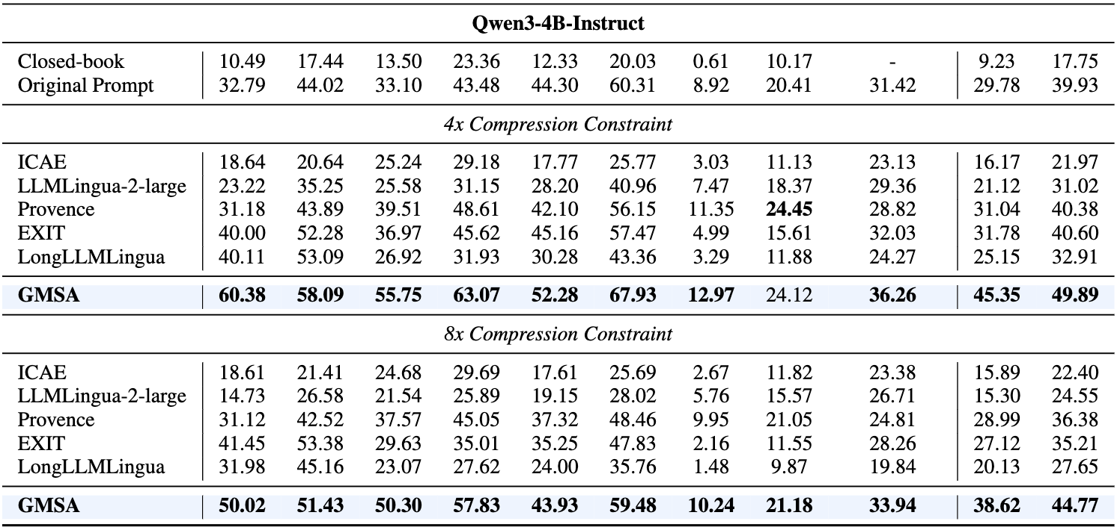
Result and Analysis - Downstream Tasks
GMSA consistently outperforms all baselines across most of the tasks and compression rates
Notes:
We evaluated on multiple long-context benchmarks: NaturalQA, 2WikiMQA, HotpotQA, NarrativeQA, and MultiNews.
Under both 4× and 8× compression, GMSA consistently outperforms all baselines including hard compression and state-of-the-art soft compression methods.
The improvement is significant and stable across LLaMA and Qwen backbones.

Slide 17
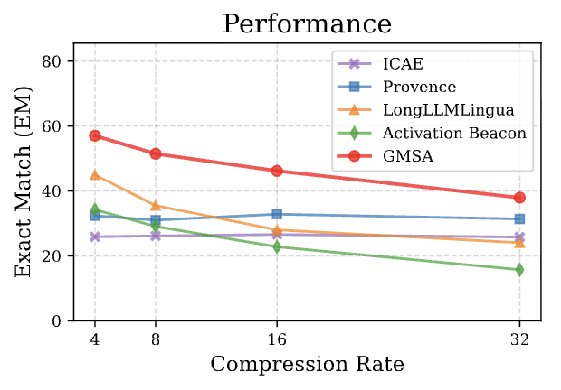
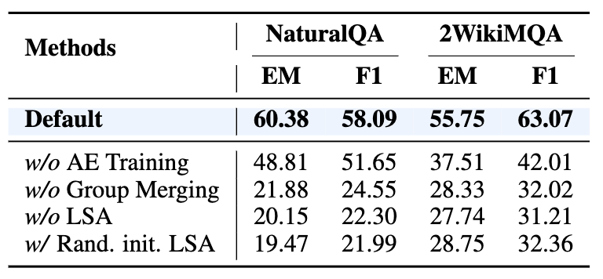
Result and Analysis - Ablation Study and Stress Test
Removing any component leads to a drop
GMSA maintains best performance across different compression rates
Notes:
In the ablation study, removing any component—autoencoder pretraining, Group Merging, or LSA—causes a huge performance drop.
This proves every module is indispensable.
In the stress test up to 32× compression, GMSA maintains the highest and most stable performance, while other baselines degrade rapidly.

Slide 18
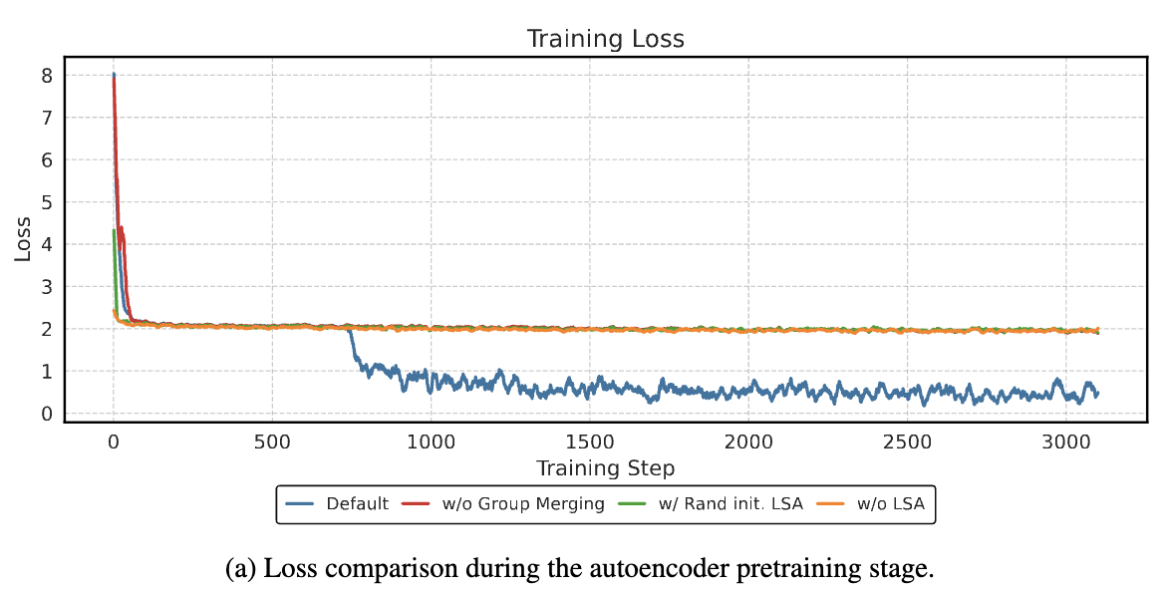
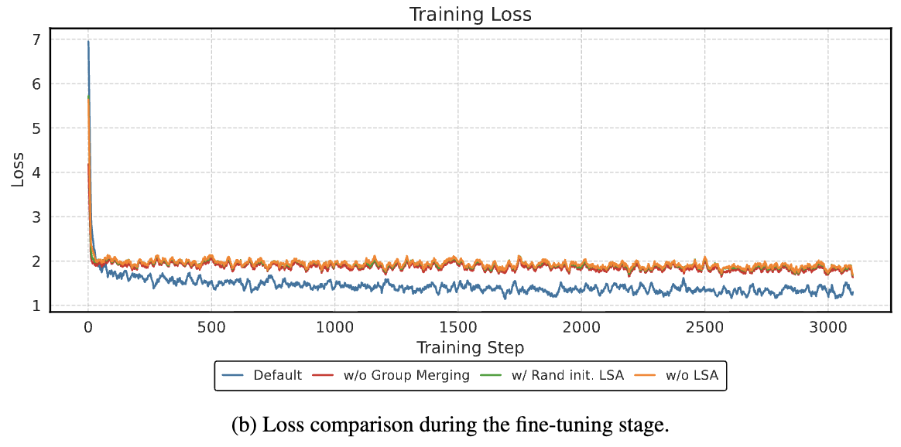
Result and Analysis - Training Loss Comparison
(a) Pretraining Loss Curves
(b) Fine-tuning Loss Curves
Group Merging and LSA are essential for stable and effective optimization
Notes:
We also compared training loss.
The full GMSA model converges much faster and reaches lower loss in both pretraining and fine-tuning.
Ablated models suffer from unstable optimization and higher loss, confirming the effectiveness of our design.

Slide 19
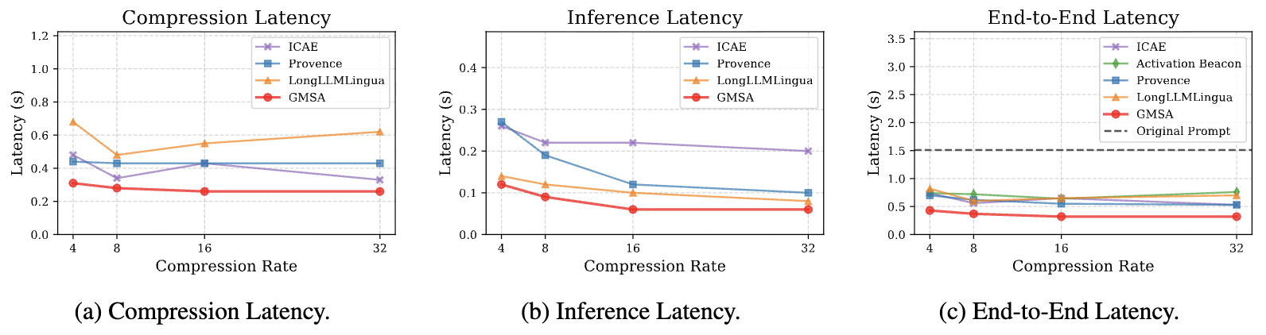
Result and Analysis - Latency Evaluation
Latency evaluation across methods on NaturalQuestions
GMSA achieves the lowest end-to-end inference latency
Notes:
Regarding efficiency, GMSA achieves the lowest compression latency, inference latency, and end-to-end latency.
Under 32× compression, it is nearly 5× faster than using the original prompt.
This makes GMSA both effective and practical for real-world deployment.

Slide 20




GMSA: Enhancing Context Compression via Group Merging and Layer Semantic Alignment
Jiwei Tang, Zhicheng Zhang, Shunlong Wu, Jingheng Ye, Lichen Bai, Zitai Wang, Tingwei Lu, Lin Hai, Yiming Zhao,
Hai-Tao Zheng∗, Hong-Gee Kim
tangjw24@mails.tsinghua.edu.cn
THANKS！Q&A
Code
Contact
Slides
Full Paper
Presenter：Jingheng Ye
Notes:
To conclude, we proposed GMSA, a novel context compression framework with two core innovations:
1. Group Merging to mitigate semantic dominance.
2. Layer Semantic Alignment to bridge the gap between compressed semantics and input semantics.
GMSA achieves superior performance, strong robustness, and high efficiency.
Thank you for listening. I’m happy to take any questions.
---------------------------------------------------------------------------------------------------------------------------------------------------------
Q1. How is the number of layers in LSA determined? If there are too many layers, will it hurt efficiency?
A1. This is a great question. Based on diagnostic experiments using context reconstruction, we found that LSA only needs one layer to achieve strong performance. We believe this is because a single-layer LSA already provides sufficient basic semantic modeling, whereas adding more layers may reduce efficiency by introducing additional computation.
Q2. Why does group merging help with the semantic dominance issue? Do the authors provide further experimental evidence?
A2. In the original paper, group merging is described as mitigating—not completely eliminating—semantic occupancy during autoencoder training. We support this rationale mainly from two perspectives: (1) Compared with appending learnable tokens, compressing via group merging avoids having the anchor tokens’ semantics “occupy” layer by layer, and it naturally treats each token more evenly. (2) During autoencoder training, we observed that group merging converges much faster and achieves a much lower loss than appending learnable tokens (especially when comparing loss below 1 vs. above 2). From the standpoint of faster convergence and better reconstruction loss, this also indirectly suggests that group merging helps alleviate semantic occupancy.
Q3. Some decoder-only text compression methods exist now, such as Beacon. How do encoder-decoder structure compare in terms of advantages?
A3. Thank you for the question. While decoder-only methods can adapt well to today’s mainstream large models, they have the following issues: (1) The compression model and the generation model must be the same size. When the decoder is already large, this causes extra computational overhead. In contrast, encoder-decoder structures decouple compression from generation: a smaller model can be used for compression while a larger decoder handles generation. (2) Online computation may be unacceptable in real-time scenarios. For long-text inputs, online computation is unavoidable and consumes significant time, which is unacceptable in real-time applications such as recommendation. Task-agnostic encoder-decoder designs (e.g., GMSA) typically allow offline precomputation of compressed embeddings; online inference then retrieves compressed representations from a cache for the decoder, enabling high real-time performance. (3) Poor compatibility with acceleration frameworks. Compression strategies tailored for decoder-only models often rely on KV-cache operations and may involve autoregressive compression, which is difficult to integrate into mainstream acceleration systems such as vLLM—leading to limited real-world efficiency. By contrast, GMSA is essentially built from simple arithmetic operations and end-to-end differentiable transformer blocks, making it much easier to fuse with vLLM and unlocking further acceleration potential. As far as I know, the text compression framework most commonly used in industry is a straightforward encoder-decoder structure.
Q4. Why does appending learnable tokens perform worse than merging?
A4. In our experiments, we found that for relatively short texts (e.g., with an average length of fewer than 1,000 tokens), the appending learnable tokens approach is not inferior to the merging approach and can even achieve comparable performance. However, as the input length increases—for example, to several thousand tokens or beyond 10k tokens—the performance of the appending approach degrades significantly.
We believe this can be attributed to two factors:
Semantic dominance becomes more severe in long contexts, making it difficult for the appended learnable tokens to capture comprehensive semantic information, which ultimately leads to inferior performance.
The positional encoding of the appended learnable tokens inherently limits their ability to effectively capture information distributed across different positions in the input sequence, thereby reducing the quality of the compressed semantic representations.
Q1. LSA的层数如何确定？如果LSA的层数太多是否会影响效率？
A1. 这是一个好问题，我们通过上下文重建的诊断性实验发现，LSA只需要一层就能取得好的效果。我们认为这可能是因为1层LSA已具备足够的初级语义，而多层LSA反而可能会因引入更多层数导致效率下降。
Q2. 为什么分组平均能解决语义占据问题？作者是否有进一步的实验证据
A2. group merging，即分组平均，在原文的表述中提到的是能缓解而非彻底解决autoencoder training中的语义占据现象。我们主要从两个角度说明这个事情的合理性：（1）相比于appending learnable tokens，以group merging的方式压缩不会逐层被anchor tokens的语义占据，并且天然会更加均匀地对待每一个token。（2）在autoencoder training训练过程中，我们发现使用group merging的方式会比appending learnable tokens损失收敛快特别多、损失低很多（1以下，与2以上的比较），所以，从重建损失收敛更快、更好的角度，也可以侧面说明group merging有助于缓解语义占据现象。
Q3. 当前会出现一些decoder-only的文本压缩技术，比如beacon，这样的方法可以无缝适配至现有的以decoder-only为主的大模型上，与这样的方法相比，encoder-decoder结构有何优势？
A3. 感谢您的提问。确实decoder-only相关的方法可以较好地适配到当前主流大模型中，但却存在以下问题：（1）压缩与生成模型必须同等大小，这在decoder本身比较大时会造成额外的计算开销。而encoder-decoder结构可以解耦压缩模型和decoder，可以用较小模型压缩，较大decoder生成。（2）
需要在线计算、在实时性要求高的场景可能不可接受。长文本场景下的在线计算不可避免地会消耗较多时间，这在实时性要求高的场景，如推荐，是不可接受的。而任务无关类的encoder-decoder结构，如GMSA，往往支持离线先计算出compressed embeddings，线上使用时召回库中的压缩表示用于decoder。这种方式能支持高实时性的场景。（3）与加速框架的兼容性欠佳。能适配到decoder-only模型的压缩策略往往涉及kv-cache操作，且通常会涉及自回归压缩，这样的操作策略难以融合到主流加速框架，如vllm中，从而在实际场景中的效率难以较高。而GMSA本质上由简单的算术操作和端到端可导的transformer block组成，能很方便地与vllm融合，从而进一步释放加速的潜力。据我了解，目前工业界主要采用的文本压缩框架就是简单的encoder-decoder结构。
Q4. 为什么appending learnable tokens的方式表现会比merging差？
A4. 在我们实验中发现，在短文本的情况下，如平均长度小于1000，appending tokens的方法并不会差于merging的方法，甚至取得相近的表现。但文本长度一旦变长，比如超过几k、超过10k，appending tokens的方法会显著变差。我们认为这有两个原因：（1）semantic dominance在长文本中更加严重，导致appending tokens难以学习完整语义信息，从而导致表现下降（2）appending tokens本身的位置编码使其难以有效学习到不同位置的信息，同样影响压缩后语义信息的质量。

