Slide 1
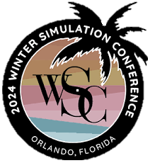


AI-DRIVEN MULTI-OBJECTIVE UAV ROUTE OPTIMIZATION Mohammad Dehghani Sahil Belsare Ashwin Devanga Mechanical and industrial engineering Northeastern University

Slide 2

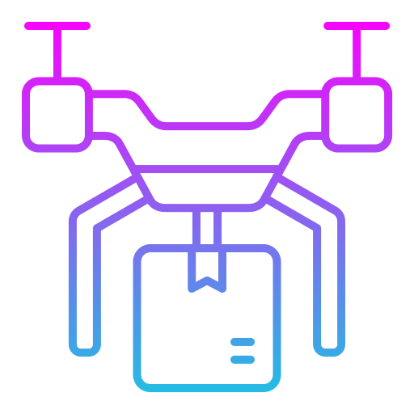

Applications and Challenges
AI
UAVs
Supply Chain
Reliability
Medical Care Delivery
Short-Range
Pipeline inspection

Slide 3




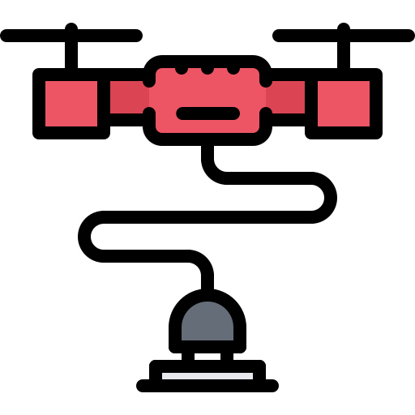




Problem Definition
UAVs
Visited nodes
Un-visited nodes
UAV tours

Slide 4
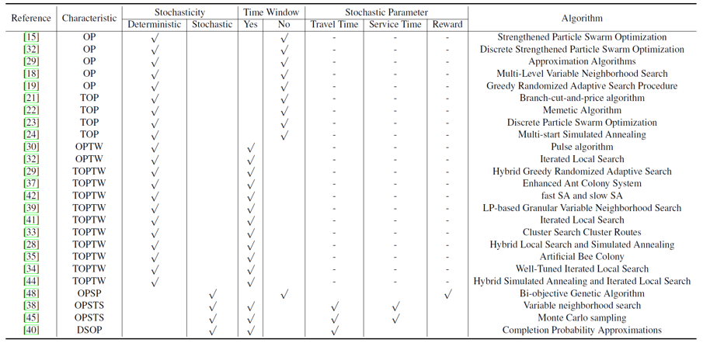

Existing Approaches
TOPTW     

Slide 5

Solution Approaches

Slide 6



Motivation
Team Orienteering Problem of UAVs with Charging Station
Max Node Coverage
Min Travel Distance
Max Reliability

Slide 7





Solution Approaches
K-Means + Max Reward
K-Means + Min Distance
AI-enabled SA
Clusters nodes by rewards
Prioritizes high-reward nodes
Clusters nodes by rewards
Prioritizes minimizing travel distance between nodes.
Simulated Annealing
Enhances SA by incorporating Neural Networks.

Slide 8
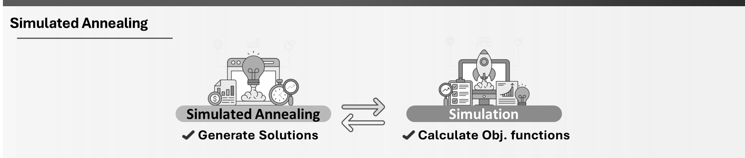





Solution Approaches
SA Models
Simulated Annealing
Simulated Annealing
Simulation
Generate Solutions
Calculate Obj. functions
Simulated Annealing + NN
Simulated Annealing
Neural Network
Generate Solutions
Predict Obj. functions

Slide 9
Experiment Results
Key Metrics
Total Reward
Total Distance
Total Time Window Violation
TR
TD
TTWV
CR
TTOC
1
3
5
2
4
Coverage Ratio
Total Time Out of Charge

Slide 10


Solution Approaches
Metamodel
Feed Forward Neural Network
1
2
KPIs
3

Slide 11

Experiment Results

Slide 12



Experiment Results
Experiment Setup
Model Settings
Machine Configuration
NN Hidden Layers (Feed Froward)
30
3
32 GB
8 Core
128, 64, 64

Slide 13
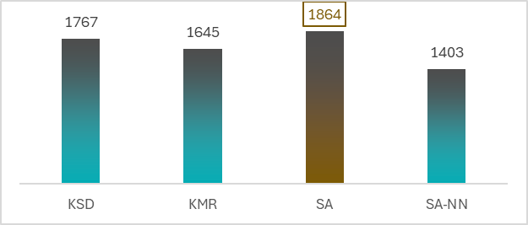
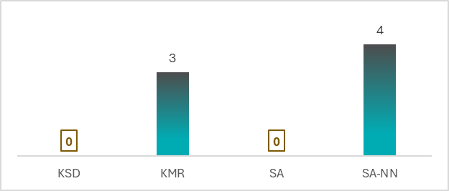
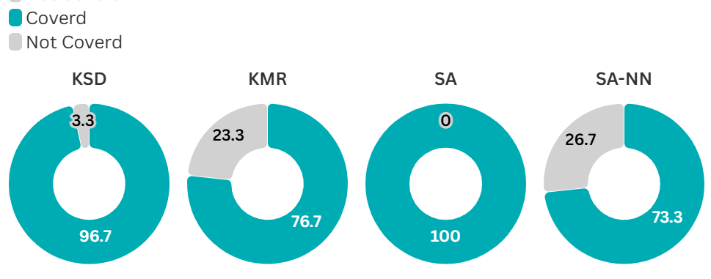
Experiment Results
Results: Experiment 1
TR
TTOC

Slide 14

Experiment Results
SA-NN Hybrid Approach
Neural Network
50%
Predict Obj. functions
Simulated Annealing
Generate Solutions
50%
Simulation
Calculate Obj. functions

Slide 15
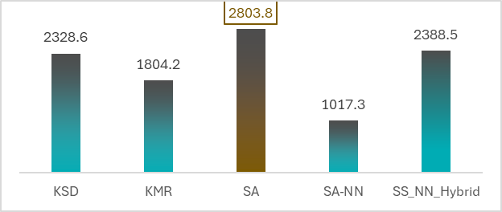
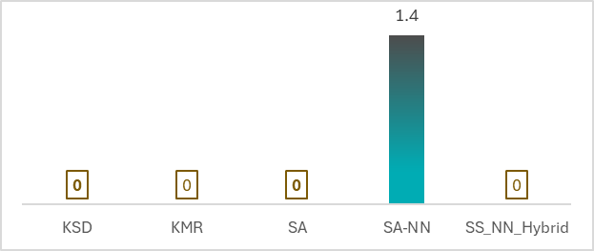
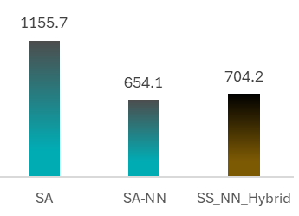
Experiment Results
Results: Experiment 2
TR
TTOC
Runtime (s)

Slide 16

Discussion and Next steps
SA outperformed all methods in overall effectiveness for node coverage and reward metrics.
The SA-NN-Hybrid approach demonstrated significant potential by blending predictive and optimization techniques to achieve high-quality results with reduced computational effort.
Future Research
Future research should explore reinforcement learning and dynamic models
Develop dynamic models combining learning and optimization.
Explore additional hybrid techniques to improve scalability.

Slide 17


Thank You
m.dehghani@northeastern.edu

