Slide 1
A TUTORIAL ON HOW TO CONNECT PYTHON WITH DIFFERENT SIMULATION SOFTWARE TO DEVELOP RICH SIMHEURISTICS
Presented by
Dr. Mohammad Dehghanimohammadabadi
Northeastern University
Department of Mechanical and Industrial Engineering
360 Huntington Avenue
Boston, Massachusetts, 02115, USA
Authors:
Mohammad Peyman
Dr. Pedro Copado
Dr. Javier Panadero
Dr.Prof. Angel A. Juan
Universitat Oberta de Catalunya – IN3
Euncet Business School 156 Rambla del Poblenou Barcelona, 08018, SPAIN

Slide 2
Context:
Introduction
SIMPY AND PYTHON
CALLING PYTHON FROM ANYLOGIC
CALLING ANYLOGIC FROM PYTHON
SIMUL8 AND PYTHON
Conclusion
Notes:
How presentation will benefit audience: Adult learners are more interested in a subject if they know how or why it is important to them.
Presenter’s level of expertise in the subject: Briefly state your credentials in this area, or explain why participants should listen to you.

Slide 3
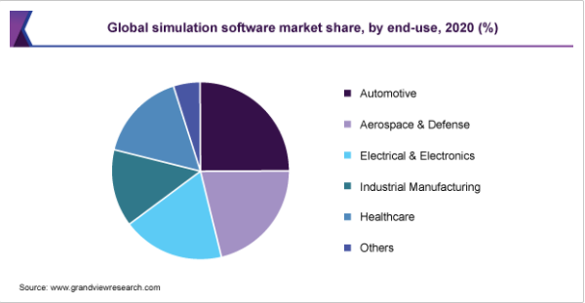
Introduction
Simulation modeling solves real-world problems safely and efficiently.
Risk-free environment
Cost and time effective
Visualization
Insight into dynamics
Increased accuracy
Deal with uncertainty
Discrete-event simulation (DES)
Conventional simulation approach to model time-dependent and complex systems.
Powerful decision making tool.
Enables the study of systems which are discrete, dynamic and stochastic.
Fits to many applications in mining, the optimization of the load-haul-dump cycle and etc.
Most critical for achieving higher efficiency and cost reduction.
Notes:
Example objectives
At the end of this lesson, you will be able to:
Save files to the team Web server.
Move files to different locations on the team Web server.
Share files on the team Web server.

Slide 4






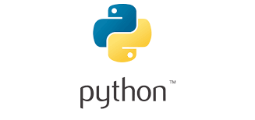
Commercial and Non-commercial simulation software packages
Commercial: Simio, AnyLogic, Simul8, Arena, etc.
Non-commercial: SimPy, Salabim, Simulus, etc.
These simulation software are capable for modeling real-life systems with a high accuracy.
To simulate a complex control system in logistics and production environments.
Combination of DES platforms with external programming languages (R, Python, or MATLAB) provide:
Additional mathematical operations
Algorithmic flexibility (combining scalable metaheuristic components with simulation)
Intelligent simulation modeling
PYTHON:
Popular language in the field of data science and artificial intelligence
Portability : you don’t need to change your code to run the program on different platforms.
Vast Libraries Support
Free and Open-Source
Dynamically Typed : The programmer doesn’t need to worry about declaring variables and their data types.
Notes:
Example objectives
At the end of this lesson, you will be able to:
Save files to the team Web server.
Move files to different locations on the team Web server.
Share files on the team Web server.

Slide 5
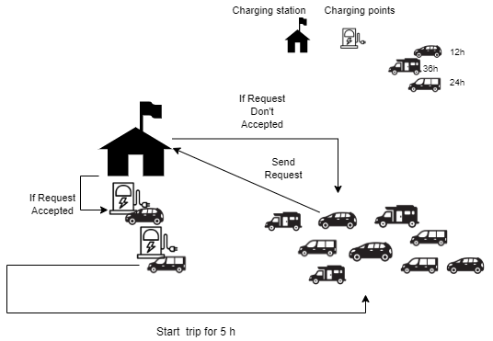
SIMPY AND PYTHON
SimPy is an object-oriented and method-based open-source library based on Python.
Processes in SimPy are simple Python generator functions and are used to model active components like customers, vehicles or agents.
SimPy is a non-commercial DES platform that can be used to simulate different models, such as production planning, hospital operations, and vehicle routing .
Simpy can be installed by:
Case Study:
Several electric vehicles (EV)
Sharing a unique charging station
Three types of EV: (12h,24h,36h) charging time
Two charging points
Five hours trip
Duration : Three days

Slide 6
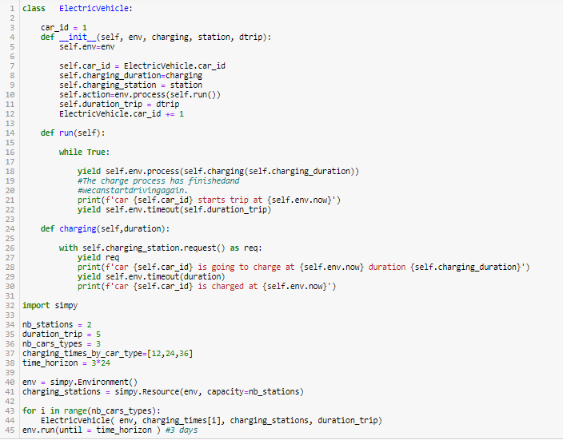
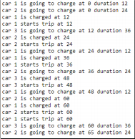
SIMPY AND PYTHON
Defines a class ElectricVehicle with two methods, run() and charging() .
Simulation environment will start by calling simpy.Environment to create an object environment env.
simpy.Resource() is used to limit the number of simultaneously used processes.
Result shows the complete process during three days for three different charging time.
This model can be extended by including additional cars, charging stations, and key performance indicators, such as waiting times.

Slide 7
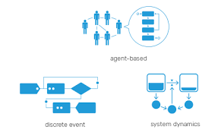
CALLING PYTHON FROM ANYLOGIC
AnyLogic (AL) simulation platform :
Multimethod simulation modeling tool developed by The AnyLogic Company
Modern simulation software based on the object-oriented paradigm
AnyLogic models can be based on any of the main simulation modeling paradigms: discrete event or process-centric , systems dynamics, and agent-based
AnyLogic is cross-platform simulation software that works on Windows, macOS and Linux
Different application problems, such as transportation systems, supply chain management, industrial development, and business process evaluation can be modeled in AL
Capability to integrate with Python packages
AL provides a cloud API for Python
Simulation model in AL includes a set of active objects :
Main structure of the model
Works simultaneously and interact with each others
enables users to develop their customized modification

Slide 8
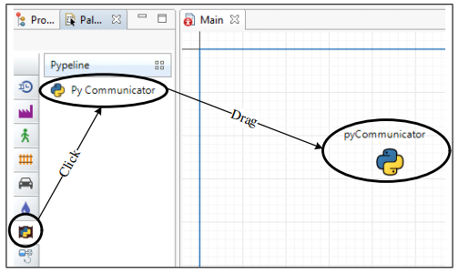
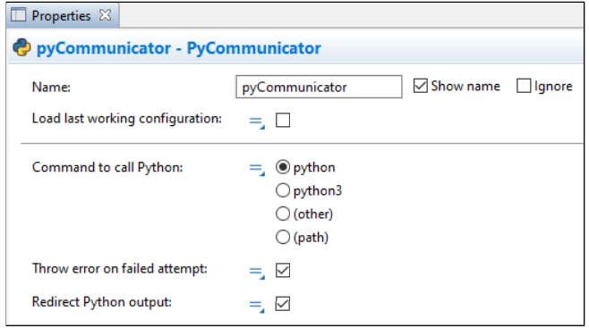
CALLING PYTHON FROM ANYLOGIC
Pypeline library :
Pypeline (pypeline.jar) can be downloaded from github.com and added to the AL palette.
AL users can link the simulation model with any customized functions and algorithms developed in Python environment to support experimentation
By adding an object called pyCommunicator to the main model, AL model is ready to connect with Python.
Pypeline is compatible with any Python installation, user needs to select an appropriate Python version and add the Python path.
run function : one-directional statement to send commands to Python
runResult : two-directional, not only sends statements to Python, but it also can receive returns based on Python calculations.
Users can change the model configuration
Conduct experiments
Perform optimization from a Python environment
Attempt, includes two outputs:
isSuccessful, a Boolean indicating whether the Python command is successful or not
getFeedback, which shows the model error if it exists.

Slide 9
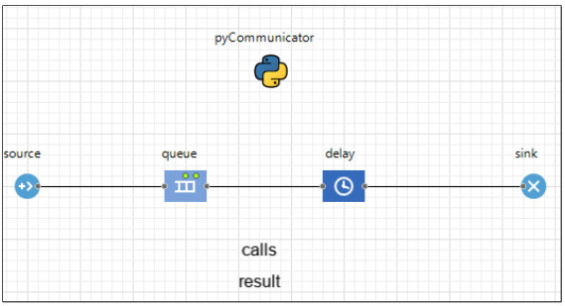
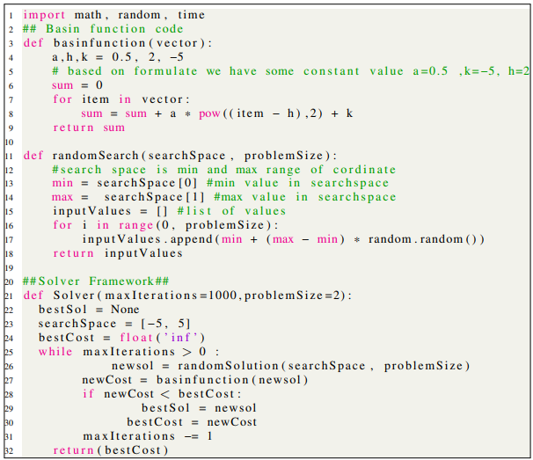


CALLING PYTHON FROM ANYLOGIC
Use Case:
Source → Main agent.
Queue → A placeholder for agent to wait for the next process.
Delay → Calls the Pypeline file.
Calls → Number of Python calls.
Result → Returned value.
Sink → After finishing the process the agent leaves the system.
The Python script is a continuous optimization problem to minimize the basinfunction function :
Decision variable :
Constant parameters :
Solver function runs the randomSearch to minimize the basinfunction objective function
This algorithm creates a new solution (newsol) by randomly selecting a value for x in each iteration. Once the search is complete, the best ever found solution (bestSol) and its corresponding cost (bestCost) are returned.

Slide 10
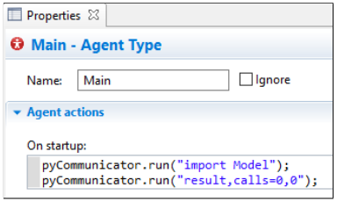
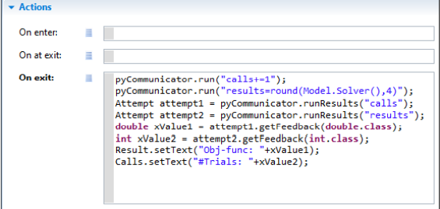
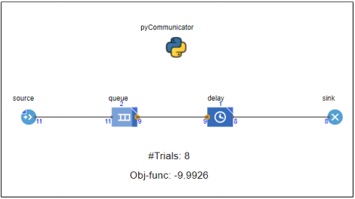
CALLING PYTHON FROM ANYLOGIC
Use Case:
Run the Python code from the AL model:
From the main tab, select the main-agent type
Modify the Agent action by changing the on startup settings:
a. pyCommunicator.run(“import filename”) → Imports the Python file.
b. pyCommunicator.run(“result, calls=0,0”) → Calls the Python function and receives its results.
3. From the delay object, modify the on exit event setting to enable the AL model to trigger the Python code
a. pyCommunicator.run(“calls += 1”) → increment the number of times the Python files are called.
b. pyCommunicator.run(“results = round(Model.Solver(), 4)”) → deploys the random search algorithm written in the Solver function. The number 4 determines how many decimal points of accuracy have to be included in the results.
c. Attempt attempt1 = pyCommunicator.runResults(“calls”) → enable the AL model to trigger Python.
d. Attempt attempt2 = pyCommunicator.runResults(“results”) → enable the AL model to receive Python results.

Slide 11
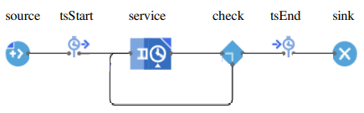
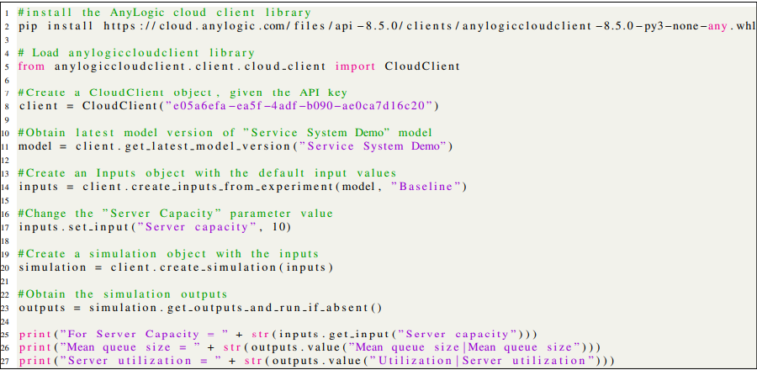

CALLING ANYLOGIC FROM PYTHON
Use Case:
Service System Demo model :
Users can perform experiments by changing the model configuration (e.g., the server capacity).
Outputs are the average size of the service queue and the resource utilization server capacity).
Develop AL models from cloud client in Python:
pip package manager → Install the AL cloud client library
Import the AL cloud client library, and set the client object API key
client.get_latest_model_version() → Create a model object .
client.create_inputs_from_experiment() → Establish the experimental settings input
client.create_simulation() → Develop the remote AL simulation model and embedding the experimental inputs.
simulation.get_outputs_and_run_if_absent() → Retrieve the simulation results by triggering the simulation experiments with
The results of the model with a server capacity of 10 Units shows the mean service queue size of approximately 1 person, and the average Server utilization of 0.25

Slide 12
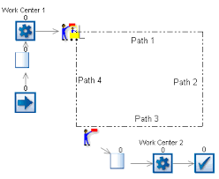
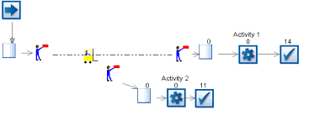
CALL SIMUL8 FROM PYTHON
Simul8 Software:
Use for simulating systems that involve processing of discrete entities at discrete times.
For planning, design, optimization and reengineering of real production, manufacturing, logistic or service provision systems.
Useful for industry and academia
Operates with 6 main parts:
Work item
Entry point
Storage bin
Work center
Work exit point
Resource
Python with Simul8
32-bit version of Python is recognizable by Simul8 as a COM application
Deeper analysis of simulation results
More data visualization options
Faster than other data analytics packages

Slide 13
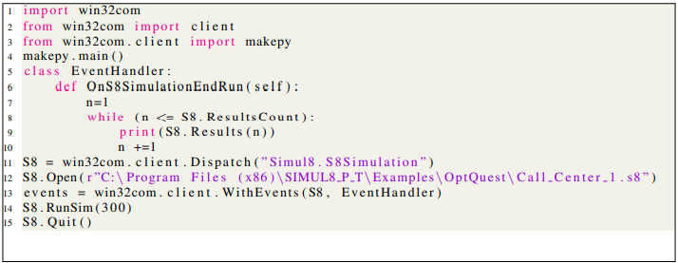
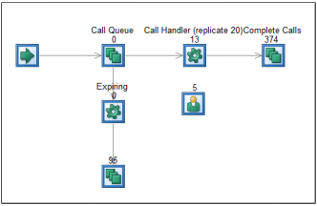
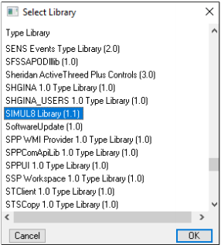
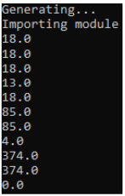
CALL SIMUL8 FROM PYTHON
Call Center Use Case:
Import the required packages
Import makepy→ to create COM modules out of COM-enabled applications
Enter into the Makepy file, select the Simul8 Library
Class EventHandler→ counts the number of times that Simul8 is called, and prints the simulation results.
A Dispatch method → open the Simul8 software
Open the developed simulation model.
Connect the EventHolder class with Simul8
Run the simulation experiment for 300 minutes
Terminate the execution.

Slide 14
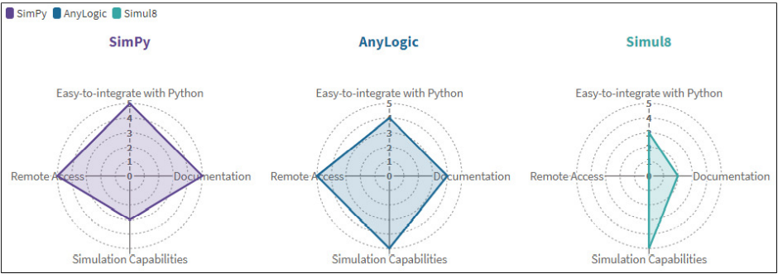
CONCLUSIONS
Easy to integrate with Python: the API capability of each application to be integrated with Python.
Documentation: the availability of documentation provided by vendors or users.
Remote access: ability to be accessed remotely without opening the software application.
Simulation capability: simulation modeling features and complexity.
Simheuristic algorithms = Metaheuristic components + Simulation(complex DES models)
excellent option to optimized real-life stochastic optimization problems, ranging from transportation and logistics to manufacturing and production or smart cities.

Slide 15
Thank You

