Slide 1



Using a Simulation-Optimization approach to Optimize Patients Scheduling- A Table-Experiment Approach
Mohammad Dehghani¹, Mandana Rezaeiahari², Thomas keyser³
1. Department of Mechanical and Industrial Engineering, Northeastern University
2. Department of Systems Science and Industrial Engineering, State University of New York at Binghamton
3. Department of Industrial Engineering and Engineering Management, Western New England University

Slide 2

MIE Department – Northeastern University
NU, private institution, founded in 1898
Mechanical Engineering: PhD program ranked #39
Industrial Engineering: PhD program ranked #32
Engineering: PhD program ranked #39
University: College program ranked #40
Top-tier co-op university in the U.S. 1300 undergrad and 1300 graduate students in MIE department
Faculty
55 tenured/tenure-track faculty members (2 NAE)
20 teaching/co-op faculty members
Annual research $13M+
$125M contract order from Veterans Health Administration
$20M contract order from Army Research Lab
Nine research clusters in the department

Slide 3

Agenda
Problem Statement & Objectives
Methodology
Methodology Flowchart
Solution Representation
Case Study
Breast Center Overview
Swim Lane Diagram
Experimental Design
Simulation Model Results
Conclusions and Future Work

Slide 4
Problem Statement & Objectives
Problem definition
The center is experiencing lack of resources that results in
High patients waiting time
Need for overtime to be able to handle the demand
Some patients are transferred to other days
Paperwork is done at home by the doctor
Project’s goals
Sequencing patients at a breast cancer center with the goal of minimizing the average time of patients in the system

Slide 5

Introduction
Appointment scheduling is a challenging task, mainly due to the uncertainties associated with service times [1].
Timely access is important for realizing good medical outcomes.
It is also an important determinant of patient satisfaction.
The focus of this article is on Appointment Scheduling Optimization in a healthcare system.
We do NOT consider system improvement aspects of the system such as the size of facilities, equipment and staff, and to resource allocation

Slide 6
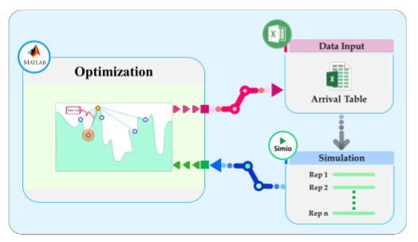
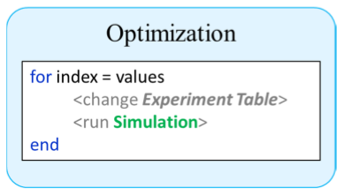
Methodology
Simheuristics table-experiment framework
Simulation optimization framework to run simulations by changing table of variables
Simulated Annealing (SA) used to provide new solution at each iteration in MATLAB
Solutions are stored in Excel then used by Simio as input
Output of simulation is fed into SA for the next iteration

Slide 7
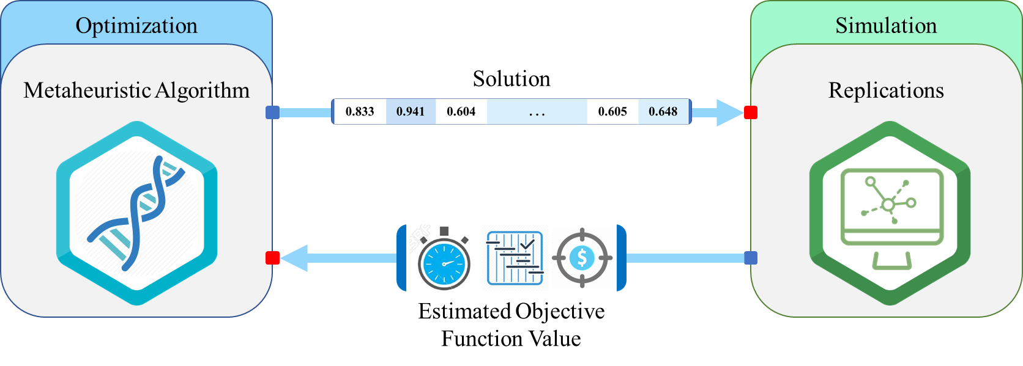



Methodology – Simheuristic Approach
Capabilities
Disc., Continues Variables (Controls)
Limitations
Table-Experiments
Arrival table
Production-mix table
Sequence table
Supplier mix Table
Optimization
Simulation
Metaheuristic Algorithm
Solution
Replications
Estimated Objective Function Value

Slide 8
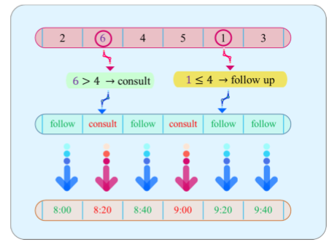
Methodology
Solution representation
Ratio of follow-up to consult patients 2:1
Block-booking strategy with fixed 20 minutes block
Order of patients is a typical solution of SA
Change order of patients randomly to improve patient length of stay

Slide 9
Breast Center Overview
Located in Binghamton, NY
Staff
2 Medical Office Assistant
1 Physician
Available rooms in the Center
2 rooms: intake process
1 room: follow-up
1 room: consultation
1 room: biopsy
Patients volume (demand at Breast Center)
Total No. of patients seen in 2014: 914
Total No. of patients seen in 2015: 1,654
Number of working hours: 7 hours

Slide 10
Swim Lane Diagram – Breast Center

Slide 11

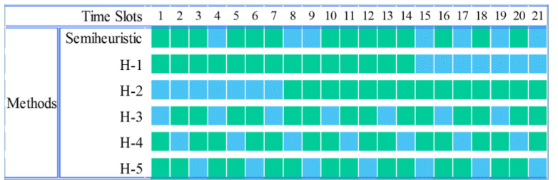

Experimental Design
Current scheduling strategy: First-In First-Out (FIFO)
Distribution of sub-processes were provided based on the director’s opinion
Effectiveness of proposed simheuristic schedule is compared to five heuristic schedules
Sub-process | Distribution (min)
Intake Process | Triangular (10,12,17)
Follow–up Time | Triangular (10,15,20)
Consultation Time | Triangular (14,20,26)
Biopsy Time | Triangular (15,17,30)

Slide 12

Simulation Model

Slide 13
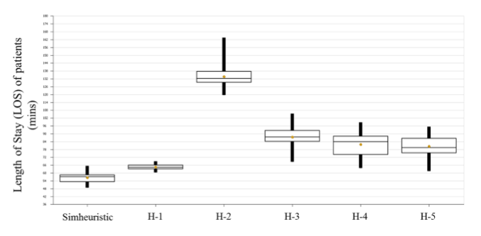
Simulation Model Results – Part 1
Patient length of stay (LOS) as response variable
30 replications
"Select Best Scenario using KN"

Slide 14

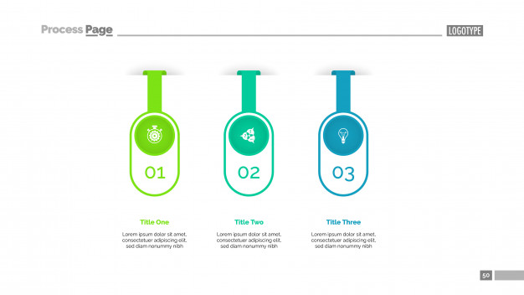
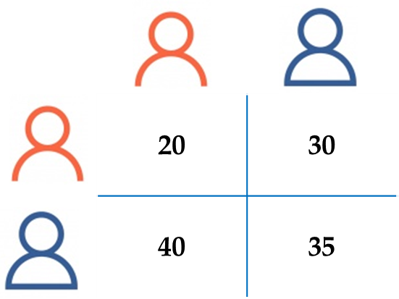

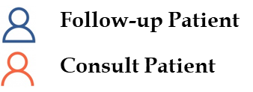
Model Extension
20 | 30
40 | 35
Follow-up Patient
Consult Patient
Block-booking
Semi Nonblocked-booking
Non-blocked Scheduling
Fixed Time Slot
Fixed 20 mins Time-slots
Dependent Inter-arrival time
Variable Time-slots
Flexible Inter-arrival time
Open Time-slots

Slide 15
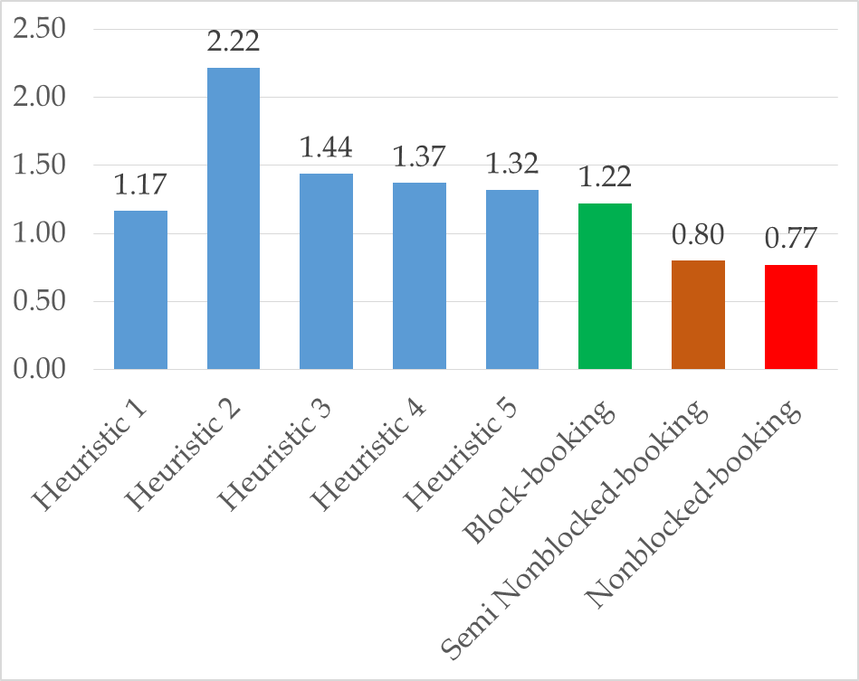
Simulation Model Results – Part II
Comparing 3 Simheuristic Methods
All Simheuristic Methods outperform Heuristic Approaches
Both Non-blocked approaches are superior to blocked scheduling approach
Semi Nonblocked-booking is more practical than Nonblocked approach

Slide 16
Conclusion & Future Work
Conclusions
Simheuristic framework to perform table-experiments for a simulation model of a breast cancer center
Optimization with Simulation-based Iterations (OSI) that links SA algorithm programmed in MATLAB with Simio
Proposed schedule is significantly better that five tested heuristics
Using s Semi Non-Blocked approach might be more practical
Future work
Study other performance measures; patient direct and indirect waiting time
Add other environmental factors; patient no-show and patient and provider punctuality
A same date appointment
Physician’s preferences

Slide 17

Thank You! m.dehghani@neu.edu
WSC

