Slide 1
TASK-1
Problem Definition :
you might know that a large percentage of employees are not sticking around. But do you have a way to understand why? An applicant tracking system can provide your business with a way to learn why employees are leaving. With that data, you can take steps to change internal processes that will keep employees around for the long term.
Design thinking:
1.Empathise
2.Define the problem statement
3.Brainstrom the ideas
4.Idea finalization
Link:
https://app.mural.co/t/ragul6253/m/ragul6253/1698657356814/bcef45d54163cf5654b7a33abac1398c29c90a00?sender=uea180ab37bbef8eb48bf0696

Slide 2
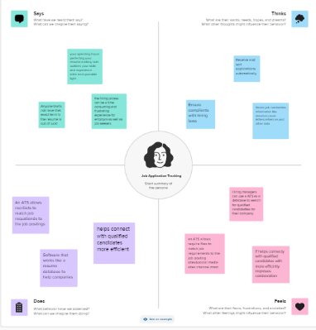
1.Empathise:

