Slide 1
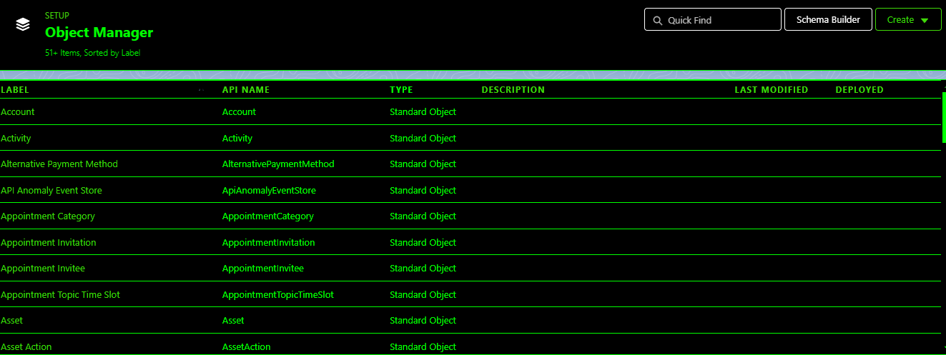
TASK-2
Implimentation project:

