Slide 1
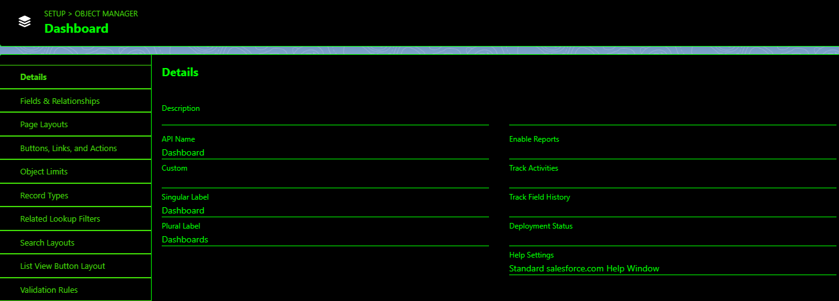
TASK-5
Reports & Dashboard

Slide 2
