Slide 1
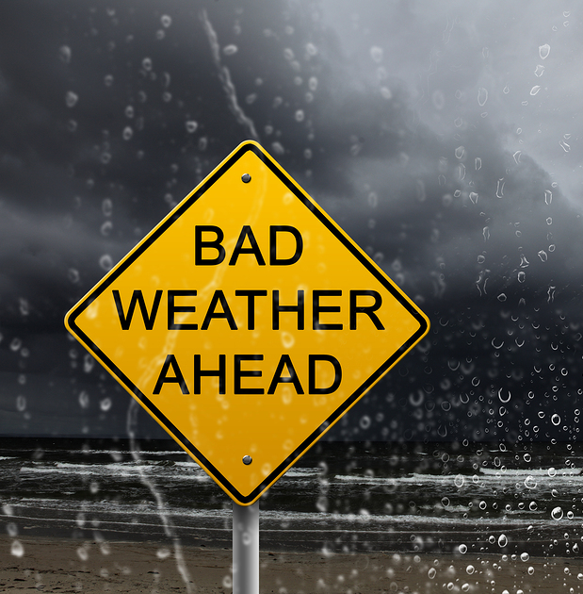
Prediction of Network Deterioration using ML Prediction Algorithm
Boppana Rhea Ramanamurthy(20BCE7389)
Rithy Raichel Soj(20BCN7026)
Twinkle Kumari(20BCN7023)
This Photo by Unknown author is licensed under CC BY-ND.

Slide 2
Progress so far…
We decided to use the same ML-algorithm as the researchers in the base paper equipped to conduct their research, the Long-Short Term Memory (LSTM) . It has been proven that dilated convolutions can be applied successfully to forecast time series of limited length.
To compare the results, we can make the use of the Dilated Convolutional-LSTM (DC-LSTM) ML-Algorithm to prepare the results.
The Lorenz 96 system model using the MATLAB, which can be used for heavy weather simulation and data capturing.
“...an improved LSTM, which is called MSM-LSTM, has shown good performance on the forecasting of typical chaotic time series obtained from the Lorenz system and the Kuramoto–Sivashinsky equation…”

Slide 3

Citation and References
Citation:
https://www.researchgate.net/publication/337365440_A_Dilated_Convolution_Network_Based_LSTM_Model_for_Multi-step_Prediction_of_Chaotic_Time-series
Open source codes for reference:
https://github.com/jaketimothy/timeseries-forecasting/blob/master/LICENSE
https://github.com/djgagne/lorenz_gan/blob/master/README.md
https://github.com/m-dml/L96sim/blob/master/inference.ipynb

Slide 4

Timeline
Dataset
Obtain accurate weather datasets, directly from the IMD using the Data Supply initiative provided for students upon submitting the undertaking signed by the Head of Department.
Code the ML algorithm
Decided approach mentioned in the previous slide will be followed, and the ML algorithm will be coded accordingly. Cloud services need to be discussed.
Train the model
Upon achieving an error-free code, we train it on 80% of available data.
Send alerts to the mobile application
Upon predicting future weather conditions, based on trained data, the prediction of network degradation will be sent as an alert to the user's device, providing the predicted date.
Test the model
The device for the training and consecutive testing (20% of available data) needs to discussed. Weather API will be used to get inputs for future 3 consecutive days for prediction.

Slide 5

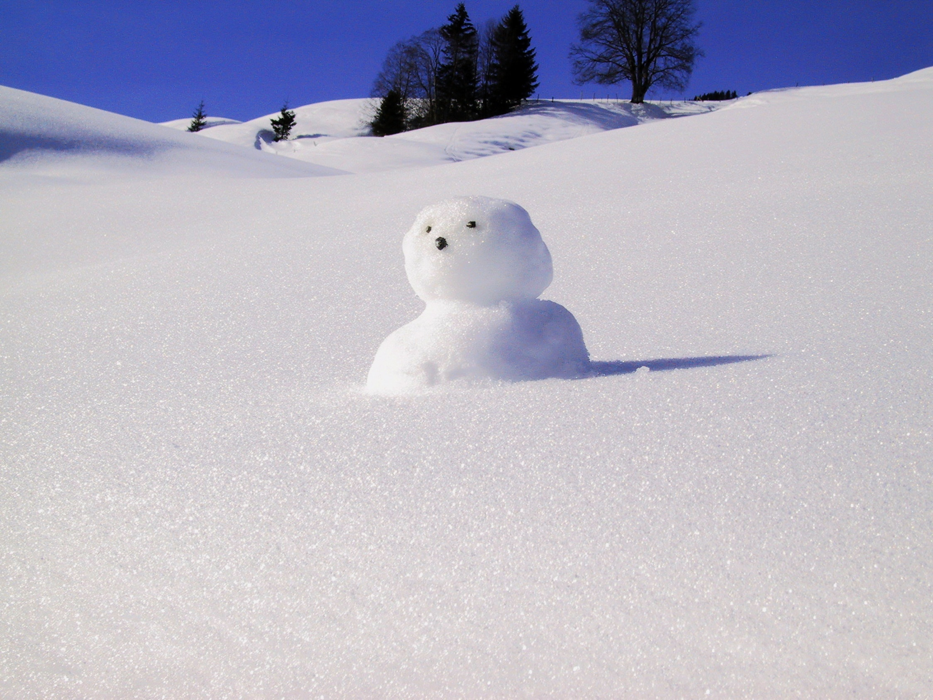

THANK YOU

