Slide 1
UART Universal Asynchronous Receiver Transmitter
Universal - Indicates that the data format and transmission speeds are configurable.
Asynchronous - Transmission of data without the use of an external clock signal

Slide 2
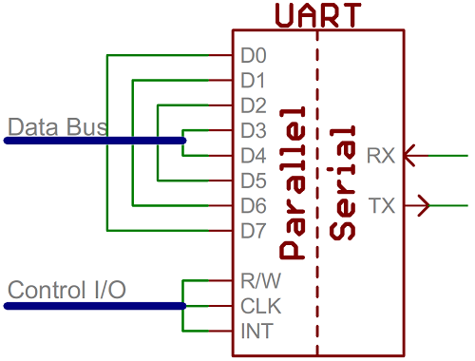
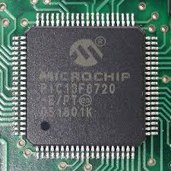
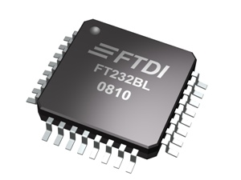
Introduction UART
Communication interface that translates data between parallel and serial forms. (other common communication interface such as I2C and SPI)
UART is usually an individual integrated circuit (IC) used for serial communication over a computer or peripheral device.
UARTs are now commonly include in microcontroller.

Slide 3
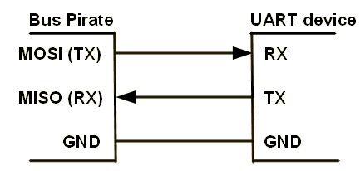
UART functional description
Any UART bidirectional communication requires a minimum of two pins: Receive Data In (RX) and Transmit Data Out (TX)
RX : Receive Data Input is the serial data input.
TX : Transmit Data Output.
GND : sharing ground.

Slide 4

UART character description
RS-232 Frame format :
- Start bit (‘0’)
- Data bit (LSB bit)
- Optional: Parity (even or odd ) bit
- Stop bit (‘1’)
Idle character is interpreted as an entire frame of “1”s followed by the start bit of the next frame which contains data.

Slide 5
Implement USART in STM32F429
USART Mode Configuration
USART Block Diagram
USART Registers
USART Function description
Configure Transmitter
Fractional baud rate generation
Parity control
TX/TXC behaviour
Configure Receiver
RXNE behaviour

Slide 6
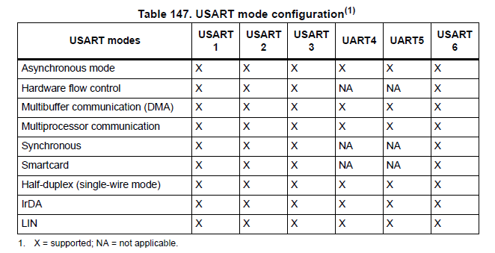
USART Mode Configuration

Slide 7
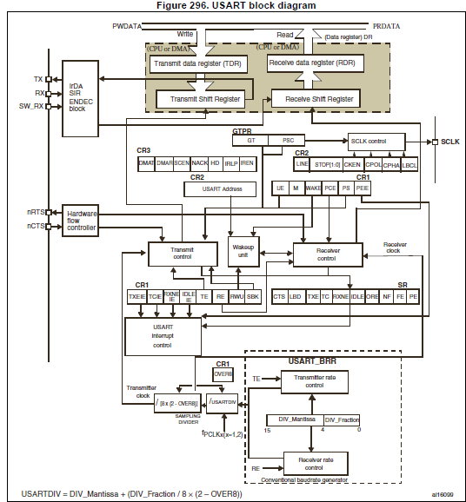
Status register ( _SR)
Data register (_DR)
Baud rate registe (_BRR)
Contorl regitster 1 (_CR1)
Contorl regitster 2 (_CR2)
Contorl regitster 3 (_CR3)
Guard time and prescaler register (_GTPR)

Slide 8
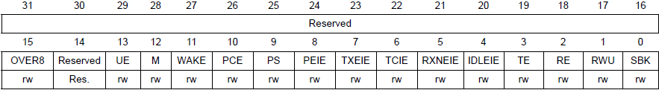
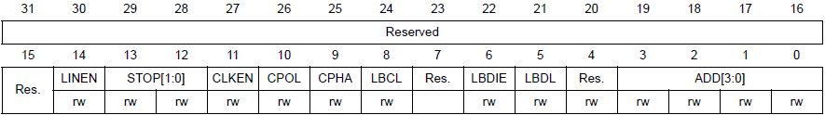
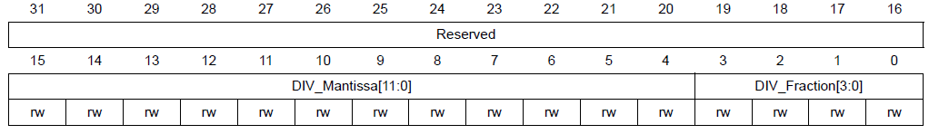
Configure Transmitter
USART_CR1
USART_CR2
USART_BRR

Slide 9
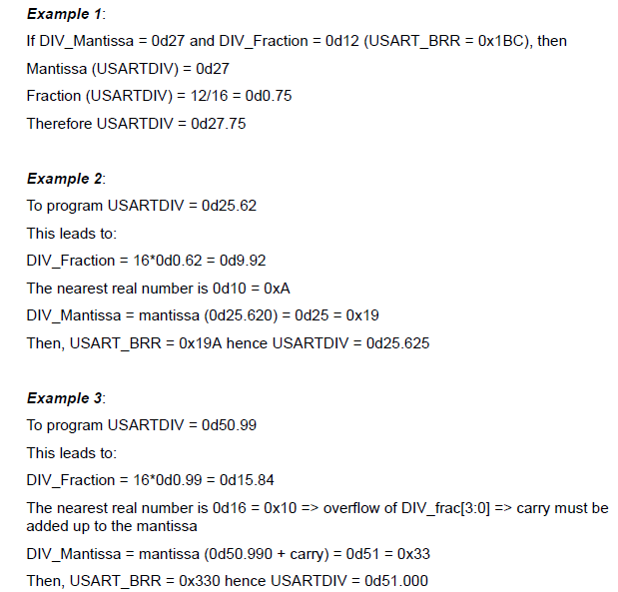
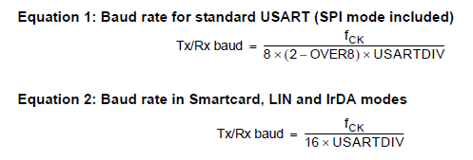
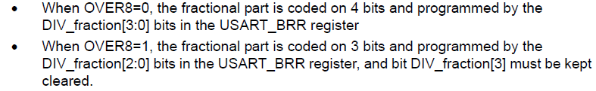
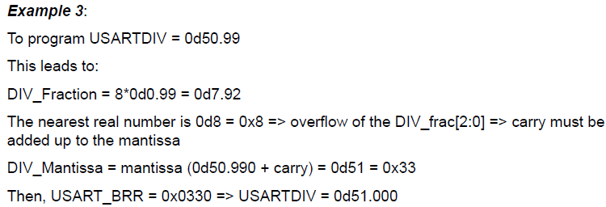
Fractional baud rate generation

Slide 10
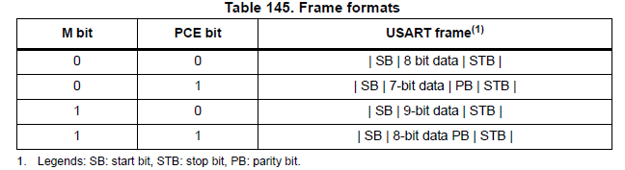
Parity Control
Parity control (generation of parity bit in transmission and parity checking in reception) can be enabled by setting the PCE bit in the USART_CR1 register. Depending on the frame length defined by the M bit, the possible USART frame formats are as listed in Table 145.
USART_CR1
PCE: Parity control enable
PS: Parity selection
USART_SR
PE: Parity error

Slide 11
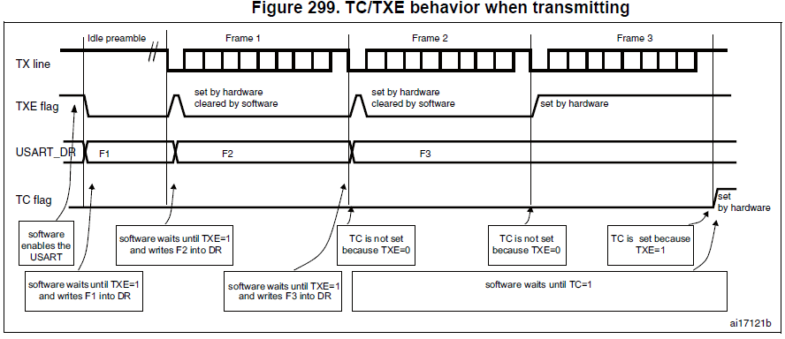
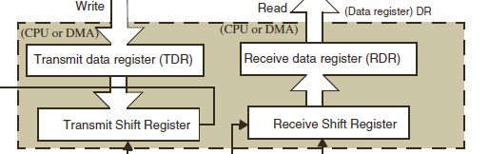
Status Register
USART_CR1
USART_CR1
TXEIE: TXE interrupt enable
USART_SR
TC: Transmission complete
TXE: Transmit data register empty
0: Data is not transferred to the shift register
1: Data is transferred to the shift register
Notes:
When a transmission is taking place, a write instruction to the USART_DR register stores
the data in the TDR register and which is copied in the shift register at the end of the current
transmission.
When no transmission is taking place, a write instruction to the USART_DR register places
the data directly in the shift register, the data transmission starts, and the TXE bit is
immediately set.

Slide 12
Configure Receiver

Slide 13
RXNE behaviour
The RXNE bit is set. It indicates that the content of the shift register is transferred to the RDR. In other words, data has been received and can be read.
Clear the RXNE bit is performed by a software read to the USART_DR register. The RXNE flag can also be cleared by writing a zero to it.
The RXNE bit must be cleared before the end of the reception of the next character to avoid an overrun error.
USART_SR
RXNE: Read data register not empty
0: Data is not received
1: Received data is ready to be read.
RXNEIE: RXNE interrupt enable

