Slide 1

VIRTUAL INTERNSHIP 7.0
Cyber Threat Analytics Platform
with Incident Visualization System
Presented By: Twinkle Mohanty | Team D | Batch – 1, Group - 1
Organization: Infosys Springboard — Virtual Internship 7.0
Mentor: Mrs. Nithyasree
1

Slide 2




VIRTUAL INTERNSHIP 7.0
OVERVIEW
Project Objectives
Model the Data
Visualize Insights
Structure cleaned features into aggregations and relationships ready for dashboarding.
Build interactive Power BI dashboards across incidents, actors, and geography.
Analyze Patterns
Report Findings
Uncover attack-type, motive, and country-level threat patterns in the data.
Summarize insights into an executive-ready threat analytics view.
2

Slide 3
VIRTUAL INTERNSHIP 7.0
INTRODUCTION
Project Description
This project models a cleaned cybersecurity incident dataset — 10,228 records spanning 141 countries and 1971–2024 — and turns it into seven interactive Power BI dashboards that reveal attack patterns, actor behaviour, and global threat distribution at a glance.
01
02
03
Data Collection & Understanding
Data Connection
Data Preprocessing
Sourced result.csv and profiled all 21 columns across 10,228 incident records.
Connected the cleaned dataset to Power BI and loaded it into the data model.
Cleaned, encoded, and scaled fields into a model-ready dataset.
04
05
06
Data Modelling
Data Visualization
Insights & Reporting
Aggregated and related incident, actor, asset, and geography dimensions.
Built 7 interactive dashboards covering incidents, actors, assets, and threat patterns.
Synthesized cross-dashboard findings into an executive-ready threat view.
3

Slide 4
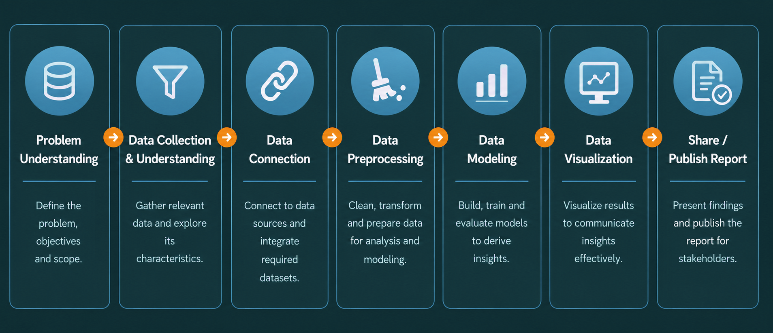
VIRTUAL INTERNSHIP 7.0
PROCESS
Workflow Diagram
4

Slide 5
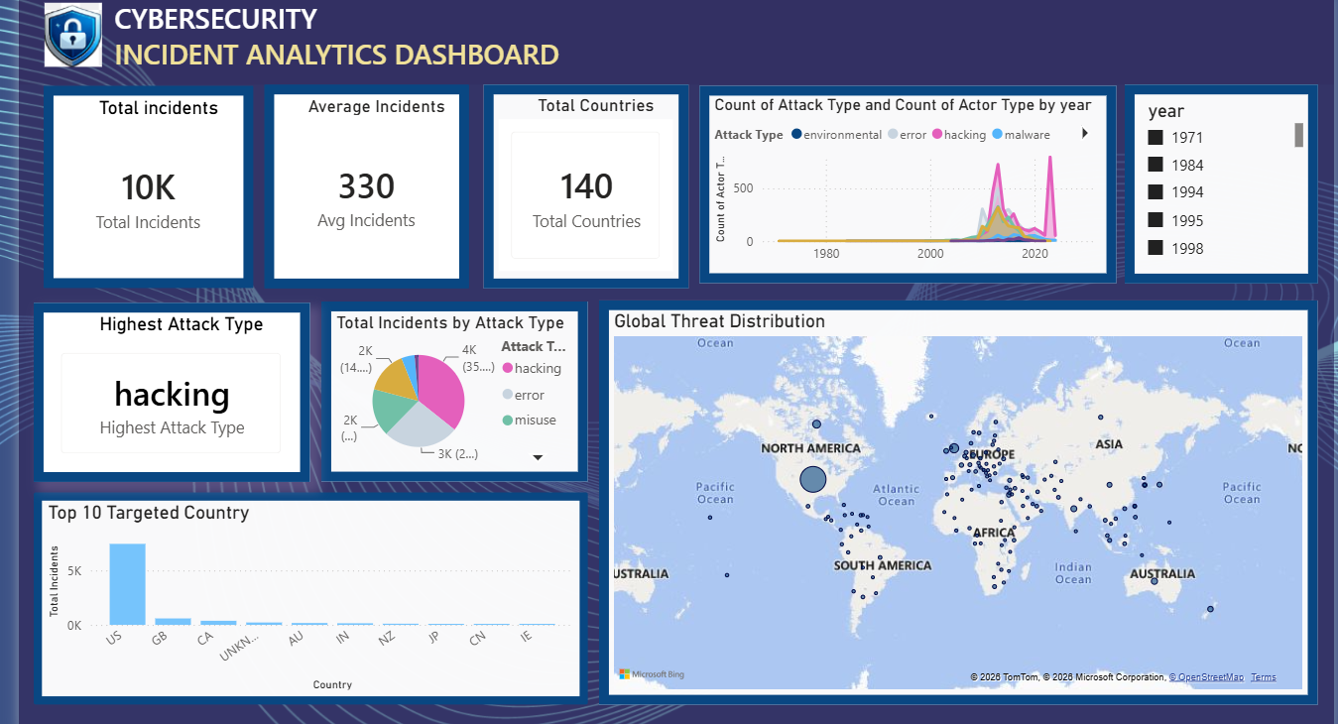
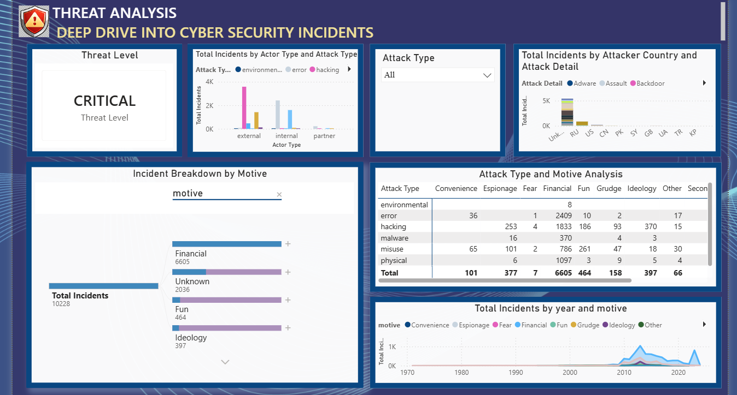
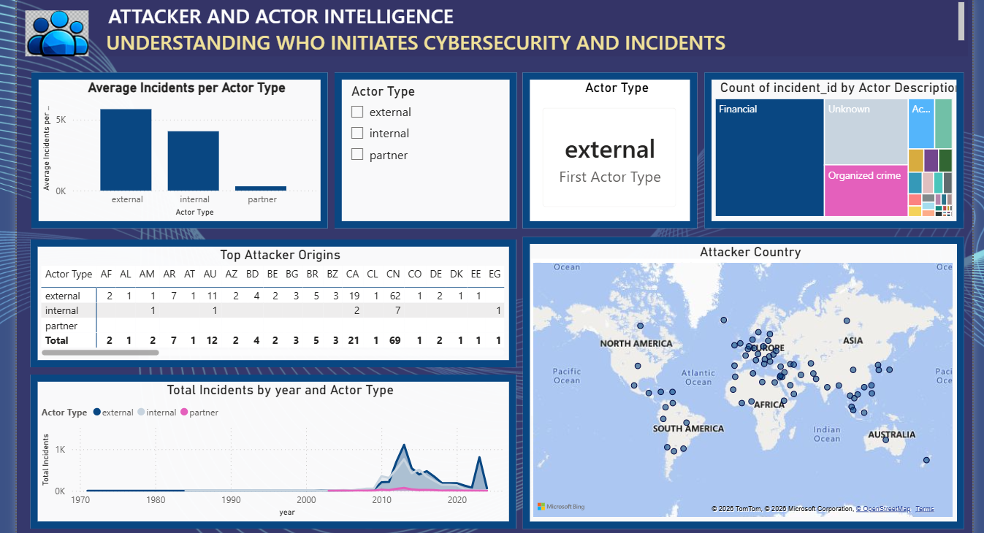
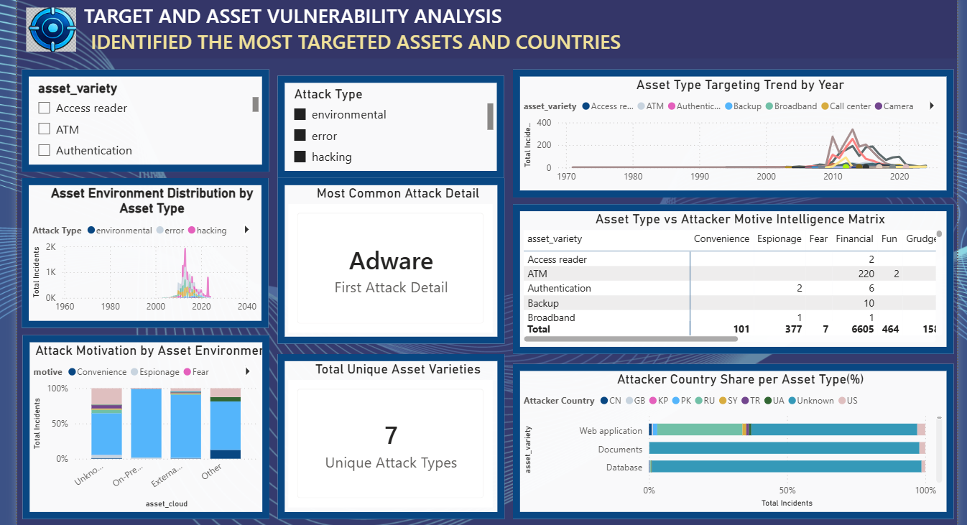
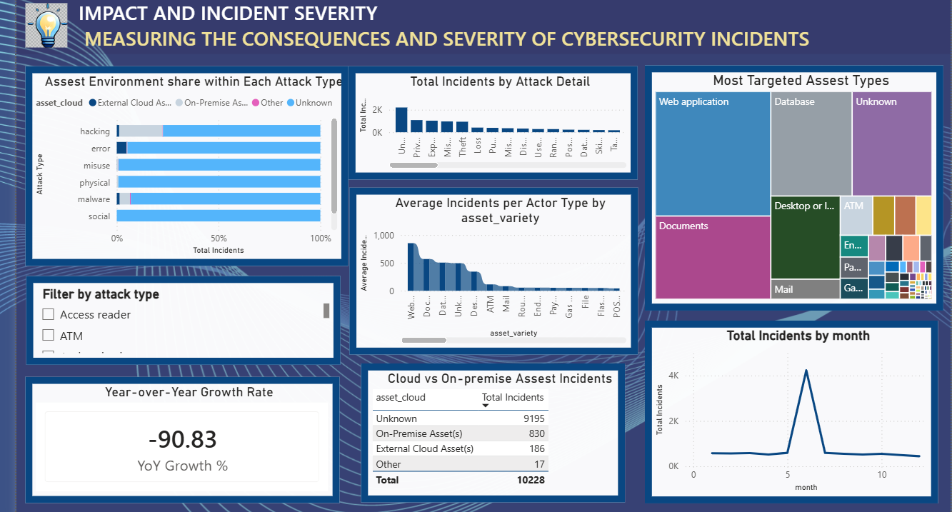
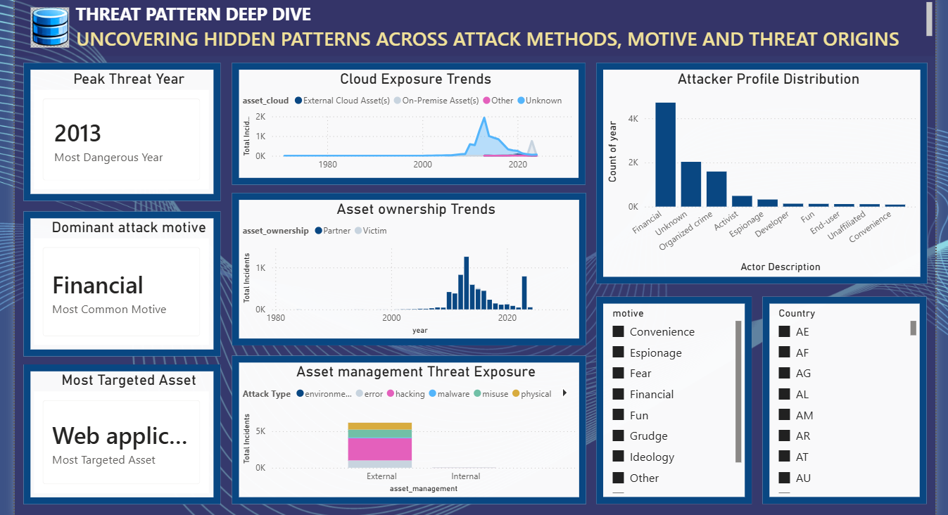
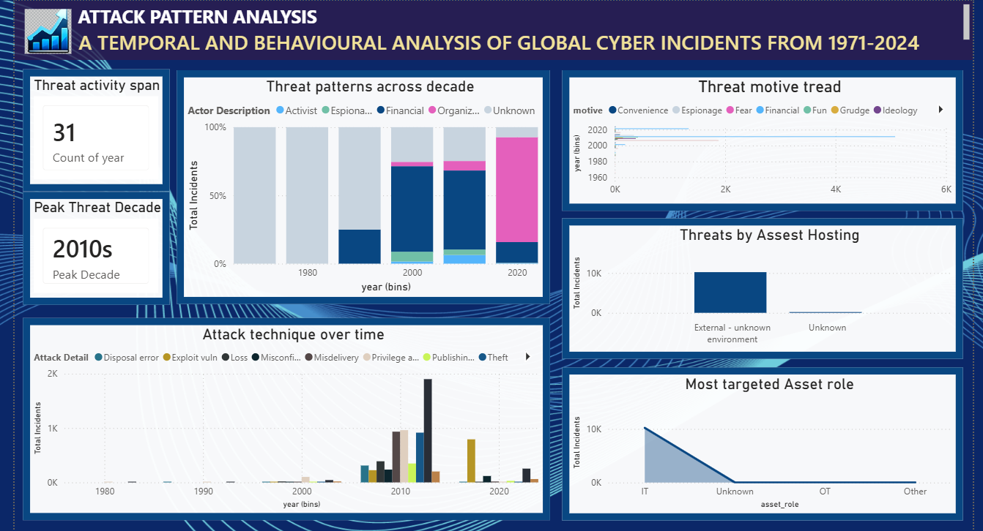
VIRTUAL INTERNSHIP 7.0
DASHBOARD
Data Visualization
1. Executive Summary
2. Threat Analysis
3. Attacker & Actor Intelligence
4. Asset Vulnerability
Top-line KPIs, attack trend by year, and global threat distribution at a glance.
Breaks incidents down by actor type, attack detail, and motive.
Profiles who initiates incidents — actor type, origin country, and trend.
Identifies the most targeted assets, attack types, and country exposure.
Components: KPI cards, line chart, pie chart, map
Components: Cards, bar chart, slicer, matrix table
Components: Bar chart, treemap, table, map
Components: Slicers, line chart, matrix, bar chart
5. Incident Severity
6. Threat Pattern Deep Dive
7. Attack Pattern Analysis
Measures impact — asset share, YoY growth, and most targeted asset types.
Uncovers hidden patterns across attack methods, motive, and origins.
Temporal and behavioural view of global incidents, 1971–2024.
Components: Bar charts, treemap, table, line chart
Components: Cards, line chart, histogram, slicers
Components: Cards, stacked bar, line & bar charts
5

Slide 6
VIRTUAL INTERNSHIP 7.0
ROADMAP
Project Execution Milestones
The project was executed through 4 structured milestones to ensure systematic progress and accuracy.
Dataset / Source Used: result.csv → preprocessing_report.xlsx → Power BI Dashboards
1
→
2
→
3
→
4
Data Understanding & Preprocessing
Data Connection & Modelling
Dashboard Development
Insight Generation & Reporting
Loaded and profiled 10,228 records; cleaned, encoded, and scaled every field.
Connected the cleaned dataset to Power BI and built an aggregated relational model.
Designed 7 interactive dashboards covering incidents, actors, assets, and geography.
Synthesized cross-dashboard findings into key insights and an executive summary.
6

Slide 7




VIRTUAL INTERNSHIP 7.0
PROBLEM SOLVING
Challenges Faced and Resolutions
CHALLENGE 1
CHALLENGE 2
CHALLENGE 3
Messy, Inconsistent Data
Interacting Dimensions
Unknown Attribution
The raw dataset had inconsistent category labels and a large volume of missing values.
Attack type, actor type, motive, and geography interact simultaneously, obscuring trends.
A large share of incidents had no confirmed attacker country or identity.
RESOLUTION 1
RESOLUTION 2
RESOLUTION 3
Standardized labels and imputed missing values through a systematic cleaning pipeline.
Aggregated and related the data across dimensions in Power BI's model for instant cross-filtering.
Built dedicated filters and visuals to isolate and analyze 'Unknown' attribution on its own.
7

Slide 8


VIRTUAL INTERNSHIP 7.0
GROWTH
Learnings & Skills Acquired
Technical Skills
Soft Skills
Power BI dashboard design and DAX-based aggregation
Python & pandas for data cleaning and preprocessing
Data modelling and relationship design
Translating raw data into visual analytics
Analytical and structured problem-solving
Attention to detail with large, messy datasets
Communicating technical insights clearly
Overall Learning: This milestone gave end-to-end, hands-on experience turning a large, messy dataset into decision-ready visual intelligence — from data profiling through modelling to executive dashboard storytelling.
8

Slide 9



VIRTUAL INTERNSHIP 7.0
WHAT'S NEXT
Future Enhancements
Enhancements
Add real-time data refresh for live threat monitoring.
Incorporate predictive analytics to forecast attack trends.
Expand the dataset with more recent incident records.
Add drill-through pages for deeper per-incident investigation.
Key Insights
Hacking dominates attack volume — 3.4K of ~10.2K incidents.
Financial gain drives most motives — 3,951 incidents.
The US is targeted far more than any other country — ~5K incidents.
9

Slide 10


VIRTUAL INTERNSHIP 7.0
WRAP UP
Conclusion
Cyber Threat Analytics Platform with Incident Visualization System successfully transformed a cleaned cybersecurity incident dataset into interactive, decision-ready Power BI dashboards.
Learning / Technical Impact
Industry / Practical Experience
Overall Conclusion
Deepened skills in data modelling, DAX, and dashboard design across a real-world scale dataset.
Simulated a real-world security analytics workflow, from raw records to stakeholder-ready visuals.
Turned 10,228 numeric records into clear, actionable threat intelligence for decision-makers.
10

Slide 11


VIRTUAL INTERNSHIP 7.0
GRATITUDE
Acknowledgements and References
I would like to express my heartfelt gratitude to:
Infosys Springboard Virtual Internship 7.0
My mentor, Mrs. Nithyasree, for continuous guidance
My teammates in Team D : Vennela Pathipaka, Subhashree Subhasmita, Maddula Tejasri Lakshmi, for their collaboration
Everyone who supported this project along the way
References
Cybersecurity incident dataset (result.csv / preprocessing_report.xlsx)
Microsoft Power BI documentation
Python pandas documentation
11

Slide 12

VIRTUAL INTERNSHIP 7.0
Thank You
12

