Slide 1
Virtual Internship 7.0
Infosys | Springboard
Cyber Threat Analytics Platform with Incident Visualization System
Presented By: Tejasri Lakshmi
Virtual Internship 7.0 | Infosys Springboard
Mentor: NityaSree
Team D

Slide 2




Project Objectives
A structured framework for turning incident records into security intelligence.
Detect and classify cyber threats
Clean and prepare incident data
Identify malicious incident patterns and organize events by attack type, actor, motive, asset, and severity.
Standardize missing months, motives, actor varieties, countries, and other fields without losing records.
Visualize security intelligence
Support faster incident response
Convert complex incident data into dashboards, charts, timelines, maps, and comparisons for rapid interpretation.
Surface high-risk patterns and actionable insights so analysts can prioritize investigation and mitigation.
10,229 records | 21 columns | 141 countries represented in the analyzed dashboards

Slide 3
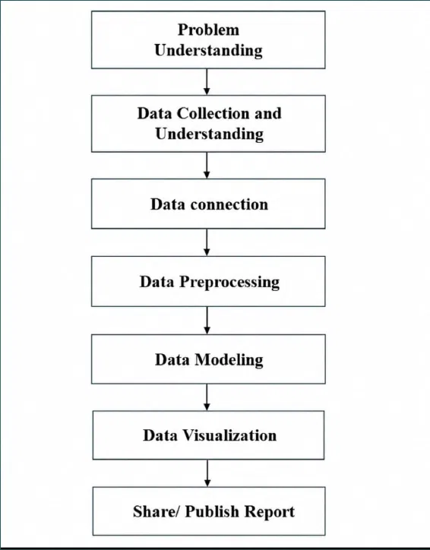
Project Description
A repeatable framework that connects cybersecurity analytics, data preparation, machine-learning readiness, and dashboard design.
WORKFLOW
Module 1 — Problem Understanding: Define the threat-analysis questions and decisions the dashboards must support.
Module 2 — Data Collection: Use the VERIS Community Database dataset sourced through Kaggle.
Module 3 — Data Connection: Bring incident records into the workflow and establish the source baseline.
Module 4 — Data Preprocessing: Clean nulls, harmonize categories, cast types, and create conditional fields.
Module 5 — Data Modeling: Organize threat vectors across actor, action, asset, motive, country, and time.
Module 6 — Data Visualization: Publish dashboards for incident analytics, threat patterns, vulnerability, and severity.

Slide 4







Top Visualizations / Components Used
Seven views used to move from incident volume to actionable threat insight.
Visual Type
Purpose / What It Shows
Icon
Incident analytics dashboard
Overall volume, attack types, countries, and major incident indicators.
Threat analysis view
Attack trends, severity distribution, and filterable threat categories.
Attacker and actor intelligence
Actor types, geographic distribution, and responsible profiles.
Target and asset vulnerability
Targeted assets, attack details, and vulnerable surfaces.
Impact and incident severity
Severity patterns across attacks, assets, environments, and time.
Threat pattern deep dive
Motive, asset, application, and peak-period relationships.
Attack pattern analysis
Long-term trend changes, dominant techniques, and external-asset exposure.

Slide 5

Project Execution Milestones
The project was executed through four structured milestones to ensure systematic progress, traceability, and analytical accuracy.
Dataset / Source Used: VERIS Community Database (VCDB), Kaggle-sourced processed dataset | 10,229 incident records | 21 columns
1
2
3
4
Understand and baseline
Confirm the incident schema, dimensions, relationships, and baseline record count.
Clean and standardize
Resolve missing months, motives, actor varieties, countries, and inconsistent values while preserving records.
Transform and model
Apply type casting, filtering, conditional columns, custom columns, removal, and renaming.
Visualize and publish
Build dashboard pages for analytics, threat analysis, actor intelligence, vulnerability, severity, and patterns.
Each milestone was validated against the next step in the workflow to keep the project repeatable and audit-friendly.

Slide 6
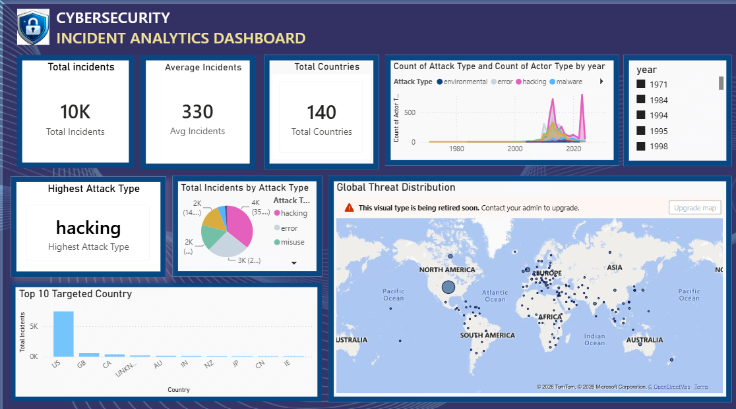
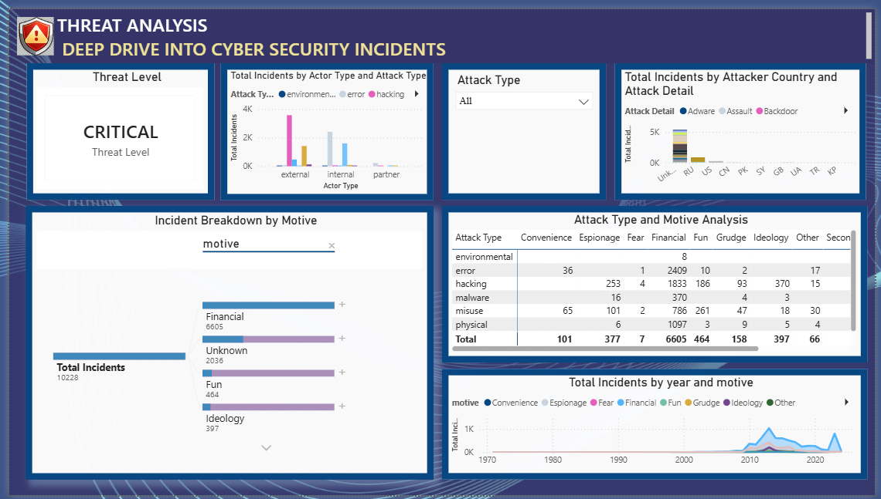
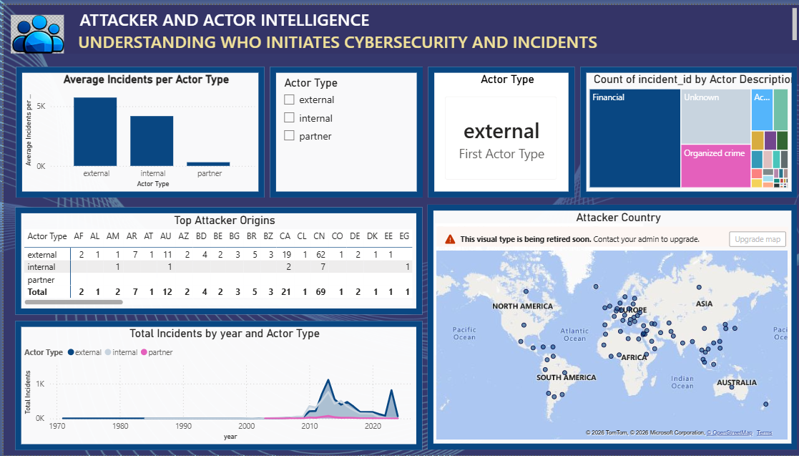
DASHBOARDS:

Slide 7
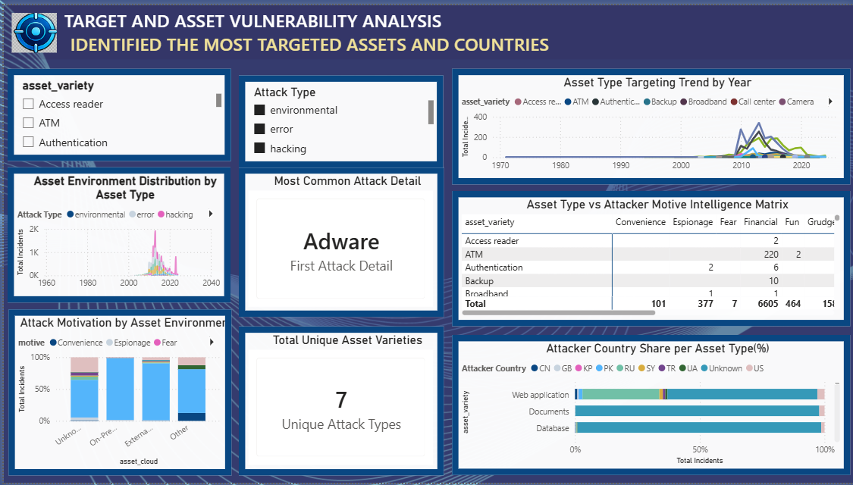
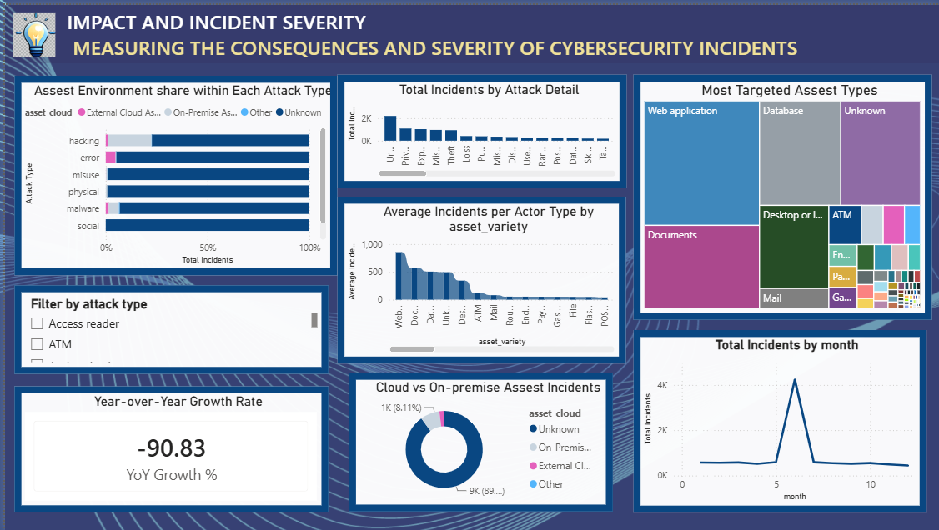
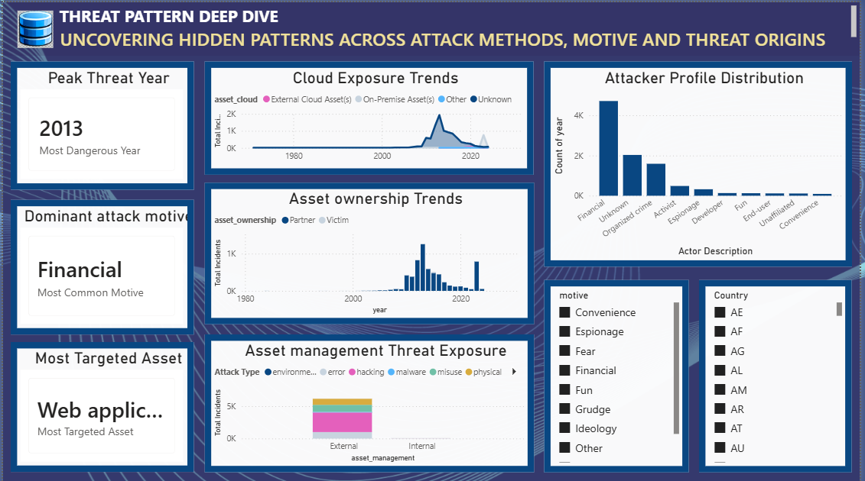
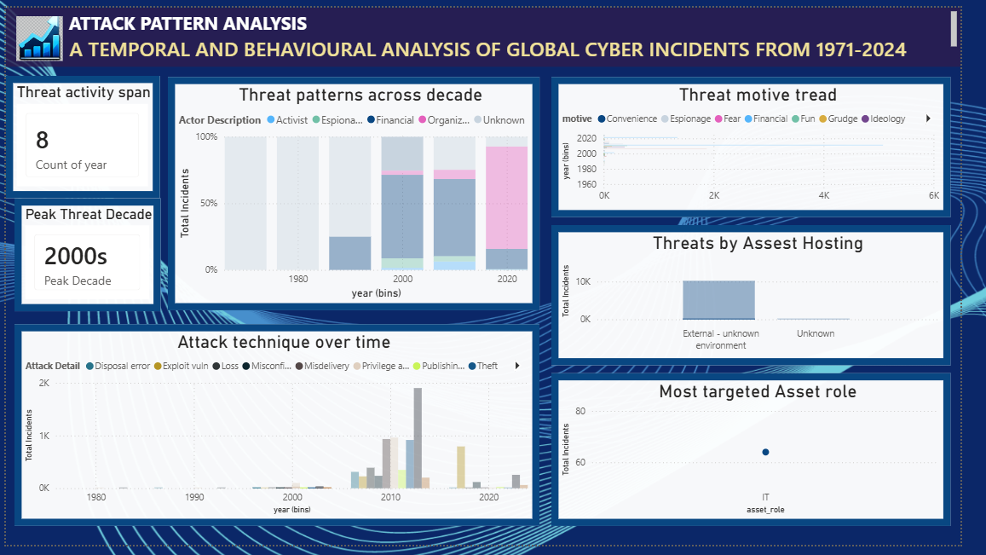

Slide 8
Challenges Faced and Resolutions
The project focused on preserving data integrity while making the incident landscape easier to interpret and act upon.
1. High-volume, noisy data
2. Missing and ambiguous values
3. Slow manual investigation
Thousands of records and many categorical fields made direct interpretation difficult.
Nulls and values such as “Unknown” and “NA” could break trend lines, maps, and comparisons.
Raw logs were difficult to compare across time, geography, actors, and assets.
Resolution: Structure the data into consistent threat dimensions and summarize it through dashboards.
Resolution: Replace or regroup values into explicit analytical categories such as “Undetermined Motive” and “Undetermined Source”.
Resolution: Use repeatable transformations and interactive filters to shorten the path from event to insight.
Core principle: preserve the record, clarify the category, accelerate the decision.

Slide 9


Learnings & Skills Acquired
The project strengthened both hands-on analytics capability and the ability to communicate technical findings clearly.
Technical Skills
Soft Skills
Cybersecurity incident analytics using VCDB / VERIS-style dimensions.
Data cleaning, type casting, filtering, conditional columns, and feature preparation.
Power Query ETL and repeatable transformation workflows.
Dashboard design using charts, maps, KPI cards, timelines, and comparative views.
Translate complex analysis into clear business-facing narratives.
Use structured problem solving and validate data quality before interpretation.
Document workflows, present findings, and communicate with stakeholders.
Connect technical choices to the usefulness of the final security insight.
Overall learning: The strongest learning was connecting data preparation decisions directly to the quality and usefulness of the final security insight.

Slide 10




Future Enhancements
The framework can grow from a validated dashboard workflow into a continuously learning security intelligence system.
Real-time ingestion
Predictive risk scoring
Connect streaming security logs and refresh the dashboards continuously.
Add machine-learning models to estimate incident severity and likely impact.
Automated alerting
Drill-through investigation
Trigger notifications when unusual actor, motive, asset, or time patterns emerge.
Link dashboard summaries to incident-level evidence and response playbooks.
Key Insights
01 Clean categorical structure is essential for reliable threat comparisons.
02 A repeatable ETL workflow improves trust, refreshability, and auditability.
03 The most useful dashboard helps an analyst decide what to investigate next.

Slide 11



Conclusion
Advanced Threat Incident Analytics and Security Visualization Framework successfully converted a large, noisy cybersecurity dataset into structured threat intelligence and actionable dashboard views.
Learning impact
Strengthened practical capability in cybersecurity analytics, Power Query, data preparation, and visualization.
Technical impact
Established a clean and modeled dataset ready for machine-learning experiments and interactive reporting.
Industry relevance
Demonstrated how organizations can move from raw telemetry to faster, evidence-based security decisions.
Overall conclusion
The framework bridges data engineering, threat analysis, and security communication in one coherent workflow.
Strategic impact: the project turns raw, chaotic incident records into a trusted analytical foundation for faster, more accurate mitigation decisions.

Slide 12


Acknowledgements and References
Thank you to the people, program, and public resources that supported this project.
Acknowledgements
References
I would like to express my heartfelt gratitude to:
Infosys Springboard and the Virtual Internship 7.0 program.
I sincerely thank the Infosys Springboard Team for this structured internship and our mentor, Ms. Nityasree, for her invaluable guidance. I appreciate my team members for their excellent collaboration. Thanks also to the Power BI community and Kaggle for essential tools and data. This experience significantly enhanced our technical skills and analytical mindset.
VERIS Framework — The VERIS Community Database (VCDB)
Kaggle — VCDB Dataset
Microsoft Learn — What is Power Query?

Slide 13
Virtual Internship 7.0
Infosys | Springboard
Thank You
Cyber Threat Analytics Platform with Incident Visualization System

