Slide 1

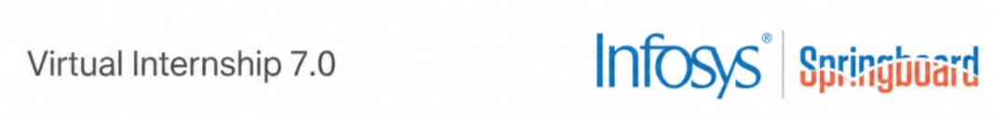

CYBER THREAT ANALYTICS PLATFORM WITH
INCIDENT VISUALIZATION SYSTEM GROUP -1
A data-driven solution for detecting cyber threats, cleaning incident records, and communicating risk through interactive dashboards.
BATCH-1 | TEAM D
PRESENTED BY
Twinkle Mohanty | Tejasri Lakshmi Maddula | Subhashree Subhasmita | Vennela Pathipaka
Infosys Springboard — Virtual Internship 7.0
Mentor : Mrs. Nithyasree
1
1

Slide 2
02
Project Objective
OBJECTIVES
1
Detect malicious activity
2
Clean incident records
Identify attack patterns and suspicious network behavior.
Standardize incomplete or ambiguous fields for trustworthy analysis.
3
Visualize security data
4
Improve response readiness
Translate complex incidents into dashboards, charts, and timelines.
Help analysts prioritize critical threats and act faster.
PROJECT MODULES
1
Data acquisition & understanding
2
Preprocessing & feature engineering
3
Threat modeling & classification
4
Dashboard & incident visualization
5
Reporting & decision support
2

Slide 3
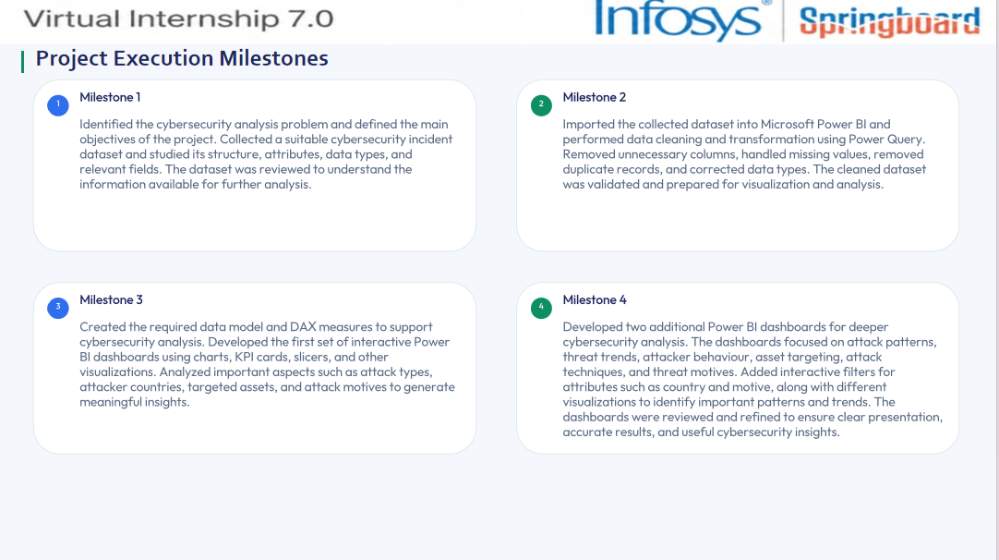
3

Slide 4
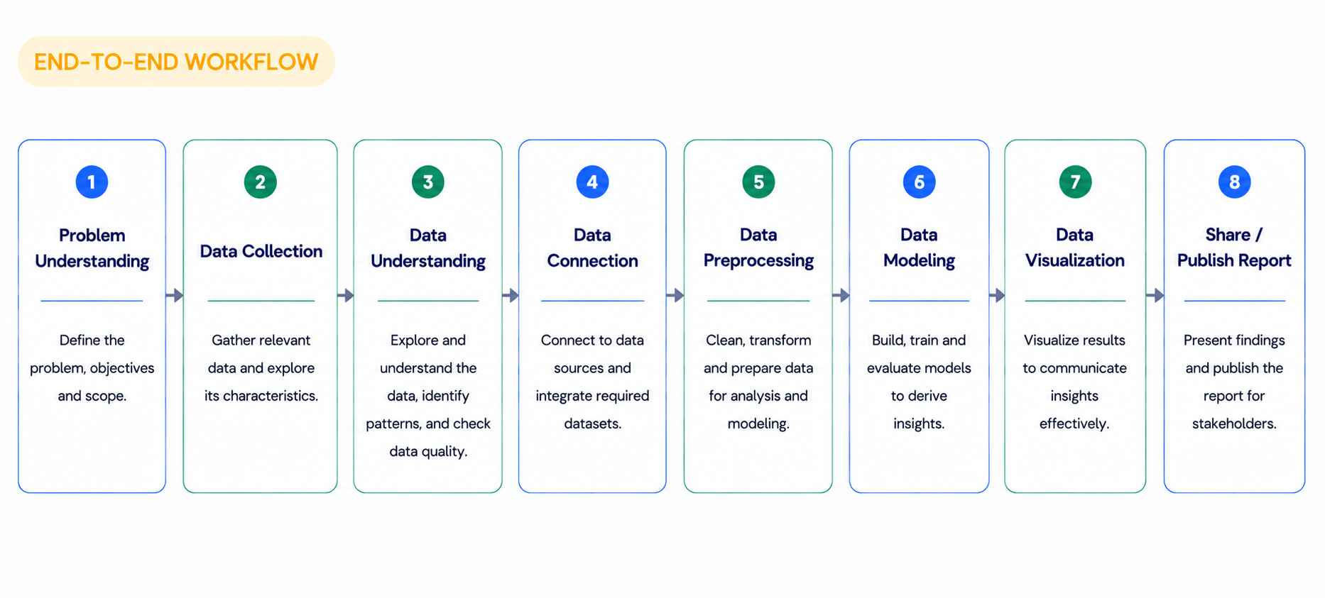
03
Project Workflow
END-TO-END WORKFLOW
From raw incident records to decision-ready security insight
The workflow preserves record counts while turning noisy event data into structured, explainable outputs.
4

Slide 5
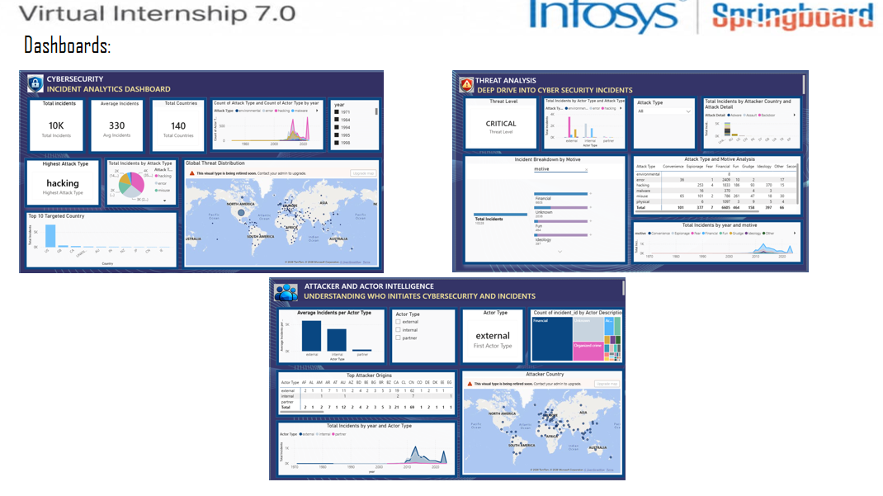
Dashboards
5

Slide 6
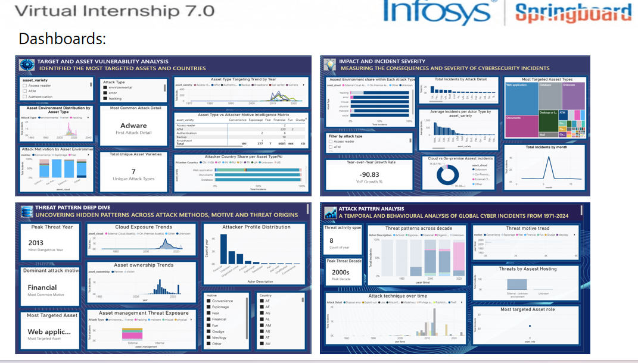
Dashboards
6

Slide 7
04
Challenges & Resolutions
RESOLUTIONS
CHALLENGES
1
High-volume records
1
Repeatable cleaning pipeline
Large, inconsistent incident logs made manual review slow.
Standardized records through Power Query transformation steps.
2
Missing or ambiguous fields
2
Neutral classification rules
Blank months, motives, actor classes, and countries weakened completeness.
Applied consistent labels for missing or unknown values.
3
Complex categorical dimensions
3
Analyst-friendly dashboards
Many variables made threat patterns hard to compare at a glance.
Used filters, KPIs, charts, and geographic views to surface trends.
4
Selecting appropriate visualizations
4
Refined visualization selection
Choosing suitable charts for different types of cybersecurity information was challenging.
Different visualization types were tested and the most meaningful ones were selected to represent trends and comparisons.
5
Creating DAX measures
5
Tested DAX calculations
Developing calculated measures such as total incidents, averages, and other KPIs required understanding basic DAX functions.
Overcame through practice, testing, and checking results against the dataset.
Outcome: a cleaner, more comparable dataset with faster paths from incident evidence to analyst action.
7

Slide 8
05
Future Enhancements & Key Insights
KEY INSIGHTS
FUTURE ENHANCEMENTS
1
Near-real-time data ingestion
10,228 incidents across 141 countries.
1
2
Advanced ML and anomaly detection
Hacking was dominant; the United States was most targeted.
2
3
Alerting and role-based dashboards
Financial motive, external actors, and authentication-related assets were recurring risk signals.
4
SIEM and streaming-log integrations
3
Strategic direction: move from retrospective dashboards toward proactive, explainable detection and response.
8

Slide 9
06
Conclusion
The Cyber Threat Analytics Platform successfully transformed raw cybersecurity incident data into a clean, structured, analysis-ready dataset and an interactive Power BI analytics system for decision support.
KEY PROJECT OUTCOMES
1
2
3
4
Improved Data Quality
Efficient Data Modelling
Comprehensive Dashboards
Actionable Insights
Missing values handled and 10,228 records standardized.
Power BI model + DAX measures built for analysis.
Seven interactive dashboards built for threat analysis.
Insights surfaced on attack patterns, assets, regions, and threats.
TECHNICAL SKILLS
SOFT SKILLS
Repeatable data transformation and standardization.
Power Query :-
Problem Solving
Data Modelling :- Feature preparation and analytical relationships.
Communication
Visual Analytics :- Dashboard design, KPI summaries, and storytelling.
Teamwork
Presentation
9

Slide 10
07
Acknowledgements & References
ACKNOWLEDGEMENTS
We would like to express our sincere gratitude to the Infosys Springboard Team for organizing this highly enriching virtual internship program and for
providing a structured, industry-aligned learning platform. The well- designed modules, milestone-based framework, and practical orientation of the internship enabled us to gain meaningful exposure to real-world business intelligence applications.
We extend our heartfelt appreciation to our mentor, Mrs. Nithyasree, for her consistent guidance, valuable feedback, and continuous encouragement
throughout the project lifecycle. Her insights and structured direction played a significant role in shaping the analytical depth and professional quality of this project.
We would also like to acknowledge our team members for their strong collaboration, accountability, and shared commitment toward achieving project objectives. The coordinated distribution of responsibilities, open communication, and collective problem-solving approach significantly contributed to the successful execution of this project.
In addition, we extend our appreciation to the creators and maintainers of Microsoft Power BI documentation and community resources, which served
as essential references during dashboard development and KPI implementation. We are also grateful to Kaggle for providing access to publicly available datasets that facilitated practical, hands-on analytical experience.
The structured learning resources and practical exposure provided through this internship have significantly strengthened our analytical thinking, technical proficiency, and business interpretation skills. This experience has enhanced our ability to approach data with a strategic mindset, collaborate effectively within a team environment, and execute projects with professional discipline.
Overall, this internship has been a meaningful milestone in our academic and professional journey, reinforcing the value of data-driven decision-making and structured analytical execution in modern business environments.
REFERENCES
VERIS Community Database (VCDB), accessed through Kaggle
Microsoft Learn — Power Query documentation
Internship course and training materials
10

Slide 11

Thank You
11

