Slide 1
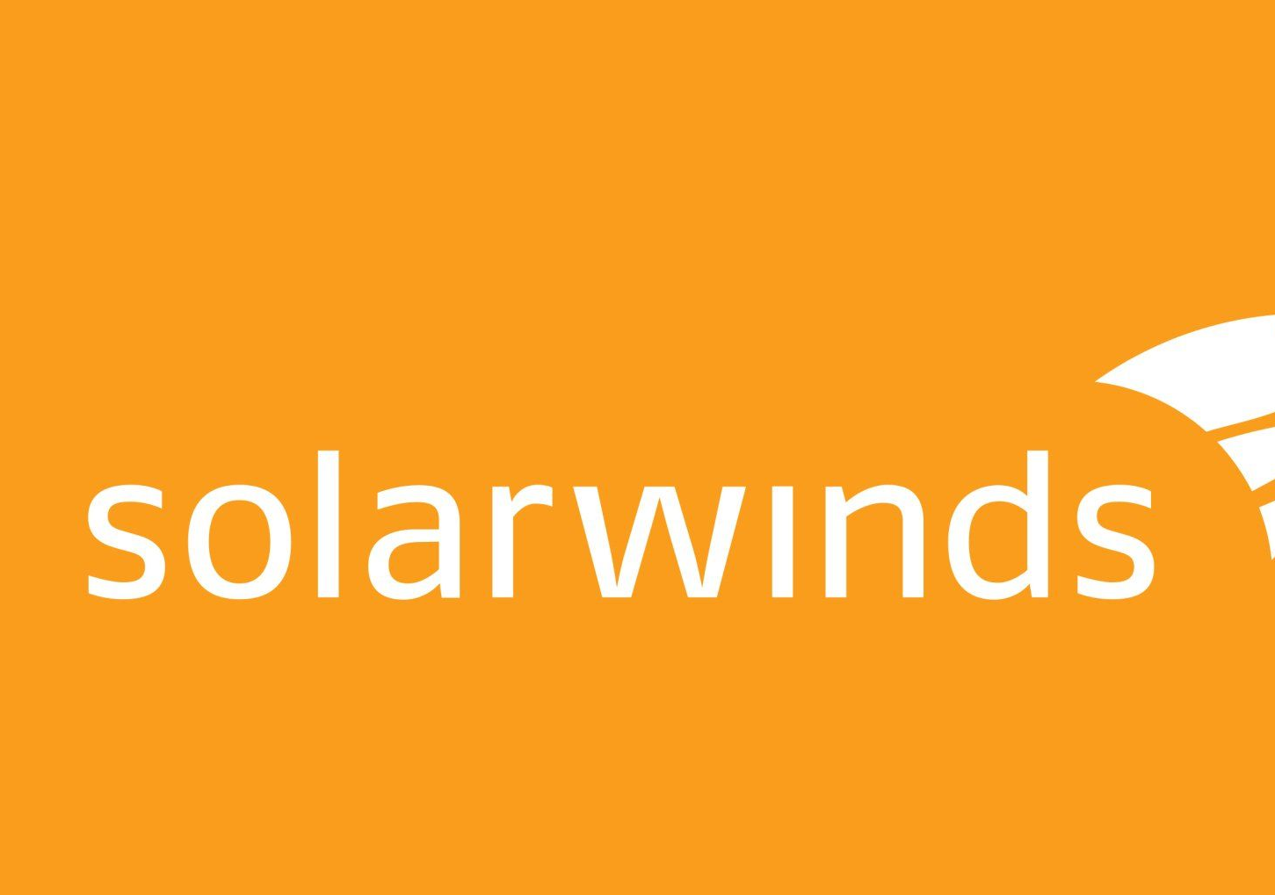

INFO8965 – NETWORK AND SECURITY Course Project Report:
1. ANTHEM INC
2. SOLARWINDS
Group-3:
Lei Chen
Twinkle Akhilesh Mishra
RishiKumar Amrutbhai Patel

Slide 2
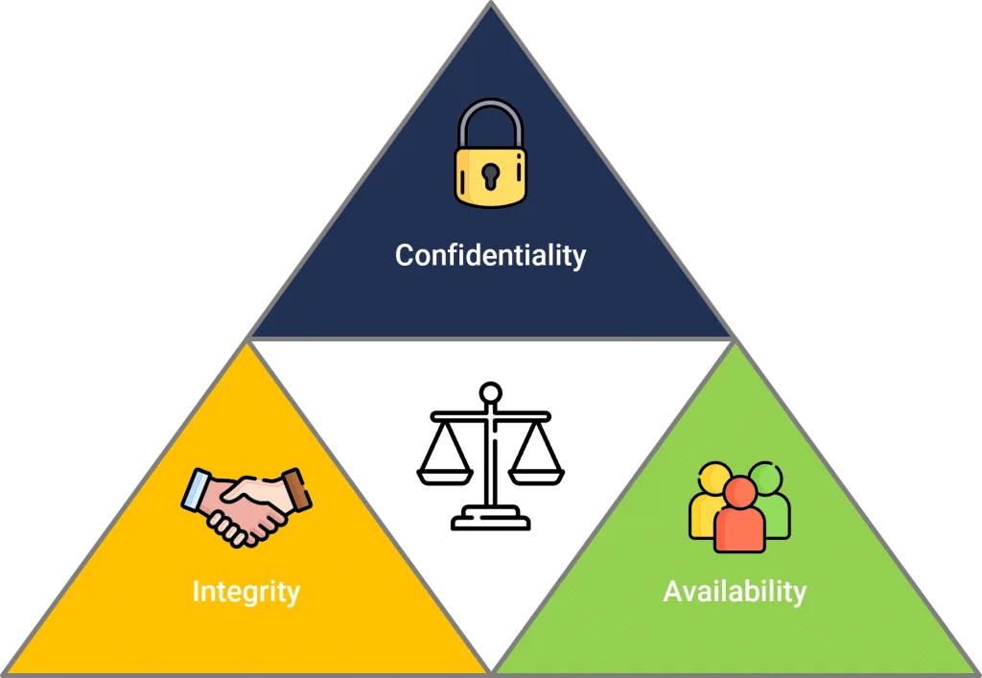
Security Analysis and Recommendations for Anthem Inc. and SolarWinds

Slide 3

Executive Summary
Comparative cybersecurity assessment for:
1. Anthem Inc. (Healthcare)
2. SolarWinds (Technology)
Breaches analyzed:
Anthem: 2015 breach (80M+ records)
SolarWinds: 2020 SUNBURST supply chain attack
Strategic recommendations aligned with CIA triad
Implementation timeline & estimated costs provided

Slide 4
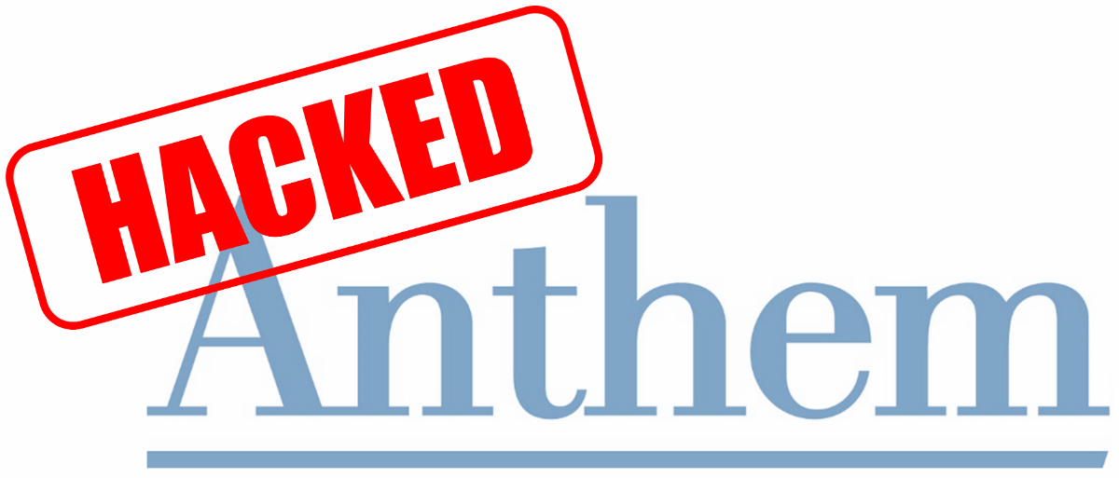
Organization Overview – Anthem Inc.
Rebranded as Elevance Health (2022)
45M+ members, $61B+ revenue, 98,000+ staff
Sensitive data managed: PII, PHI, claims
Regulatory compliance: HIPAA, HITECH
2015 breach due to stolen credentials

Slide 5
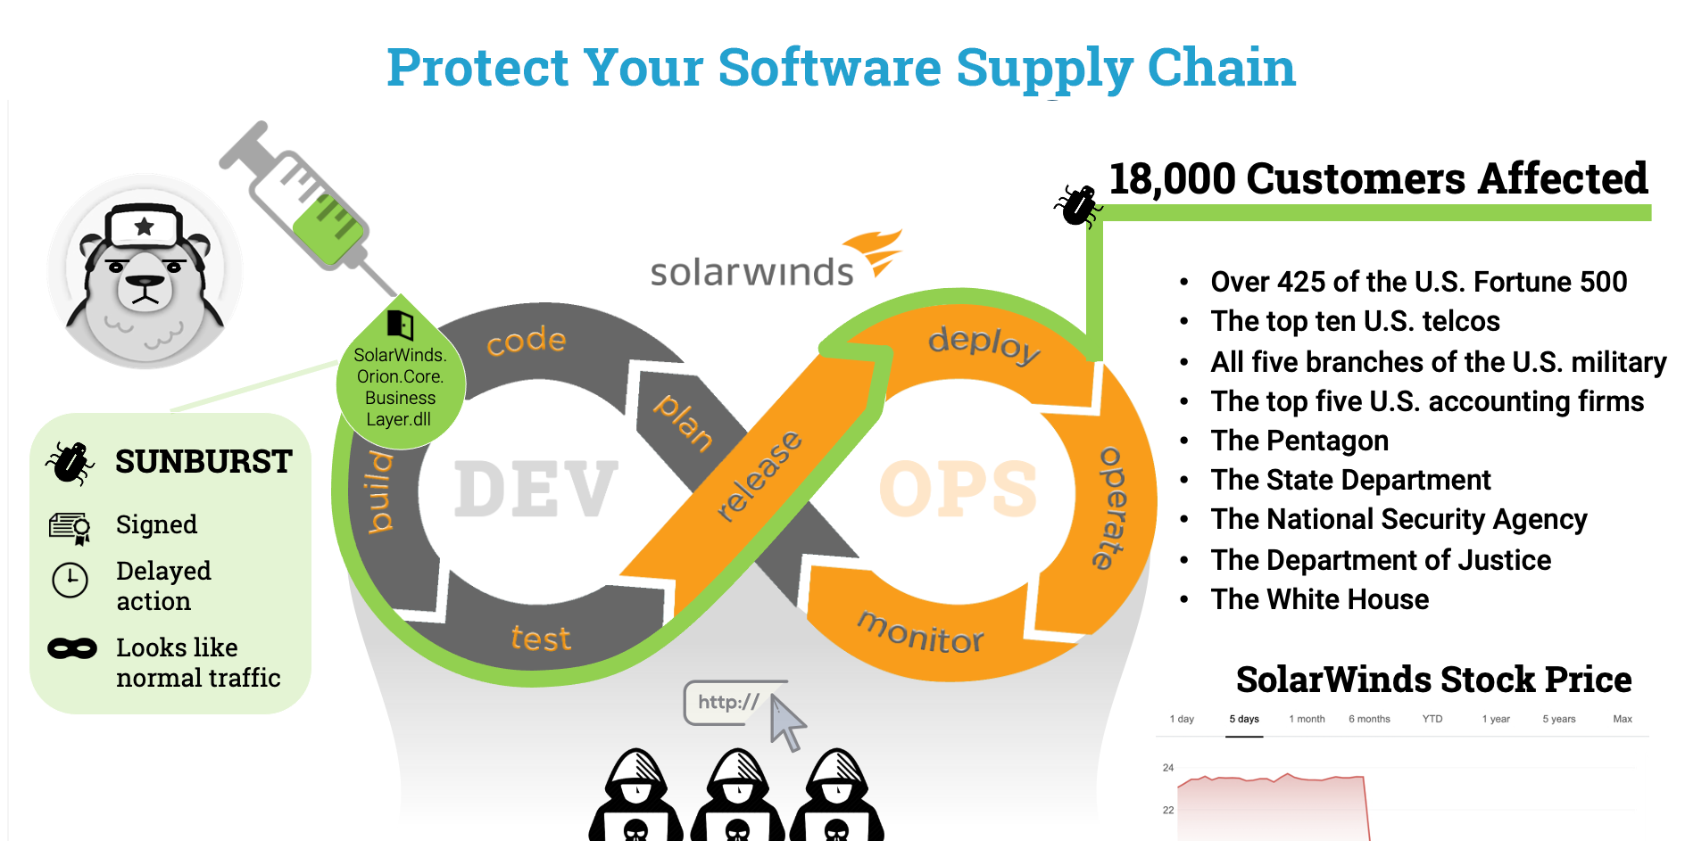
Organization Overview – SolarWinds
IT management software company
300K+ customers globally
Orion software exploited via SUNBURST backdoor
December 2020 supply chain attack
Affected 18K+ customers (ex. Pentagon, NSA)

Slide 6
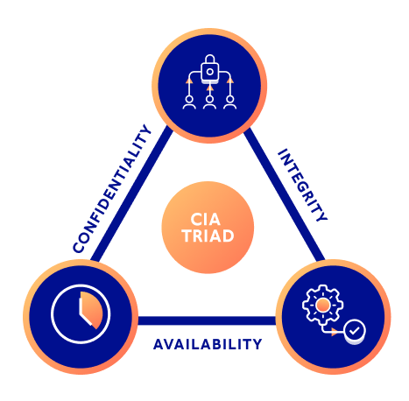
CIA Triad Analysis
Confidentiality: Protecting access to data
Integrity: Preventing unauthorized modifications
Availability: Ensuring continuous access

Slide 7

CIA Triad – SolarWinds
Confidentiality
Strength: AES-256, TLS 1.3, DLP tools
Weakness: Legacy system gaps, overprivileged users
Integrity
Strength: Checksums, access audit logs
Weakness: Incomplete signature validation
Availability
Strength: Redundant DCs, regular backups
Weakness: Weak DDoS defense, limited DR drills

Slide 8

CIA Triad – SolarWinds
Confidentiality
Strength: TLS, network segmentation
Weakness: Incomplete MFA, over-permissioned users
Integrity
Strength: Commit signing, version control
Weakness: No reproducible builds, 3rd-party risk
Availability
Strength: Cloud-hosted infra, load balancing
Weakness: Weak DDoS handling, BCP inconsistencies

Slide 9
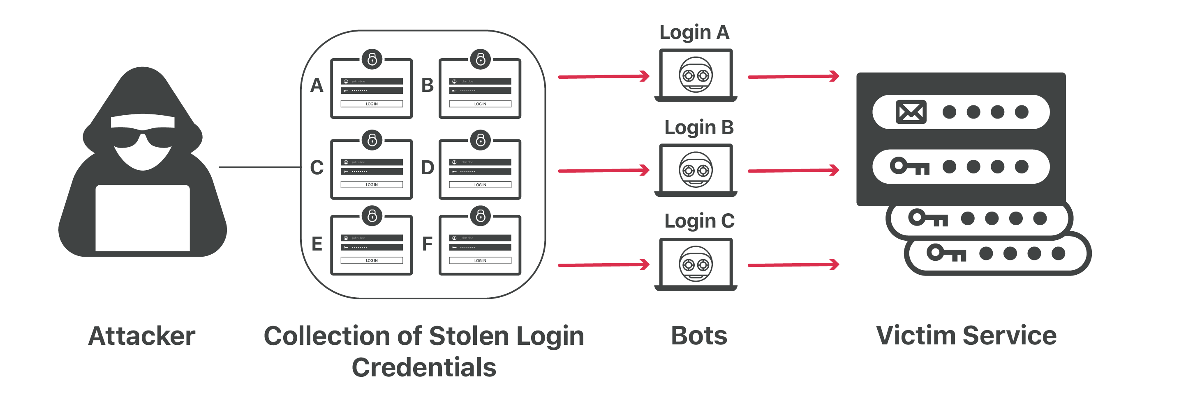
Problem Statement – Anthem Inc.
Confidentiality Issue:
Credential-based attacks
Lax access control policies
Availability Issue:
No air-gapped backups
Weak DR readiness

Slide 10
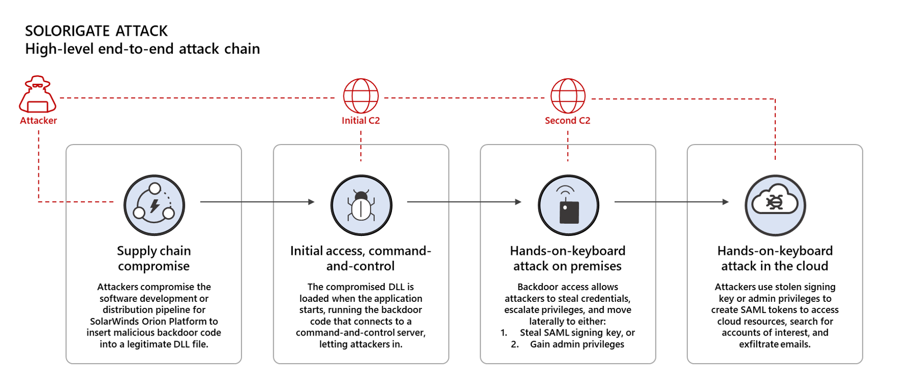
Problem Statement – SolarWinds
Integrity Issue:
Build pipeline lacked tamper-proofing
No reproducible builds
Confidentiality Issue:
MFA inconsistencies
Weak environmental segmentation

Slide 11
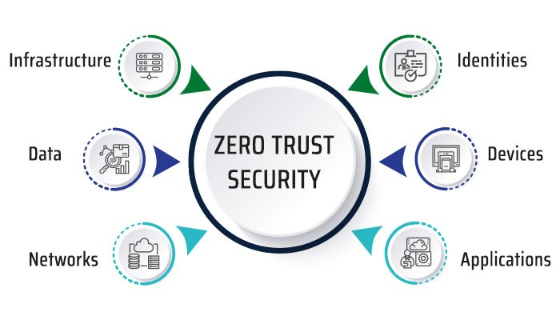
Solutions – Anthem Inc.
1. Zero Trust Security Framework
Tools: Cisco Duo, CrowdStrike, Okta, VMware NSX
Cost: $1.5M, Timeline: 12 months
Strategy: Microsegmentation, RBAC, MFA
2. Ransomware-Proof Backups
Tools: Rubrik, Cohesity, Microsoft Sentinel
Cost: $750K
Features: Immutable, air-gapped, tested restores

Slide 12
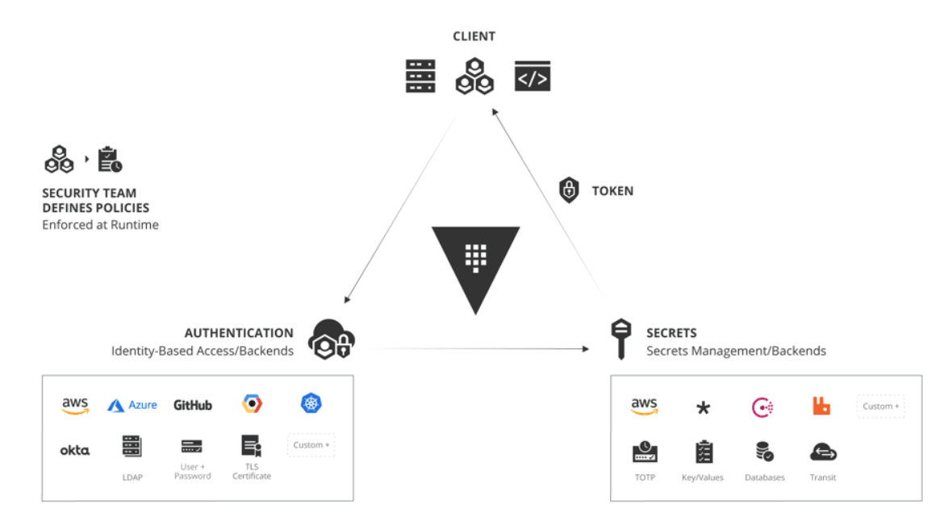
Solutions – SolarWinds
1. Secure Dev Pipeline
Tools: Bazel, Grafeas, GitGuardian, Sigstore
Cost: $900K
Goals: Reproducibility, audit, validation
2. MFA and Credential Hardening
Tools: CyberArk, HashiCorp Vault, YubiKeys
Cost: $450K
Benefits: Strong identity enforcement

Slide 13
Implementation Timeline
Phase 1: Months 1–2
Review systems, finalize tools, assign responsibilities
Phase 2: Months 3–6
Pilot core system upgrades, train staff
Phase 3: Months 7–12
Complete roll-out, validate integrations
Phase 4: Continuous
Security audits, ongoing refinement, patch cycles

Slide 14
Course Knowledge Integration
INFO8965 Concepts Applied:
Endpoint detection (CrowdStrike)
Secure SDLC (Bazel, SonarQube)
Cryptography (Sigstore, TLS)
Access control (RBAC, MFA, PAM)
Disaster recovery (Air-gapped backup models)

Slide 15
Key Takeaways
Both breaches exposed CIA vulnerabilities
Layered defense is critical
Zero trust is now essential
Continuous improvement prevents stagnation
Implementation costs are small vs breach losses

Slide 16

Thank You / Q&A

