Slide 1


Online Tiffin Ordering System
Presented By-
Mrunali Madhav Dhote(239050)
Twinkle Pramod Nemade(239107)

Slide 2
Project Introduction
The Tiffin Ordering System is a software solution designed to facilitate the ordering, management, and delivery of freshly prepared meals, commonly referred to as “Tiffins," to customers' doorsteps. This document outlines the requirements for the development of the Tiffin Ordering System, addressing the functional, non-functional, and user interface specifications necessary for its successful implementation.

Slide 3
Objective (Purpose):
The primary objective of an online Tiffin ordering system project is to provide a convenient, efficient, and user-friendly platform for customers to order freshly prepared meals. Below are the key purposes or objectives of such a project:
Convenience
Efficiency
Variety and Choice
Healthy Eating
Business Growth

Slide 4
Scope:
The scope of a Tiffin ordering system includes designing an intuitive user interface, enabling users to browse menus, place orders, and make payments online. It involves menu management, order tracking, delivery logistics, and administrative tools for managing orders and analyzing data. The system aims to streamline the ordering process, enhance customer experience, and facilitate efficient operations for the service provider.

Slide 5
Technology Used:
Front End: ReactJS
Back End: Java Spring Boot API.
Database: MySQL

Slide 6
S/W and H/W Requirements
Server Side:
Processor: Intel core i5 or above
HDD: 500 GB or above
RAM: 4GB or above
Database: MySQL
Client Side (minimum requirement):
Processor: Intel Dual Core
HDD: Minimum 80GB Disk Space
RAM: Minimum 2GB
OS: Windows 7, Linux

Slide 7
Functionalities - Module wise /user wise
Online Tiffin Ordering System consists of two modules named below
1. Admin
2. Customer/User
3. Delivery Person
User Roles:
Admin : Admin can login to the system.
Admin : login, add menu, delete menu, update menu.
Customer/User : register itself, logins ,update her/his details, add food items, view food items, buy food items.

Slide 8
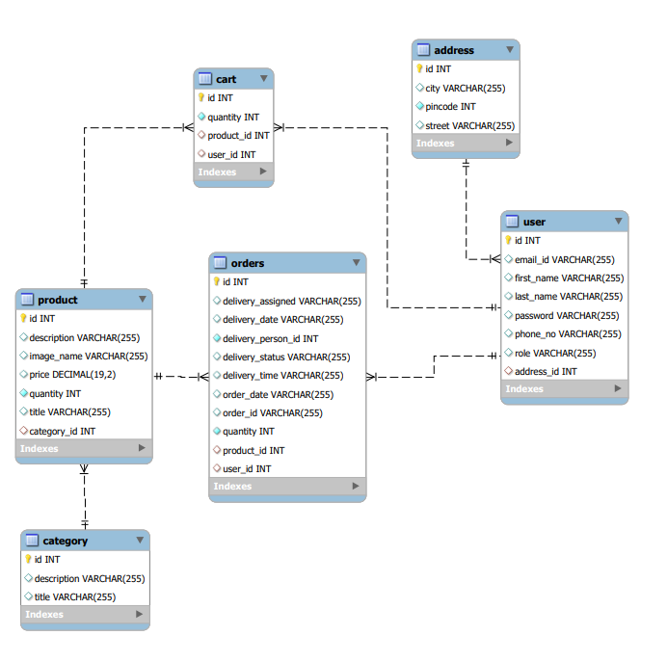
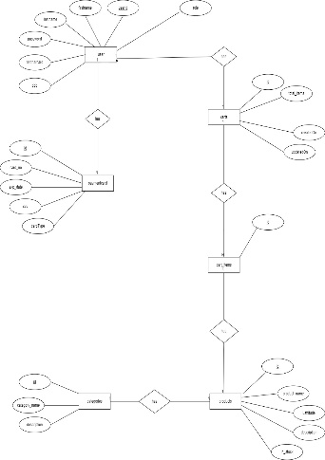
UML Diagrams: E-R Diagram

Slide 9
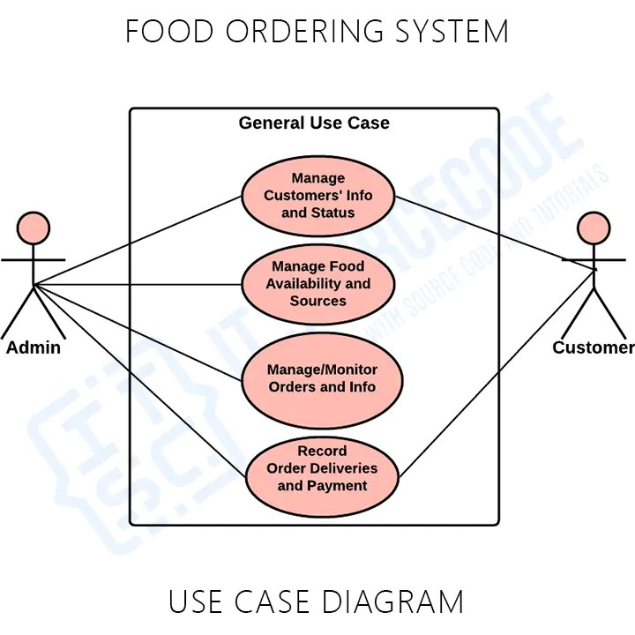
Use Case

Slide 10
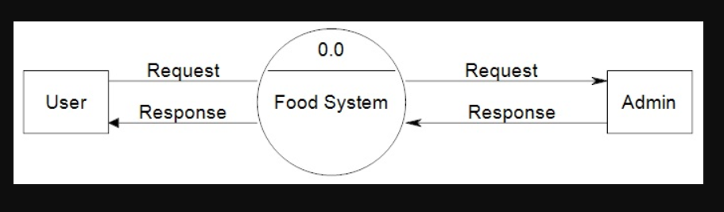
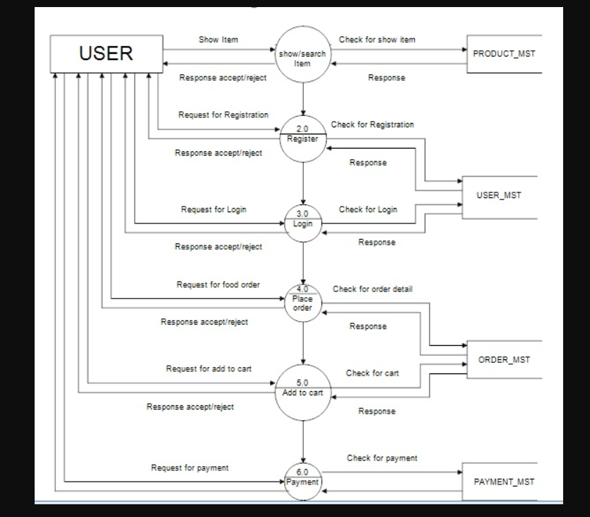
DFD diagrams
Level 0:
Level 1:

Slide 11
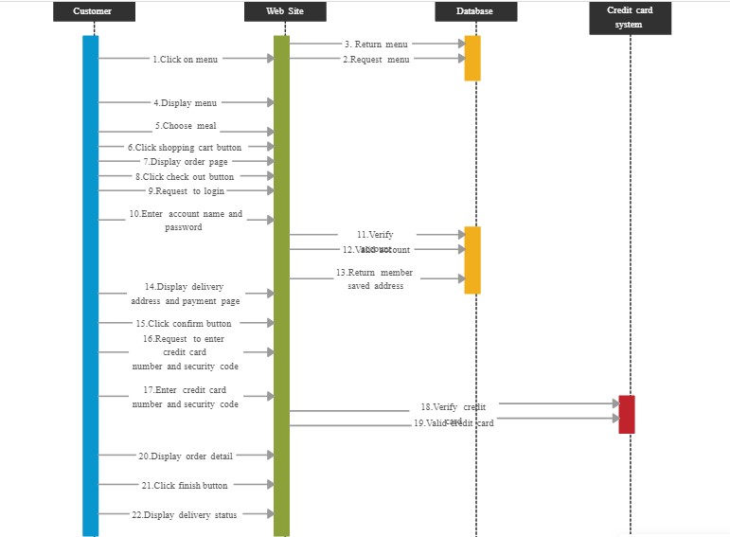
Sequence
Diagram

Slide 12
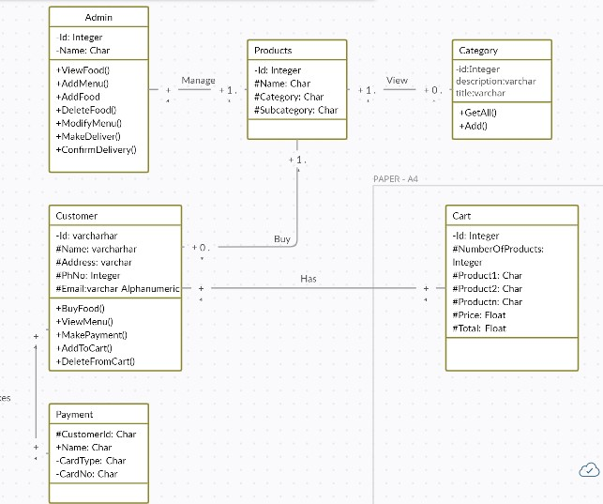
Class
Diagram

Slide 13
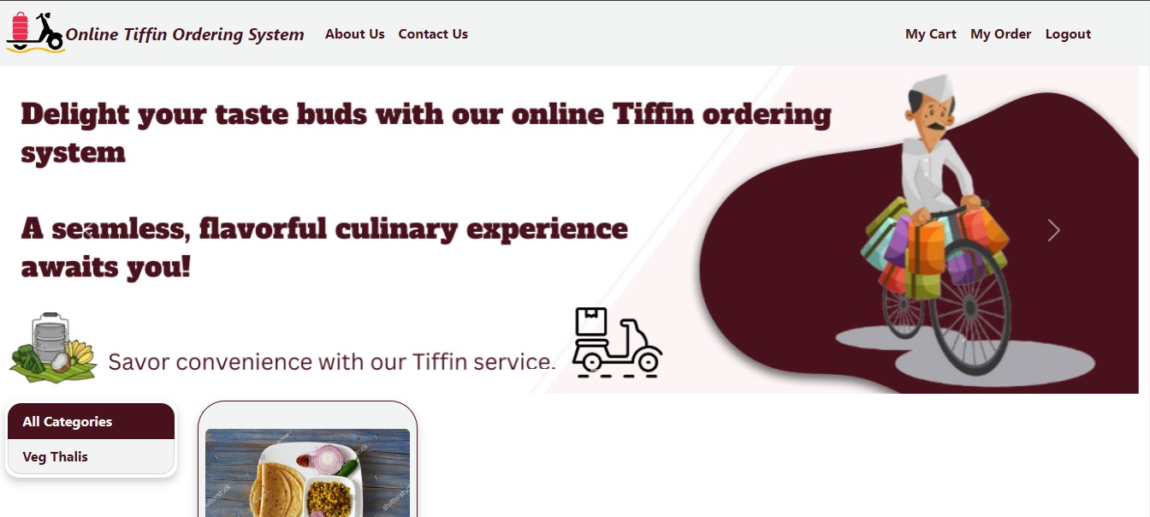
UI
Screen Shots

Slide 14
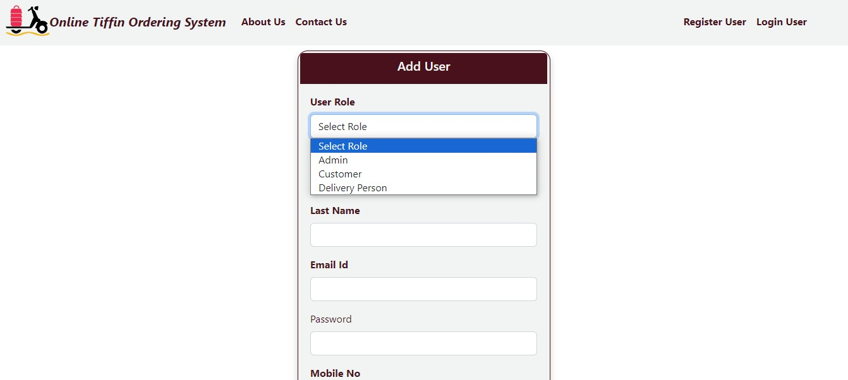
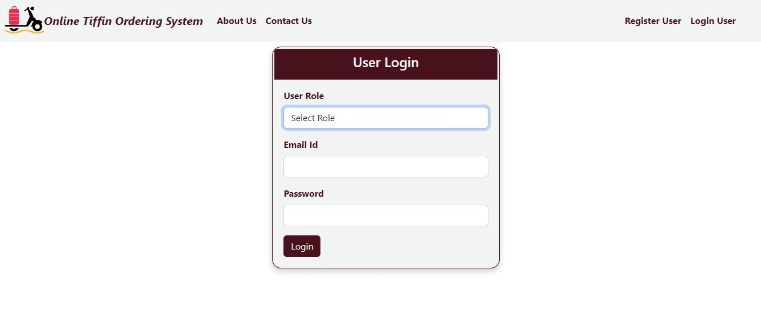

Slide 15
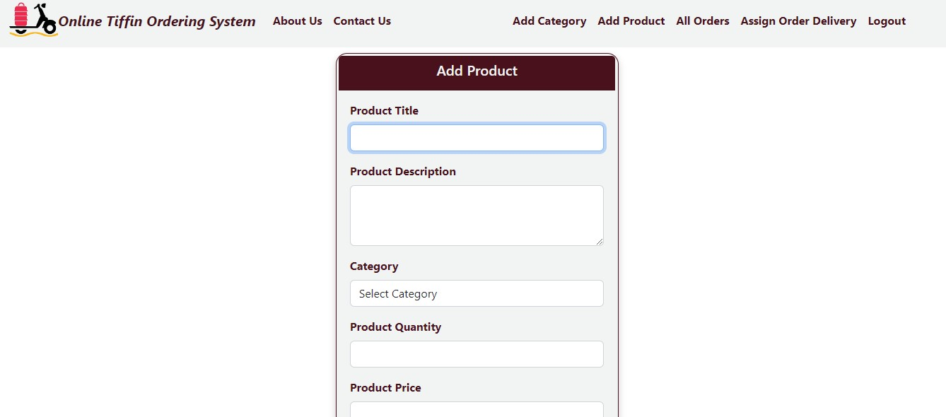
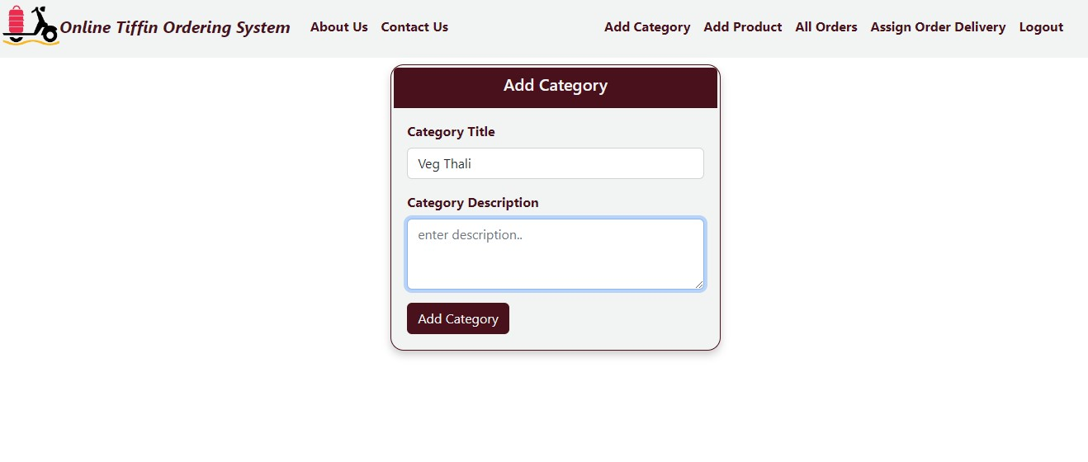
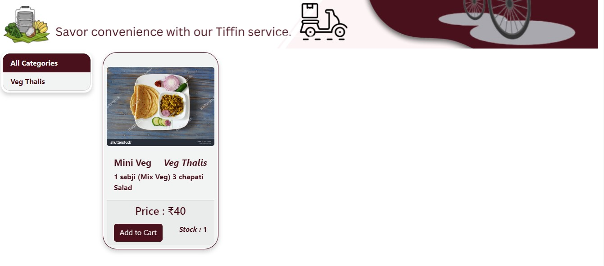

Slide 16
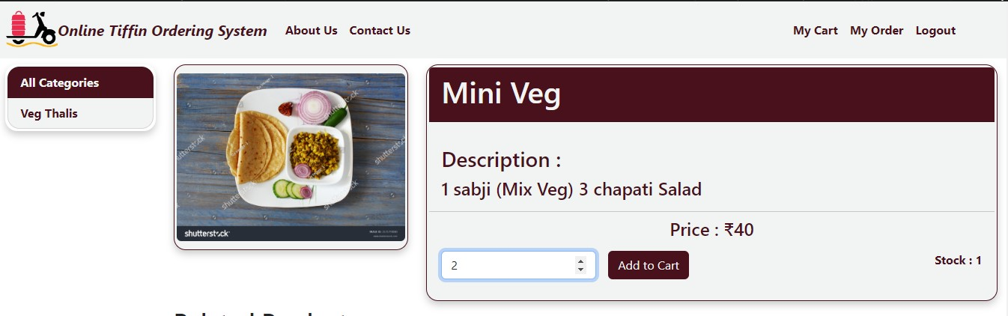

Slide 17
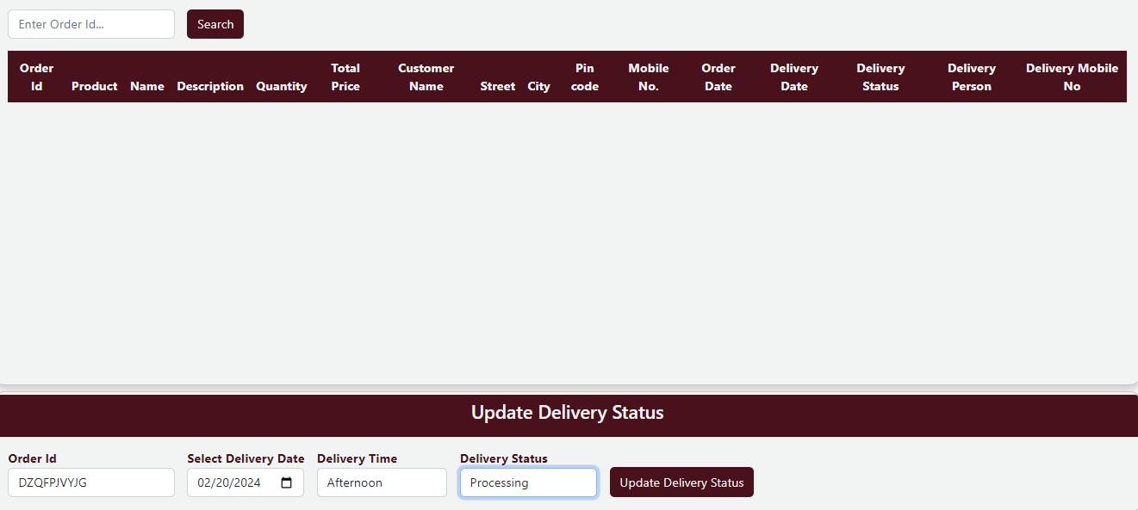
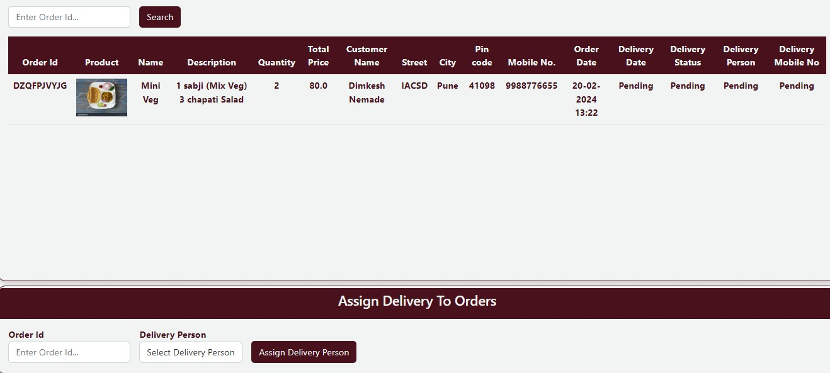

Slide 18
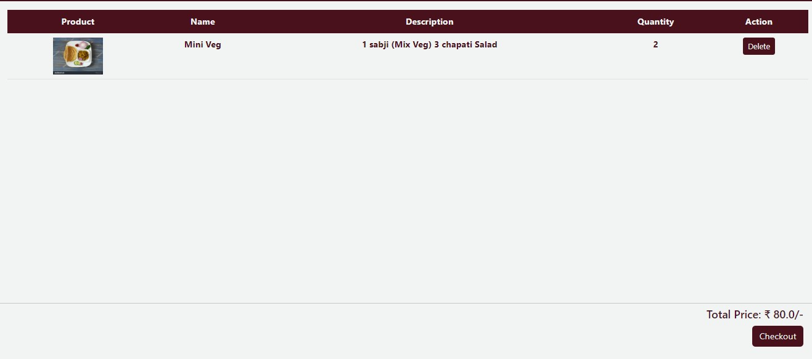
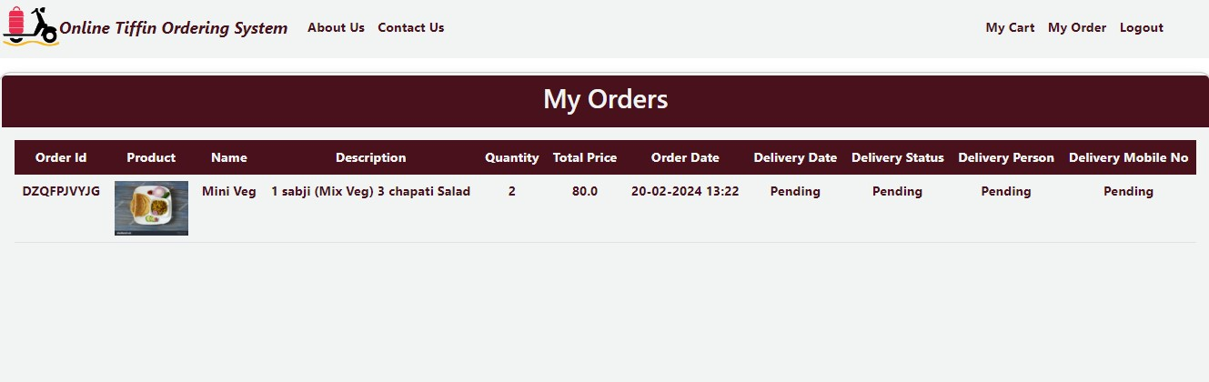

Slide 19
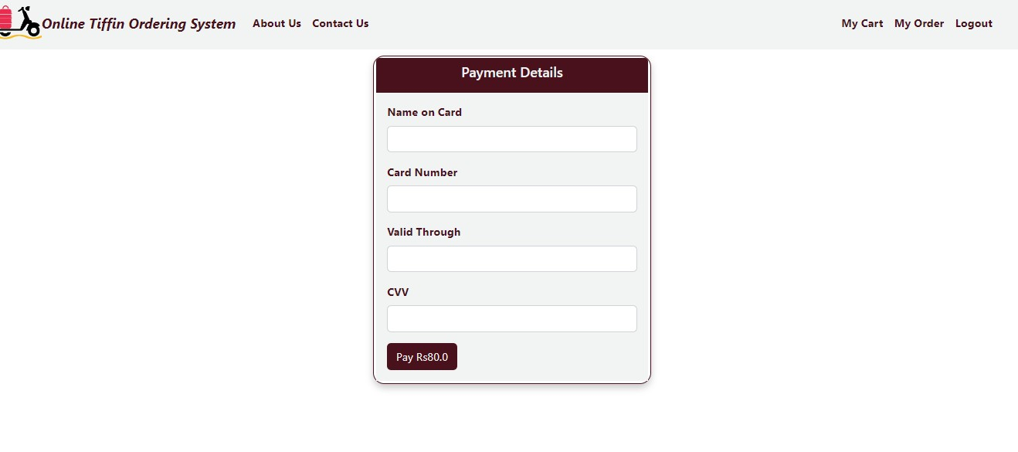

Slide 20
Futures Scope
Online Tiffin ordering systems continue to evolve and expand, they are not just meeting customer needs but also shaping the future of the food delivery landscape. By embracing emerging technologies, promoting sustainability, and fostering collaborations, these platforms are poised to redefine the way people dine, connecting communities through the shared experience of delicious, freshly prepared meals delivered right to their doorsteps.

Slide 21
Conclusion
Online Tiffin ordering systems make it super easy for people to order freshly cooked meals from their phones or computers. They save us time and effort by eliminating the need to cook or go out to eat. These systems offer a wide range of delicious food options to choose from, catering to different tastes and dietary needs.
Looking ahead, these systems are getting even smarter with new technologies like AI . They'll soon offer personalized suggestions, ensure food safety, and even let us experience virtual dining adventures. With these advancements, online Tiffin ordering systems are set to make our lives even more convenient and enjoyable.

Slide 22
References
http://www.javatpoint.com/java-tutorial
http://www.w3.org
http://www.wikipedia.org
https://www.tutorialspoint.com/java

Slide 23

THANK YOU

