Slide 1
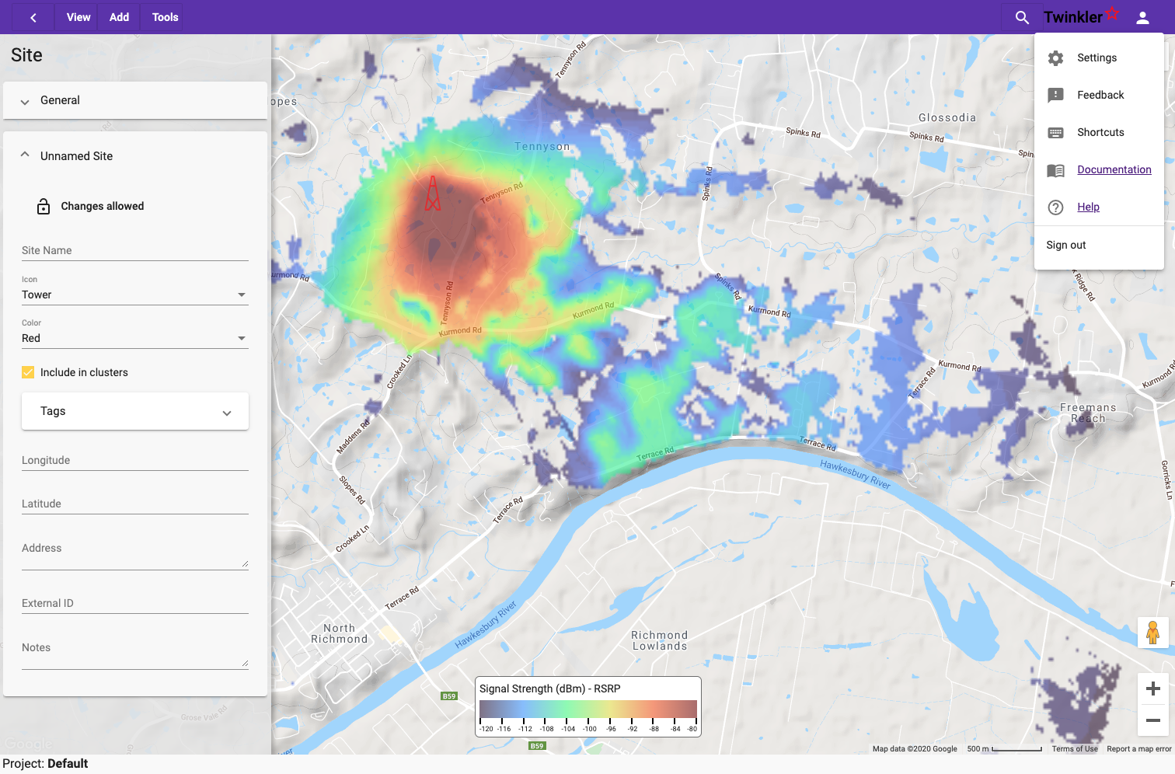
menu bar
settings menu
map menu
map or antenna display
status bar

Slide 2


Antenna
Antenna
Receiver
Transmitter
Transmit System
Radio Channel
Receive System

Slide 3


Ramesh
Bill
Management
Sarah
Raul
Sales
Dmitri
Customer Care
Miguel
Engineering
Carol
Operations
Christoph
Lina
Groups
Users

Slide 4
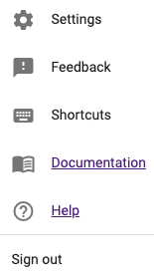
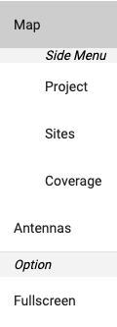
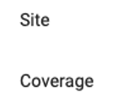
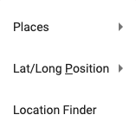
Map menu toggle
Search
Account

Slide 5
map menu

