Slide 1
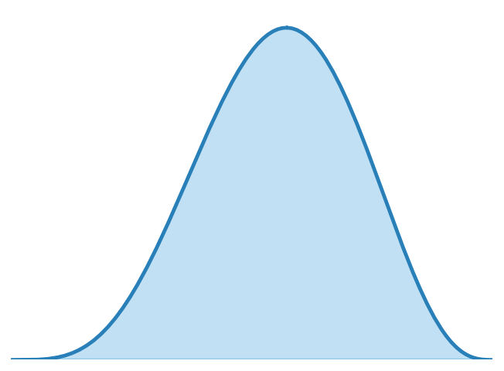
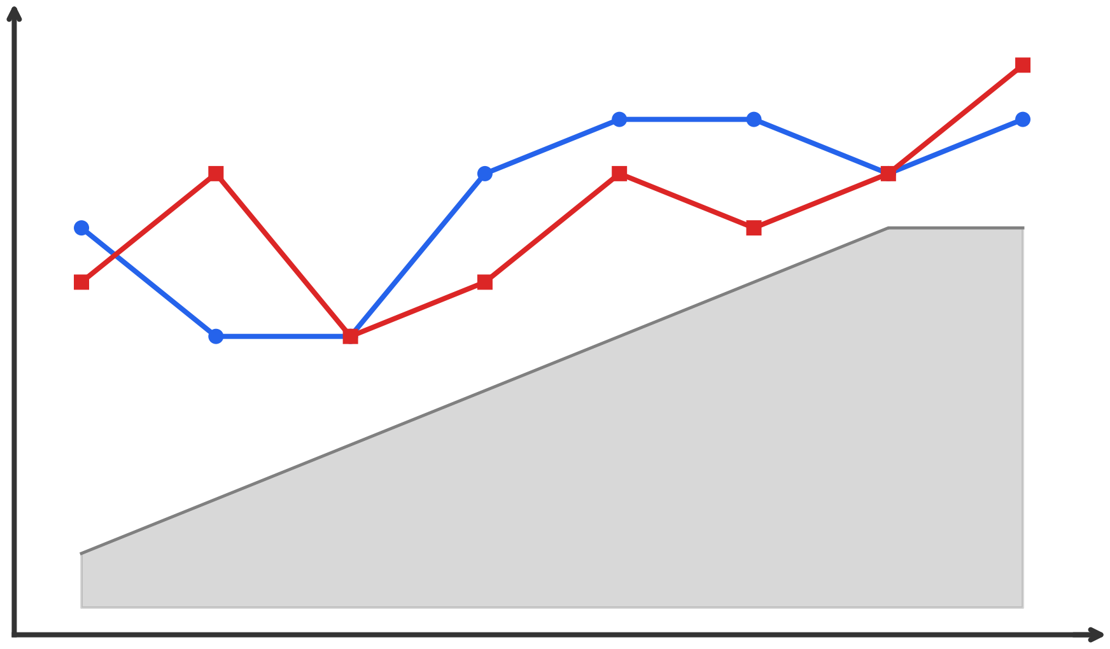


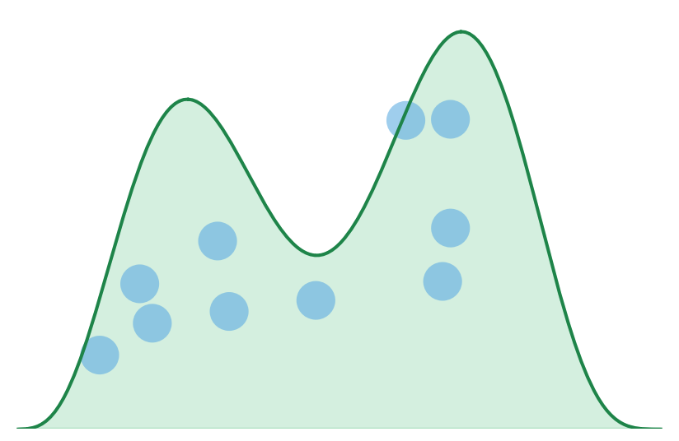



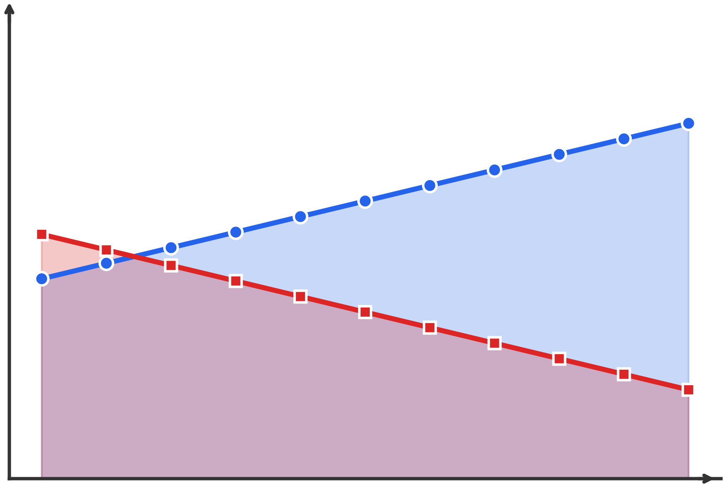



Bayesian Inference Framework
Simulation-Based Outcome Analysis
Prior Distribution
Posterior samples
Comparison
Simulation
Evaluation
Data-Driven Prior
Smoothness Prior
Rank
Elimination Stability
$$P(E_{t}|f_{t}, J_{t})$$
$$\left\{f_{t}^{(1)}, ..., f_{t}^{(N)}\right\}$$
VS
Method Discrepancy
Posterior Distribution
Percentage
Judge‑Save Impact
MCMC
Recommendation
Dual-Track Hierarchical Model
Processed data
Judges Track
Fan-Vote Track
Progressive Technical Fairness System
Celebrity traits
Celebrity traits
Week trend
Judges’ score
Dynamic Weighting
Fan-driven Early Judge-driven Late
Partner effect
Partner effect
Raw data
$$S_{i,t}=w_{J}(t){\tilde{J}}_{i,t}+(1−w_{J}(t)){\tilde{F}}_{i,t}$$
Judges’ scores
Technical evaluation
ICCᴶ
Fan votes
Popularity outcome
ICCᶠ

Slide 2
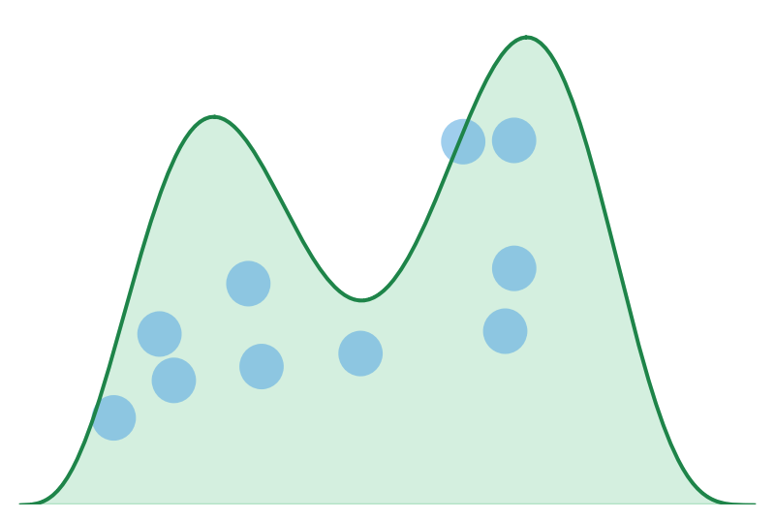


Bayesian Inference Framework
Prior Distribution
Posterior samples
Data-Driven Prior
Smoothness Prior
$$P(E_{t}|f_{t}, J_{t})$$
$$\left\{f_{t}^{(1)}, ..., f_{t}^{(N)}\right\}$$
Posterior Distribution
MCMC
Dual-Track Hierarchical Model
Judges Track
Fan-Vote Track
Celebrity traits
Celebrity traits
Week trend
Judges’ score
Partner effect
Partner effect
Memo
Judges’ scores
Technical evaluation
ICCᴶ
Fan votes
Popularity outcome
ICCᶠ

Slide 3
















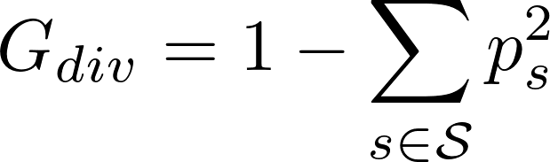

Semantic Entity Insertion Operator
Semantic-Aware LiDAR Simulation
Semantic Pose Generation
Operator
Virtual LiDAR Setup
Beam Propagation
Point Cloud Generation
Test data
Test dataset
Spatial Constraints
Sensor Specification
Range Computation
Point Computation
Semantic Constraints
。。。
Beam Generation
Reflectivity Modeling
Scene Integration
Instance-level Operators
Initial Seeds
Entity Database
LiDAR-based
perception system
Vehicle
Person
Semantic Diversity-Guided Testing
Vegetation
Animal
。。。
Diversity Guidance : Measuring the diversity of generate point cloud S
Y
Increased?
Interaction-level Operators
Infrastructure
Others
N
Seed Queue
Transformed
point cloud
Discarded
Test Report
Metamorphic Relations
Add seeds back to the queue

Slide 4

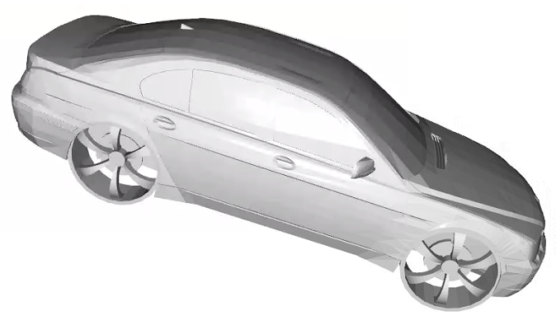

Semantic-Aware LiDAR Simulation
Semantic Entity Insertion Operator
Virtual LiDAR Setup
Beam Propagation
Point Cloud Generation
Insertion Operators
Range Computation
Point Computation
Test data
$$(x,y,z,r_{z})$$
Beam Generation
Instance-level
interaction-level
Test dataset
Physically
and Semantic Plausible Pose
Sensor Specification
Reflectivity Modeling
Scene Integration
Semantic Pose Generation
Spatial Constraints
Initial Seeds
Semantic Constraints
LiDAR-based
perception system
Semantic Diversity-Guided Testing
Entity Database
Diversity Guidance : Measuring the diversity of generate point cloud S
Vehicle
Person
Increased?
N
Seed Queue
Vegetation
Animal
Entity
instance
Transformed
point cloud
Discarded
Infrastructure
Test Report
Others
Add seeds back to the queue
Metamorphic Relations

Slide 5

Semantic Entity Insertion Operator
Semantic-Aware LiDAR Simulation
Semantic Pose Generation
Virtual LiDAR Setup
Beam Propagation
Point Cloud Generation
Test data
Test dataset
Spatial Constraints
$$(x,y,z,r_{z})$$
Beam Generation
Range Computation
Point Computation
Semantic Constraints
Physically
and Semantic Plausible Pose
Sensor Specification
Reflectivity Modeling
Scene Integration
Entity Insertion Operator
Initial Seeds
LiDAR-based
perception system
Instance-level
interaction-level
Semantic Diversity-Guided Testing
Entity Database
Diversity Guidance : Measuring the diversity of generate point cloud S
Entity
instance
Increased?
{Vehicle,Person,Vegetation,Animal,Infrastructure,Others}
N
Seed Queue
Transformed
point cloud
Discarded
Test Report
Metamorphic Relations
Add seeds back to the queue
Entity Insertion Operator

Slide 6
Semantic Entity Insertion Operator
Semantic-Aware LiDAR Simulation
Semantic Pose Generation
Virtual LiDAR Setup
Beam Propagation
Point Cloud Generation
Test data
Test dataset
Spatial Constraints
$$(x,y,z,r_{z})$$
Beam Generation
Range Computation
Point Computation
Semantic Constraints
Physically
and Semantic Plausible Pose
Sensor Specification
Reflectivity Modeling
Scene Integration
Initial Seeds
Entity Database
LiDAR-based
perception system
Vehicle
Person
Semantic Diversity-Guided Testing
Vegetation
Animal
Diversity Guidance : Measuring the diversity of generate point cloud S
Y
Entity
instance
Increased?
Infrastructure
Others
N
Seed Queue
Transformed
point cloud
Discarded
Test Report
Metamorphic Relations
Add seeds back to the queue

Slide 7
Semantic Entity Insertion Operator
Semantic-Aware LiDAR Simulation
Semantic Pose Generation
Operator
Virtual LiDAR Setup
Beam Propagation
Point Cloud Generation
Test data
Test dataset
Spatial Constraints
Beam Generation
Range Computation
Point Computation
Semantic Constraints
。。。
Sensor Specification
Reflectivity Modeling
Scene Integration
Instance-level Operators
Initial Seeds
Entity Database
LiDAR-based
perception system
Vehicle
Person
Semantic Diversity-Guided Testing
Vegetation
Animal
。。。
Diversity Guidance : Measuring the diversity of generate point cloud S
Y
Increased?
Interaction-level Operators
Infrastructure
Others
N
Seed Queue
Transformed
point cloud
Discarded
Test Report
Metamorphic Relations
Add seeds back to the queue

Slide 8








Finess Guidance : Measuring the ability of test data to reveal errors
①
②
③
$$Fitness= α∗F_{OM} + β∗F_{FD} + γ∗F_{LE}$$
①
②
③
Increased?
N
Discarded
Y
Testing
Feedback
Retraining
Generated Data
MSF Model
Semantic-Diversity Guided Testing
Diversity Guidance : Measuring the diversity of generate point cloud S
Test data
Initial Seeds
Increased?
N
Discarded
Feedback
Y
Transformed
point cloud
Seed Queue
Testing
Generated Data
LiDAR-based perception system

Slide 9
Semantic Entity Insertion Operator
Semantic-Aware LiDAR Simulation
Pose Generation
Virtual LiDAR Setup
Beam Propagation
Entity Integration
Test data
Range Computation
Occlusion Handling
Test dataset
Spatial Constraints
Beam Generation
$$(x,y,z,r_{z})$$
Sensor Specification
Reflectivity Modeling
Point Cloud Generation
Semantic Constraints
Physically
and Semantic Plausible Pose
Initial Seeds
Entity Database
Semantic-Diversity Guided Testing
LiDAR-based
perception system
Vehicle
Person
Diversity Guidance : Measuring the diversity of generate point cloud S
Increased?
Vegetation
Animal
N
Seed Queue
Entity
instance
Infrastructure
Others
Transformed
point cloud
Discarded
Test Report
Add seeds back to the queue

Slide 10


Semantic-Aware LiDAR Simulation
Semantic Entity Insertion Operator
Virtual LiDAR Setup
Beam Propagation
Entity Integration
Test data
Pose Generation
Beam Generation
Range Computation
Occlusion Handling
Test dataset
Spatial Constraints
$$(x,y,z,r_{z})$$
Sensor Specification
Reflectivity Modeling
Point Cloud Generation
Physically and Semantic Plausible Pose
Semantic Constraints
Initial Seeds
Semantic-Diversity Guided Testing
Entity Operator
Diversity Guidance : Measuring the diversity of generate point cloud S
LiDAR-based
perception system
Increased?
Vehicle
Person
Infrastructure
Transformed
point cloud
N
Vegetation
Animal
Others
Seed Queue
Discarded
Entity Database
Test
Report
Add seeds back to the queue
Y

Slide 11
Semantic-Aware LiDAR Simulation
Semantic Entity Insertion Operator
Virtual LiDAR Setup
Beam Propagation
Entity Integration
Test data
Pose Generation
Beam Generation
Range Computation
Occlusion Handling
Test dataset
Spatial Constraints
$$(x,y,z,r_{z})$$
Sensor Specification
Reflectivity Modeling
Point Cloud Generation
Physically and Semantic Plausible Pose
Semantic Constraints
Initial Seeds
Semantic-Diversity Guided Testing
Entity Operator
Diversity Guidance : Measuring the diversity of generate point cloud S
LiDAR-based
perception system
Increased?
Vehicle
Person
Infrastructure
Transformed
point cloud
N
Vegetation
Animal
Others
Seed Queue
Discarded
Entity Database
Test
Report
Add seeds back to the queue
Y

Slide 12
Entity Operator
Semantic-Aware LiDAR Simulation
Pose Generation
Virtual LiDAR Setup
Beam Propagation
Entity Integration
Test data
Spatial Constraints
Beam Generation
Range Computation
Occlusion Handling
Test dataset
Sensor Specification
Reflectivity Modeling
Point Cloud Generation
Semantic Constraints
Physically Plausible Pose
Initial Seeds
Entity Operator
Semantic-Diversity Guided Testing
Diversity Guidance : Measuring the diversity of generate point cloud S
LiDAR-based
perception system
Vehicle
Person
Infrastructure
Increased?
Vegetation
Animal
Others
Transformed
point cloud
N
Seed Queue
Discarded
Entity Database
Test
Report
Add seeds back to the queue
Y

Slide 13
Entity Database
Pose Generation
Vehicle
Person
Infrastructure
Spatial Constraints
Test data
Vegetation
Animal
Others
Semantic Constraints
Initial Seeds
Seed Queue

Slide 14
Entity Database
Pose Generation
Vehicle
Person
Infrastructure
Spatial Constraints
Test data
Vegetation
Animal
Others
Semantic Constraints
Initial Seeds
Seed Queue

Slide 15
Point Cloud
Object Insertion Operator
Physic-Aware LiDAR Simulation
Object level
Init Seeds
Fitness-Guided Testing
Interaction-Level
Behavior-Level

Slide 16
Transmit
Pulse
Signal
Target Object
Laser Emission Unit
Laser Receiving Unit
Signal Processing Unit
这里我是模拟一个虚拟雷达 他也能旋转，然后也能按照设定好的分辨率发射激光。同时激光也有能量 你觉得怎么拆分Laser Emission Unit 好一些，最好一对一和这三个功能对应上

Slide 17
