Slide 1
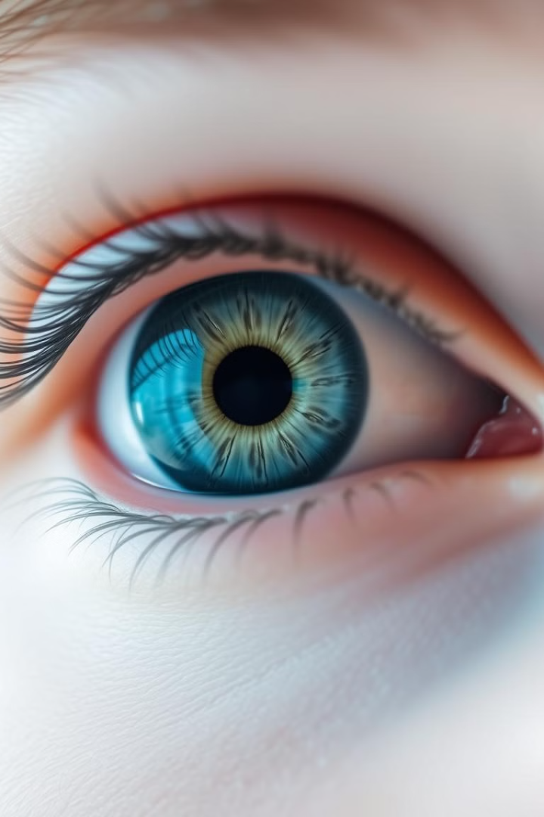
Iris Tumor Detection with Convolutional Neural Networks(CNN)
TEAM-4 MEMBERS:
SKANDA KS
TAMEEM ABRAR UL HAQ
TWINKLE ROY DARA
VRINDA MEPANI
YASH JAIN

Slide 2
PROBLEM STATEMENT:
The goal of this project is to develop a Convolutional Neural Network (CNN) model capable of detecting tumors in iris images to aid early diagnosis. The model is showcased, allowing users to upload iris images and receive real-time tumor detection results to facilitate diagnosis.
The model should classify images of the iris as either normal or tumor-present with high accuracy.
Interns learnt about iris tumors, data preprocessing techniques, and model evaluation metrics, ultimately providing a foundation in using artificial intelligence for medical diagnostics.

Slide 3
PROJECT OVERVIEW:
Objective
Develop a CNN model to accurately identify iris tumors.
Approach
Train a CNN model on a dataset of iris images.
Upload Image:
The "upload image" feature allows users to submit an image—either showing a tumor or not through the application.
Detect Image:
The "detect image" feature processes the user-uploaded image to determine if a tumor is present by using a
Convolutional Neural Network (CNN) algorithm
Show result:
After processing the image through the CNN algorithm, the application displays a clear result indicating whether a tumor is detected or not.

Slide 4
PROJECT WORKFLOW :
DATA COLLECTION
DATA PREPROCESSING
Building user interface
Integration of user interface and model.
Designing the CNN model

Slide 5
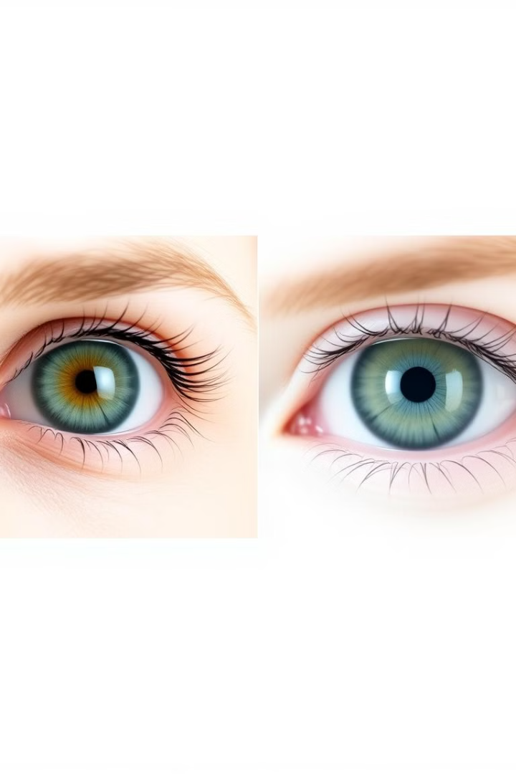
Dataset
Affected Eyes
Normal Eyes
Images of eyes with tumors.
Images of healthy eyes.

Slide 6
MODULES USED:
Data Processing and Scientific Computing:
Numpy (np) : Library for Array operations and numerical computations
Sklearn : Provides tools like train_test_split for splitting data into training and testing sets.
Deep Learning and Machine Learning Modules:
Tensorflow- keras.models : Framework for building and loading deep learning models with Sequential and Model.
keras.layers : used Conv2D, MaxPooling2D, Dense, Flatten, Dropout, BatchNormalization, GlobalAveragePooling2D to reduce spatial dimensions, for combining features, normalising inputs , and for reducing the features by averaging values respectively.
keras.preprocessing.image : used ImageDataGenerator, load_img, img_to_array for loading and preprocessing image data
keras.callbacks : Functions like EarlyStopping, ModelCheckpoint, ReduceLROnPlateau for controlling training flow and improving model performance.
keras.applications : Pre-Trained deep learning models such as MobileNetV2 for transfer learning.

Slide 7
Iris Tumor Detection - Model Architecture
BASE MODEL : MobileNetV2 (Pre-trained on ImageNet)
Input Shape : 224 x 224 x 3
Transfer Learning Approach
CUSTOM LAYERS:
1. Global Average Pooling 2D
2. Dropout (0.5)
3. Dense Layer (256 units) + ReLU
4. Batch Normalization
5. Dropout (0.3)
6. Dense Layer (128 units) + ReLU
7. Batch Normalization
8. Dropout (0.2)
9. Output Layer (1 unit) + Sigmoid

Slide 8
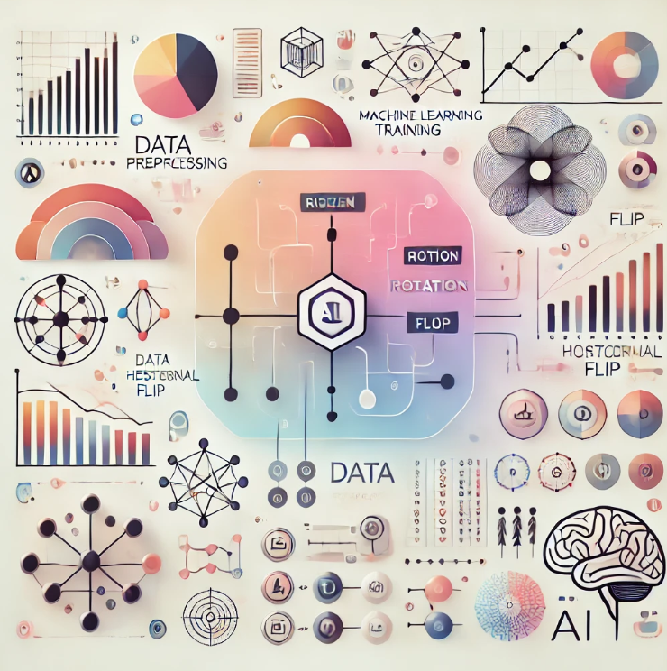
Training and Evaluation Strategy
Data Preprocessing:
Image Size: 224 x 224
Data Augmentation: Rotation (±20°)
Width/Height Shift (±20%)
Shear/Zoom (20%) , Horizontal Flip
Training Process:
Initial Training (30 epochs)
Frozen Base Model
Fine-tuning (40 epochs)
Unfrozen layers (100+)
Lower learning rate (1E-5)
Training Features:
Batch Size: 16
Class Weight Balancing , Early Stopping (patience: 15)
Learning Rate Reduction and Best Model Checkpointing

Slide 9
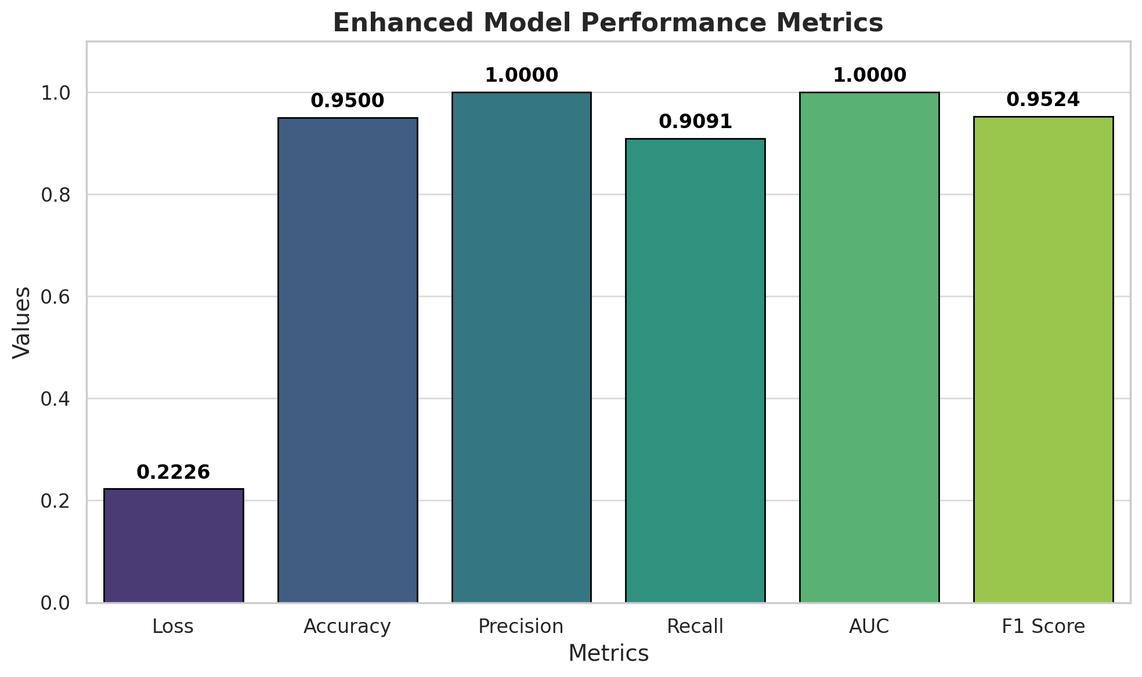
results
Loss: 0.2226
Accuracy: 0.9500
Precision: 1.0000
Recall: 0.9091
Auc: 1.0000
F1 Score: 0.9524

Slide 10
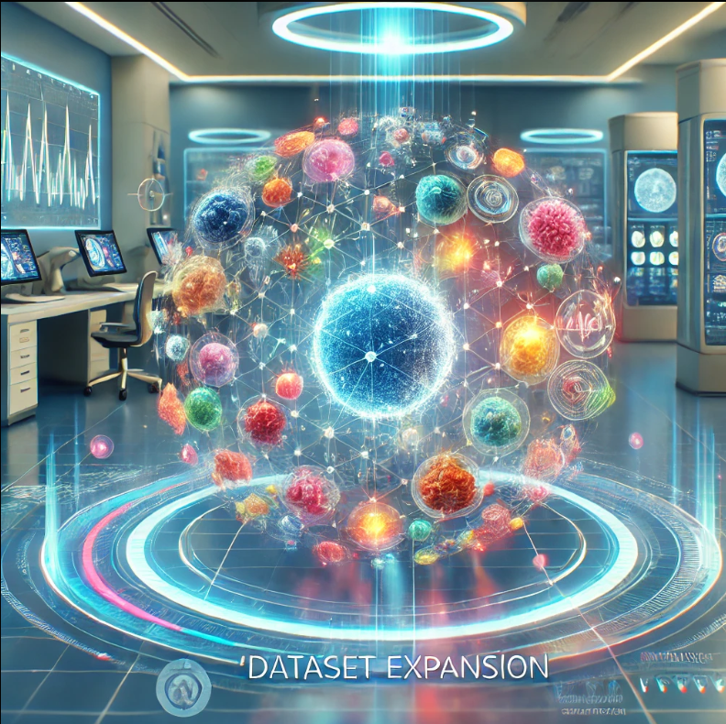
DATASET EXPANSION
Objective: Increase the size and diversity of the dataset to improve the robustness and generalizability of the model.
Proposed Actions:
Incorporate more tumor images across a variety of demographics (age, gender, and ethnicity) and tumor types.
Augment the dataset with synthetic data using advanced augmentation techniques like GANs (Generative Adversarial Networks).
Collaborate with medical institutions or open-source repositories for access to high-quality labeled datasets.

Slide 11
MODEL OPTIMIZATION:
Objective: Enhance the model's performance for real-world applications.
Proposed Actions:
Fine-tune the existing model by experimenting with advanced architectures (e.g., EfficientNet or ResNet variants).
Implement techniques like transfer learning to leverage pre-trained models on similar medical imaging tasks.
Optimize hyperparameters using automated tools such as Optuna or grid search to improve training efficiency.
Address overfitting issues by incorporating regularization techniques like dropout or L2 regularization.
Explore ensemble methods by combining predictions from multiple models to increase accuracy.

Slide 12
CONCLUSION :
The project successfully showcases the integration of Convolutional Neural Networks (CNNs) within a web application to facilitate tumor detection in medical imaging.
With a powerful combination of artificial intelligence and an accessible interface, this solution aims to support medical professionals in achieving accurate and timely diagnosis of iris tumors, potentially improving patient outcomes through early detection and intervention.

Slide 13
THANK YOU

