Slide 1
Automatic Question Tagger
Nazmun Nahar Tui
Group 04 : team_quad
Group Members:
Nazmun nahar tui- 2018331047
Aahsanul azim - 2018331041
Jakir hasan - 2018331057
Alfeh sani - 2018331119

Slide 2
Motivation
Enhance the user experience of Q&A sites like Stack Overflow and Quora.

Slide 3
Why use automatic question tagger
When we want to ask a question in stack Overflow, we need to give some tag. Most of the time we are confused. This project will help us to select appropriate tag.

Slide 4
Data Preparation

Slide 5
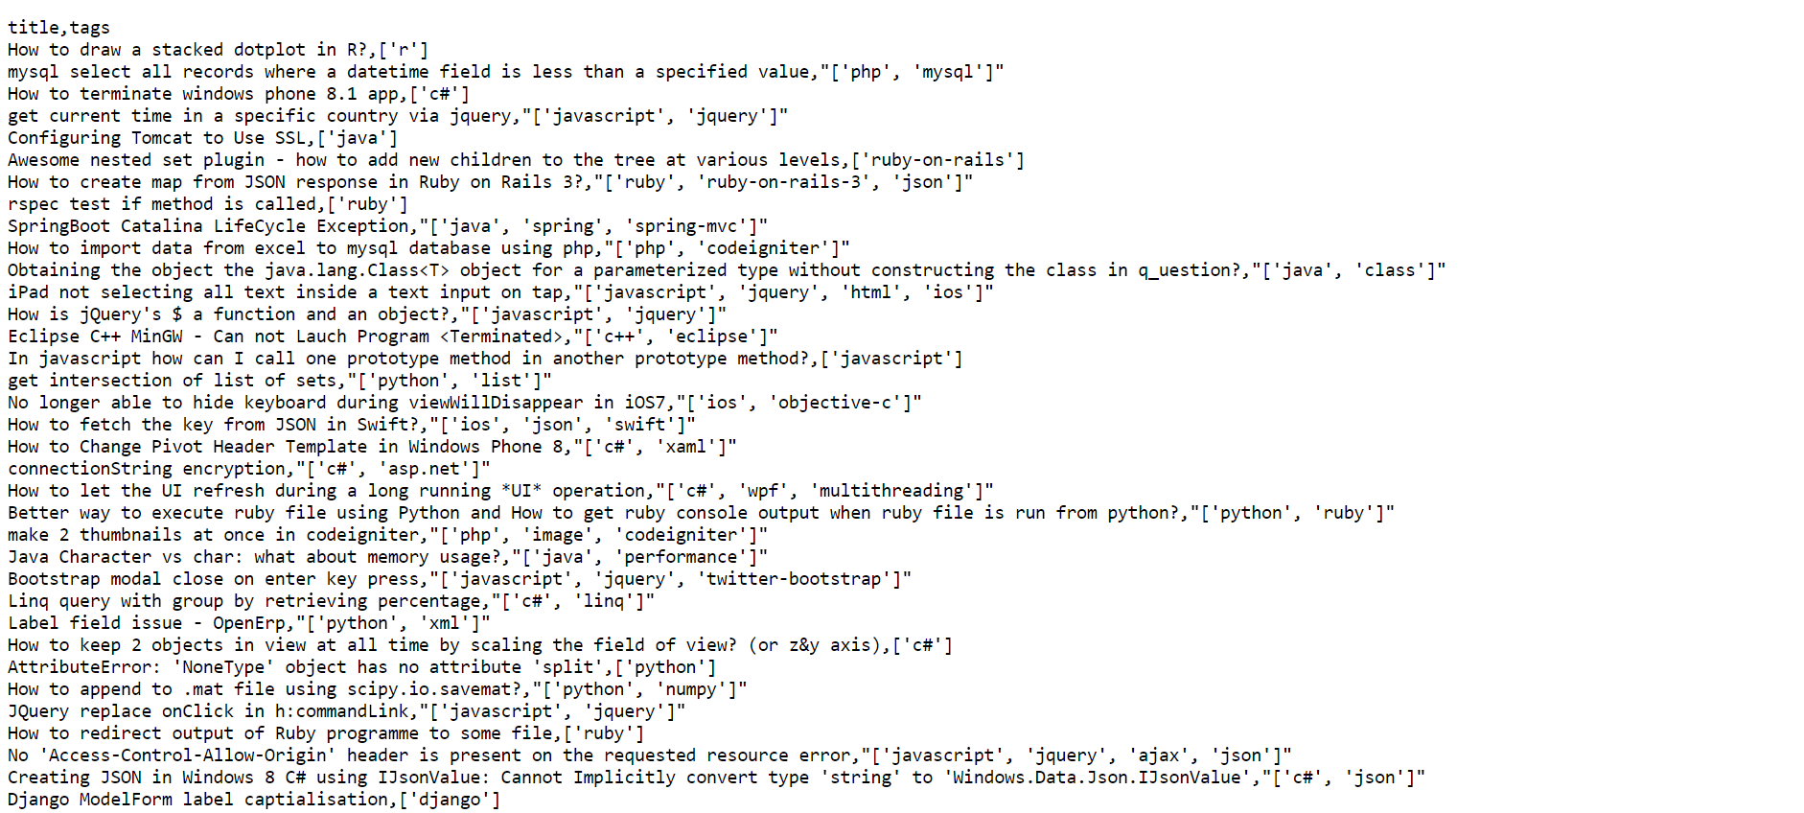
Dataset collection

Slide 6
Data Cleaning
Eliminate duplicates, null values.
Removing html tags.
Get rid of stopwords.

Slide 7
Model preprocessing

Slide 8
Stemming
Stemming is the process of reducing words to their root form in order to reduce the dimensionality of text data. This is useful in this project as it reduce the number of unique words in a question and make it easier to identify correct tag.

Slide 9
Splitting dataset
Initial Dataset
Training (80%)
Testing (20%)

Slide 10
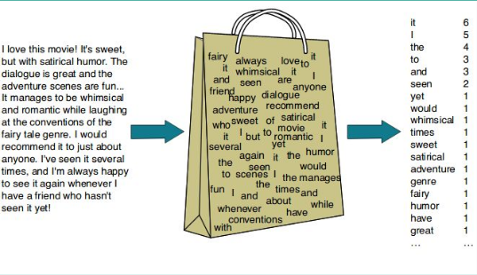
Vectorization
Vectorization is a step in feature extraction. The idea is to get some distinct features out of the text for the model to train on, by converting text to numerical vectors.

Slide 11
Training model

Slide 12
Training and testing
OneVsRest Classifier : Used one vs rest classifier which is a multilabel classifier for classifying all questions in separate binary classification tasks.
SGD Classifier : Used SGD classifier as a parameter of the one vs rest classifier which uses single sample to compute gradient of the model.

Slide 13
Accuracy of The Model
Accuracy : 64%
Benchmark Used : F1 Score

Slide 14
Application

Slide 15
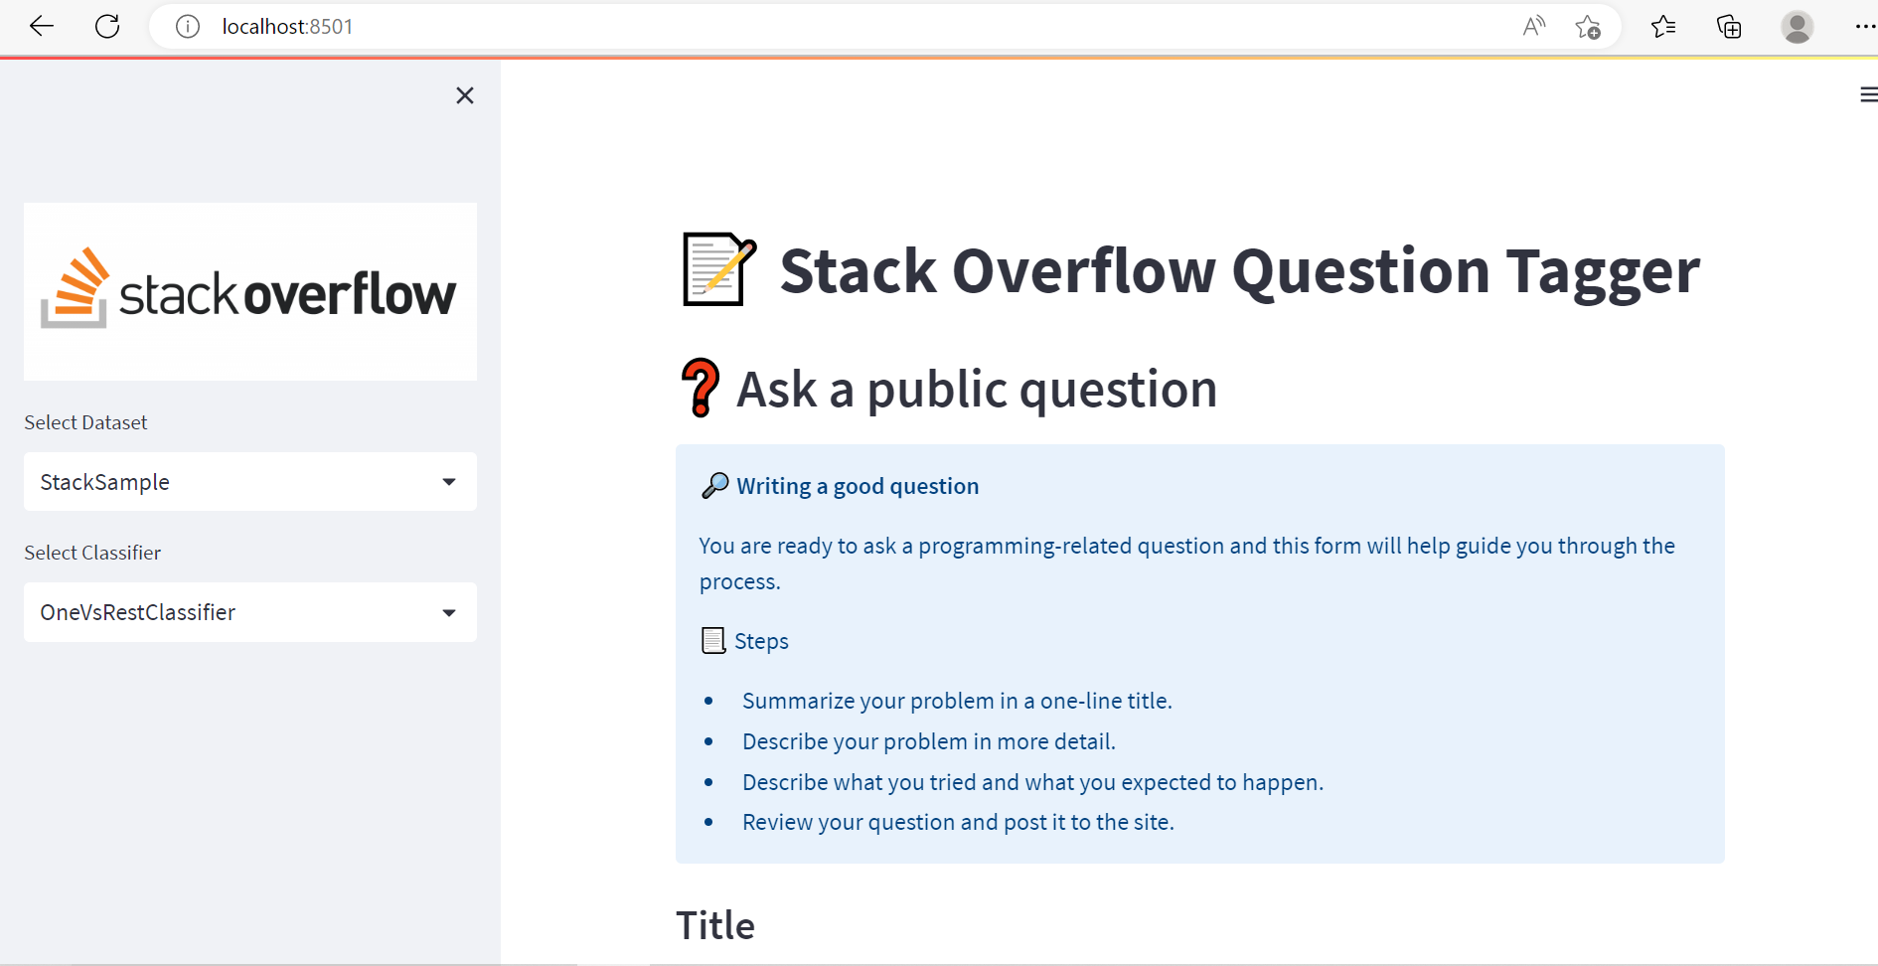

Slide 16
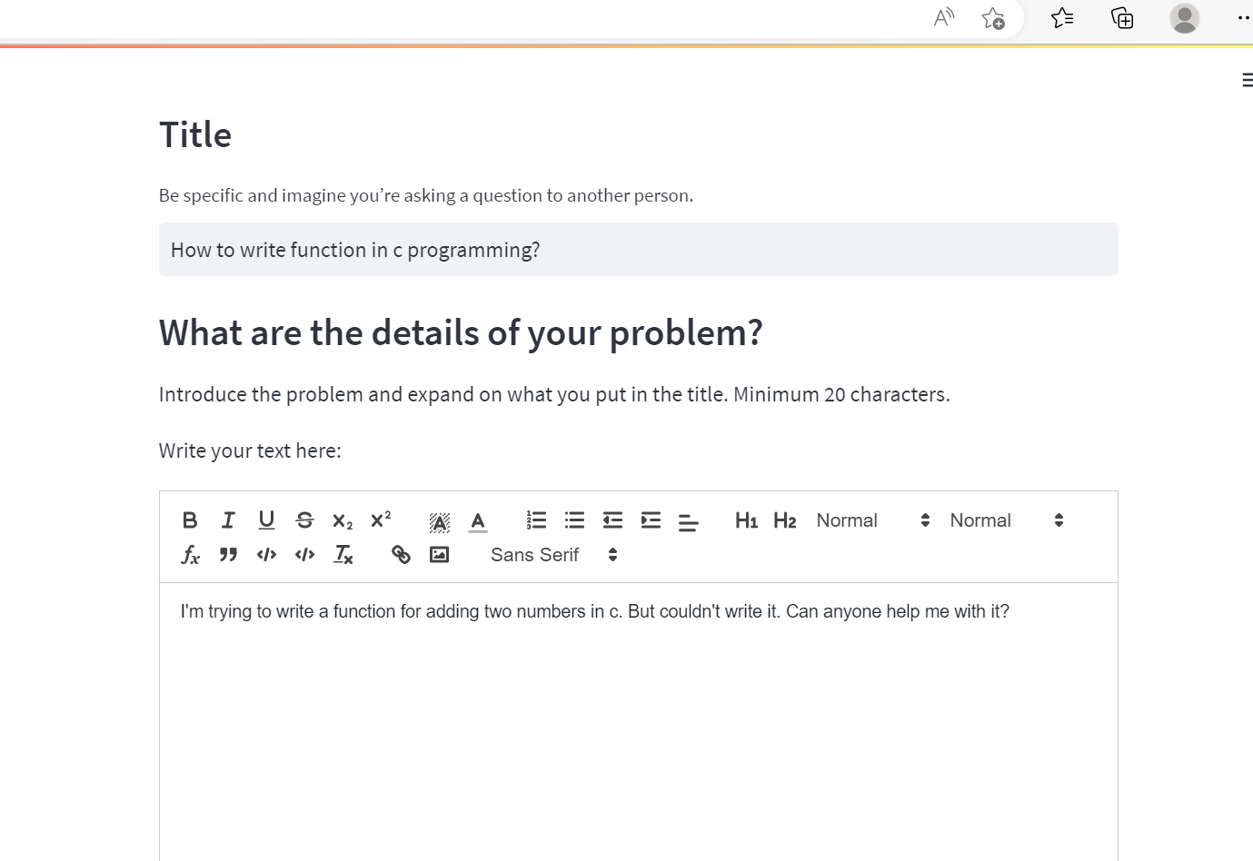

Slide 17
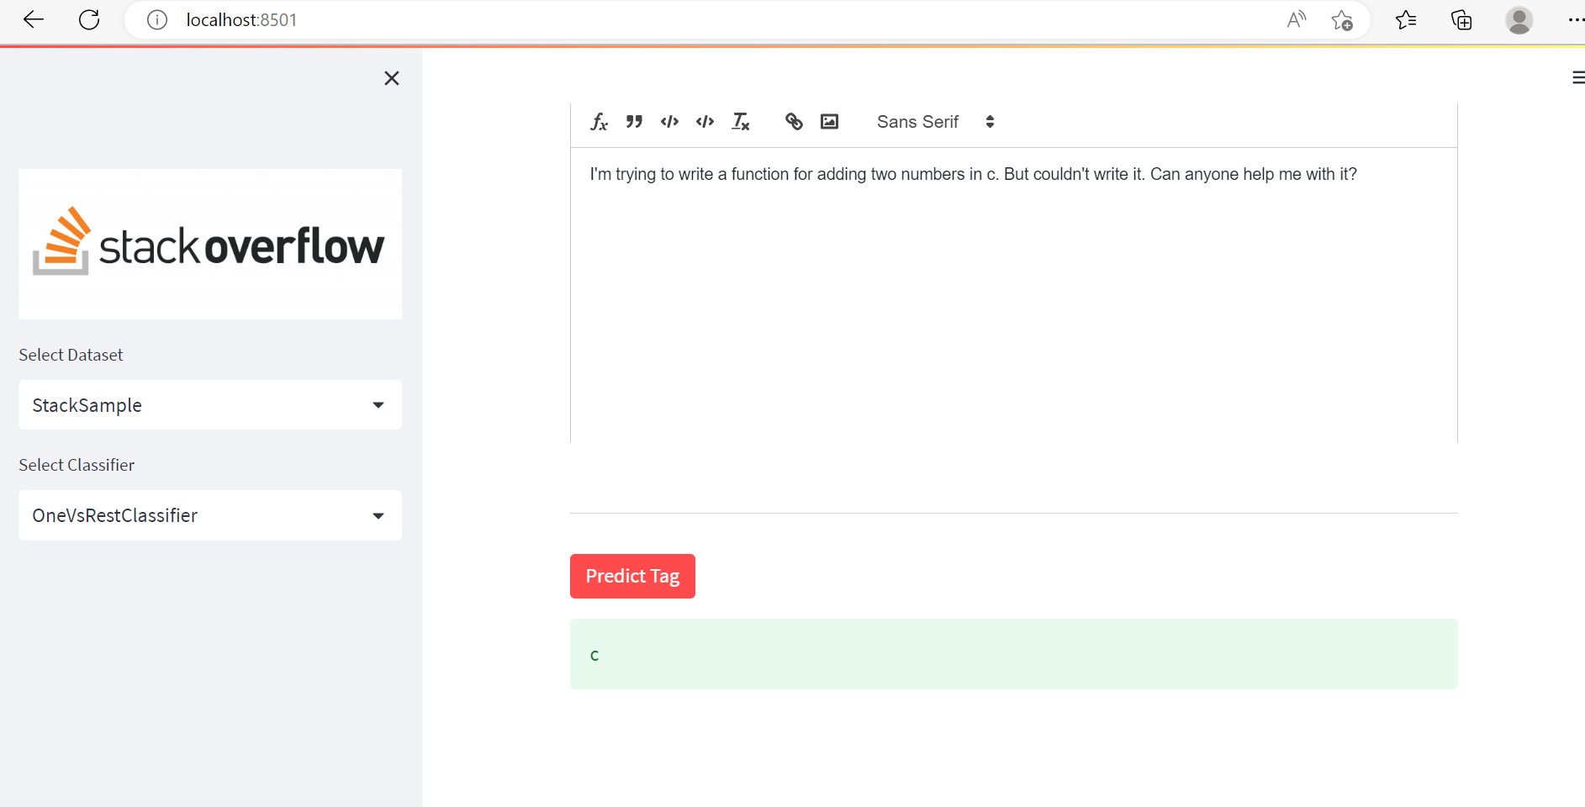

Slide 18
Unimplemented

Slide 19
Thank you

