Slide 1
Vehicle Detection and Classification
Group Number: 5
Group Name: MAVY
Mentor: Professor Mehul Raval
AU1940098: Manan Anjaria
AU1940145: Anar Bhagat
AU1940225: Vedanshee Trivedi
AU1920082: Yuvraj Patel

Slide 2
Literature Review
Problem Statement:
Highways and roads are getting overcrowded due to rise in the number of vehicles aided by the lack of data for intelligent transportation management. A variety of issues such as pollution, traffic jam, and absence of vehicle parking have been problematic for humans.
Different methods for vehicle detection and classification:
Improved Spatio-Temporal Sample Consensus ( Yu Wang et al, 2019): Moving vehicles are identified using this algorithm from intrusion of brightness variation and vehicle shadow.
Optimised Convolutional Neural network Architecture( Chia Chi Tsai et al, 2018): Based on Deep Learning algorithms, using eight concatenated ReLU layers, and eight inception layers as the base network.
Visual Analysis with a fix Camera( Velazquez-Pupo et al, 2018): To monitor the traffic, occlusion handling, and classifier used was SVM ( Support Vector Machine).
Adaptive Neuro Fuzzy Inference System classiﬁer( Murugan and VijayKumar, 2018): To classify moving vehicles using 6 phases such as feature extraction, preprocessing, detection, tracking, structural matching, and classification.
Traffic Video analysis using basic computer vision( Ahmad Arinaldi et al, 2017): Detection and Classification using MoG+ SVM and using faster RCNN.

Slide 3
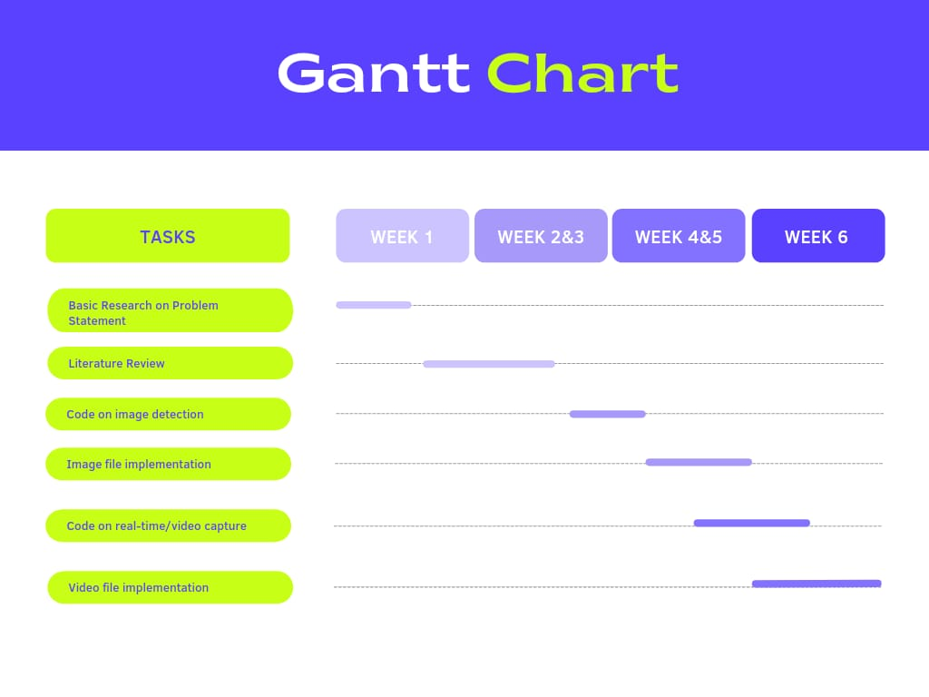
Central idea- body of work and Timeline
To develop an automatic vehicle detector, classifier and counter that can be utilized for better traffic management
Use OpenCV for tracking and for better classification we use CNN
Create a database post detection to count and classify the vehicles that can help in traffic management

Slide 4
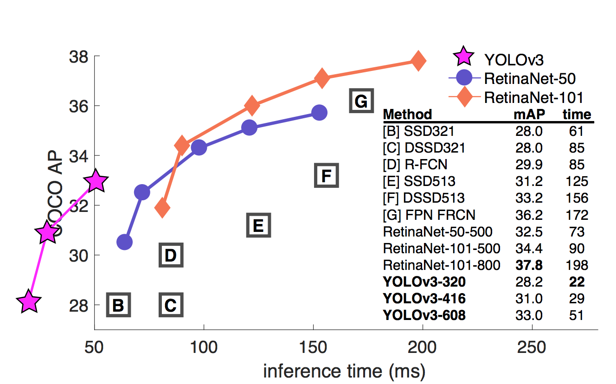
Your approach
Used YOLOv3 model trained with coco dataset with OpenCV.
YOLO v3 is much more accurate in identifying smaller object and in our case while taking the top view of cars from distance they appear much smaller.
It is much more faster than the nearest competitor.
YOLO works using –
Residual Blocks: Divides an image into NXN grids
Bounding Box Regression: YOLO determines the probability of each grid cell and among the different classes, class with maximum probability is chosen.
Intersection Over Union: It evaluates the intersection between predicted and actual bounding box. We apply non-maximal suppression that will eliminate the nearby bounding boxes and select the one that has highest probability.
References:Redmon, J., & Farhadi, A. (2018). Yolov3: An incremental improvement. arXiv preprint arXiv:1804.02767.

Slide 5
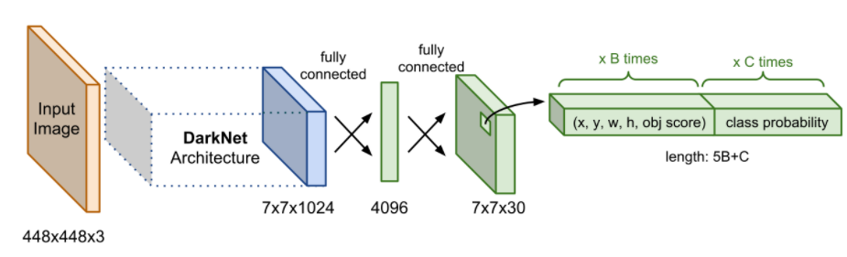
YOLO Architecture
24 Convolutional Layers followed by 2 fully connected layer.
Convolutional Layers are pre-trained on ImageNet dataset for classification at half of the resolution and double for vehicle detection. The resolution of dataset is 224X224.
The last layer predicts the class probability.
The convolutional layers are followed by a maximum pooling layer that will reduce the size by finding the maximum value of the pixel.
The last four layers are trained for object detection.
The input image size is 448X448X3 and the output volume is 7X7X30.
The final layer uses a linear activation function whereas the previous layers use Leaky ReLU activation function.
References:Weng, L. (2018, December 27). Object detection part 4: Fast detection models. Lil'Log (Alt + H). Retrieved March 27, 2022, from https://lilianweng.github.io/posts/2018-12-27-object-recognition-part-4/

Slide 6
About the dataset?
We have used the MS COCO dataset for training
The MS COCO ( Microsoft Common Objects in context) dataset is a large-scale object detection ( Bounding boxes and per instance segmentation masks), keypoint detection ( consists of 200,000 images and 250,000 person instances with 17 key points), segmentation, and captioning dataset ( natural language description of images) published by Microsoft.
The dataset contains 328K images.
The classes used are as follows:
Car
Truck
Motorcycle
Bus
It is widely used and is free of cost.
References:Lin, T. Y., Maire, M., Belongie, S., Hays, J., Perona, P., Ramanan, D., ... & Zitnick, C. L. (2014, September). Microsoft coco: Common objects in context. In European conference on computer vision (pp. 740-755). Springer, Cham.

Slide 7
Your Approach
Read frames from a video file instead of image
Tracking of vehicles ( using tracker).
Pre-process the frame and run detection
Finding the optimum confidence threshold.
Post process the output
Count all the vehicles on road and the direction they move in with respect to the centerline in the Video
Save the data to CSV file
Github Repository Link: https://github.com/Twistedbeast23/CSE541-Computer-Vision-2022_MAVY

Slide 8
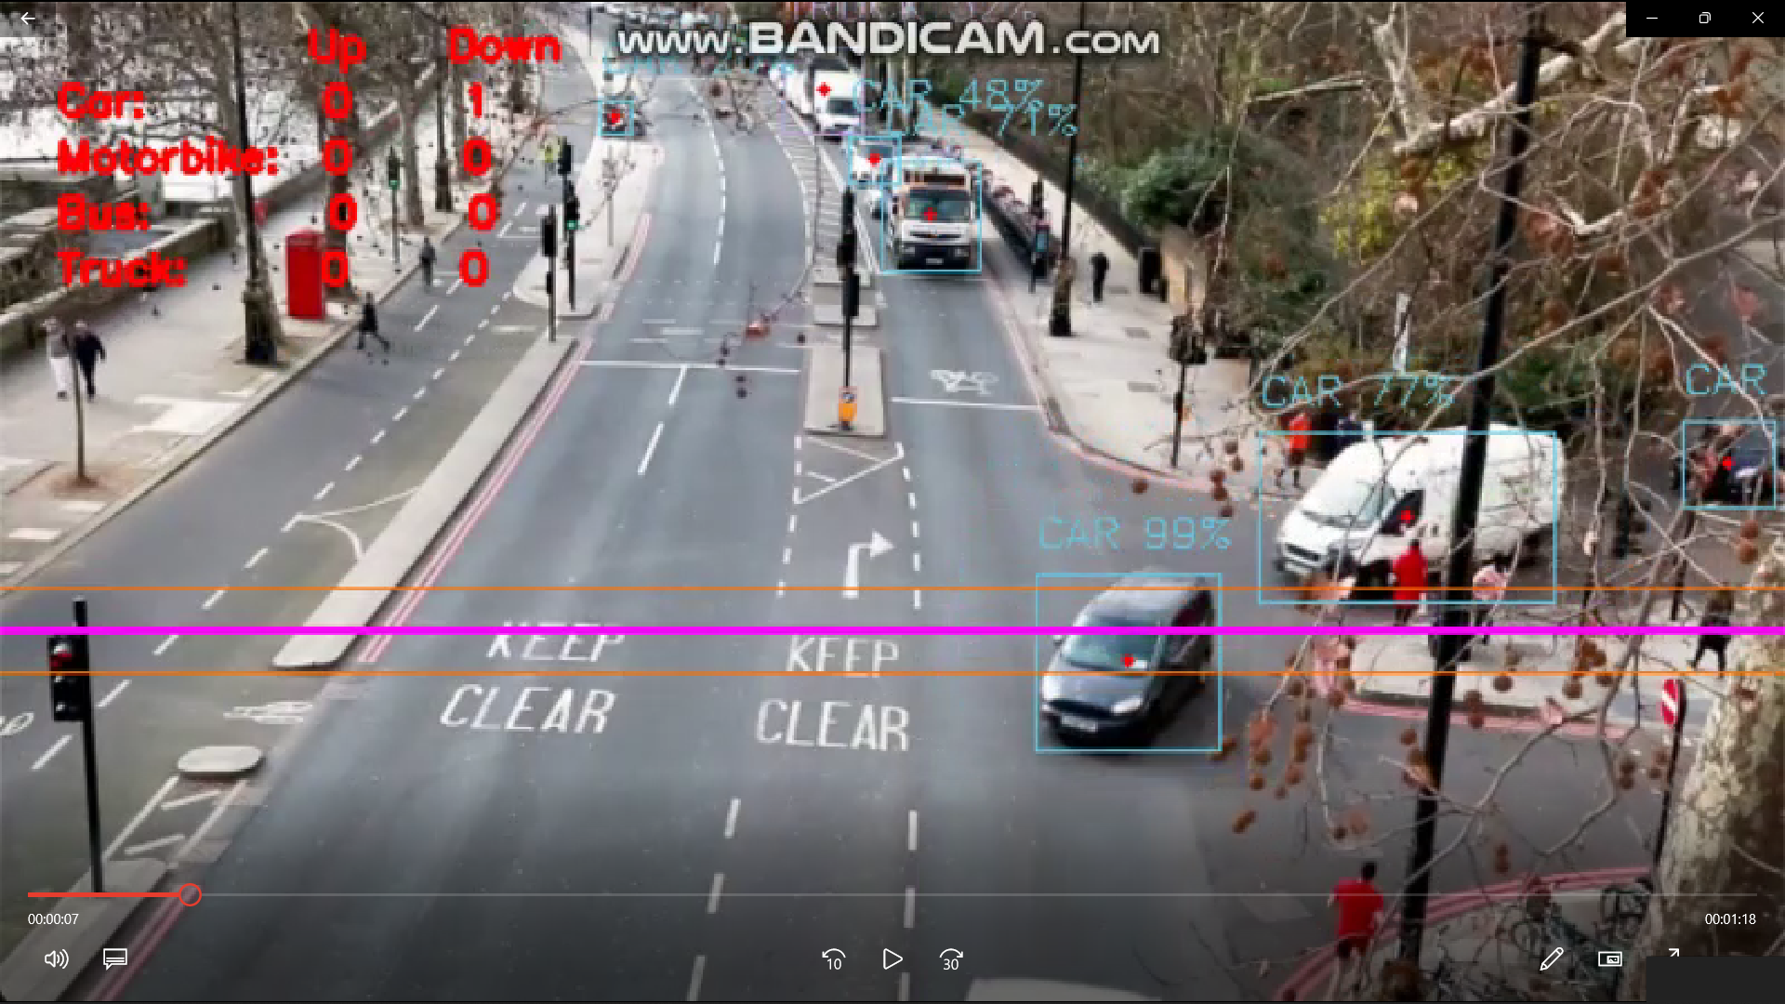
Results
Figure 1.This figure shows the final implementation of our vehicle counting and classification system on an online random dataset.

Slide 9
Contribution of Group Members
Name | Contribution
Vedanshee Trivedi | PPT, Report, coding
Yuvraj Patel | Vehicle classification coding
Manan Anjaria | Coding and execution on real world dataset
Anar Bhagat | Report, PPT

Slide 10
References
Vehicle counting, classification & detection using opencv & python. TechVidvan. (2021, July 11). Retrieved March 27, 2022, from https://techvidvan.com/tutorials/opencv-vehicle-detection-classification-counting/
Poltavsky, A. (2019, September 8). Real-time object detection using yolo upon google colab in 5 minutes. Medium. Retrieved March 27, 2022, from https://medium.com/@artinte7/real-time-object-detection-using-yolo-upon-google-colab-in-5-minutes-fd65a4903df5
Vehicle detection and counting system using opencv. Analytics Vidhya. (2021, December 31). Retrieved March 27, 2022, from https://www.analyticsvidhya.com/blog/2021/12/vehicle-detection-and-counting-system-using-opencv/
Weng, L. (2018, December 27). Object detection part 4: Fast detection models. Lil'Log (Alt + H). Retrieved March 27, 2022, from https://lilianweng.github.io/posts/2018-12-27-object-recognition-part-4/
Papers with code - coco dataset. COCO Dataset | Papers With Code. (n.d.). Retrieved April 24, 2022, from https://paperswithcode.com/dataset/coco
Kapil, D. (2018, June 8). Yolo V1 : Part 1. Medium. Retrieved April 24, 2022, from https://medium.com/adventures-with-deep-learning/yolo-v1-part-1-cfb47135f81f
Vehicle detection and classification: A review - researchgate. (n.d.). Retrieved April 24, 2022, from https://www.researchgate.net/profile/Priyadarsan-Parida/publication/343482198_Vehicle_Detection_and_Classification_A_Review/links/5f2ebabc92851cd302e95221/Vehicle-Detection-and-Classification-A-Review.pdf

