Slide 1

WELP
Team Oreo
Chris Steinbrenner, Jeff Snowden, Jimmy Bradley

Slide 2
Overview
Search your local area for restaurants which fit your budget
Use when you’re not sure what to eat
Target audience; budget eating
Users can sign up; repeat previous searches

Slide 3
User Story
Input a budget, city, and zip code
Permission for geolocation
If user is signed in; store the search in database
Display up to 20 results in a list
Display a map with pins for each location
Can click a button to search again
If signed in, can see past searches and pick one of those

Slide 4
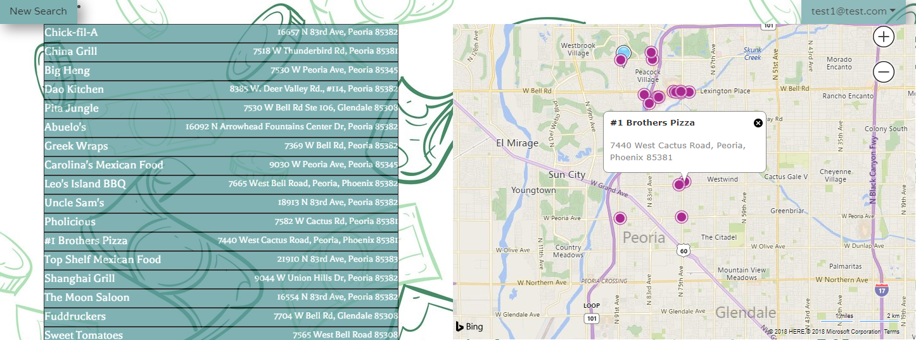
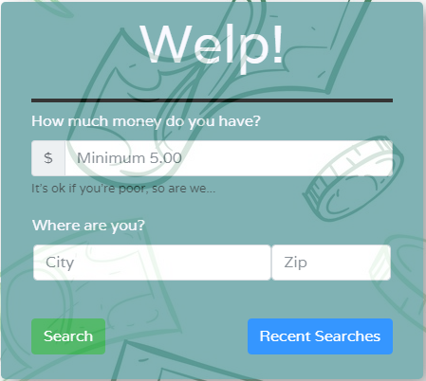
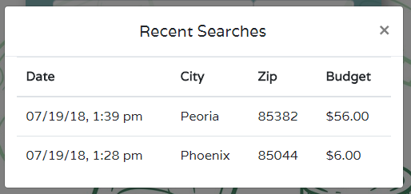
Layout

Slide 5
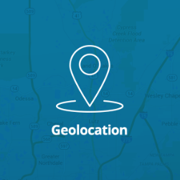
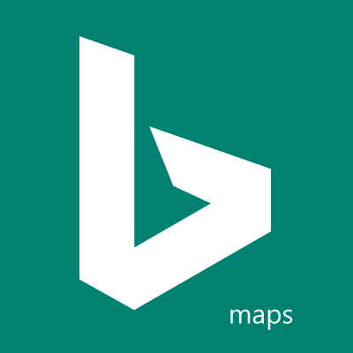

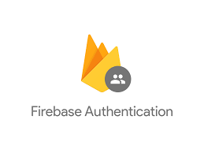


Implementation
Tools:
Bing Maps API
Zomato API
Firebase
Moment.js
Modals
Geolocation
Authentication through Firebase
Maintaining past search results
Email and password

Slide 6
Limitations/Challenges
Zomato API limitations:
Restaurant data is limited; 20 results
Lack of variation in restaurants per are
Not as many restaurants as other competitors
Other parameters we can’t use based on small data set (cuisines, etc.)
Radius parameter has unknown functionality
Bing Maps API limitations
Extremely difficult to manipulate HTML and CSS
Could not determine distance between user and locations

Slide 7
Value Proposition
For Users:
Quick and easy way to find a budget bite
For potential “Partners”:
Search data related to area; budgets, site traffic, etc.
Elevate results for partners to show up first
Display more info for partnered restaurants
Promotions and exposure (marketing)

Slide 8
Growth Potential
Selecting a result starts a GPS route
Collect more user data for demographic information
Predictive analytics
Jeff wants to sell it
Partnerships with restaurants
Support ordering, promotions, loyalty programs, etc.
Theme the food options to target a specific demo
Mobile app
Consumer engagement through email/SMS

Slide 9
DEMO Want to see it work? https://steinbrennergit.github.io/welp-project/

