Slide 1

LEGENDARY MOTOR SPORTS
Saran MY.SC.I5MCA21039
Arjun MY.SC.I5MCA21010
Sreeshanth MY.SC.I5MCA21005
Anushob MY.SC.I5MCA21024

Slide 2


Index
Introduction
Flowchart
Snippets
Conclusion

Slide 3

Introduction
The Legendary Motorsport project aimed to create an immersive and user-friendly car dealership website that offers virtual cars from the popular video game Grand Theft Auto V (GTA 5) for sale. The objective was to provide enthusiasts of the game with a platform where they could explore, purchase, and track their orders of virtual vehicles within the GTA 5 universe. The website incorporated essential features such as user registration and login, allowing users to create personalized accounts and access exclusive features.

Slide 4
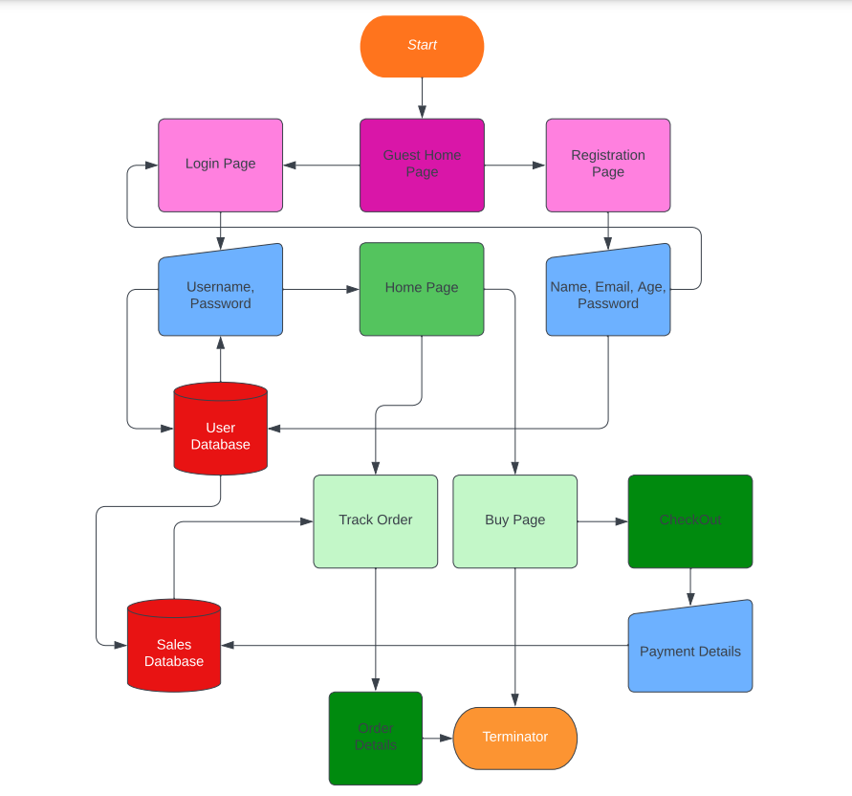
FlowChart
The given flow chart consists of several components,
Initiation,
Processes that represent the Webpages,
Manual inputs that the user inputs for the next page,
Databases for both sales and user registration and log-in, and
Termination.

Slide 5
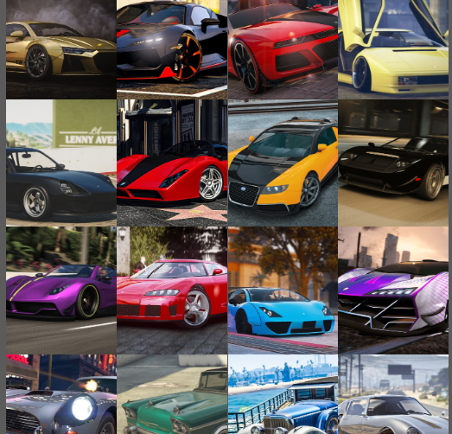
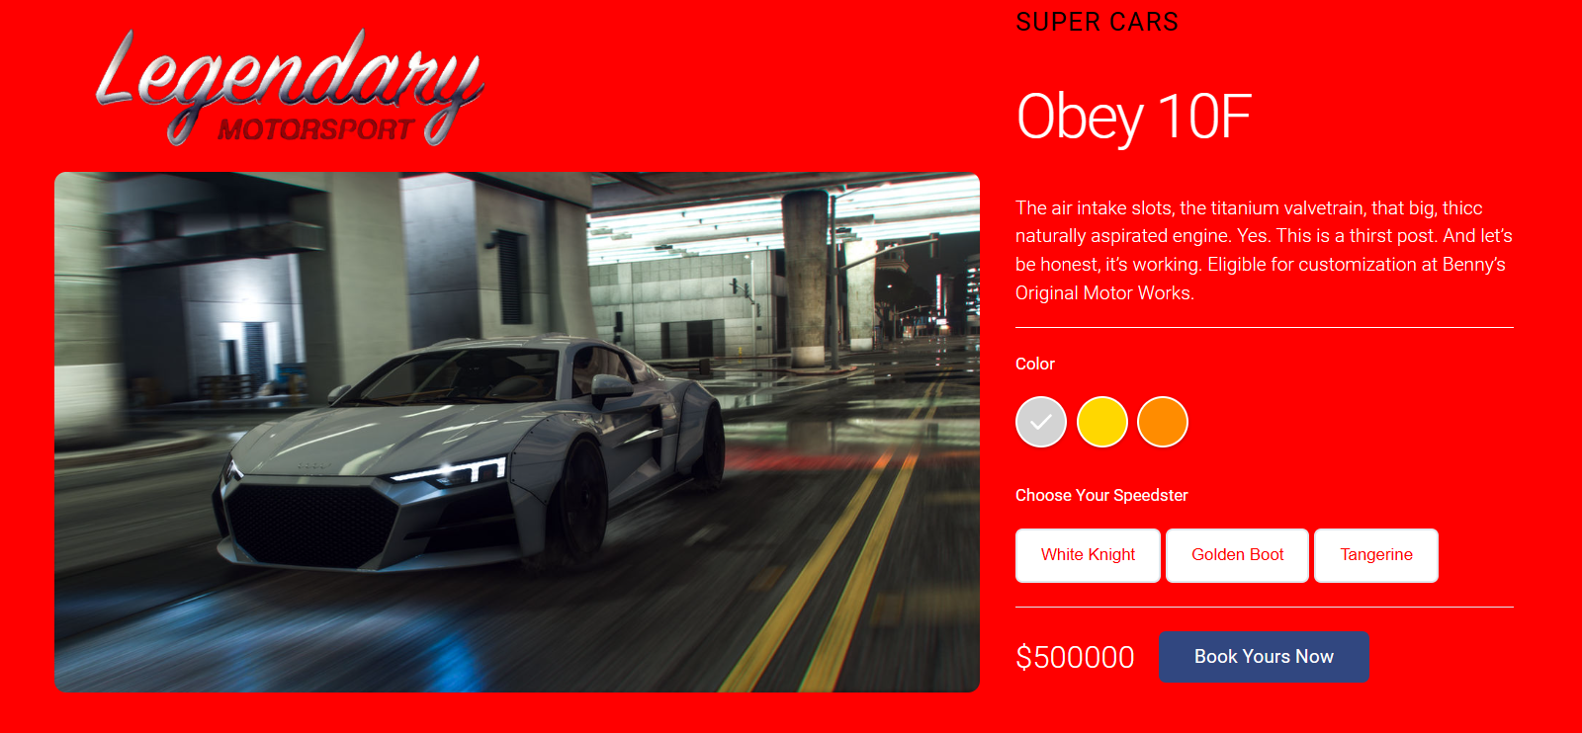
Snippets

Slide 6
Conclusion
The development of Legendary Motorsport successfully achieved its objectives, creating a robust car dealership website centered around GTA 5 vehicles. The website offers an engaging user experience, providing users with the ability to browse, purchase, and track their orders. The incorporation of user registration and login enhances personalization and allows for a seamless shopping experience. The implementation of a well-designed inventory management system ensures accurate stock information. Overall, Legendary Motorsport provides a comprehensive and efficient platform for GTA 5 car enthusiasts to explore and acquire their favorite virtual vehicles.

Slide 7


Thank you

