Slide 1
Ego networks

Slide 2
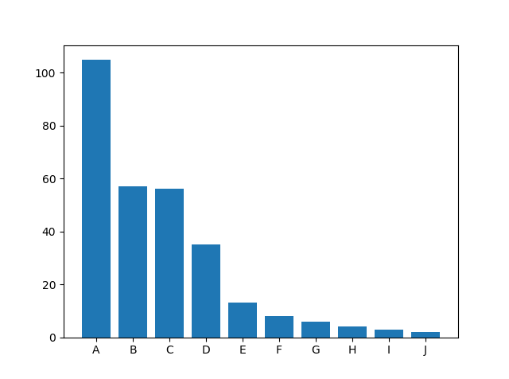
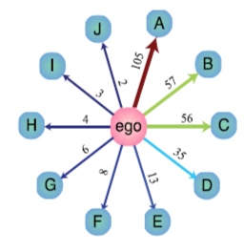
One ego network per individual
Take the average over the whole group → Species-ego network
Humans’ barplots are close to exponential. (Few close friends, a lot of acquaintances)
What are animal ego network barplots like?

Slide 3
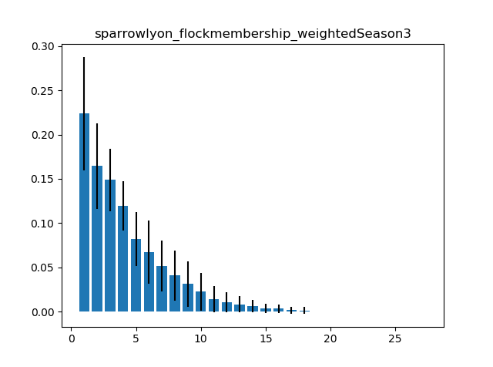
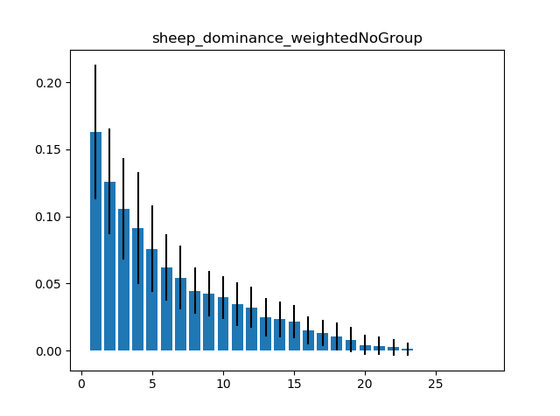
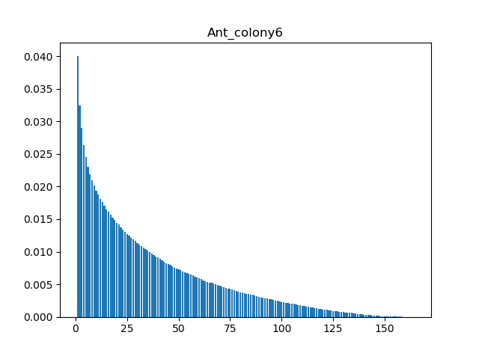
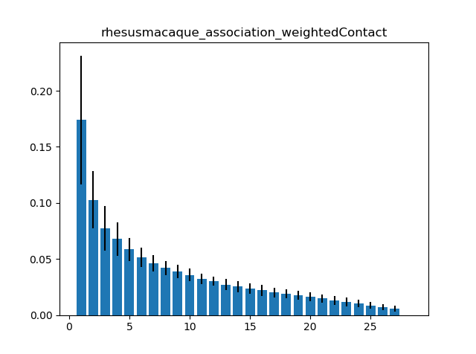
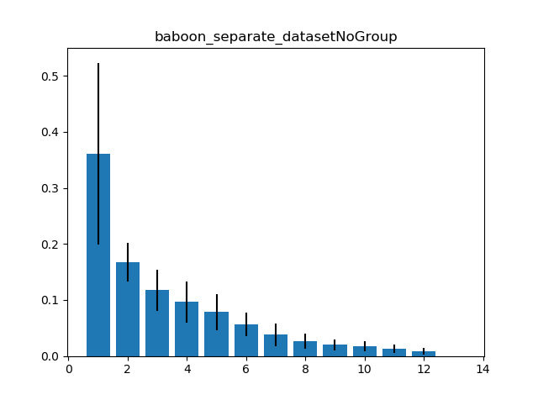
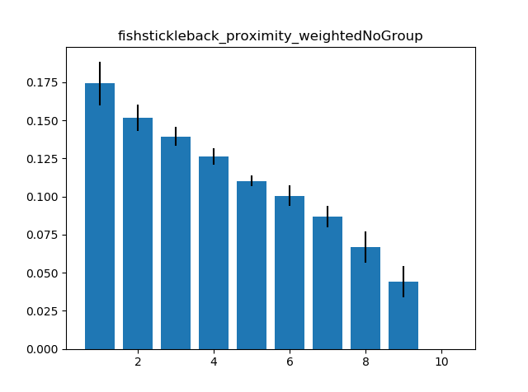
Sparrow
Flock membership
Sheep
Dominance (fights)
Ants
proximity
Baboons (different paper)
Proximity (RFID)
Stickleback fish
Proximity
Rhesus macaque
Association

Slide 4
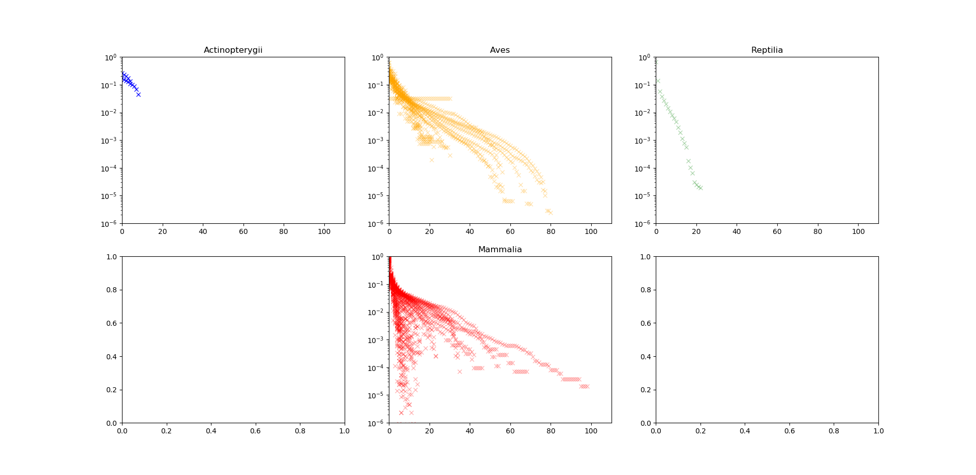
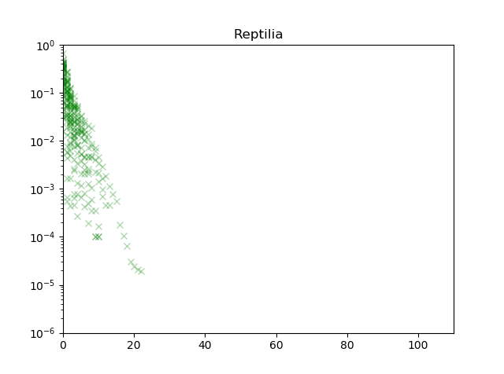
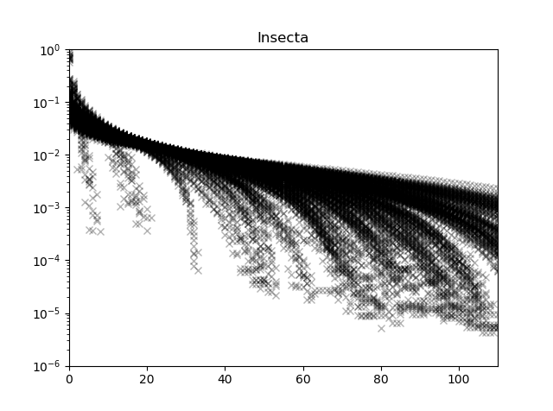
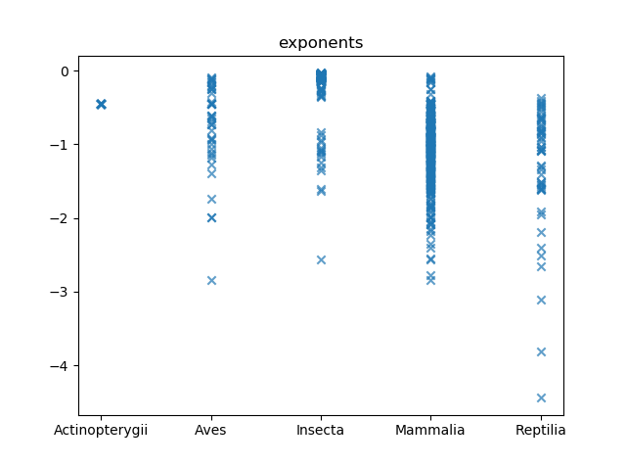
Logarithmic scale plots and exponents
* Daily measurements

Slide 5
More insights:
Null model for random walkers
Extend analysis beyond pairwise interactions

Slide 6
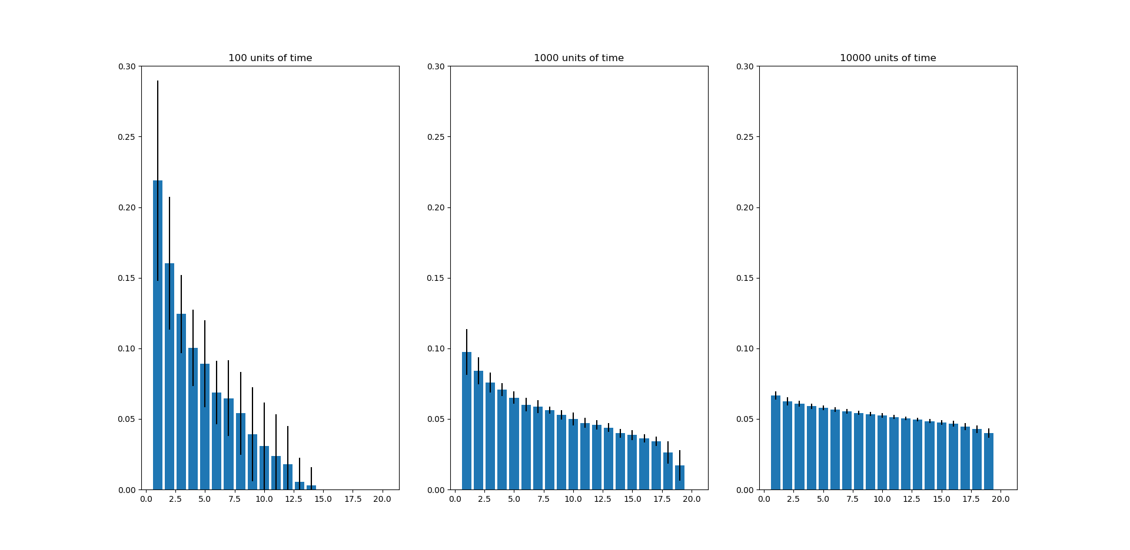
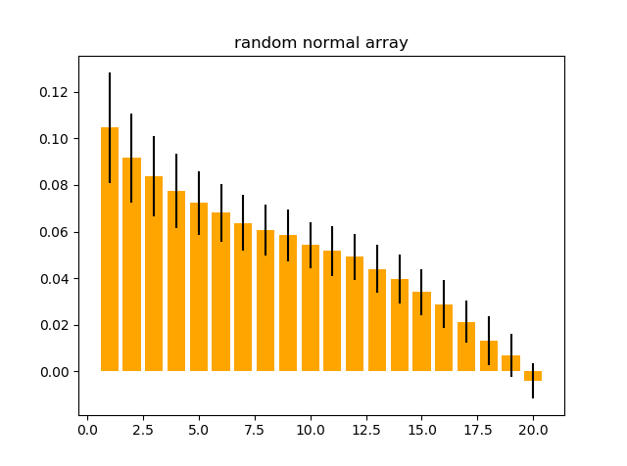
1
Null model
What kind of plots would random walkers in 2D produce?
Does the time window of the measurements affect the results?
20 random walkers
Gaussian
adj. matrix
100
units of time
1000
units of time
10000
units of time

Slide 7
1
Null model
Future work
Explore time evolution of time-dependent networks (baboon dataset)
Look for quantity that accounts for ‘humanness ’ of ego networks
What kind of plots would random walkers in 2D produce?
Does the time window of the measurements affect the results?
20 random walkers
Gaussian
adj. matrix
100
units of time
1000
units of time
10000
units of time

Slide 8
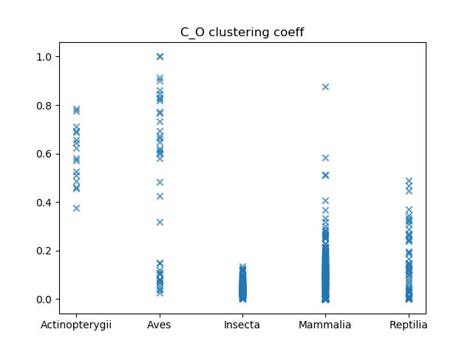

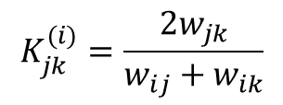
2
Beyond pairwise interactions
So far, the analysis has been pairwise: ego – alters
What about triangles?
$$K_{jk}^{(i)}=\frac{{2w}_{jk}}{w_{ij}+w_{ik}}$$

