Slide 1
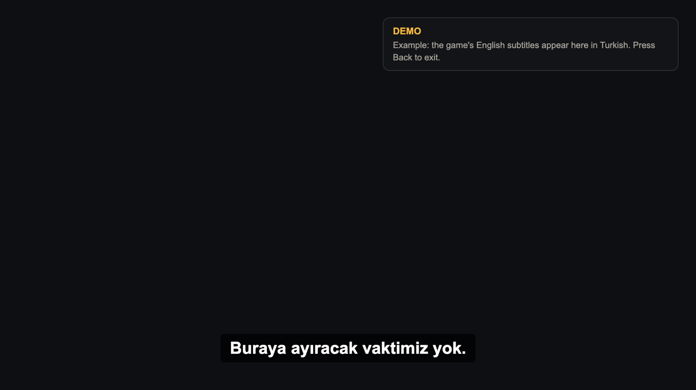
CouchSubs: UX scenario
A TV app that draws translated game subtitles over the HDMI picture. The text comes from a companion app on a computer in the same network.
Free and open source, no account on the TV, no data collected
Reviewers do not need a console or a computer: use the demo below

Slide 2
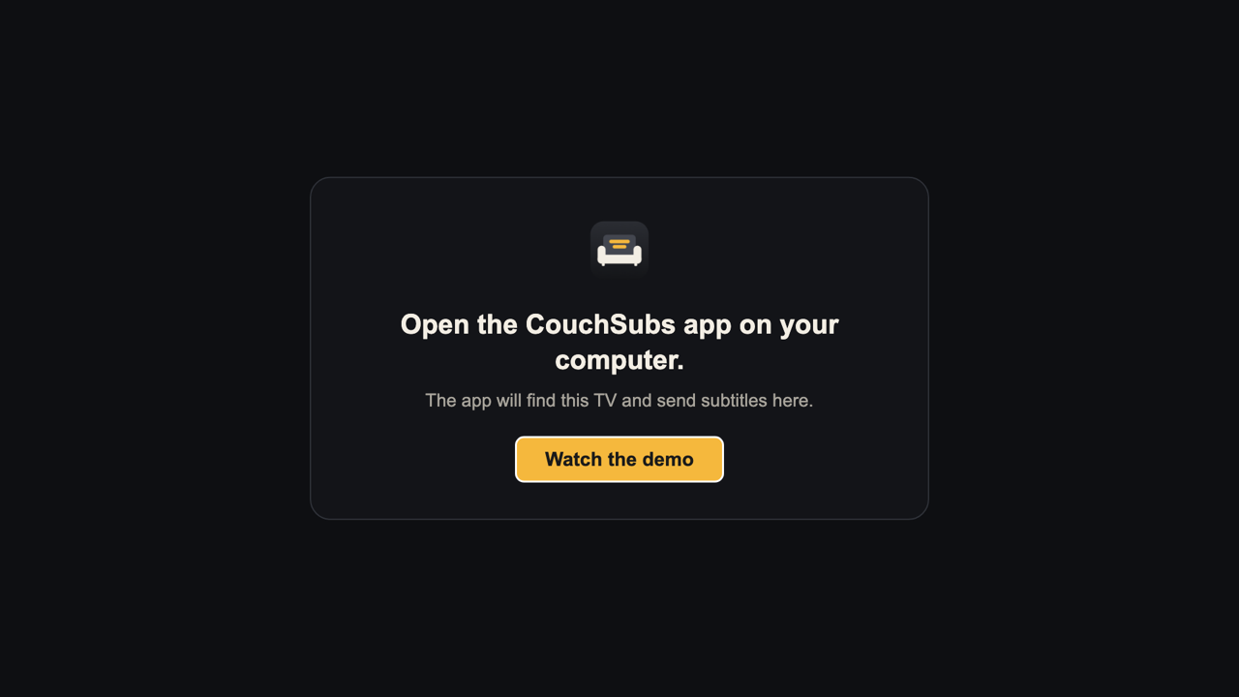
Review without a console: demo mode
1
Open the app
The first screen appears, with “Watch the demo” selected.
2
Press OK
Or the Blue key at any time. Sample subtitles start.
3
Press Back
The demo stops and the first screen returns.
4
Press Back again
The app returns to the TV's home screen.

Slide 3
Demo: what you should see
A DEMO note at the top right explains what is shown
Five sample Turkish lines repeat at the bottom
Without an HDMI source the picture behind stays black
Up and Down move the subtitles, as in normal use

Slide 4
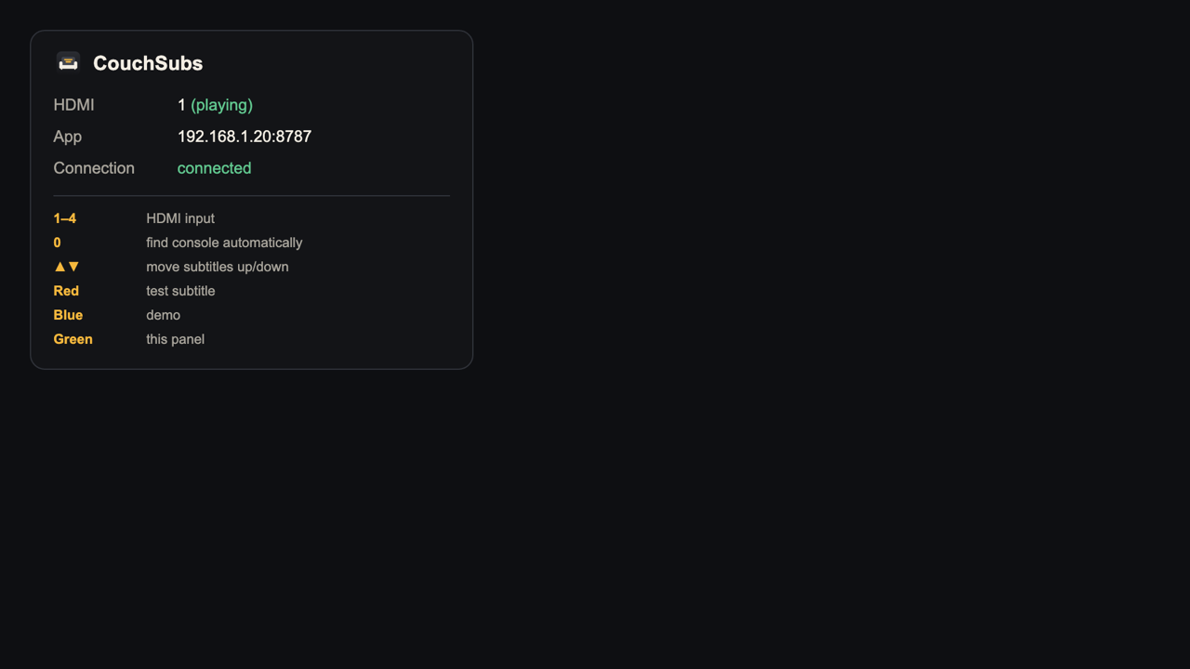
Status panel: Green key
Shows the HDMI input, the computer app's address and the connection
Number keys 1–4 pick the HDMI input, 0 searches for the console
Red shows a test subtitle
Green or Back closes the panel

Slide 5
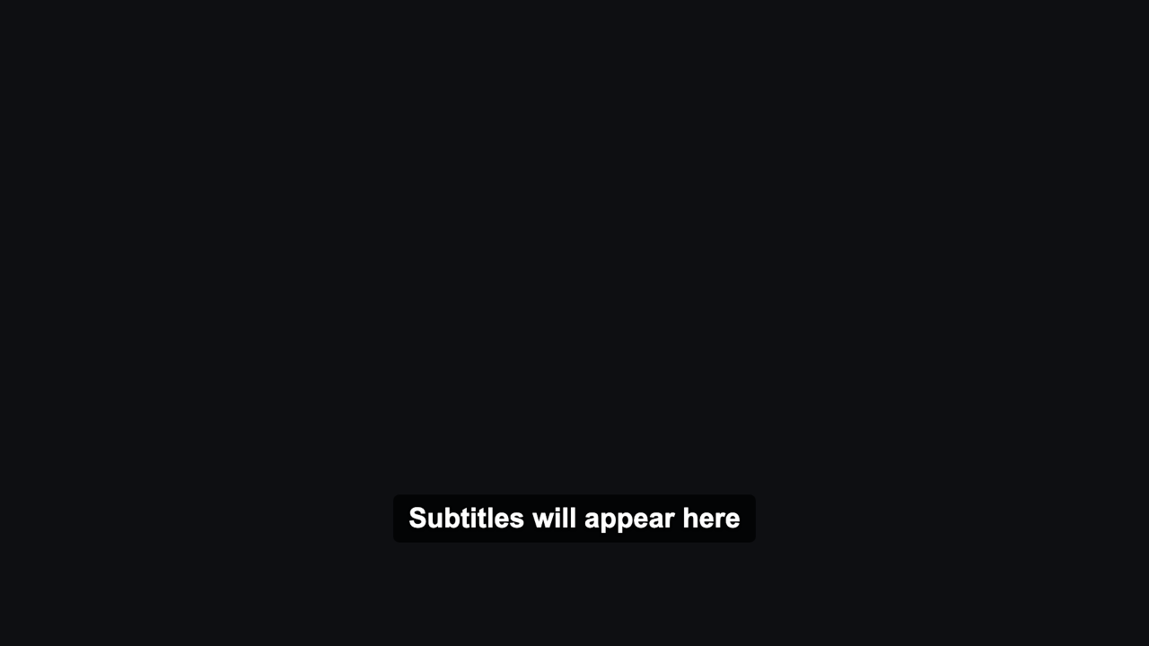
Normal use with the computer app
1
Pair once
The computer app finds the TV. The user accepts the prompt on the TV.
2
Start
The computer app opens this TV app with its own address.
3
Play
The game stays on HDMI. Translated lines appear at the bottom.
4
Adjust
Up and Down move the subtitles. The position is remembered.

