Slide 1
Presentation Deck
OnePacificHub Authentication System
Supabase Integration
Main Topics
A clear walkthrough of how login, registration, OAuth, session handling,
and password reset are implemented in the website.
Login and registration
OAuth providers
Password reset with OTP
Supabase dashboard setup and code flow
Presentation Focus
Frontend UI to Supabase Auth flow
Supabase dashboard configuration
Actual code integration points in the project

Slide 2
What Supabase Does Here
Supabase is the auth layer, not the full application backend
Summary
Handles login and signup
Manages sessions and token refresh
Supports Google and Facebook OAuth
Supports password reset through Edge Functions.

Slide 3
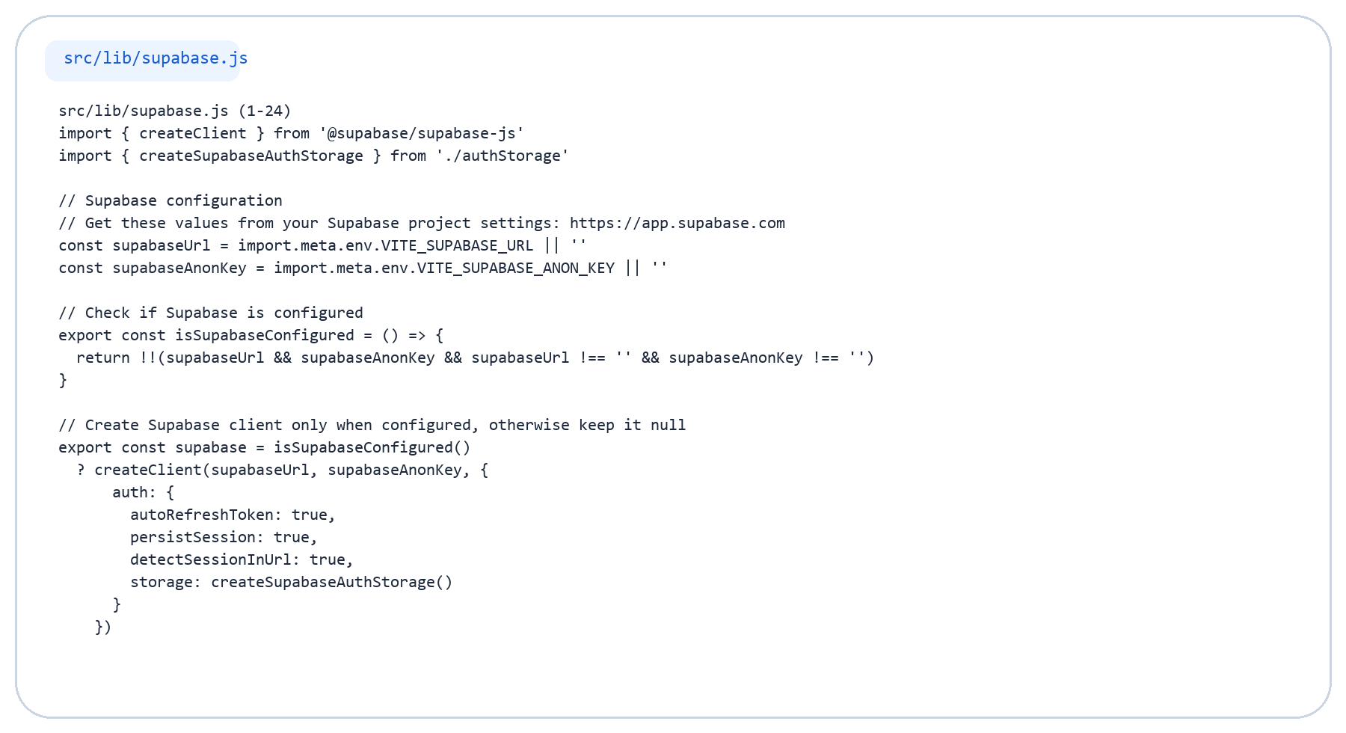
Supabase Client Code
Core browser client setup

Slide 4
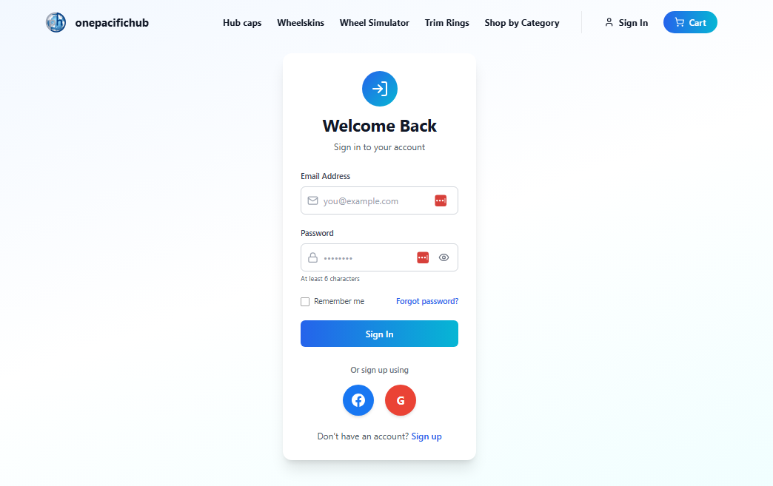
Sign In Page
Email/password login plus social login entry point
Key Points
Users can log in with email and password.
The same screen also exposes Google and Facebook login.
Successful login creates a Supabase session.

Slide 5
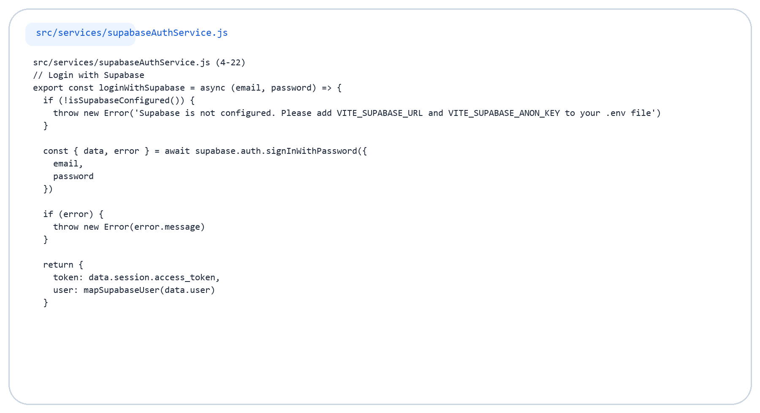
Sign In Code
Email/password authentication logic

Slide 6
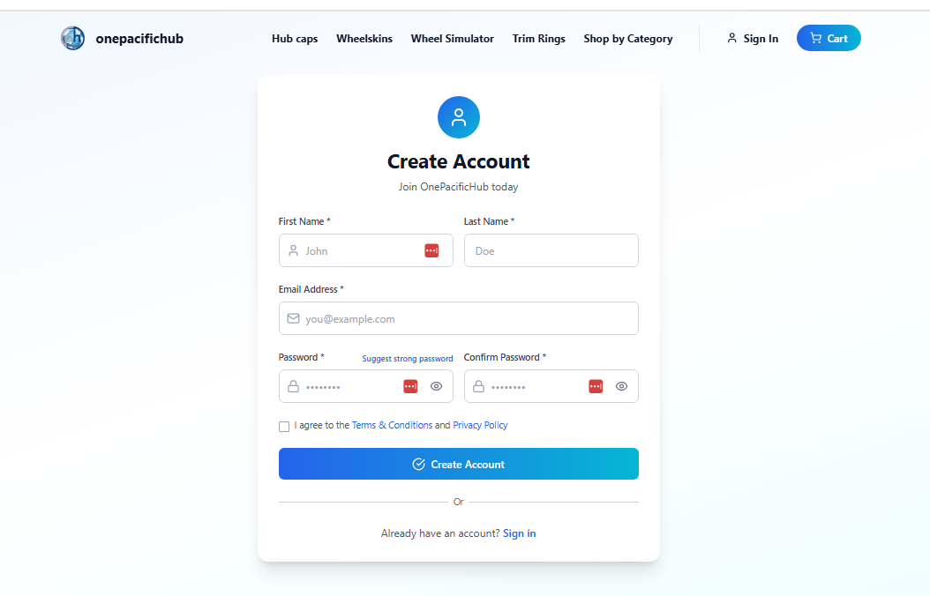
Sign Up Page
User registration form connected directly to Supabase Auth
Key Points
The form collects first name, last name, email, and password.
The signup request is sent to Supabase Auth.
Verification can be required before first login.

Slide 7
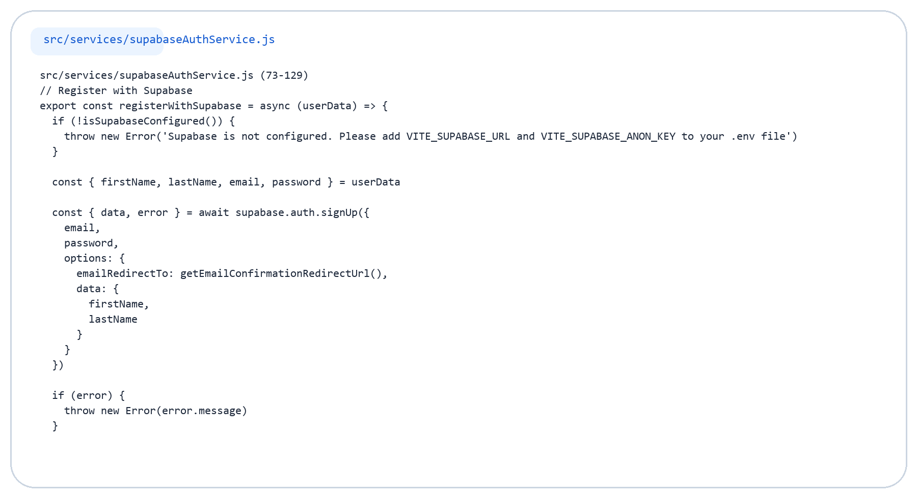
Sign Up Code (1/3)
Account creation and verification flow

Slide 8
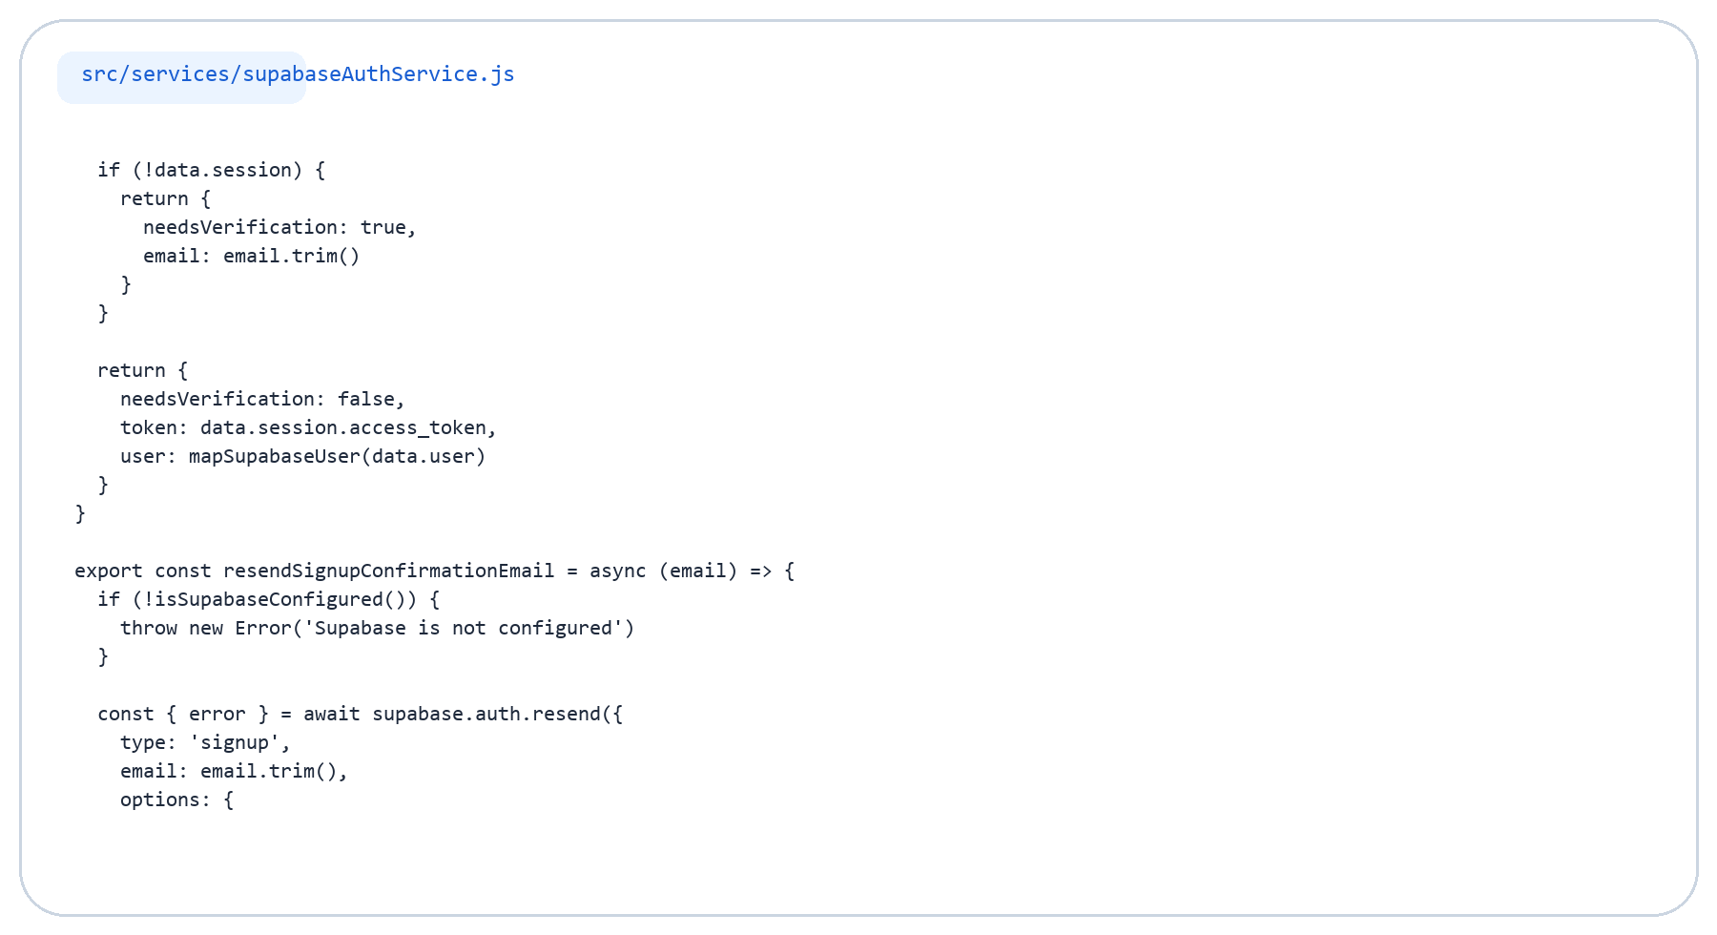
Sign Up Code (2/3)
Account creation and verification flow

Slide 9
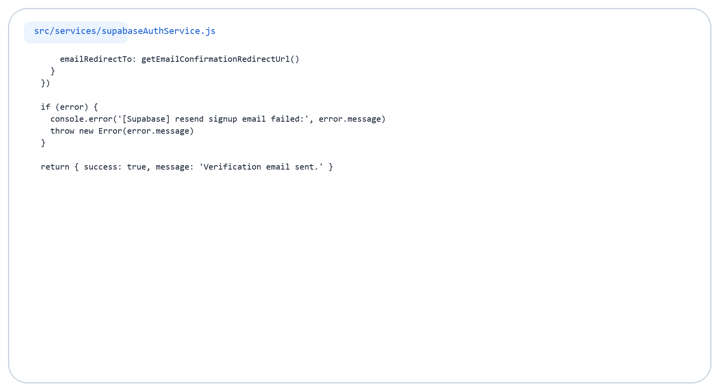
Sign Up Code (3/3)
Account creation and verification flow

Slide 10
OAuth Login
Social authentication through Supabase providers
Key Points
Google and Facebook buttons are available in the login UI.
Supabase handles the provider redirect and callback.
OAuth returns the user to the app with a valid session.

Slide 11
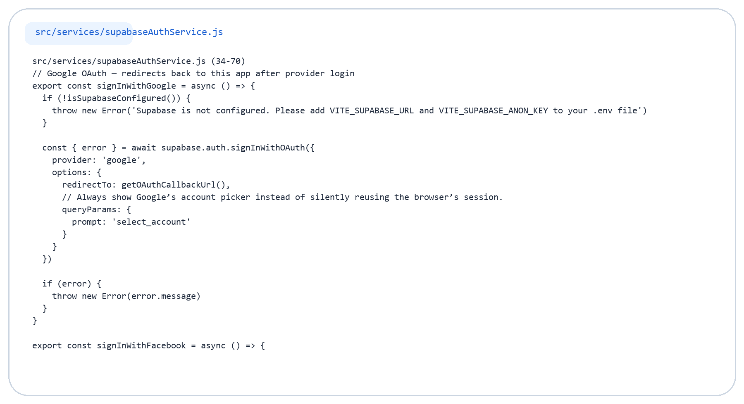
OAuth Code (1/2)
Google and Facebook login logic

Slide 12
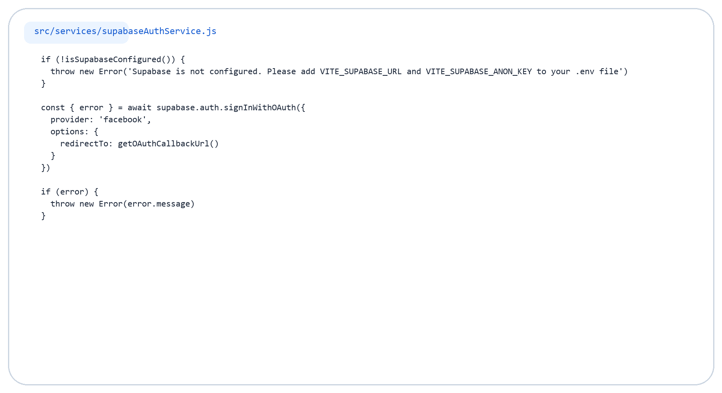
OAuth Code (2/2)
Google and Facebook login logic

Slide 13
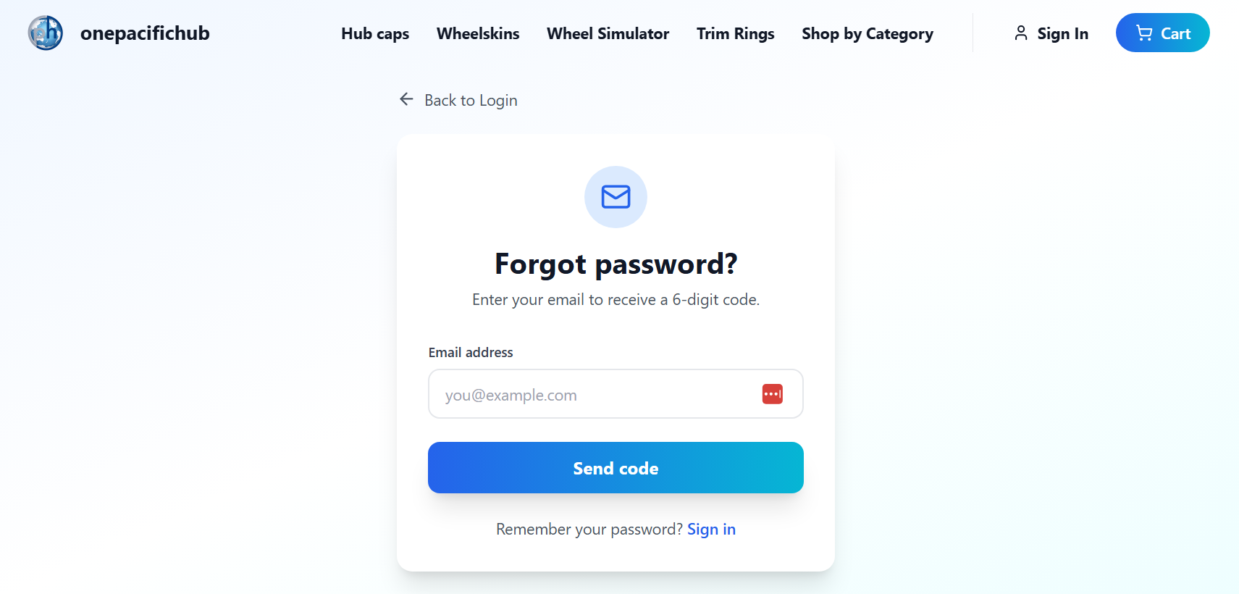
Forgot Password
Password reset starts by requesting a one-time code
Key Points
The user enters an email address to start recovery.
The app does not use the default magic-link reset flow.
It calls a custom Edge Function to send an OTP.

Slide 14
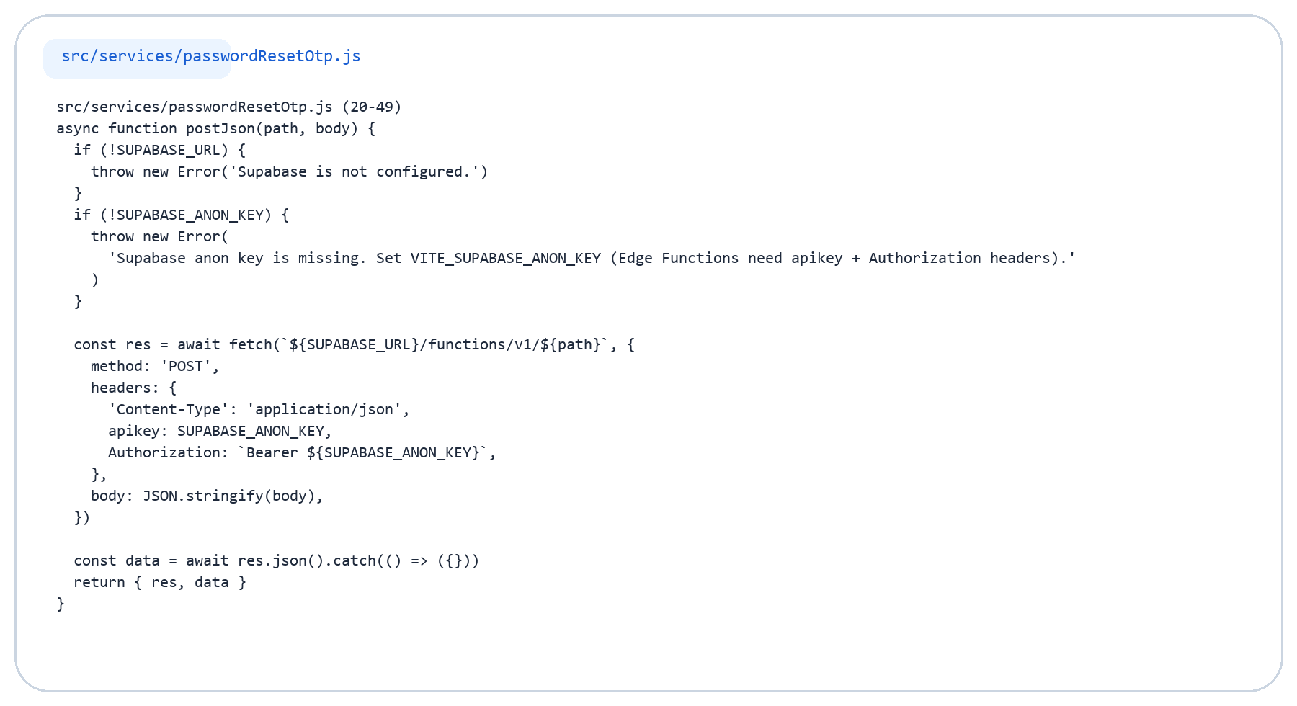
Forgot Password Code (1/2)
Reset code request through Edge Functions

Slide 15
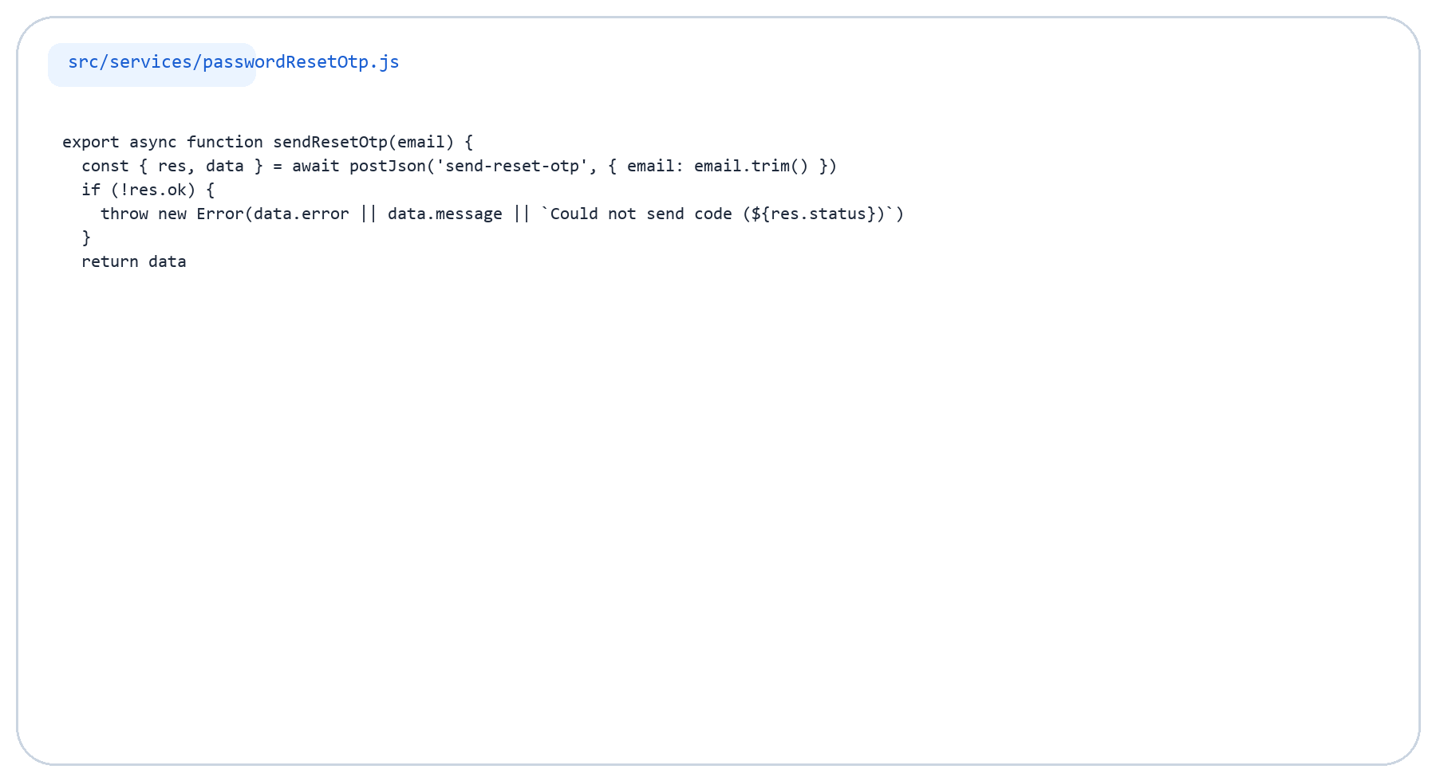
Forgot Password Code (2/2)
Reset code request through Edge Functions

Slide 16
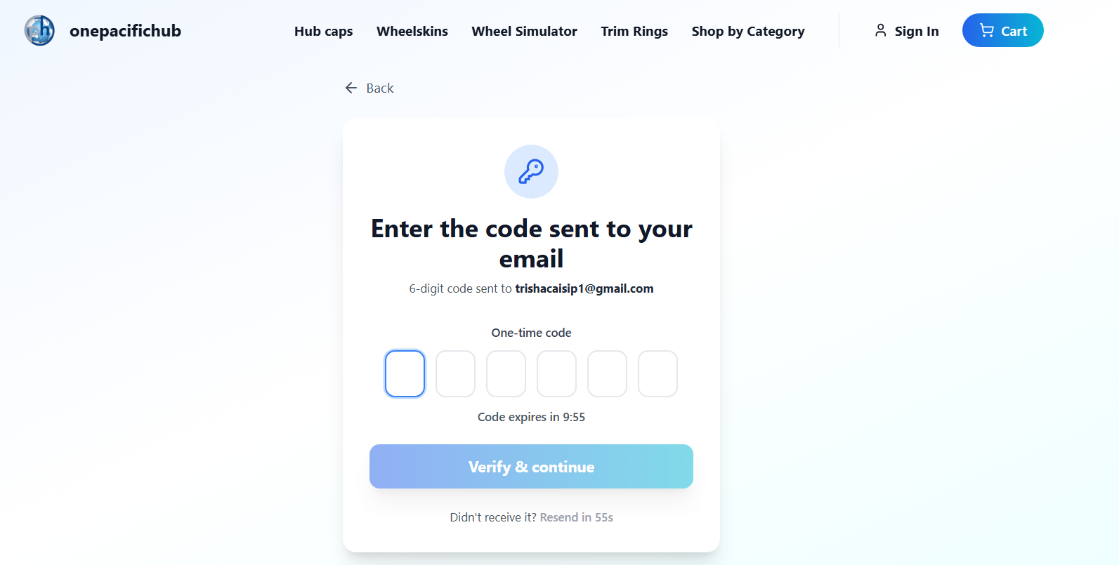
OTP Verification
The reset flow continues with a six-digit code
Key Points
The user enters the one-time code sent by email.
The backend validates the OTP and returns a short-lived reset token.
That token is then used to set the new password.

Slide 17
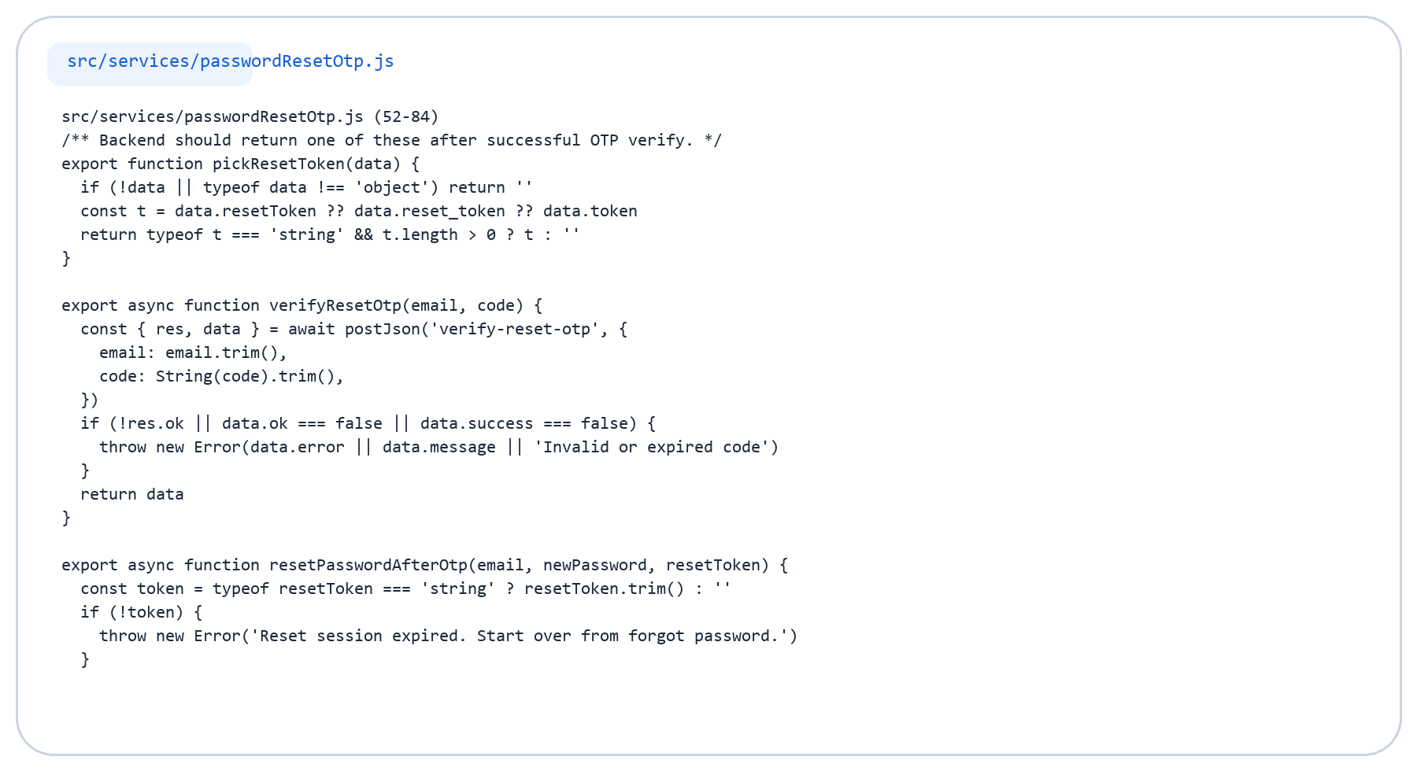
OTP Verification Code (1/2)
OTP validation and reset token handling

Slide 18
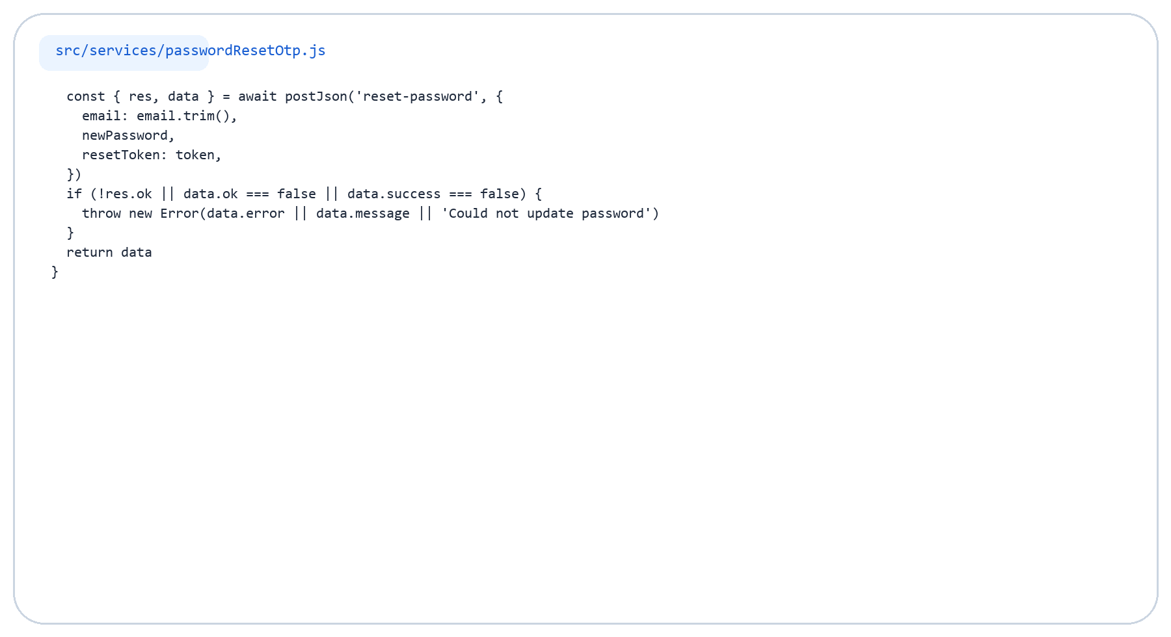
OTP Verification Code (2/2)
OTP validation and reset token handling

Slide 19
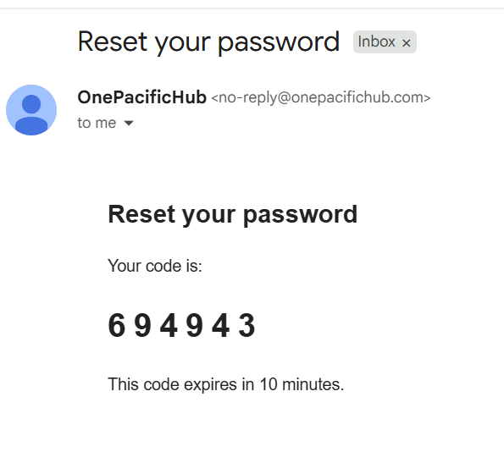
Email Received
The code is delivered to the user outside the app UI
Key Points
The email contains the verification code used in the reset flow.
The code expires after a limited time window.
This keeps recovery time-bound and more secure.

Slide 20
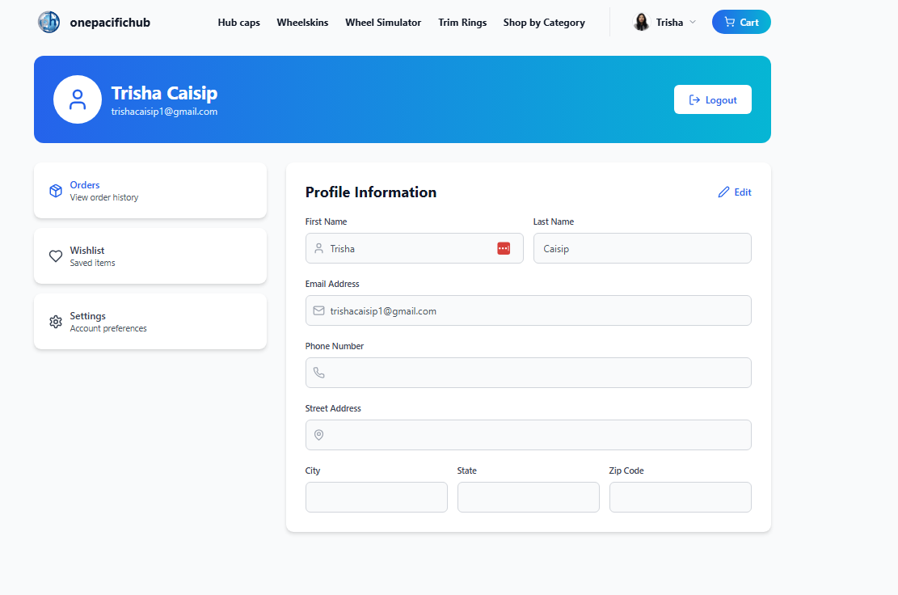
Logged-in Account Page
Protected pages become available after authentication succeeds
Key Points
After login, the user is redirected to the account dashboard.
The route is protected by authentication state.
Session changes are monitored through AuthContext.

Slide 21
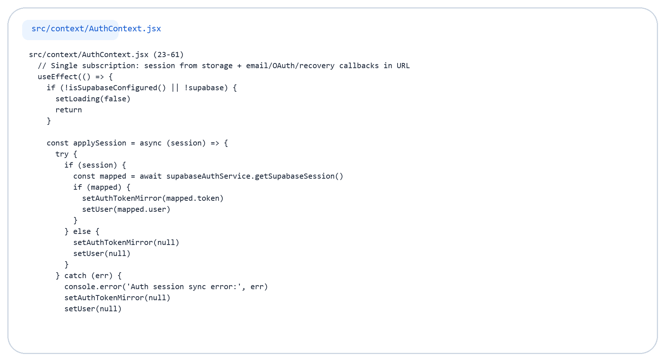
Session Code (1/2)
AuthContext session subscription and sync

Slide 22
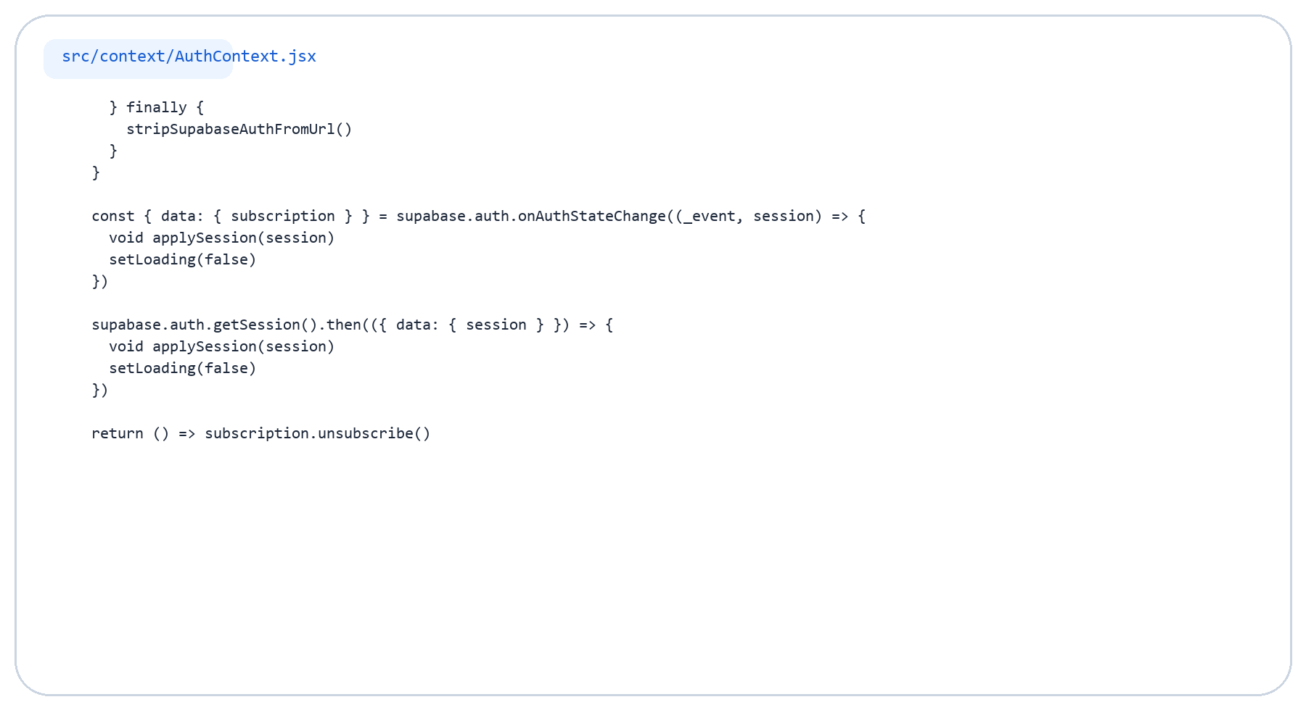
Session Code (2/2)
AuthContext session subscription and sync

Slide 23
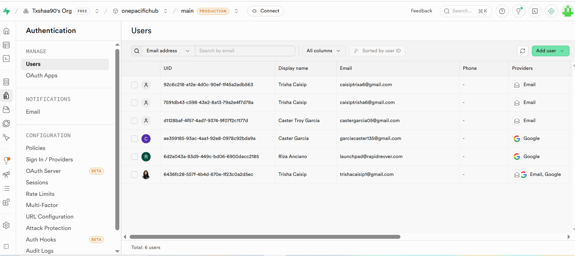
Supabase Users
Registered users are stored in Supabase Authentication
Key Points
The dashboard stores each user record in Supabase Auth.
Key details include email, provider, and user ID.
Custom metadata such as first and last name can also be attached.

Slide 24
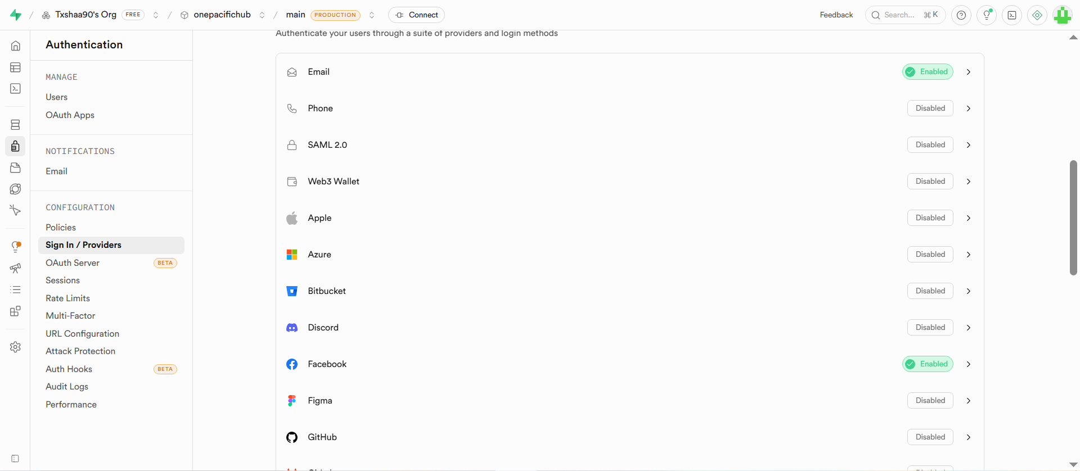
Auth Providers
Enabled providers determine which login methods can be used
Key Points
Email login is configured in Supabase.
Google and Facebook can be enabled as OAuth providers.
Only enabled providers should be exposed in the UI.

Slide 25
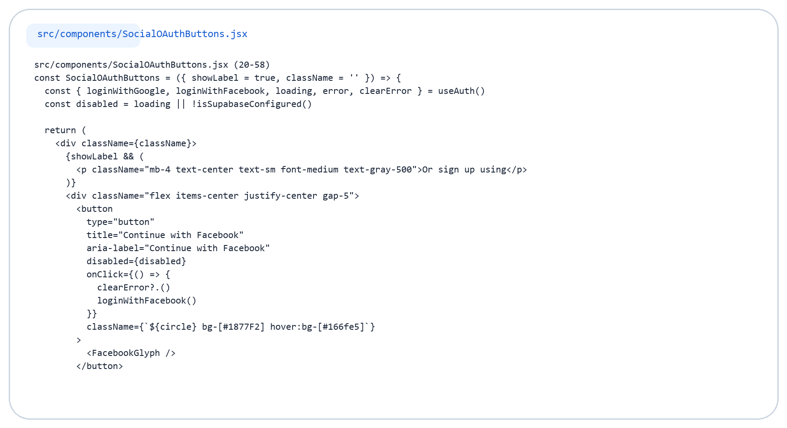
Provider Button Code (1/2)
Frontend buttons for social login

Slide 26
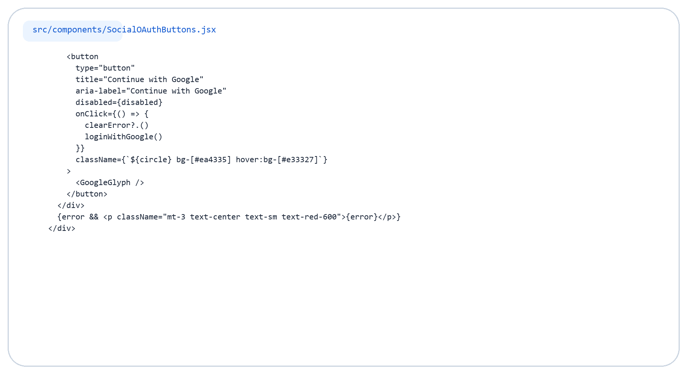
Provider Button Code (2/2)
Frontend buttons for social login

Slide 27
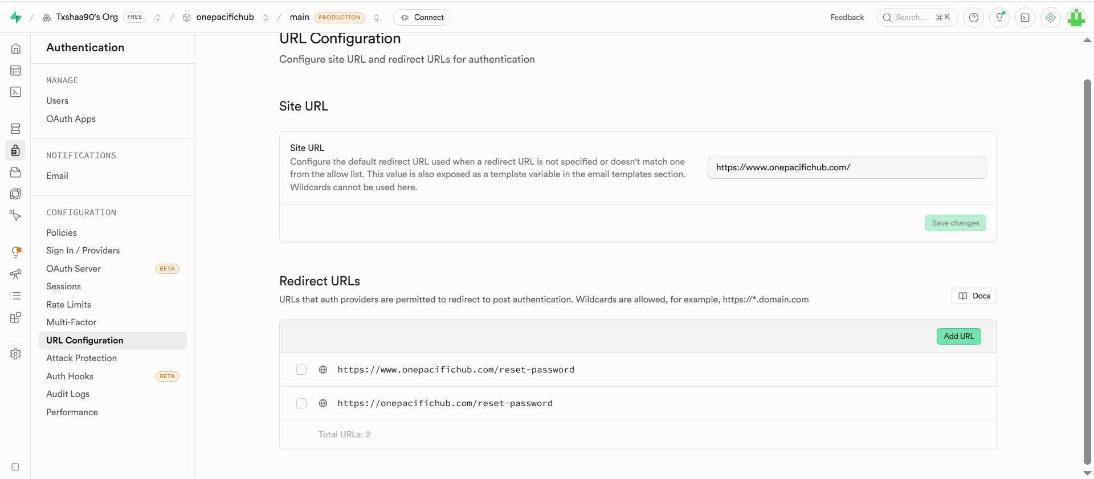
URL Configuration
Redirect URLs connect the dashboard settings to the frontend callback route
Key Points
Supabase needs approved redirect URLs for OAuth and email flows.
The site origin is built from environment variables.
This must match the AuthCallback route used by the app.

Slide 28
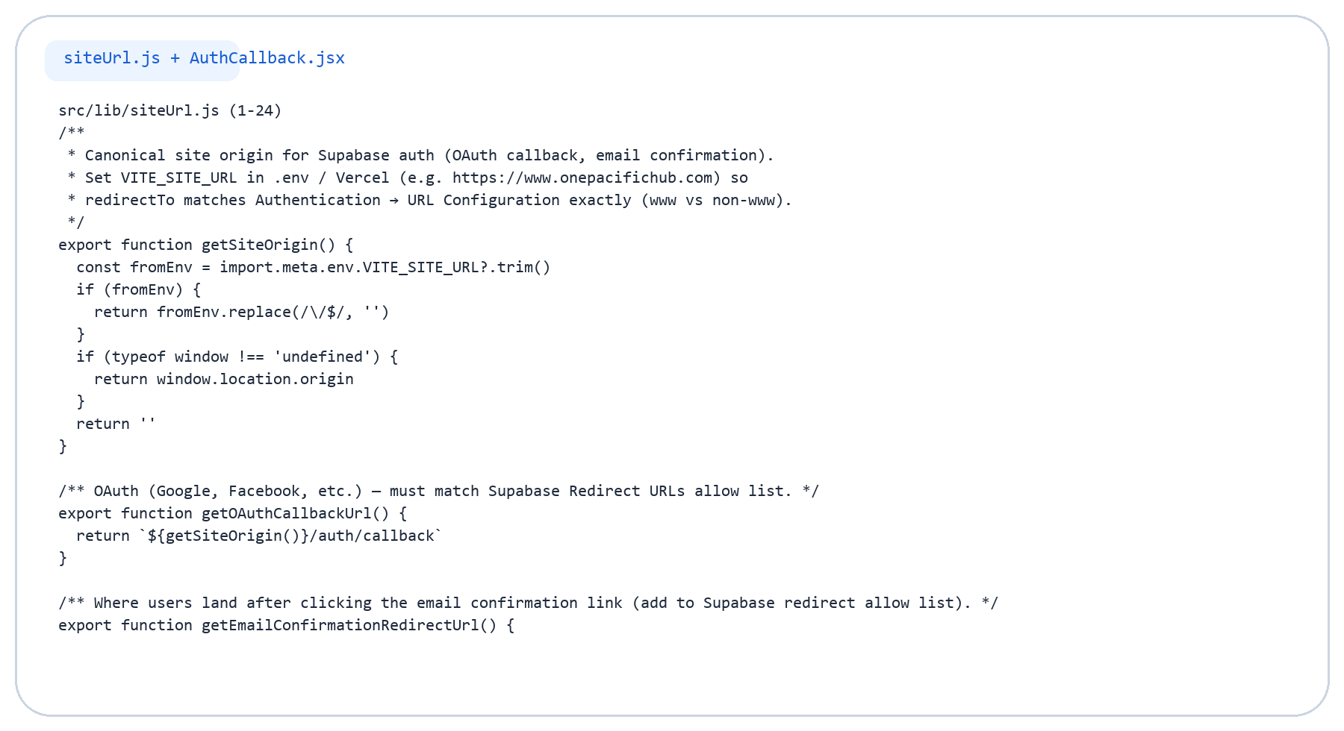
URL Callback Code (1/3)
Redirect helpers and callback exchange

Slide 29
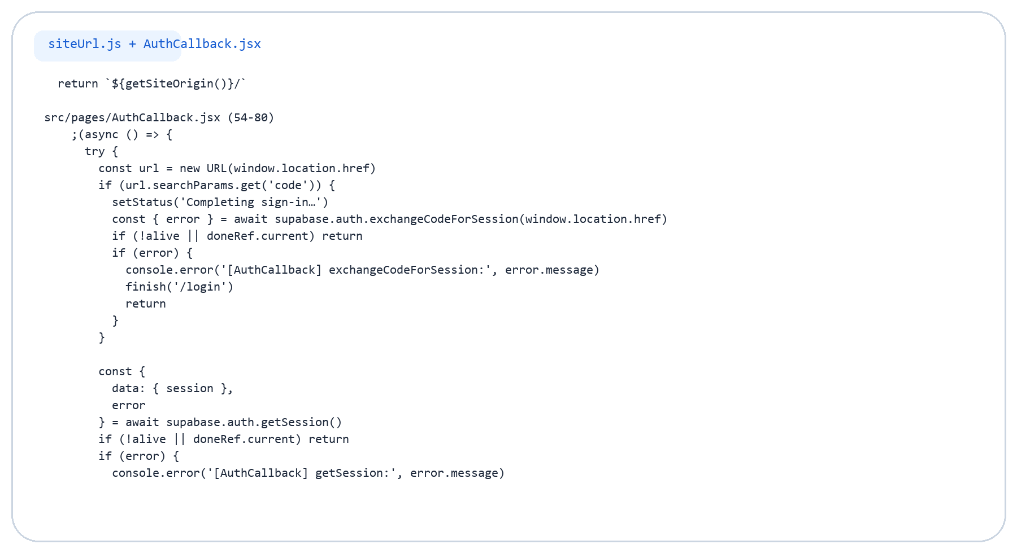
URL Callback Code (2/3)
Redirect helpers and callback exchange

Slide 30
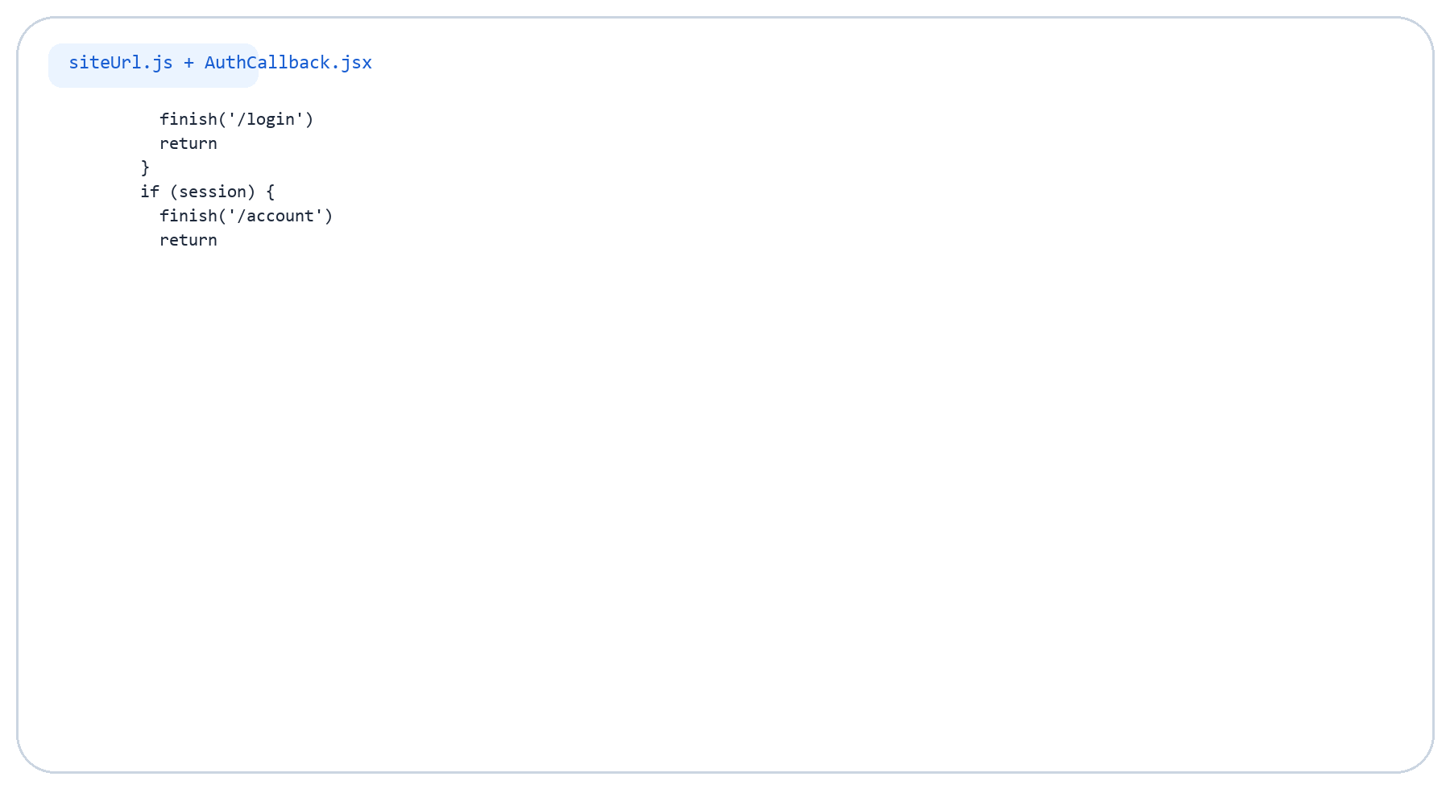
URL Callback Code (3/3)
Redirect helpers and callback exchange

Slide 31
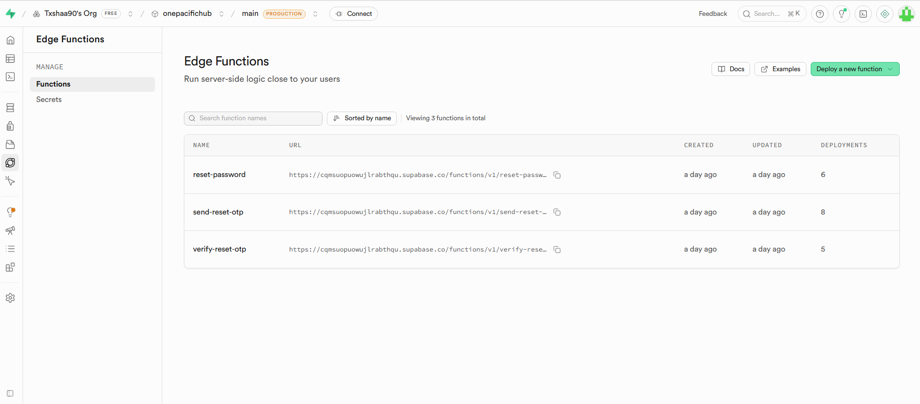
Edge Functions
Custom backend logic is used for the password reset flow
Key Points
The app expects custom functions named send-reset-otp, verify-reset-otp, and reset-password.
Those functions run behind Supabase Functions.
They extend Supabase Auth with custom OTP-based recovery.

Slide 32
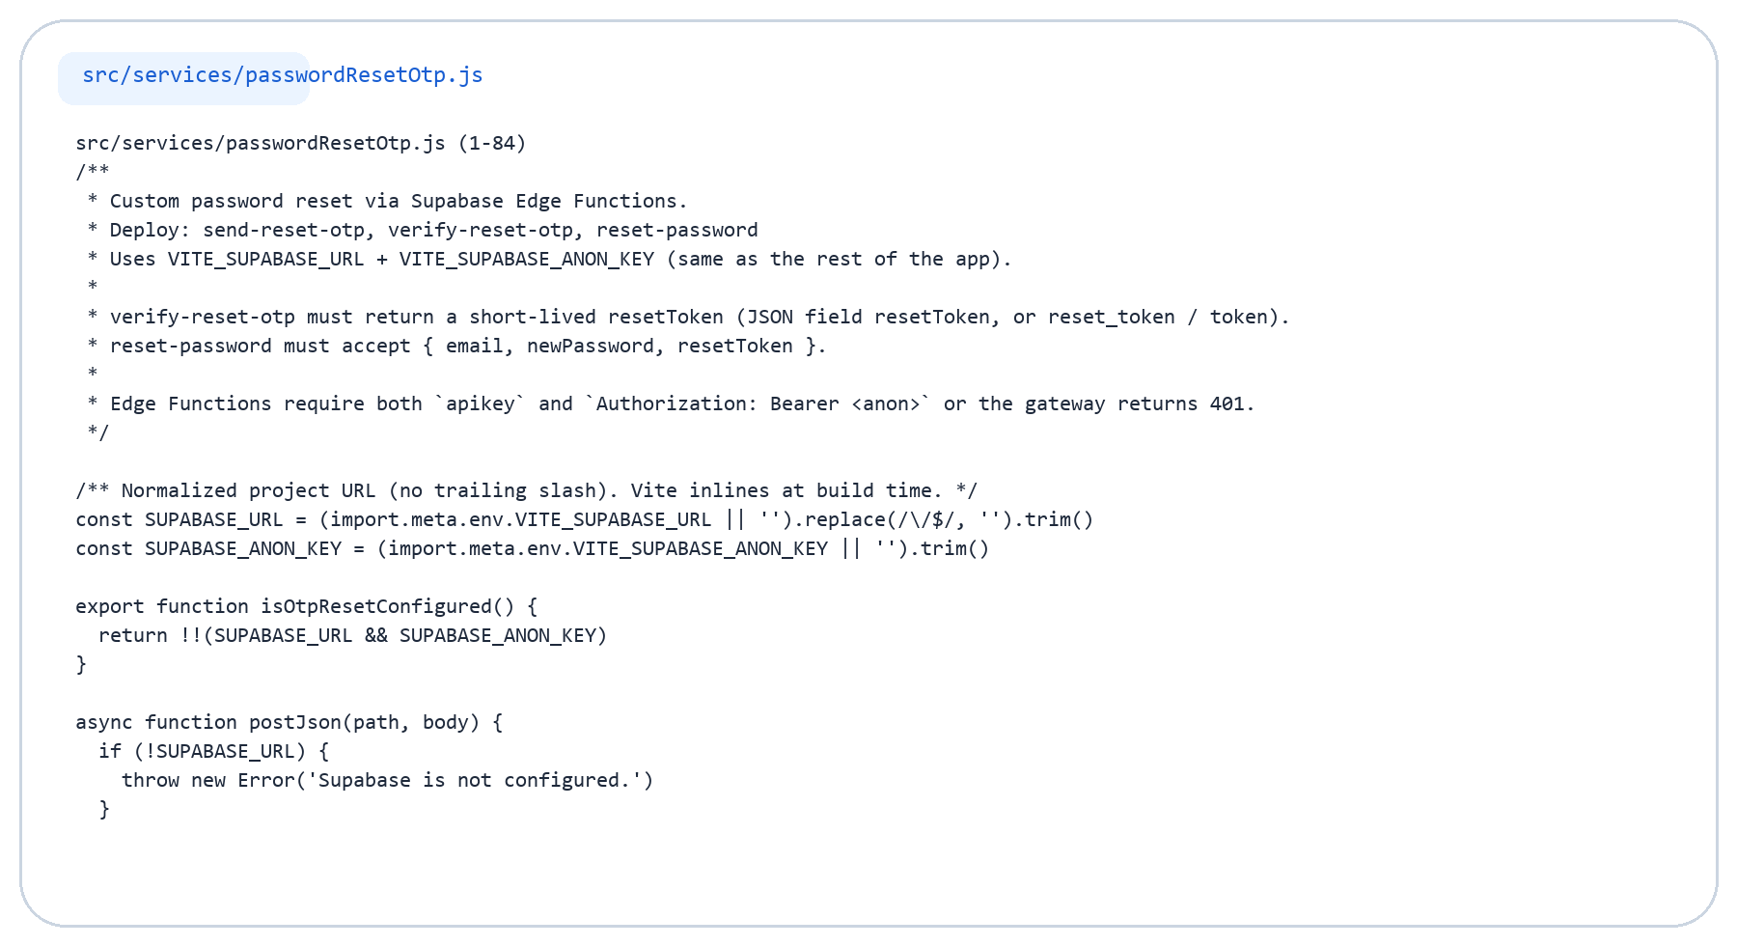
Edge Function Client Code (1/4)
Frontend calls to Supabase Functions

Slide 33
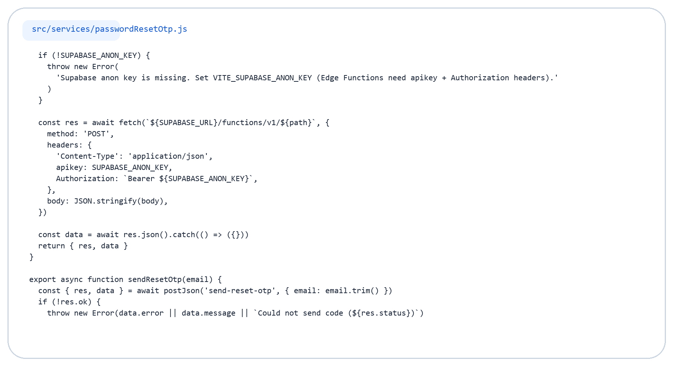
Edge Function Client Code (2/4)
Frontend calls to Supabase Functions

Slide 34
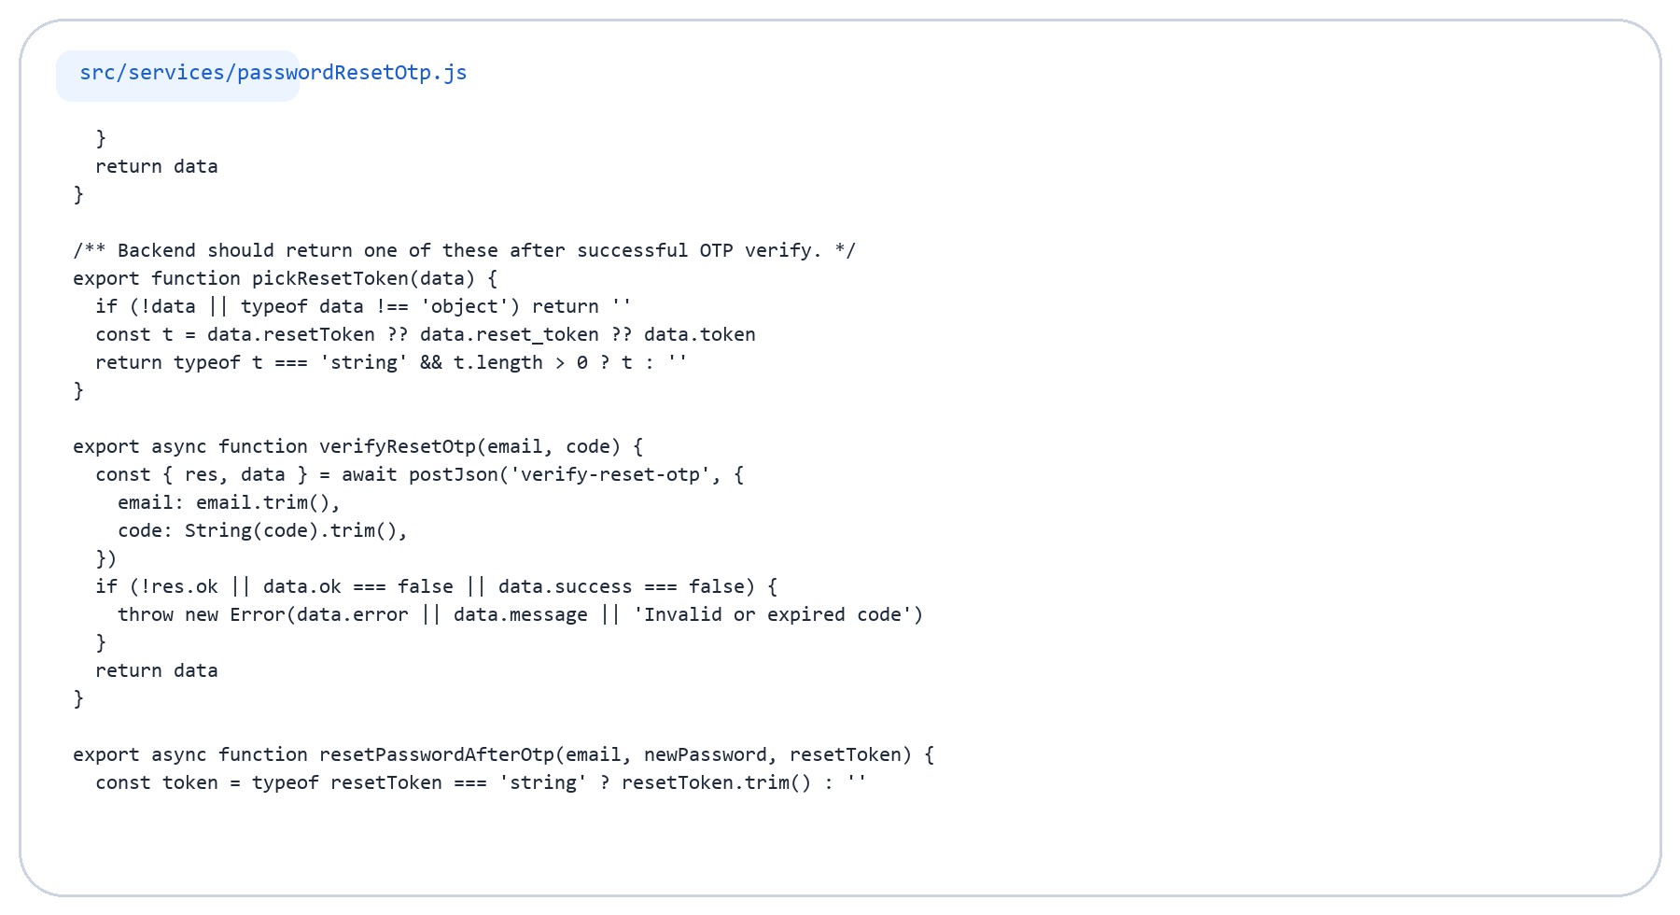
Edge Function Client Code (3/4)
Frontend calls to Supabase Functions

Slide 35
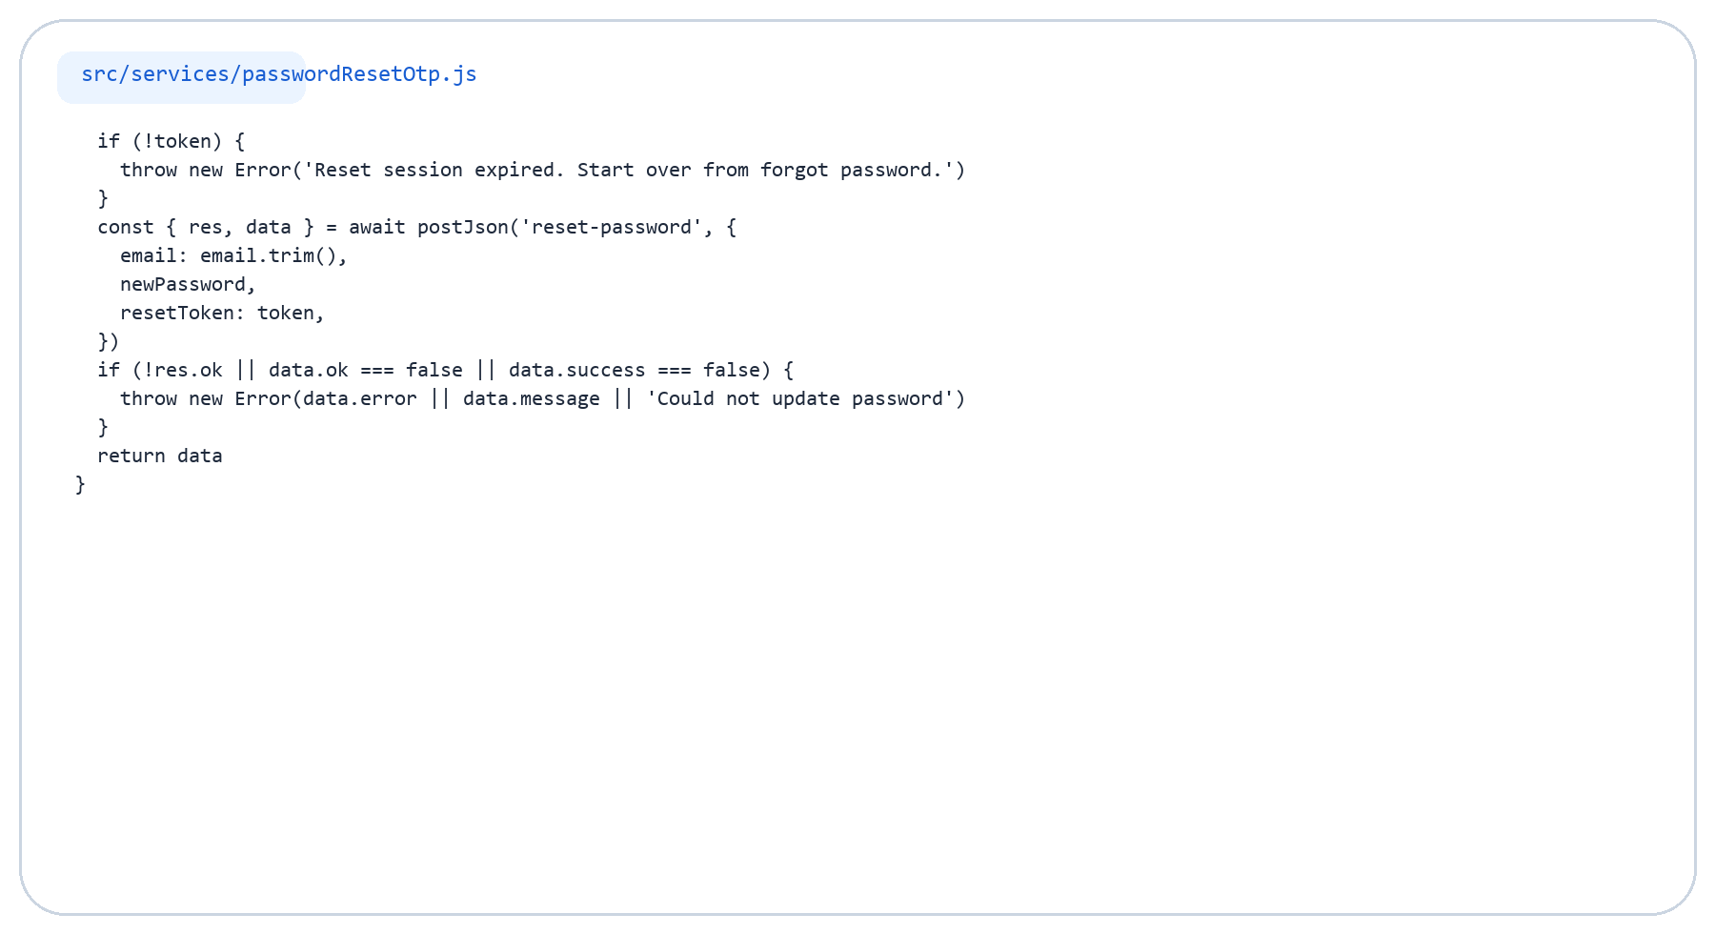
Edge Function Client Code (4/4)
Frontend calls to Supabase Functions

Slide 36
Full Auth Flow
Frontend to Supabase session lifecycle
User
Login UI
Auth Service
Supabase
Session
Protected Page
Flow Explanation
Flow Diagram
User interacts with login, signup, OAuth, or reset screens.
Service layer calls Supabase Auth or Edge Functions.
Supabase returns a session that the app uses to protect routes.
User -> LoginPage/RegisterPage -> supabaseAuthService -> Supabase Auth / Edge Functions -> session token -> AuthContext + ProtectedRoute -> Account page

Slide 37
Code Integration
Three files that connect the whole auth stack
supabase.js
AuthContext.jsx
supabaseAuthService.js
Initializes the browser client.
Reads Supabase URL and anon key from environment variables.
Configures auth persistence and session handling.
Watches auth state changes.
Stores the logged-in user in React state.
Protects routes and syncs session data.
Wraps login, signup, OAuth, logout, and session checks.
Keeps Supabase calls out of page components.
Returns simplified user/session objects to the app.
How They Work Together
The client connects to Supabase, the service performs authentication requests, and AuthContext keeps the session active across the website.

Slide 38
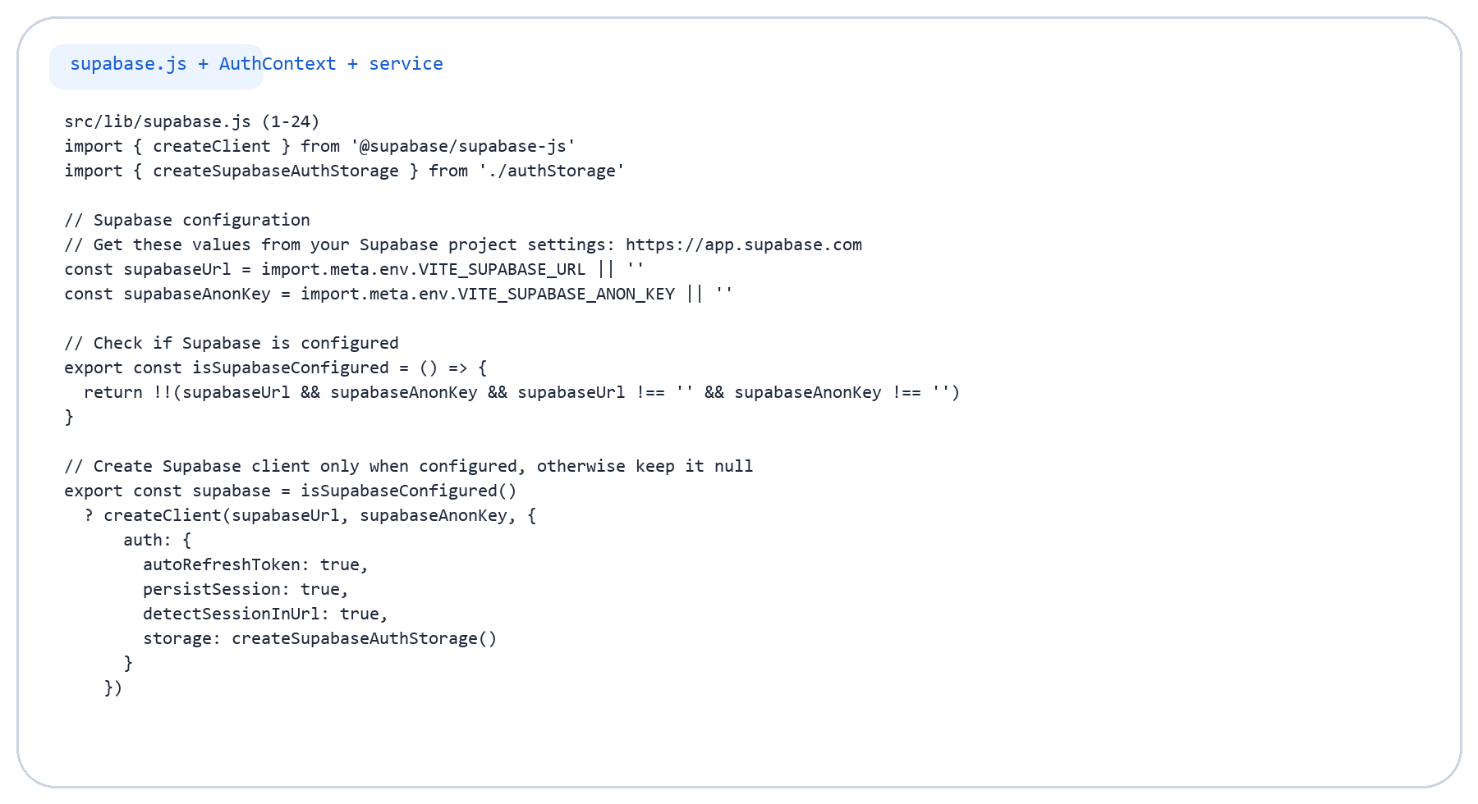
Integration Code Detail (1/6)
The three main files behind the auth system

Slide 39
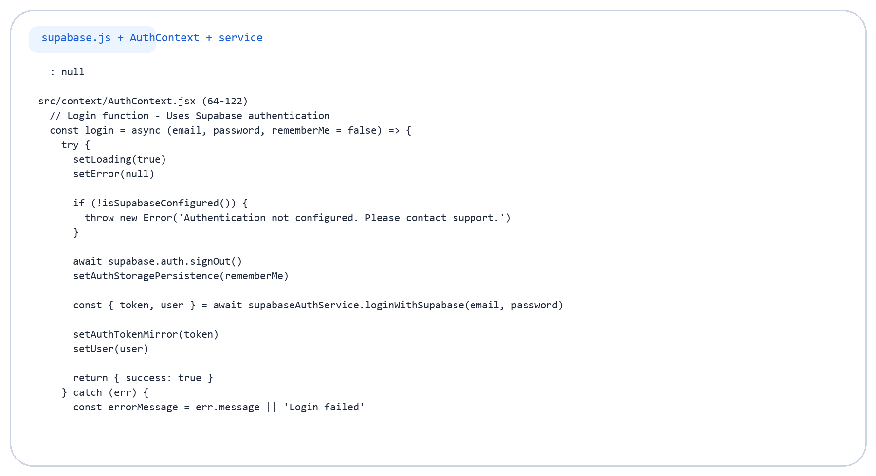
Integration Code Detail (2/6)
The three main files behind the auth system

Slide 40
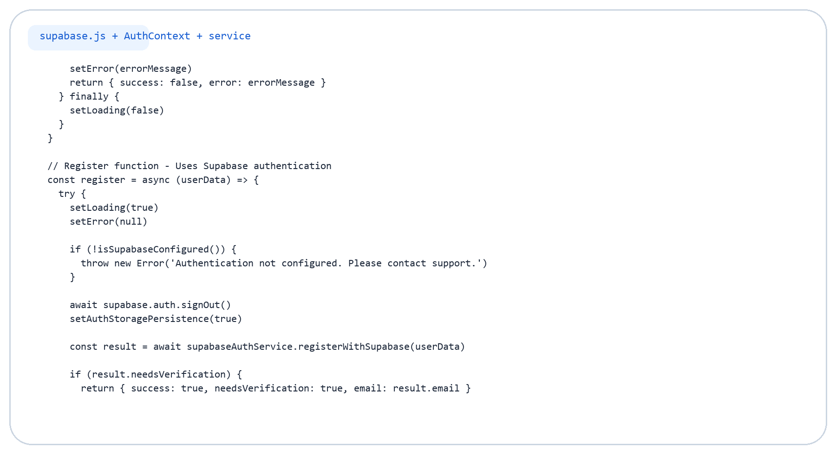
Integration Code Detail (3/6)
The three main files behind the auth system

Slide 41
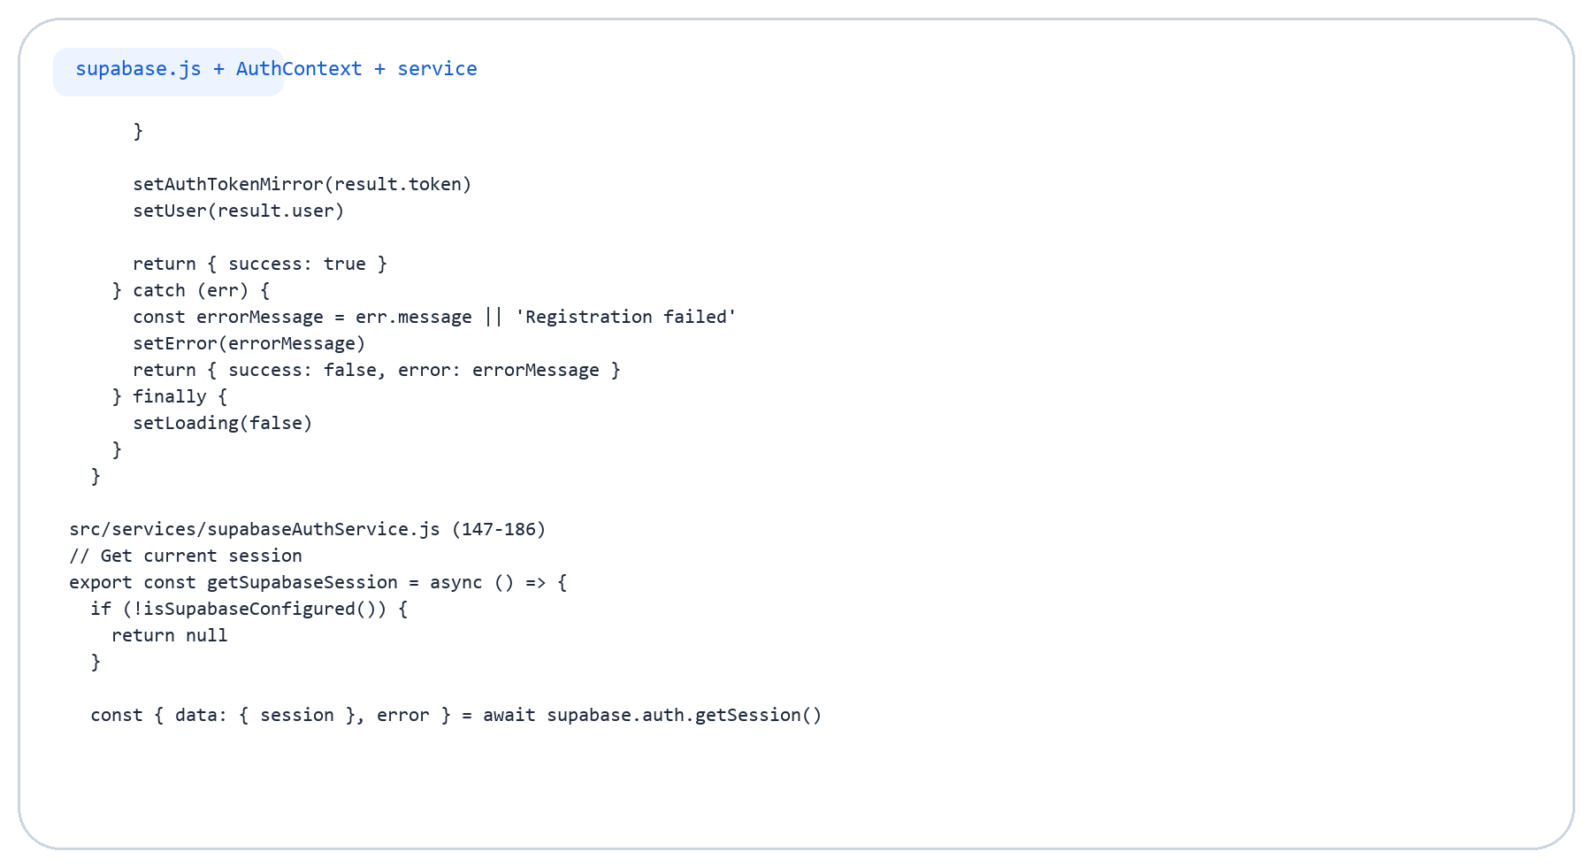
Integration Code Detail (4/6)
The three main files behind the auth system

Slide 42
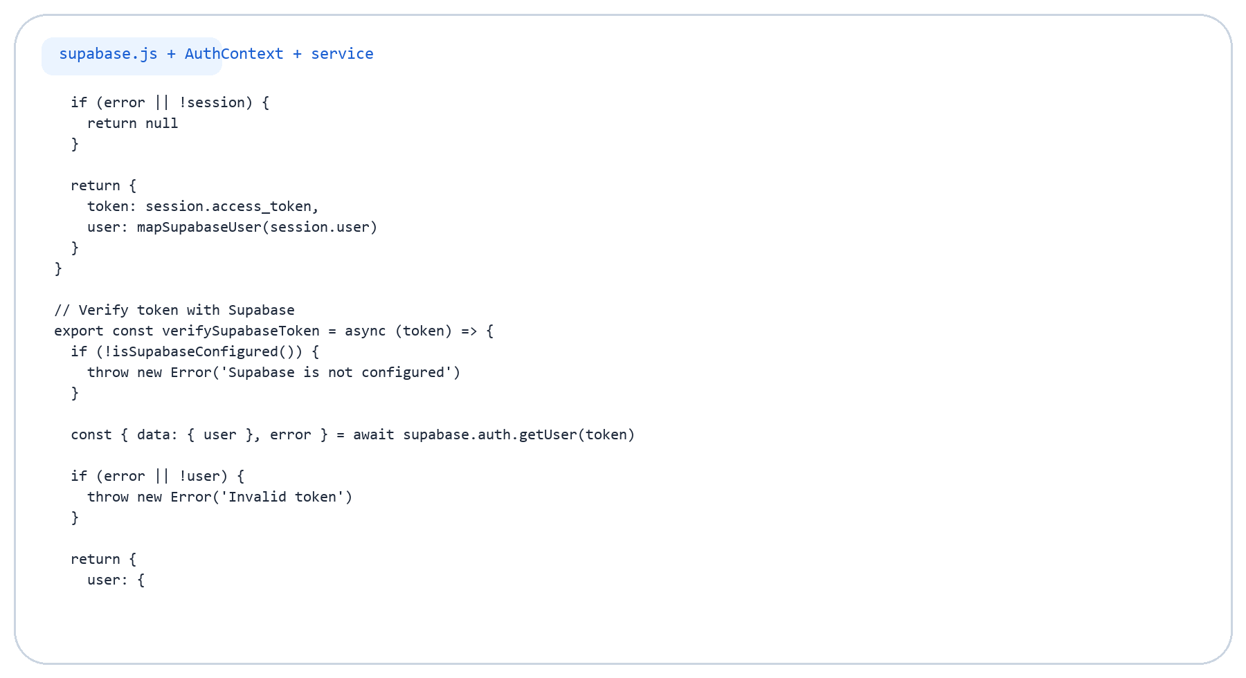
Integration Code Detail (5/6)
The three main files behind the auth system

Slide 43
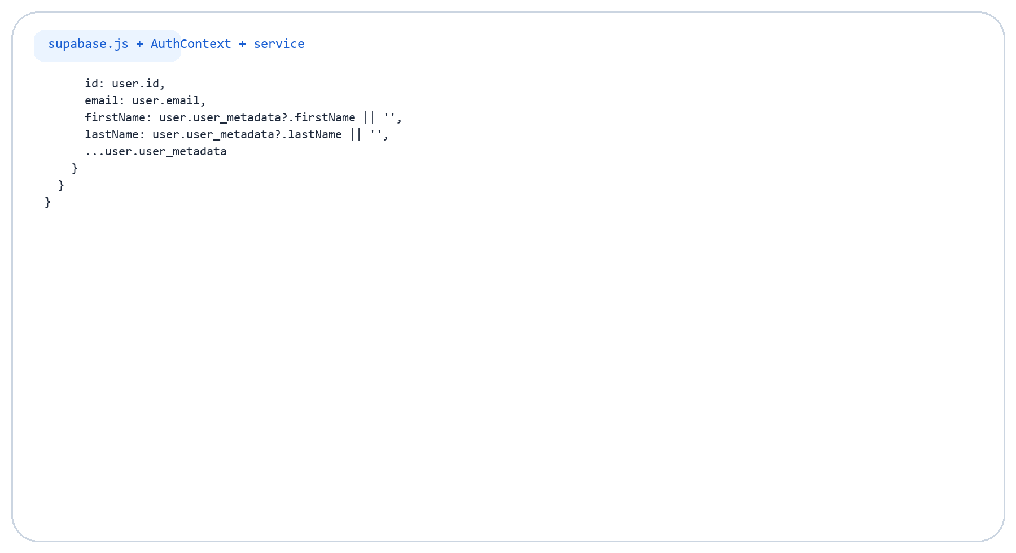
Integration Code Detail (6/6)
The three main files behind the auth system

Slide 44
Current Limitation
Supabase is used for authentication only in the current frontend
What This Means
Login, signup, OAuth, session handling, and reset flow are on Supabase.
Profile update and password-change helpers still call a mock local-storage service.
Products, cart, and broader app data are not being queried from Supabase here.
So the current setup is production-style auth, but not yet a full Supabase backend.

Slide 45
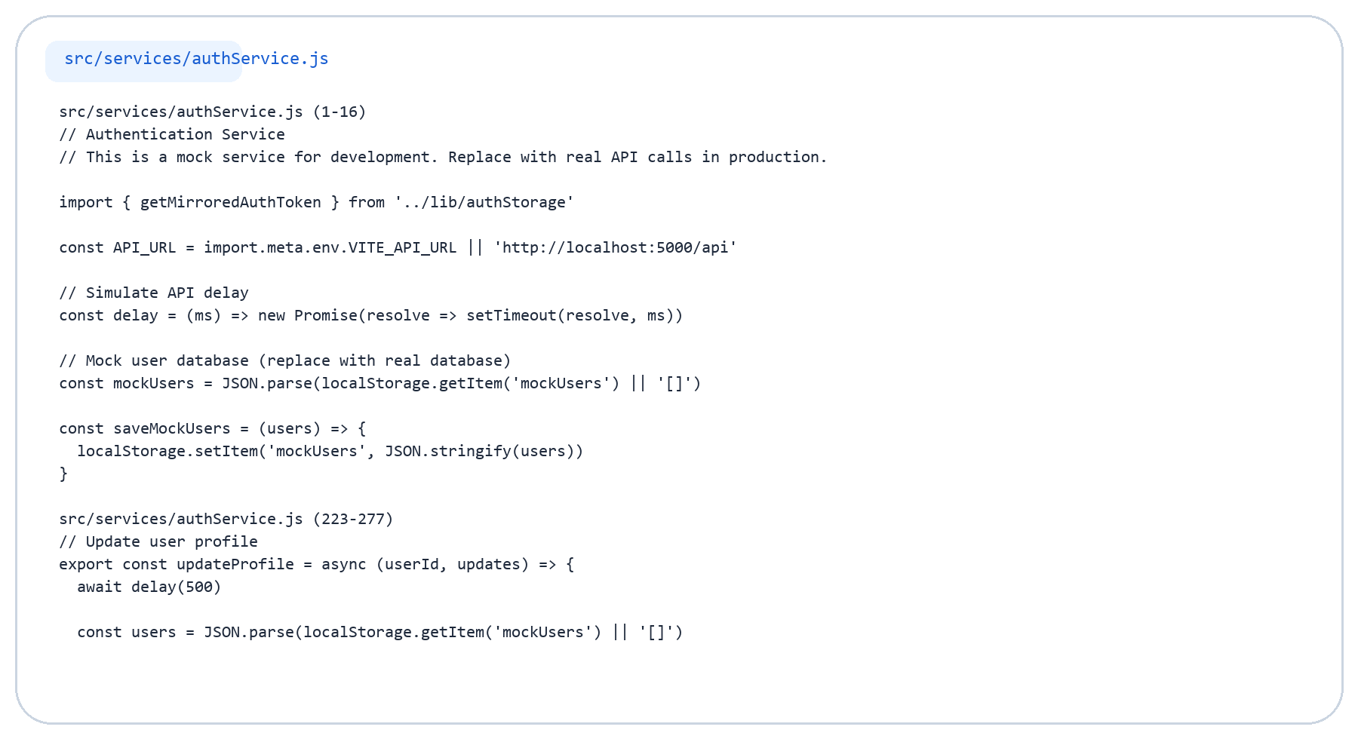
Limitation Code Detail (1/4)
Mock/local service still used outside auth

Slide 46
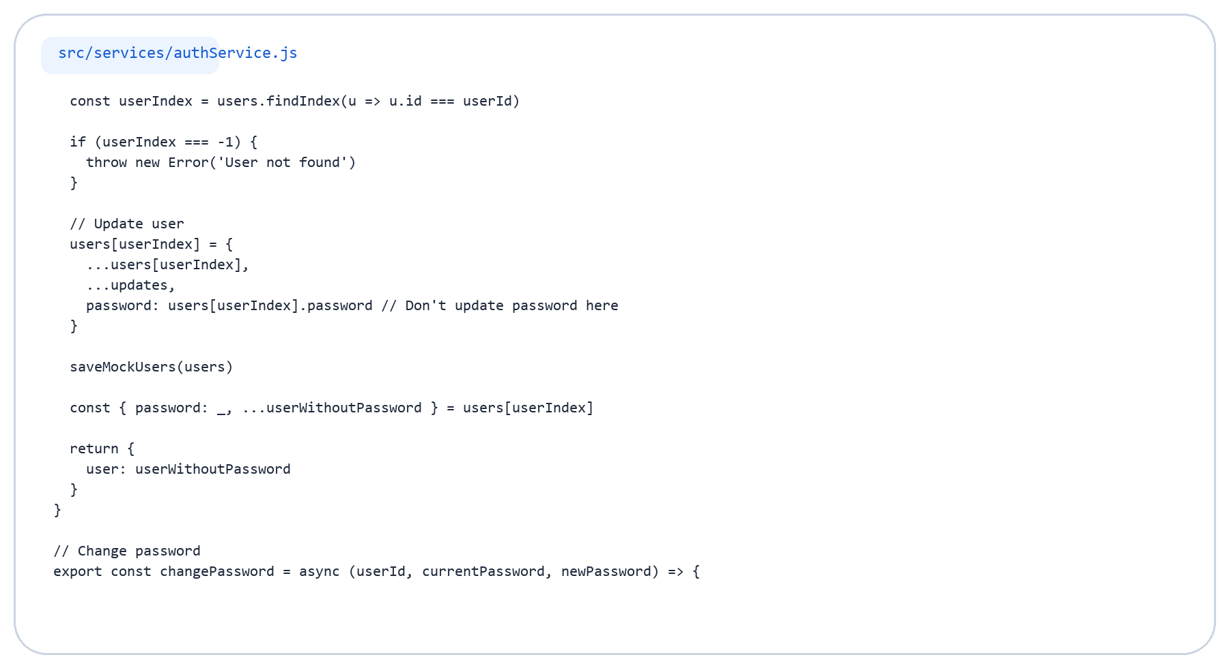
Limitation Code Detail (2/4)
Mock/local service still used outside auth

Slide 47
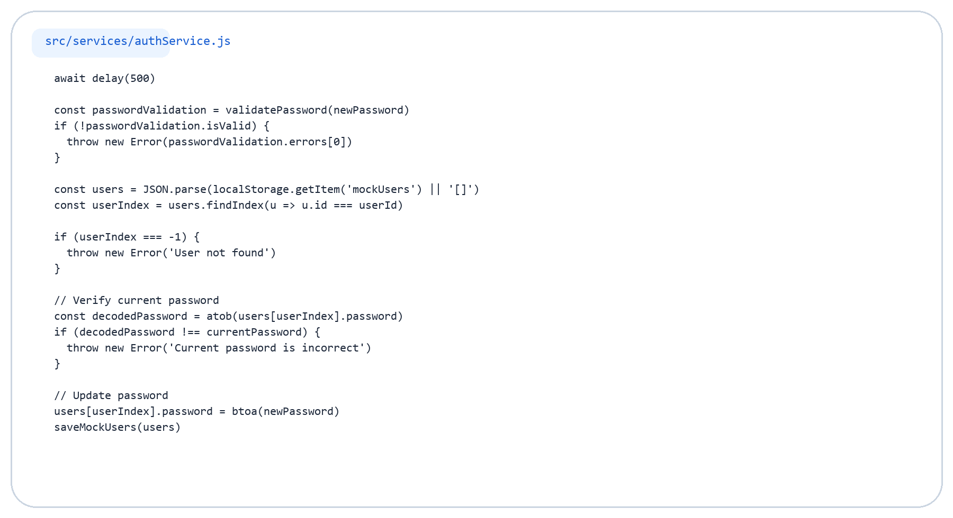
Limitation Code Detail (3/4)
Mock/local service still used outside auth

Slide 48

Limitation Code Detail (4/4)
Mock/local service still used outside auth

Slide 49
Conclusion
Why this integration is effective for the project
Strengths
Architecture
Next Step
Secure authentication is delegated to Supabase.
Frontend stays focused on UX and route protection.
OAuth and password reset are already integrated.
UI pages collect input.
Services call Supabase APIs.
AuthContext stores the active user session.
Move profile and app data to Supabase if full backend consolidation is desired.
Add database tables and replace mock services.
Final Takeaway
Supabase simplifies authentication by handling login, sessions, and security, allowing the frontend to focus on user experience and route protection.

