Slide 1

Is Moore’s Law Dead?
Ty Davis – ECE 3000

Slide 2

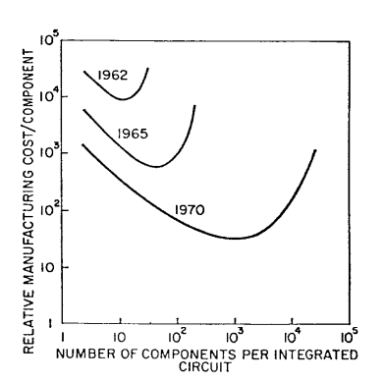
Moore’s Law - History
"With unit cost falling as the number of components per circuit rises, by 1975 economics may dictate squeezing as many as 65,000 components on a single silicon chip."
- Gordon Moore
Intel’s flagship Core i9 13900k CPU (Sept, 2022) boasts a transistor count of up to 26 billion.

Slide 3
Moore’s Law - History
"Four main factors are responsible for most of this increase in chip density:
Die size
Line dimension
Technical cleverness
Technical innovation
Together, they serve to explain most of the exponential improvements in transistors per chip described by Moore’s law."
- Ethan Mollick

Slide 4
Moore’s Law – Difficulties
Manufacturing small transistors is difficult and expensive.
“Further reduction in insulator thickness would have resulted in unacceptable (and exponential) increases in gate leakage current through direct quantum tunneling.” – Theis and Wong
“Further reduction in operating voltage swing would have resulted in either unacceptably low channel current in the ‘on’ state (unacceptable decreases in switching speed) or increased leakage current in the ‘off’ state (unacceptable increases in passive power).” – Theis and Wong

Slide 5
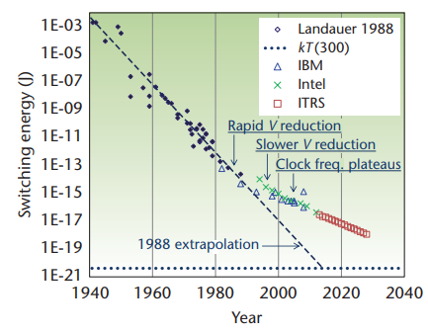
Moore’s Law – Difficulties
The amount of energy required for switching transistors is experiencing diminishing returns.

