Slide 1
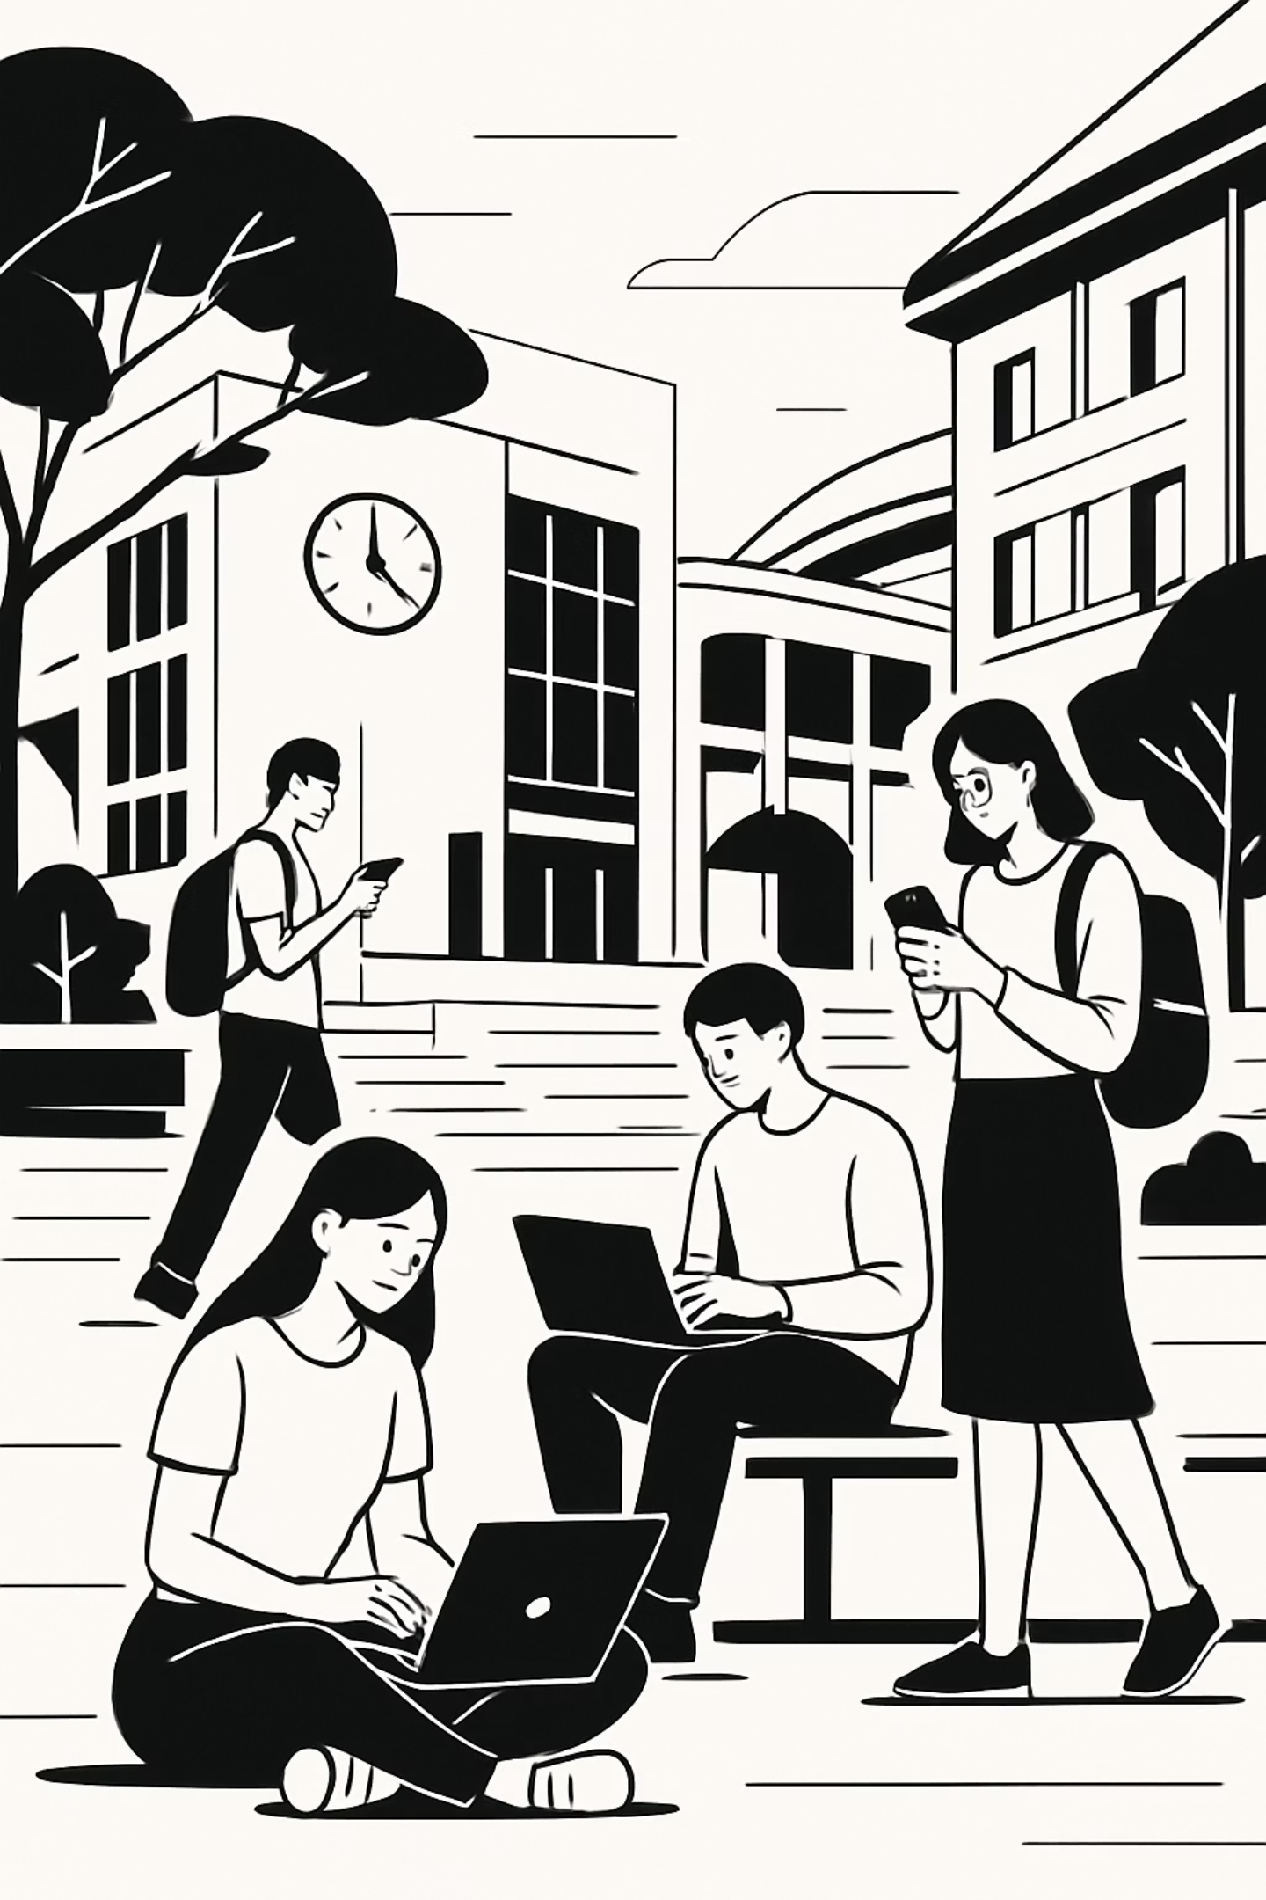
Copyright, Licences & Device Protection
Tymoteusz Miller
University of Szczecin

Slide 2
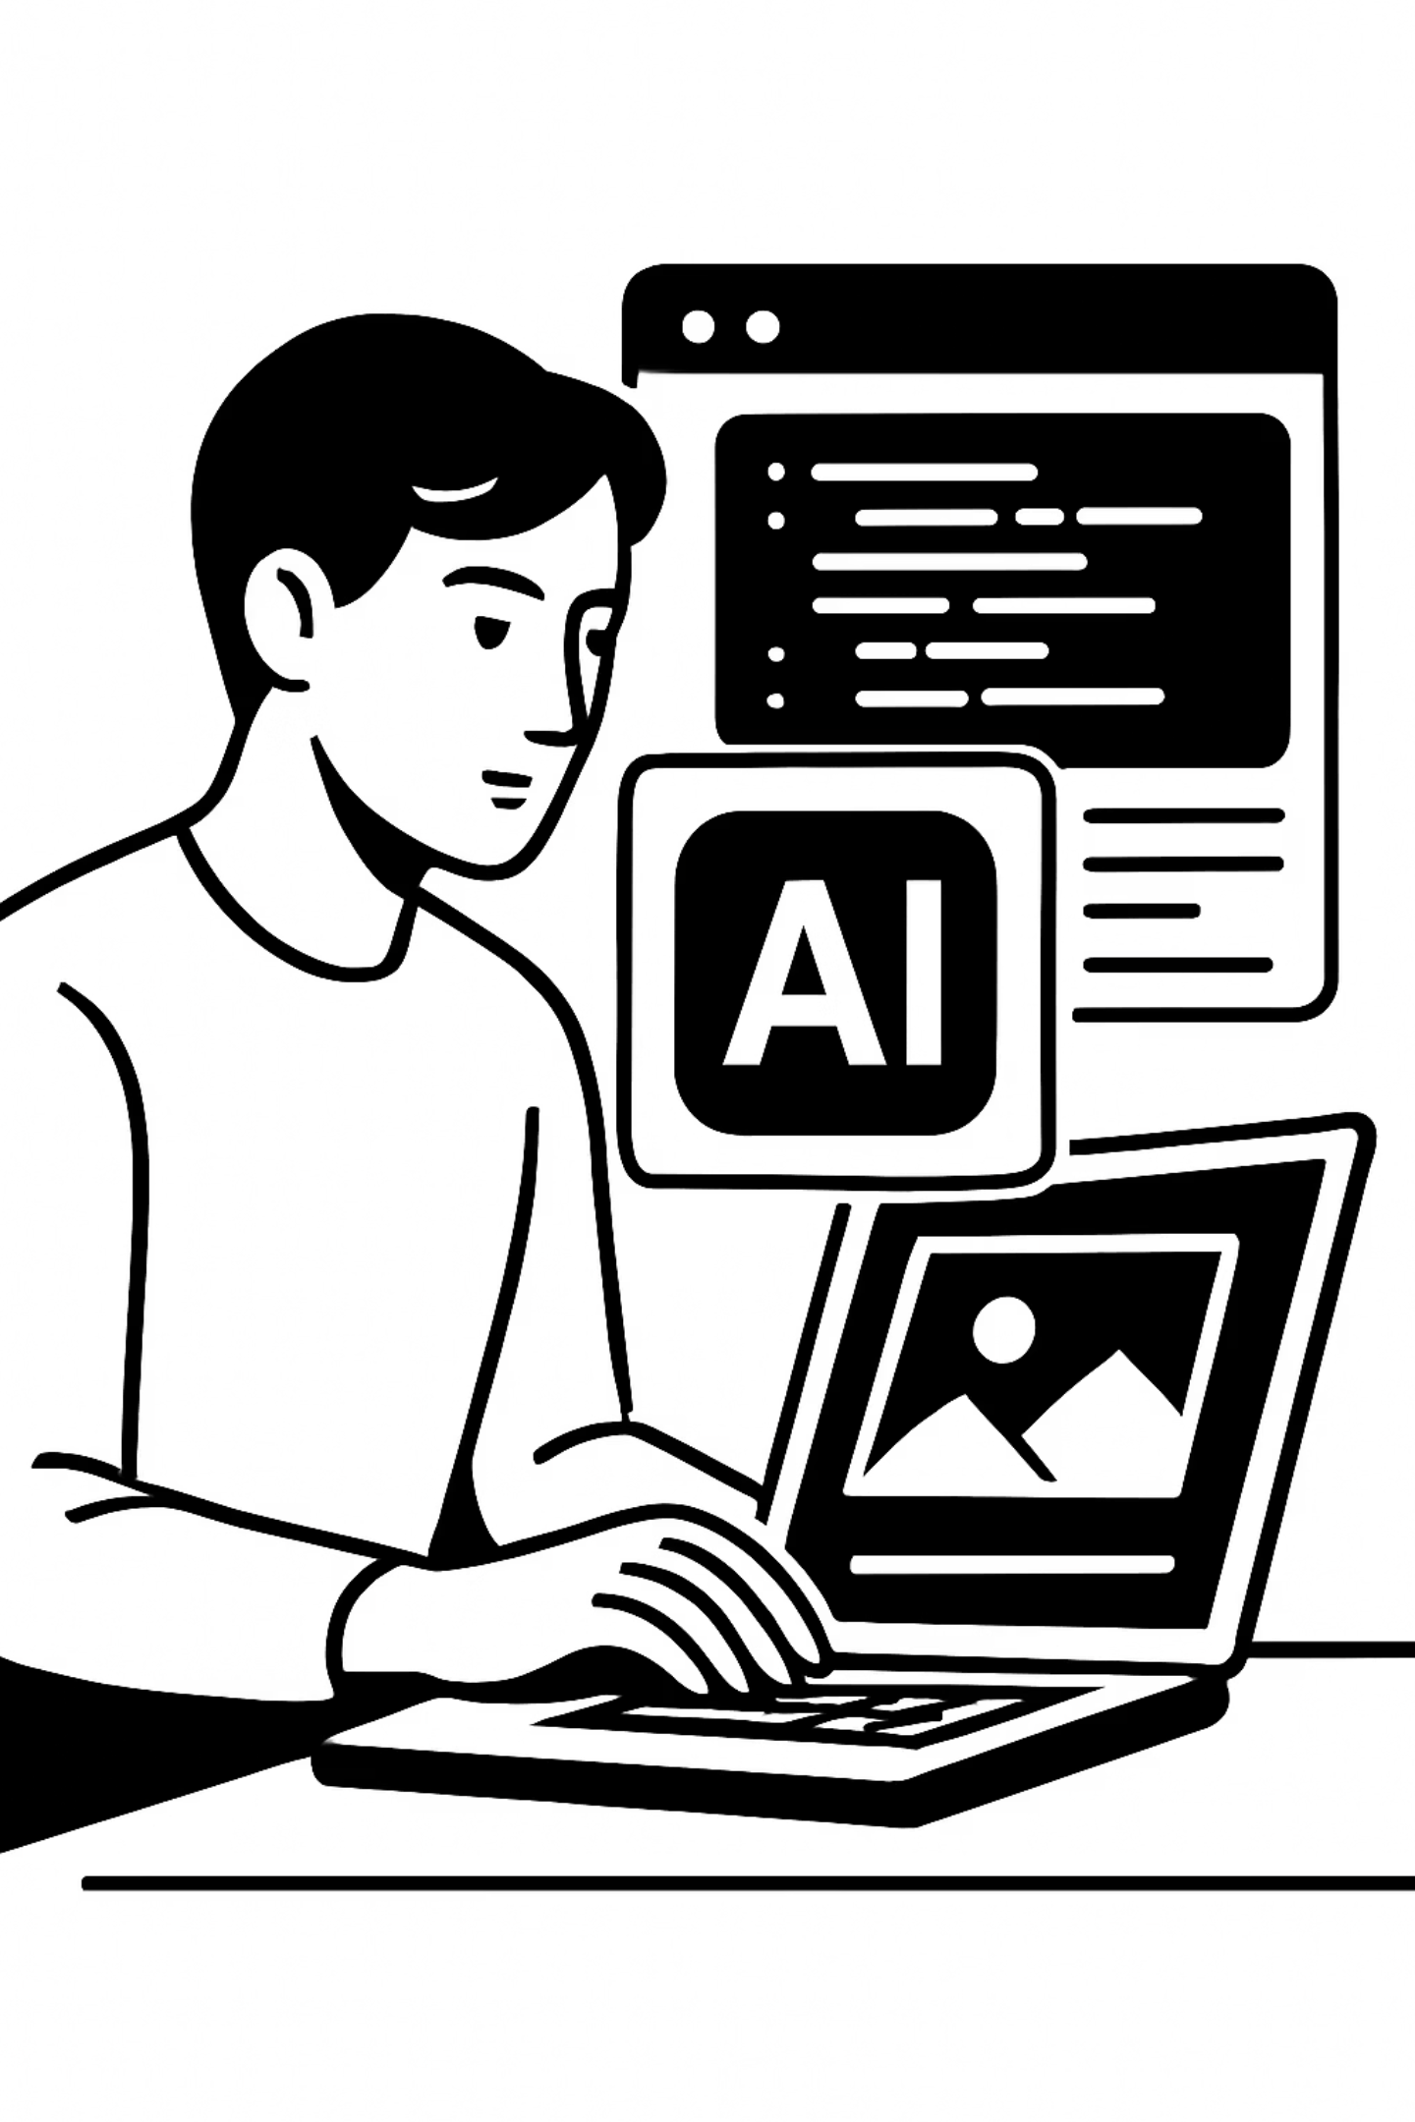
AI-generated text, images, and code are now woven into everyday academic and professional life. But convenience can come with hidden legal and ethical risks — and most people don't know where the lines are.
📄 AI Text
🖼️ AI Images
Essays, summaries, emails — generated in seconds but with uncertain authorship and copyright status.
Stunning visuals produced instantly — but trained on copyrighted works without always having permission.
💻 AI Code
Copilot and similar tools suggest entire functions — sometimes lifted directly from open-source repositories with licence obligations.

Slide 3

Quick Question
Can You Just Use Google Images?
❌ Common Assumption
✅ The Reality
If it shows up in a Google search, it must be free to use — right? After all, it's public and accessible to anyone online.
Absolutely not. Appearing in search results does not mean an image is free to use. Almost every image on the web is automatically protected by copyright from the moment it's created. Using it without permission — even in a university assignment or presentation — can be infringement.
Always check the licence before using any image, even if it appears "freely available" online. Look for a Creative Commons licence or explicit permission from the rights holder.

Slide 4
What Is Copyright?
Copyright is an automatic legal protection that arises the moment an original work is created — no registration required. It grants the creator exclusive control over how their work is used, shared, and monetized.
1
2
3
The Author
The Work
The Rights
The person (or organization) who creates an original work — a student essay, a photograph, a piece of software, a song.
Any original creative output: written text, images, music, code, films, databases, and more. The work must have a minimum level of originality.
The exclusive bundle of permissions — to copy, distribute, adapt, publicly perform, or license the work — held by the author.

Slide 5
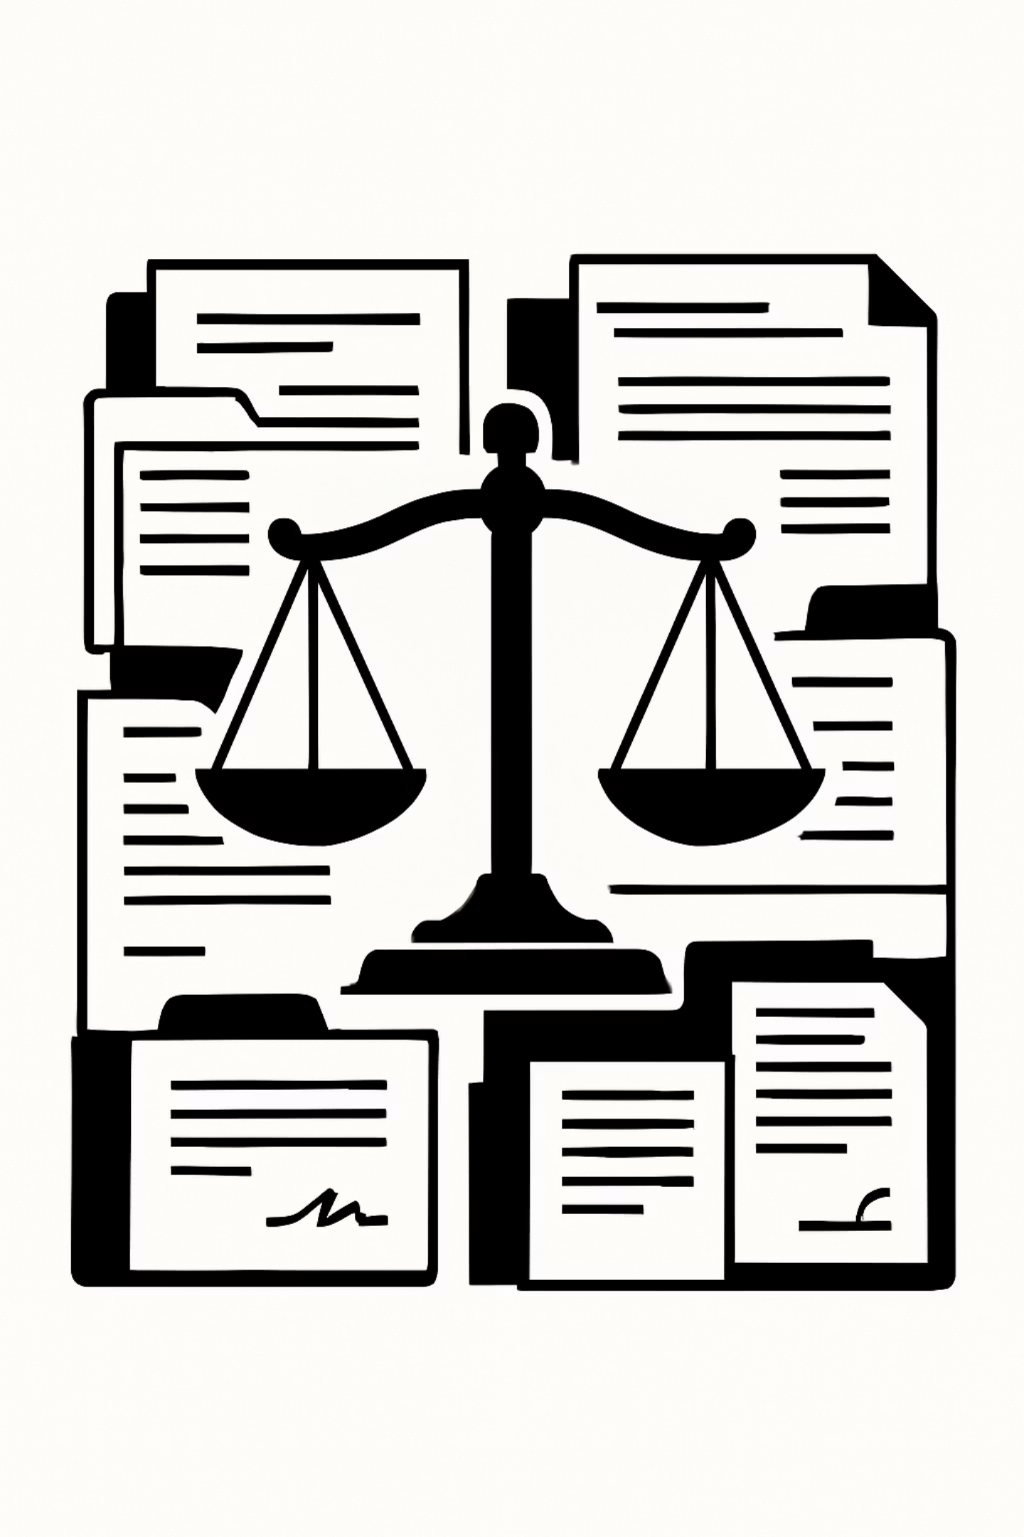
Types of Copyright Rights
Moral Rights
Economic Rights
Tied to the author as a person — they cannot be sold or transferred. These include:
These are transferable and licensable — the financial backbone of copyright. They include:
The right to be credited as the author
The right to object to distortion or mutilation of the work
The right to withdraw a work from circulation
Reproduction (copying)
Distribution and selling
Creating derivative works or adaptations
Public communication or display
Economic rights can be assigned to publishers, studios, or employers.
Even if you buy a painting, you cannot remove the artist's name from it.

Slide 6

AI & Copyright: Who Owns the Output?
This is one of the most contested legal questions of our era. When an AI model generates a poem, image, or block of code — who holds the copyright?
Not the AI
Probably Not You
Possibly the Platform
AI systems have no legal personhood and cannot hold rights. Models like ChatGPT or Midjourney are tools, not authors.
Most legal systems (including the US and EU) currently do not grant copyright to AI-generated outputs with minimal human creative input. A simple prompt may not be enough.
Some AI companies claim ownership via their Terms of Service — or explicitly grant usage rights to users. Always read the ToS of the tool you're using.
Bottom line: AI output currently exists in a legal grey zone. Treat it with caution in any formal, commercial, or academic context.

Slide 7
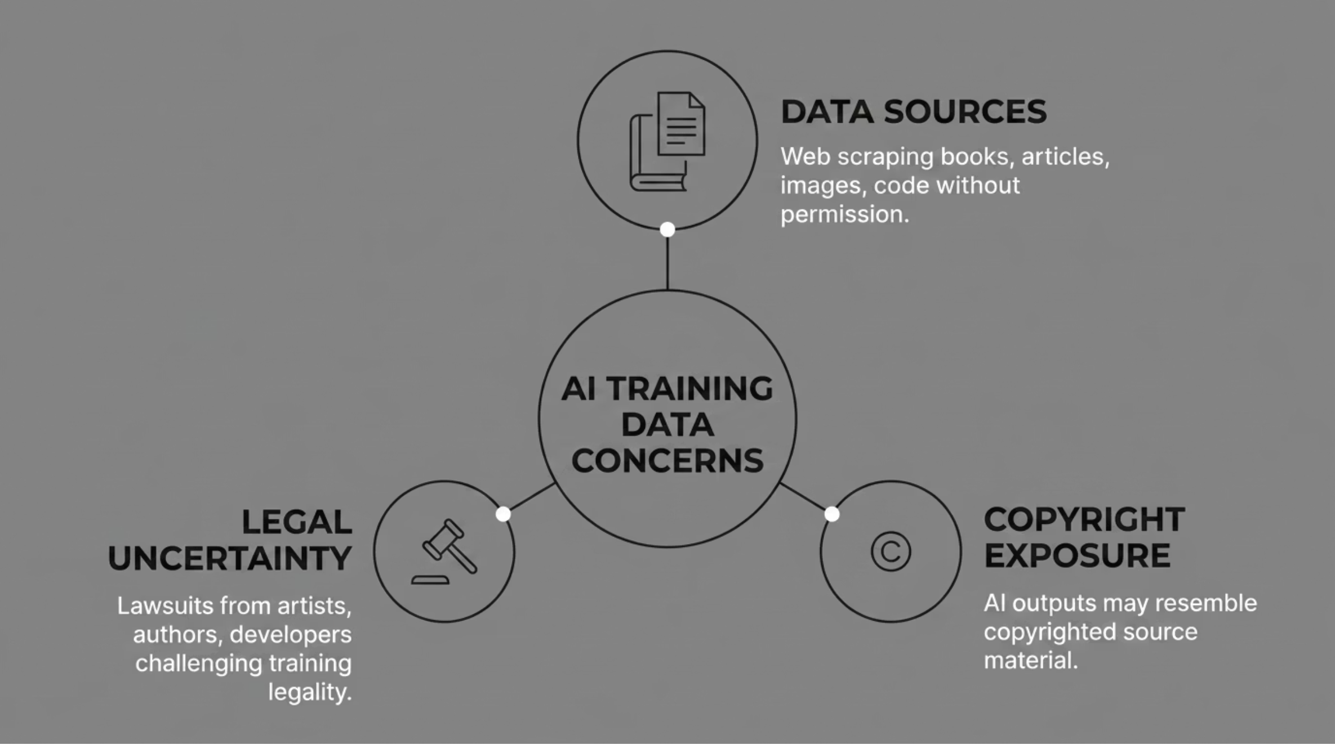

The Training Data Problem
Large language and image models are trained on vast datasets scraped from the internet — including books, articles, artwork, and code repositories — much of it without explicit permission from the original creators.
Several major lawsuits are currently underway — from the New York Times, Getty Images, and individual artists — challenging the legality of training AI on copyrighted material without consent.

Slide 8

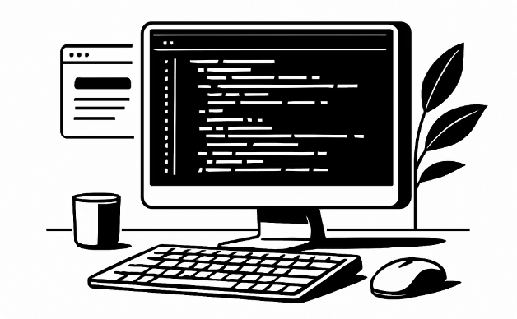

Using AI Output: What's Safe?
The type of AI-generated content matters. Here's a practical breakdown of how to think about using each type responsibly in academic and professional settings.
AI-Generated Text
AI-Generated Code
AI-Generated Images
Use as a starting draft only. Review, rewrite, and add your own voice. Submitting AI text as your own work may violate academic integrity policies.
Check the source licence — some suggestions may come from GPL-licensed repositories, which carry obligations. Always review and test before using in production.
Ownership is unclear. Avoid using AI images in commercial work without verifying the platform's terms. For academic use, cite the tool and note the AI origin.

Slide 9
Safe Rules for Using AI Output
Use as a Draft
Avoid Blind Copy-Paste
Treat AI output as raw material — a starting point that requires your judgment, editing, and original thinking before it becomes a finished work.
Never paste AI output directly into assignments, reports, or publications without substantial review. Errors, biases, and copyright-infringing passages can slip through unnoticed.
Cite Your Tools
Read the ToS
Disclose when AI tools have been used in your work. Many universities and publishers now require this. Transparency builds trust and academic integrity.
Each AI platform has different rules about who owns the output and how it can be used commercially or academically. Don't assume — always check.

Slide 10

Case Study
AI-Generated Text in Practice
A student submits a 2,000-word essay largely written by ChatGPT with only minor edits. The submission is detected by AI detection software. Consider the layers of risk involved:
Academic Integrity
The student may face disciplinary action for misrepresenting the work as their own, regardless of whether the content is technically "correct."
Copyright Grey Zone
If the AI text mirrors a training source closely, there could be infringement exposure — even if the student is unaware of it.
Lost Learning
Beyond policy risk, the student misses the critical thinking development that writing assignments are designed to build.

Slide 11
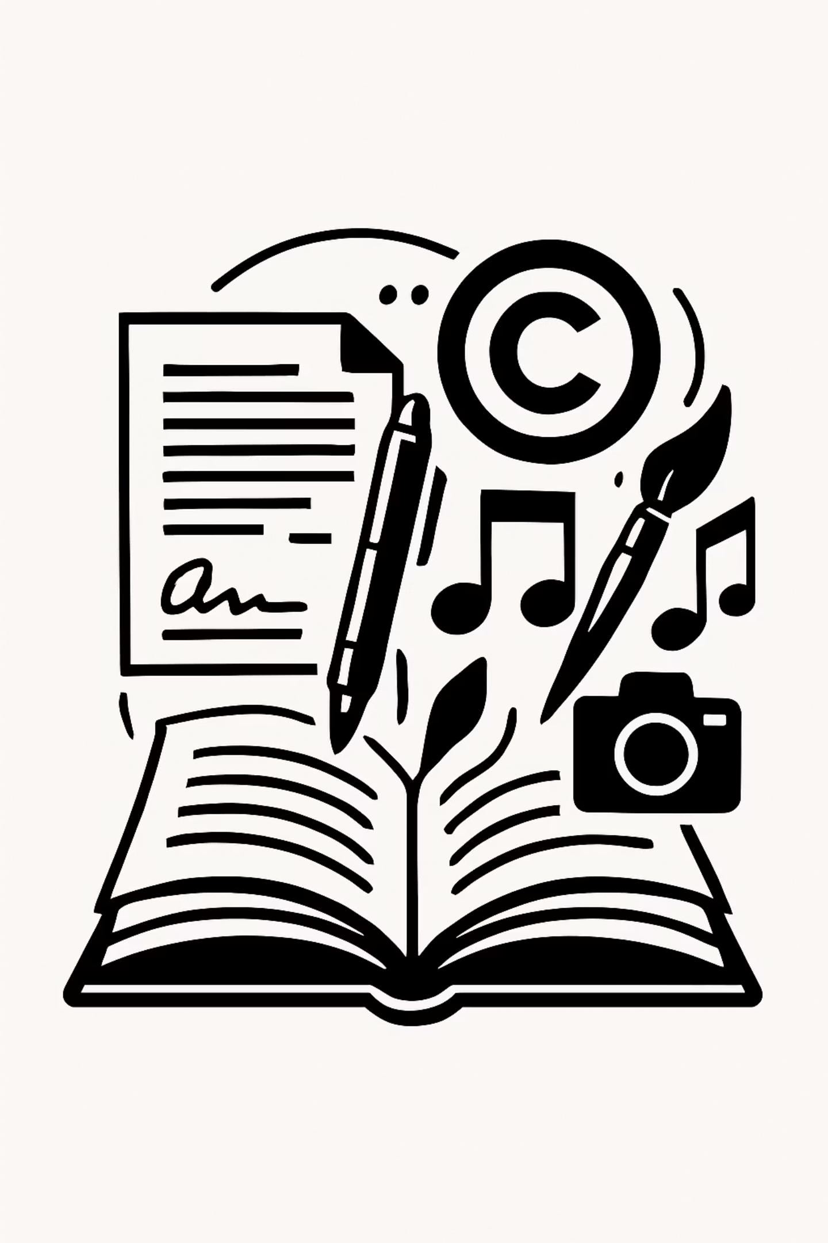
Licences: Why They Matter
A licence is a legal permission granted by a copyright holder that specifies exactly how their work can be used — and under what conditions. Without a licence, the default is: all rights reserved, meaning you cannot use, copy, or share the work.
No Licence Found
Licence Found
Assume full copyright protection applies. Do not use the work.
Read every condition carefully. Attribution, non-commercial, share-alike — each term has consequences.
Licence Followed
You're protected. Document your compliance in case questions arise later.

Slide 12
Creative Commons Licences
Creative Commons (CC) licences allow creators to share their work with the public under standardized, human-readable terms. They're widely used for images, articles, music, and educational materials.
CC BY
CC BY-NC
CC BY-SA
Most permissive. You can use, adapt, and distribute — even commercially — as long as you credit the original author. Great for educational materials.
Non-commercial only. Free to use with attribution, but not for commercial purposes. Ideal for student projects, but check your university's commercial activities.
Share-alike (copyleft). You may adapt the work, but any derivative must be released under the same licence. This "viral" condition has significant implications for larger projects.
Always note which CC version applies (e.g., CC BY 4.0) and include a proper attribution statement when using CC-licensed content.

Slide 13


Software Licences
Code is also protected by copyright. When you use, fork, or contribute to a software project, the licence governs everything you can — and can't — do.
MIT Licence
GPL Licence
Proprietary Licence
Very permissive. Use, copy, modify, distribute — including in proprietary software — with minimal restrictions. Only requirement: preserve the copyright notice.
Copyleft / viral. You can use and modify the code, but any software you distribute that incorporates GPL code must also be open-sourced under GPL.
All rights reserved. The software is owned by a company or individual. Redistribution, modification, and reverse engineering are typically prohibited.
High obligation. Check carefully before incorporating GPL code into a closed-source or commercial product.
Do not share, modify, or redistribute without explicit written permission from the rights holder.
Low risk. Widely used in open-source projects and safe for academic and commercial use.

Slide 14

Licence Risk: No Licence = No Use
Finding content online without a visible licence is not an invitation to use it freely. Under copyright law in virtually every jurisdiction, the absence of a licence means all rights are reserved by default.
Don't assume silence = permission
No stated licence means the full force of copyright applies. You need explicit permission to use, copy, or adapt the work.
Document your compliance
When you do find a valid licence, save proof of it. Licences can be revoked or changed, and documentation protects you.
When in doubt, don't use it
The safest default is to seek an alternative with a clearly stated open licence — or contact the rights holder directly.

Slide 15


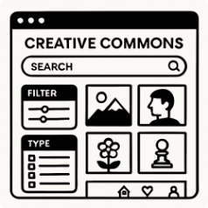
Recommended Tools for Licence-Safe Content
These platforms provide access to openly licensed or rights-cleared content suitable for academic and creative projects.
GitHub
Unsplash
CC Search / Openverse
The world's largest code-sharing platform. Most repositories display their licence prominently. Always check — and respect — the licence before cloning, forking, or incorporating code. Use the licence filter when searching for reusable projects.
A library of high-quality photographs available for free use under the Unsplash Licence — which permits commercial and non-commercial use without attribution (though attribution is appreciated). Great for presentations, websites, and publications.
Search across millions of openly licensed images, audio, and video from platforms like Flickr, Wikimedia, and more. Filter by specific CC licence type to match your project's needs.

Slide 16

Cybersecurity: The Main Risks for University Users
Universities are among the top targets for cyberattacks — they hold valuable research data, student records, and financial information, often with less mature security infrastructure than corporations.
🎣 Phishing
Fraudulent emails or messages designed to steal credentials or install malware.
🔓 Weak Passwords
Reused or simple passwords make accounts easy to compromise through brute force or credential stuffing.
📱 Unpatched Devices
Outdated software contains known vulnerabilities that attackers actively exploit.
☁️ Data Leakage
Sensitive information shared with AI tools or cloud services without understanding data retention policies.

Slide 17
Phishing in the Age of AI
Phishing — the attempt to trick users into clicking malicious links or handing over credentials — has existed for decades. But AI has made these attacks dramatically more convincing and harder to spot.
Traditional Phishing
AI-Enhanced Phishing
Generic greetings ("Dear User")
Poor grammar and spelling
Obvious sender spoofing
One-size-fits-all messaging
Personalized using scraped social data
Perfect grammar and professional tone
Cloned websites and deepfake audio/video
Contextually relevant and timely
Relatively easy to detect with training and awareness.
Significantly harder to detect — even for trained professionals.
If an email creates urgency, requests credentials, or asks you to click a link — stop and verify by contacting the sender through a known, separate channel before acting.

Slide 18
Device Protection Essentials
Your personal devices are the front door to university systems, personal data, and sensitive research. Keeping them secure is a shared responsibility — and it starts with three fundamentals.
Use Strong, Unique Passwords
Enable MFA Everywhere
Keep Software Updated
Multi-Factor Authentication adds a second verification step beyond your password. Even if your password is stolen, MFA prevents unauthorized access. Use an authenticator app rather than SMS where possible.
Never reuse passwords across accounts. Use a reputable password manager (e.g., Bitwarden, 1Password) to generate and store long, random credentials for every service.
Enable automatic updates for your OS, browsers, and apps. Most successful cyberattacks exploit known vulnerabilities in outdated software — ones that patches already fix.

Slide 19

AI Tools & Sensitive Data: A Serious Risk
When you paste text into an AI chatbot, you may be sharing it with the AI provider's servers — and it could be used to train future models. This is not hypothetical: several real-world incidents have occurred.
Never Paste Personal Data
Student IDs, health records, contact details, financial information — these are protected by FERPA, GDPR, and university policy.
Never Paste Research Data
Unpublished findings, confidential datasets, or IP under development could be exposed or claimed by the AI platform.
Check Data Retention Settings
Most AI tools allow you to disable conversation history. Always review privacy settings before using institutional information.

Slide 20

Training Complete
Your AI Safety Checklist
Before you close this training, commit these principles to practice. Every time you use AI tools, encounter new content, or work on a university device — run through this checklist.
✔ Check the Licence
✔ Recognize Phishing
Before using any image, text, or code — verify its licence. No licence means no use. Document your compliance.
Pause before clicking any link or sharing credentials. Verify urgency-inducing messages through a separate channel.
✔ Protect Your Data
✔ Use AI Responsibly
Never paste sensitive, personal, or institutional data into AI tools. Update devices, enable MFA, use a password manager.
Treat AI output as a draft. Cite your tools, add your own voice, and respect academic integrity policies at all times.
You've completed the AI4Uni training on Copyright, Licences & Device Protection. Questions? Contact your university's IT or legal compliance team.

