Slide 1
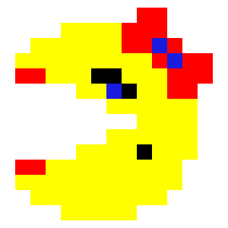
Using a DQN to simulate an Agent playing MsPacman
Ty Turner
Data Science
w/ Dr. Cook

Slide 2
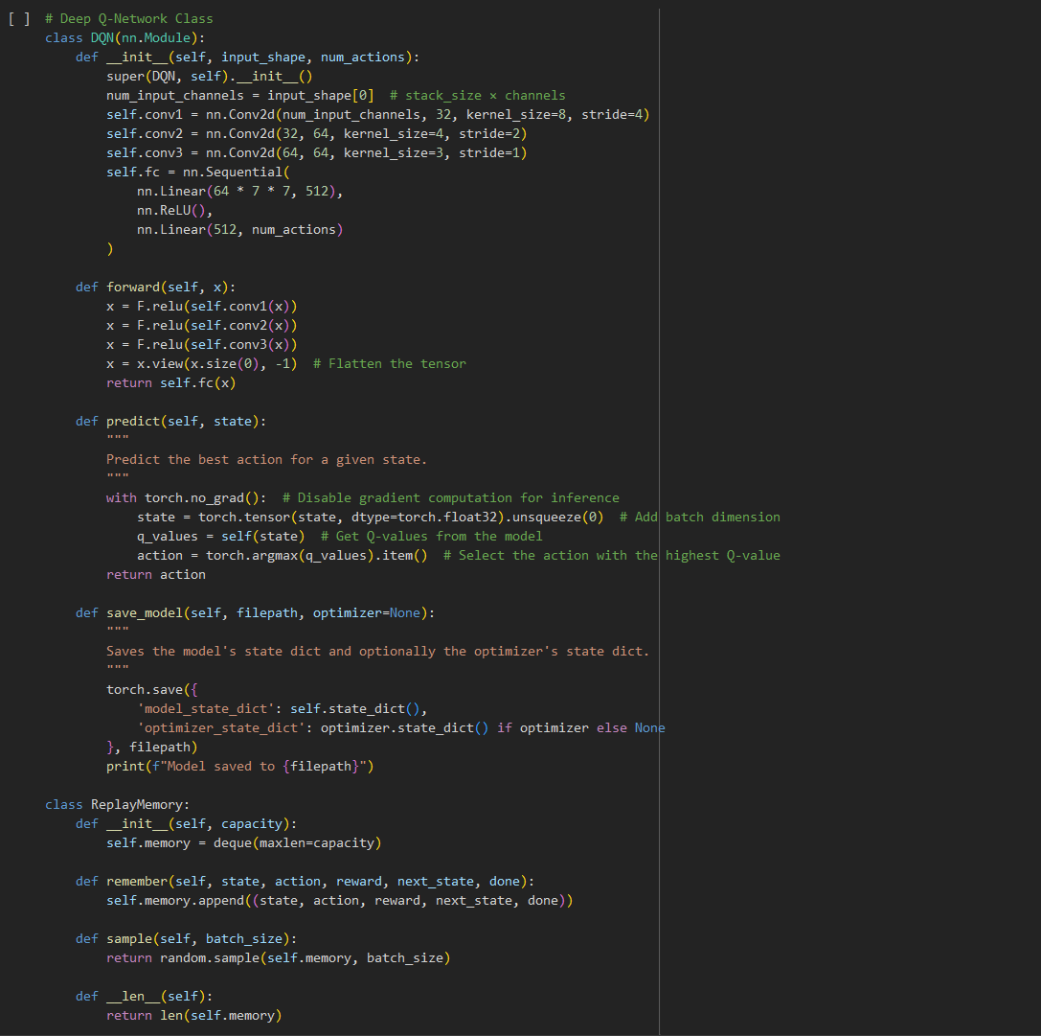
Building the DQN-Model
Using Pytorch packages, we build a DQN model that fits the Gymnasium Atari screen-size shape, as well as what types of hidden layers we want to handle the processing that our model undergoes to process the environment/state.
Building a ReplayMemory function to help train our model from past episodes.

Slide 3
Necessary Functions to run our DQN-Model
An environment in which our model will be training in and will be evaluated in.
A reward structure, to ensure you get the model is properly rewarded for doing “good” tasks and is rewarded negatively for performing “bad” tasks.
Preprocess Frame and Frame Stack functions, to process the frames and then to stack them properly for our DQN model to perform.
A Training function to the basic Q-value calculations to help move and train our model properly.
An evaluation loop with some sort of video recording implementation, so we can visually see how well our model is or isn’t doing.

Slide 4
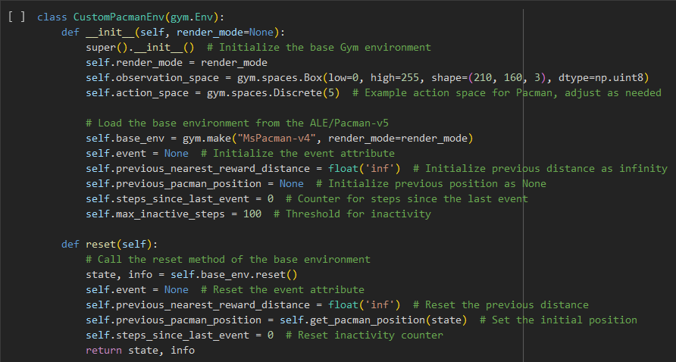
Overwriting to make our own Custom Mspacman Environment from Gymnasium
If we don’t overwrite the original Gymnasium Environment, we are at the mercy of their base code and their base structure that they have set up for a basic model.
Overwriting this, allows more and more control into our hands, allowing us to insert more order where it wouldn’t exist in the base environment.

Slide 5
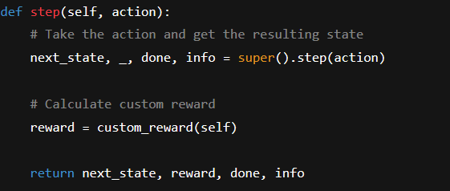
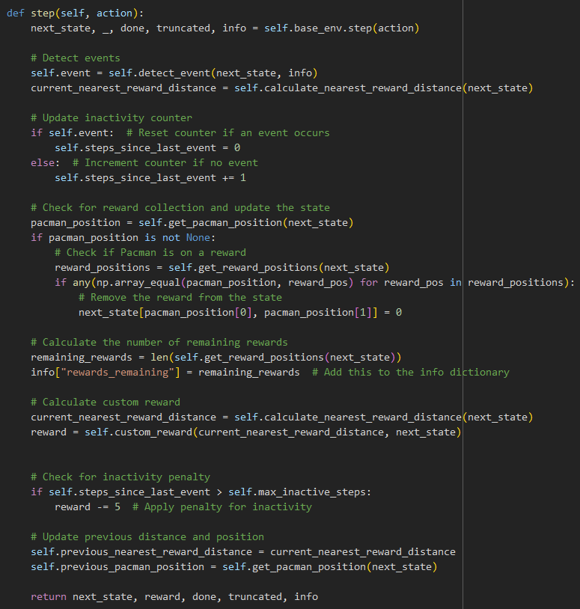
Overwriting to make our own Custom Mspacman Environment from Gymnasium
To our left, was the original step function for our gymnasium environment.
This is our new updated step function, allowing us to implement methods to detect inactivity (running into a wall), detecting whether we are closer or further away from our reward than previously, and anything else you think you would need on a step-by-step basis

Slide 6
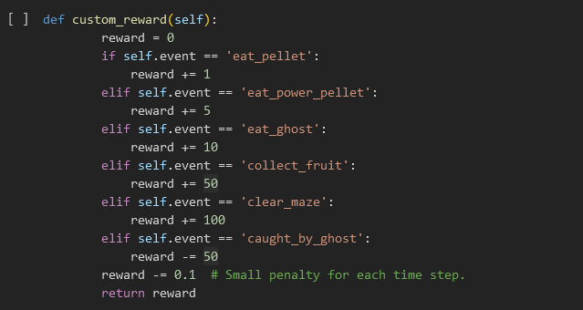
Reward Function
This was the general reward function given to us on Gymnasium for the Mspacman-v4 game.
It doesn’t have enough nuance in itself to properly train the model effectively.
We need to add sets of rules to help guide our model in the direction we want, so our model doesn’t need several 10s of thousands of episodes to begin to look functional.

Slide 7
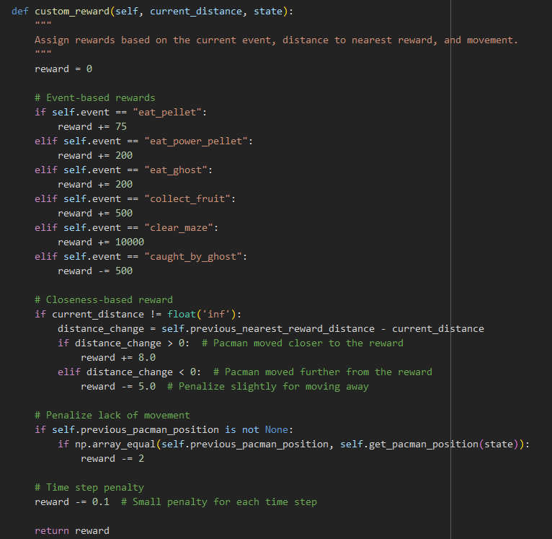
Reward Function
This reward function will act as a huge hyperparameter, to reinforce your model to prioritize the set of rules you give it via +rewards or -rewards.
This is generally called upon when your model takes the .step() action.

Slide 8
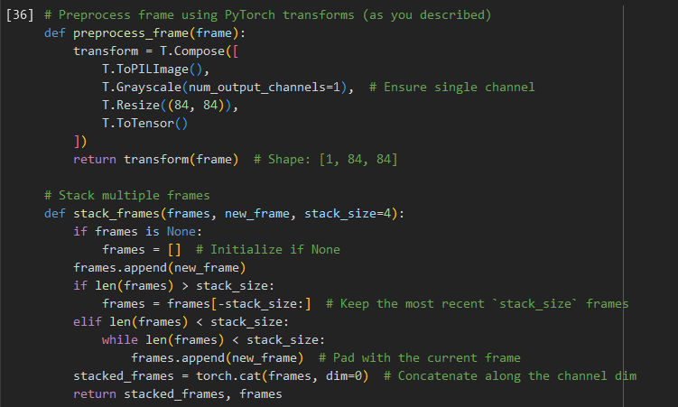
Preprocess and Stack Frame Functions
This code preprocesses game frames by converting them to grayscale, resizing them to 84x84, and normalizing them into a tensor for efficient model input.
It also manages a stack of consecutive frames to capture temporal information, essential for understanding dynamics in the environment.
By maintaining and padding a fixed number of frames, it ensures consistent input dimensions while emphasizing recent observations.

Slide 9
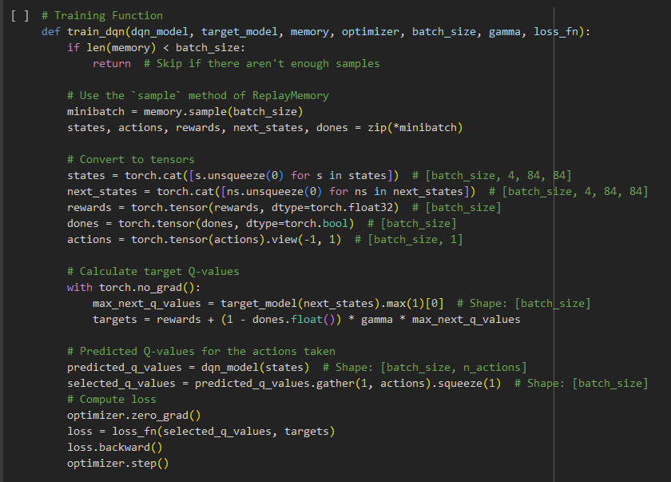
Training Function
This function trains our DQN model by sampling a batch of experiences from memory, computing the target Q-values using the target network, and minimizing the loss between predicted and target Q-values.
It leverages gradient descent to adjust the model's weights, ensuring better alignment with the optimal action-value function over time.
Key steps include tensor preparation, target computation, and backpropagation using the Adam optimizer.

Slide 10
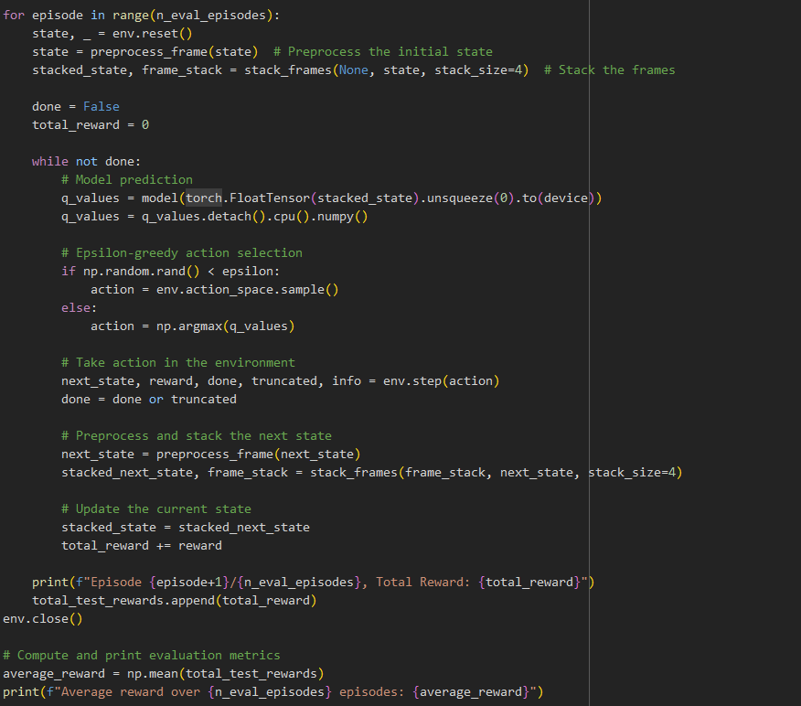
Evaluation Loop
The evaluation loop and the actually training loop are almost entire similar, with the training loop including the remember function as well as the training function.
This effectively allows our agent to “play” in the environment and then we watch back on whichever episode we want that records.

Slide 11
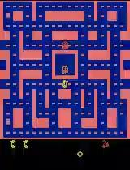
Agent playing MsPacman
Gets a score of 670. Explores bottom left and top left!

