Slide 1
SoC/SoH Estimation by an Adaptive Observer
Targets and Objectives
The drawbacks of Li-ion batteries
Unsafety when overcharged; degradation; high sensitivity to temperature.
Introduce the battery management system (BMS)
Cell balancing; temperature control.
Acquire the SoC and SoH
State of charge (SoC): the ratio between the saved energy and the total energy in the battery.
State of health (SoH): the ability of to store energy, correlated to the age of the battery.
The usage of SoC and SoH
SoH: to predict problems, and to plan replacement.
SoC: based on SoH, to control the battery.
El Lakkis, Mohamad, et al. "Combined battery SOC/SOH estimation using a nonlinear adaptive observer." 2015 European Control Conference (ECC). IEEE, 2015.
Notes:
SoC and SoH are 2 important infos for BMS.

Slide 2
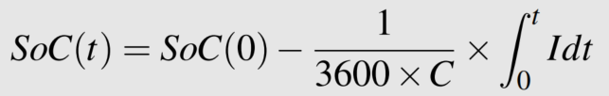
SoC/SoH Estimation by an Adaptive Observer
Existing approaches
SoC acquisition
Direct measurement: open voltage measurement; coulomb counting -
State and/or parameter estimation: Kalman filters, Luenberger observers and so on.
SoH acquisition
Number of charging/discharging cycles;
Charging curves;
Capacity;
Internal resistance.
El Lakkis, Mohamad, et al. "Combined battery SOC/SOH estimation using a nonlinear adaptive observer." 2015 European Control Conference (ECC). IEEE, 2015.
Notes:
And there are several existing approaches to acquire SoC and SoH. This paper is basically based on Luenberger observer to achieve SoC estimation and on the estimate of internal resistance to predict SoH.

Slide 3
SoC/SoH Estimation by an Adaptive Observer
The paper in a nutshell
The nonlinearity of the mathematical model
The internal parameters change with time (depending on SoC and/or T);
Two sets of parameters due to the current direction (charging and discharging).
Apply an adaptive observer to achieve combined estimation
State estimation: SoC.
Parameter identification: R₀ (related to SoH).
Based on a switching mechanism
to minimize the transinent peaks
due to the discontinuity between charging and discharging phrases.
El Lakkis, Mohamad, et al. "Combined battery SOC/SOH estimation using a nonlinear adaptive observer." 2015 European Control Conference (ECC). IEEE, 2015.
Notes:
This paper introduced a nonlinear model of the battery first. The model is nonlinear because ...
And then they applied an adaptive observer to achieve a joint estimation of state SoC and Parameter R0.

Slide 4
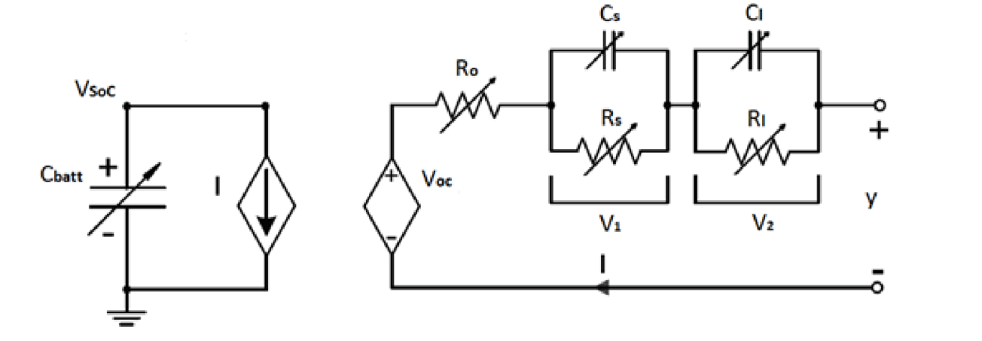
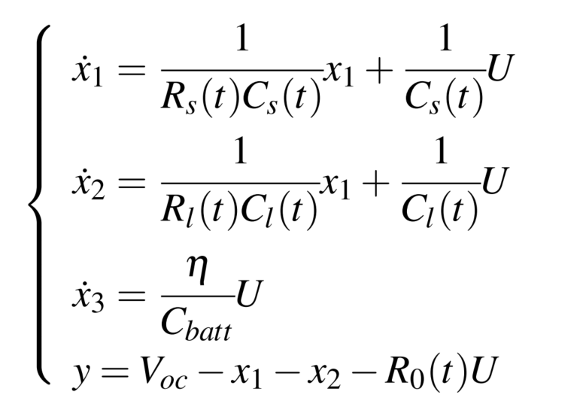
SoC/SoH Estimation by an Adaptive Observer
Nonlinear equivalent model
The input U is the current I;
the output y is the termial voltage.
The states are V₁, V₂, and SoC respectively,
where V₁ and V₂ are the transient responce.
The variable parameters are
R_{s}, C_{s}, R_{l}, C_{l}, ohmic resistance R₀, and
open circuit voltage V_{oc}.
Two sets of parameters based on the current direction.
Equivalent circuit based model
El Lakkis, Mohamad, et al. "Combined battery SOC/SOH estimation using a nonlinear adaptive observer." 2015 European Control Conference (ECC). IEEE, 2015.

Slide 5
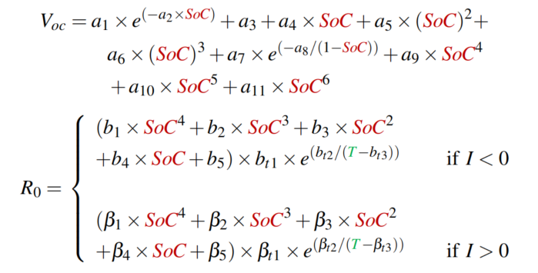
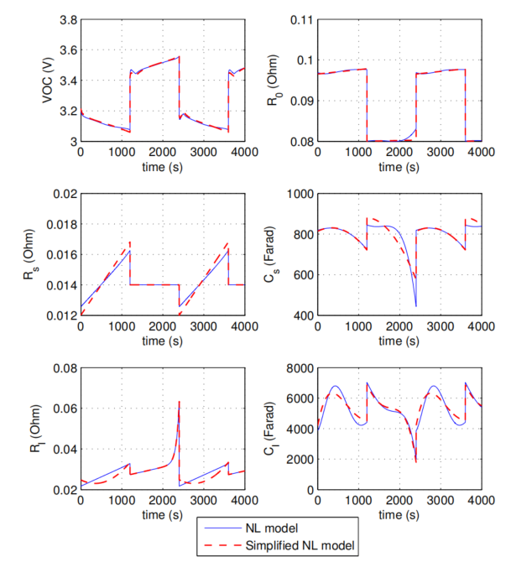
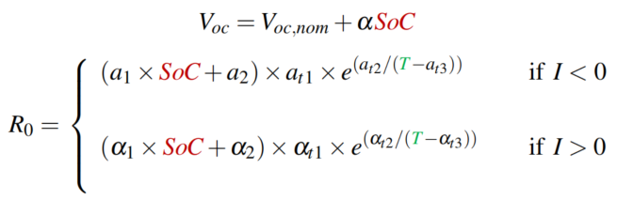
SoC/SoH Estimation by an Adaptive Observer
Correlation between internal parameters and SoC and T
↓ simplify
to correct the output equation and
to update the variable parameters on each iteration
Nonlinear original model VS nonlinear simplified model
El Lakkis, Mohamad, et al. "Combined battery SOC/SOH estimation using a nonlinear adaptive observer." 2015 European Control Conference (ECC). IEEE, 2015.
Notes:
Because for all the resistances and capacitances they share a common structure, so here we just show the one of R0.
The simplified model has a good approximation of the original one.
The formula for Voc is used to
while the ones for the rest are ...

Slide 6
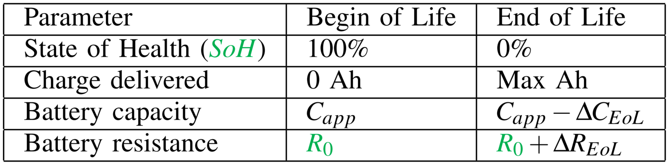
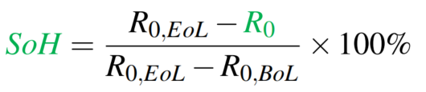
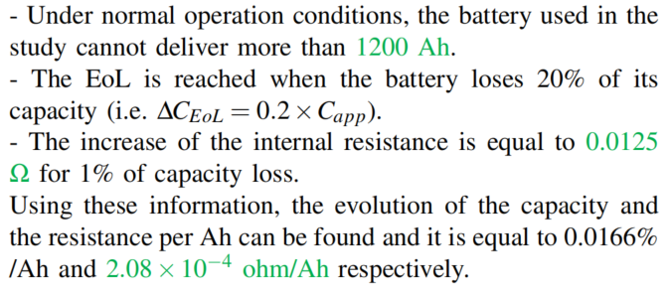
SoC/SoH Estimation by an Adaptive Observer
Ageing model (the relationship between SoH and R₀)
Predict the SoH by the estimate of R₀
Begin of Life VS End of Life
El Lakkis, Mohamad, et al. "Combined battery SOC/SOH estimation using a nonlinear adaptive observer." 2015 European Control Conference (ECC). IEEE, 2015.
Notes:
The ageing model is actually the correlation between SoH and capacity and resistance.
At the end of life,
Based on this, we can predict

Slide 7
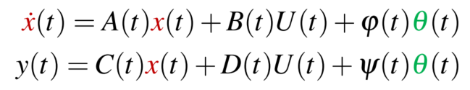
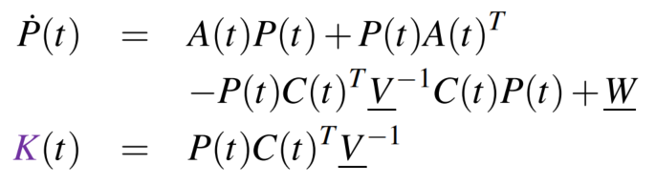
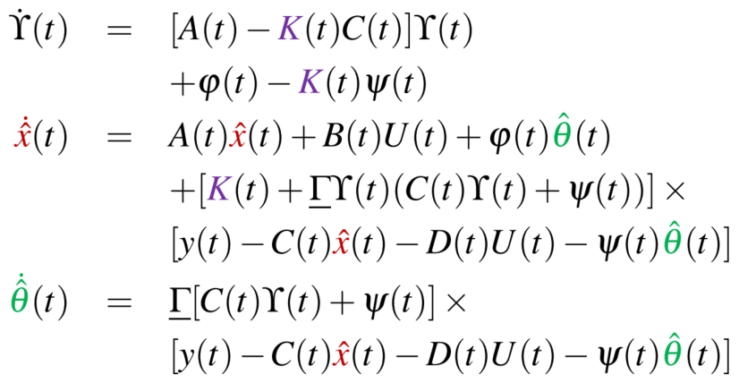
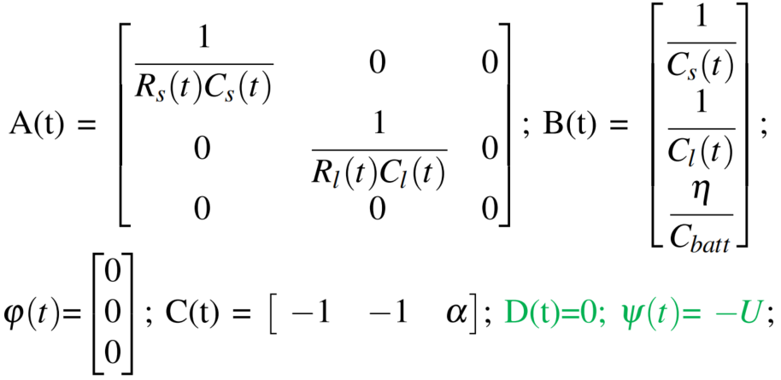

SoC/SoH Estimation by an Adaptive Observer
Adaptive observer
Li, Xiuliang, Qinghua Zhang, and Hongye Su. "An adaptive observer for joint estimation of states and parameters in both state and output equations." International Journal of adaptive control and signal processing 25.9 (2011): 831-842.
Notes:
The adaptive observer is designed for linear systems in structure like this. So based on it, the observer can achieve the joint estimations of state x and parameter \theta. The additional state \upsilon is introduced to make the linear combination x - \upsilon * \theta converges to zero as time goes to infinity. And the gain matrix K can be calculated by solving the Riccati equation written on the right hand. It will make the observer converge in an optimal way, which shares the same idea as the LQR controller. The matrix V, W plus \gamma can be assigned by trial and error. Finally, the matrices can be written based on the mathematical model we introduced before. But it’s worth noting that in order to put R0 into the parameter vector \theta, we need to reconstruct the output equation a little bit. Which is that we assign current as \psi but not U.

Slide 8
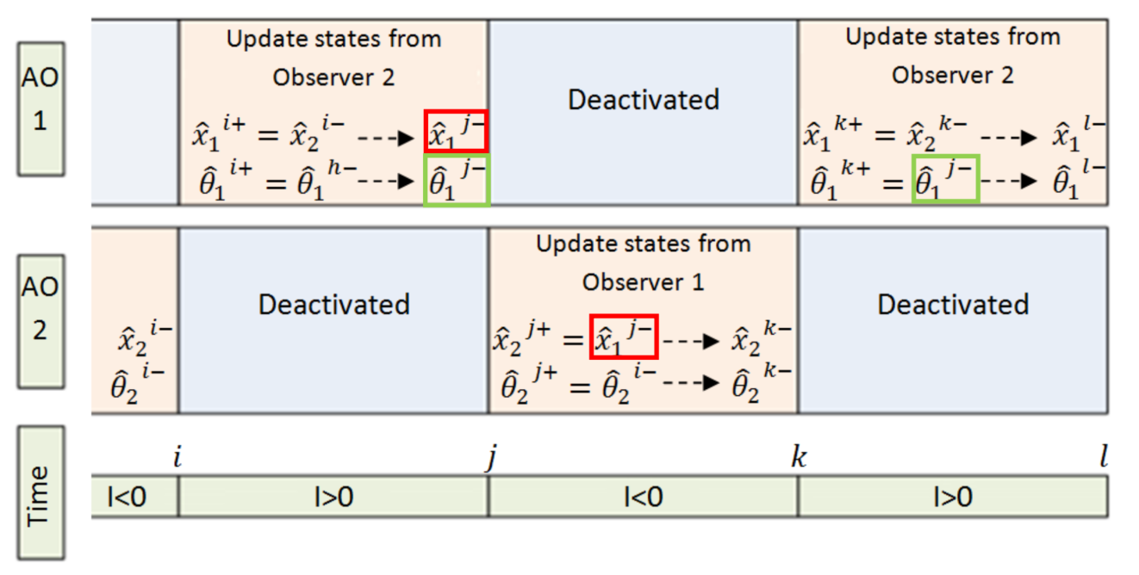
SoC/SoH Estimation by an Adaptive Observer
Switching observer
To minimize the transinent peaks in estimation curves;
2 observers with the same structure are used (charging/ discharging);
The estimate of states are updated continuously;
while the one of parameter is saved and updated in each observer individually.
Switcing mechanism
El Lakkis, Mohamad, et al. "Combined battery SOC/SOH estimation using a nonlinear adaptive observer." 2015 European Control Conference (ECC). IEEE, 2015.

Slide 9
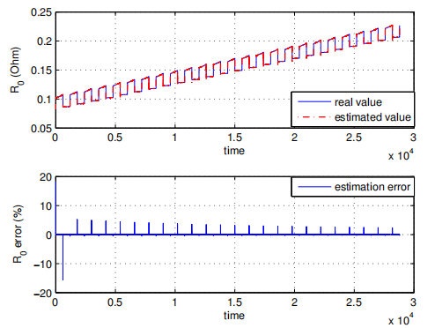
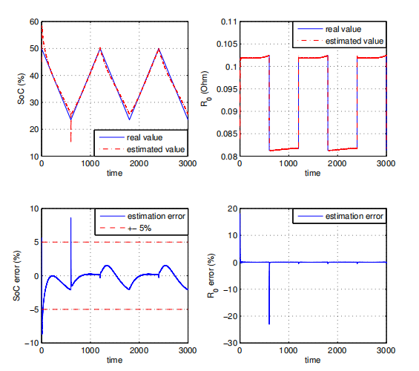
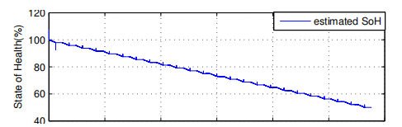
SoC/SoH Estimation by an Adaptive Observer
Simulation 1
Constant temperature and
constant charging/ discharging current
SoH estimation with ageing
SoC and R₀ estimation
El Lakkis, Mohamad, et al. "Combined battery SOC/SOH estimation using a nonlinear adaptive observer." 2015 European Control Conference (ECC). IEEE, 2015.

Slide 10
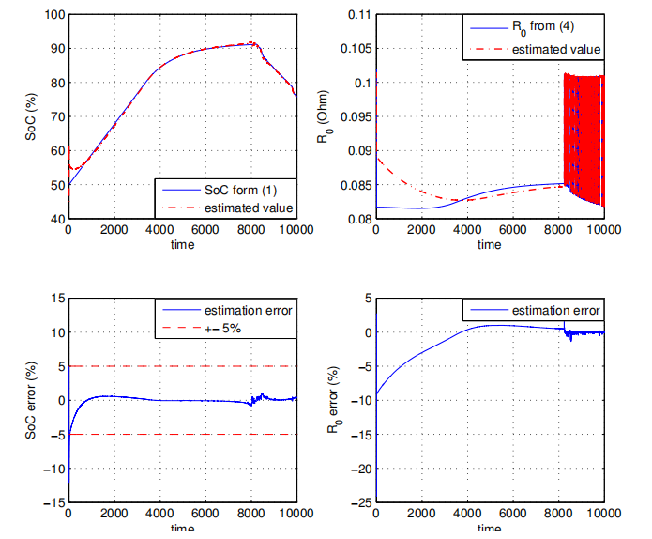
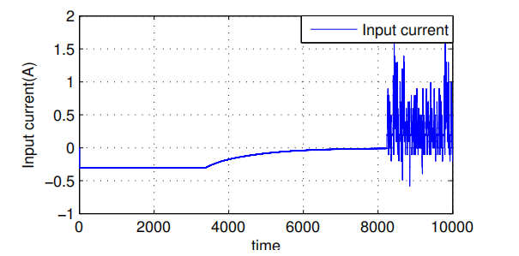
SoC/SoH Estimation by an Adaptive Observer
Simulation 2
The current used is a charging/ discharging driving cycle for an electrical vehicle available at the Politecnico di Milano
Charging/ discharging driving cycle
Validation of the proposed observer
El Lakkis, Mohamad, et al. "Combined battery SOC/SOH estimation using a nonlinear adaptive observer." 2015 European Control Conference (ECC). IEEE, 2015.

