Slide 1

AI-Powered Mental Health Self-Analysis Model
Welcome to our AI/ML Engineer Intern Assignment on developing a Self-Analysis Mental Health Model. This innovative project aims to predict potential mental health conditions based on user-reported symptoms, designed for integration into chatbots or applications.
Our journey will take us through data preparation, model development, optional LLM experimentation, and the creation of a user-friendly interface. Let's embark on this exciting adventure in AI-driven mental health analysis!
UT
by UDIT TYAGI

Slide 2

Data Preparation: Building the Foundation
Dataset Selection
We'll utilize publicly available mental health datasets, including the Mental Health in Tech Survey, Depression and Anxiety Symptoms Dataset, and WHO Mental Health Database. These diverse sources will provide a comprehensive foundation for our model.
Data Cleaning & Preprocessing
Our focus will be on ensuring data consistency and usability. We'll handle missing values, normalize text data, and perform exploratory data analysis (EDA) to uncover relationships between symptoms and conditions.
Feature Engineering & Selection
We'll encode symptoms and conditions as input features and labels, then identify the most impactful features for prediction. This step is crucial for building an accurate and efficient model.

Slide 3
Model Development: Crafting the Predictor
Model Selection
Evaluation Metrics
We'll develop and train a multi-class classification model for mental health condition prediction. Our approach involves comparing at least two models, such as Random Forest, XGBoost, Logistic Regression, Neural Networks, or Transformers. The selection will be based on performance metrics and interpretability.
To ensure our model's effectiveness, we'll use a range of evaluation metrics: - Accuracy - Precision - Recall - F1-score - ROC-AUC (for binary or multi-class classification)

Slide 4

Model Interpretation: Unveiling the Black Box
SHAP Analysis
LIME Explanation
We'll employ SHAP (SHapley Additive exPlanations) to interpret our model's predictions. This technique will help us understand which features contribute most to each prediction, enhancing the model's transparency.
LIME (Local Interpretable Model-agnostic Explanations) will be used to provide local interpretations of our model's decisions. This will offer insights into why specific predictions are made for individual cases.
Visualization
We'll create intuitive visualizations of our model's decision-making process, making it easier for non-technical stakeholders to understand and trust the predictions.

Slide 5


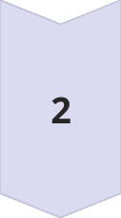

LLM Experimentation: Enhancing User Experience
Natural Language Explanations
We'll explore using a free or open-source Large Language Model (LLM) to provide natural language explanations for predicted mental health conditions. This will make our model's output more accessible and understandable to users.
Coping Mechanisms
The LLM will be tasked with suggesting potential coping mechanisms and next steps based on the predicted conditions. This adds valuable, actionable information to our model's output.
Implementation Approach
We'll primarily focus on prompt engineering to generate explanations. As a bonus challenge, we may explore fine-tuning a small transformer model like BERT or T5 for more tailored mental health explanations.

Slide 6
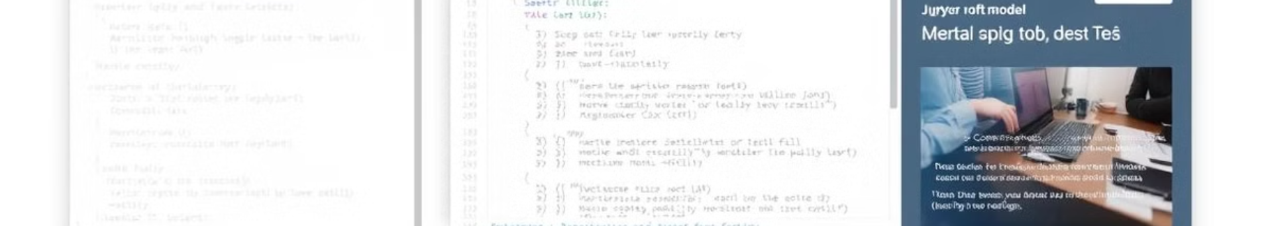



User Interface: Bringing the Model to Life
Command-Line Interface
Jupyter Notebook
Web Interface
We'll develop a CLI script (predict_mental_health.py) for efficient testing and interaction with our model. This will allow users to input symptoms and receive predictions directly in the terminal.
A Jupyter Notebook (model_testing.ipynb) will be created for interactive exploration of the model. This will be particularly useful for developers and data scientists who want to dive deeper into the model's workings.
We'll create a basic web UI using Streamlit or Gradio. This user-friendly interface will allow for easy input of symptoms and clear display of predictions, explanations, and suggested coping mechanisms.

Slide 7
Video Demonstration: Showcasing Our Work
Code Structure Overview
1
We'll start by explaining the overall structure of our codebase, highlighting key components and their interactions.
2
Model Training and Testing
Next, we'll demonstrate the process of training our model and testing its performance using various metrics.
Sample Predictions
3
We'll run through several test inputs, showing how the model makes predictions and provides explanations.
4
SHAP/LIME Explanation
A detailed walkthrough of how we use SHAP or LIME to interpret the model's predictions will be provided.
UI/CLI Demo
5
Finally, we'll show how to run the model using the command-line interface or web UI, demonstrating its real-world applicability.

Slide 8
Submission and Documentation: Wrapping Up
GitHub Repository
Documentation
Video Demonstration
All code will be uploaded to a GitHub repository, including the inference script, LLM experimentation report (if applicable), and UI/CLI implementation files.
A comprehensive README.md or PDF report will be provided, detailing dataset preprocessing steps, model selection rationale, instructions for running the inference script, and UI/CLI usage guidelines.
The 5-10 minute video walkthrough will be included, showcasing all aspects of our project from code structure to model testing and usage.
With these components in place, we'll have successfully completed the AI/ML Engineer Intern Assignment, delivering a powerful and user-friendly Self-Analysis Mental Health Model. This project not only demonstrates technical proficiency but also contributes to the important field of mental health support and awareness.

