Slide 1
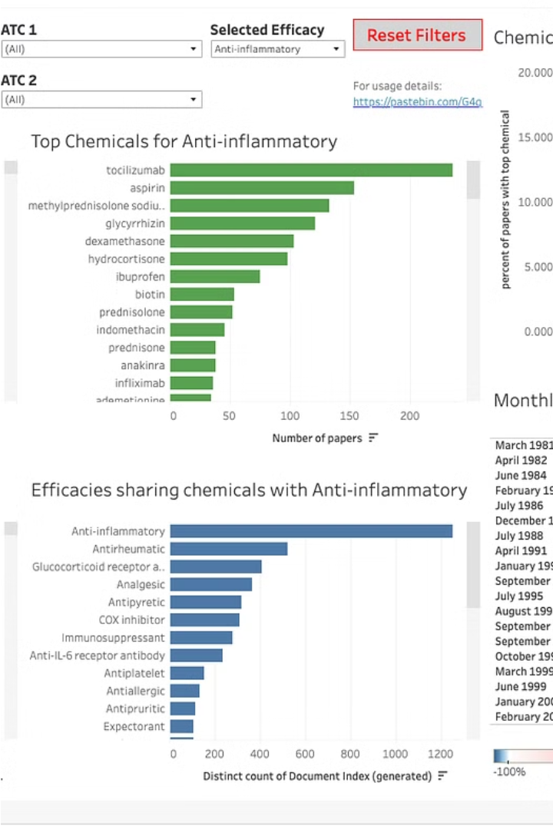

Introduction to COVID-19 Data Analysis
Analyzing COVID-19 data is crucial to understanding the pandemic's impact and informing public health decisions. This presentation will guide you through the key steps of the data analysis process, from gathering reliable sources to uncovering valuable insights and recommendations.
Ua
by UDIT TYAGI

Slide 2
Data Sources and Gathering
1
Reputable Databases
2
Real-Time Tracking
3
Supplementary Data
Collect data from trusted sources like the World Health Organization, Johns Hopkins University, and national health agencies.
Leverage online dashboards and APIs to access the latest COVID-19 case, hospitalization, and mortality data.
Gather additional information on factors like demographics, testing rates, and public health measures to enable a comprehensive analysis.

Slide 3
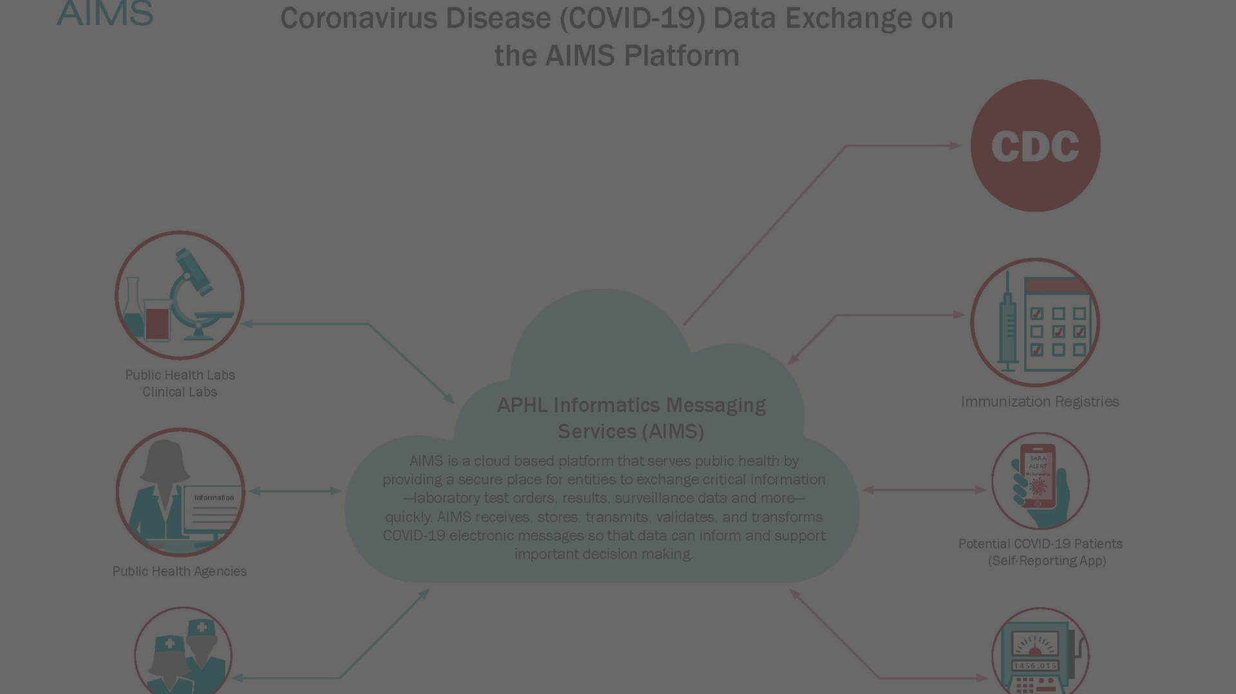
Data Cleaning and Preprocessing
Data Inspection
Carefully review the data for inconsistencies, missing values, and outliers to ensure data integrity.
Data Validation
Implement quality checks to verify the accuracy and completeness of the cleaned data set.
1
2
3
Data Transformation
Convert data into a standardized format, handle date and time formats, and create derived metrics as needed.

Slide 4
Exploratory Data Analysis
Visualizations
Statistical Summaries
Correlations
Create visual representations such as line charts, bar graphs, and scatter plots to identify trends and patterns in the data.
Calculate descriptive statistics like means, medians, and standard deviations to understand the data's distribution and central tendencies.
Analyze the relationships between different variables to uncover potential associations and causal links.

Slide 5
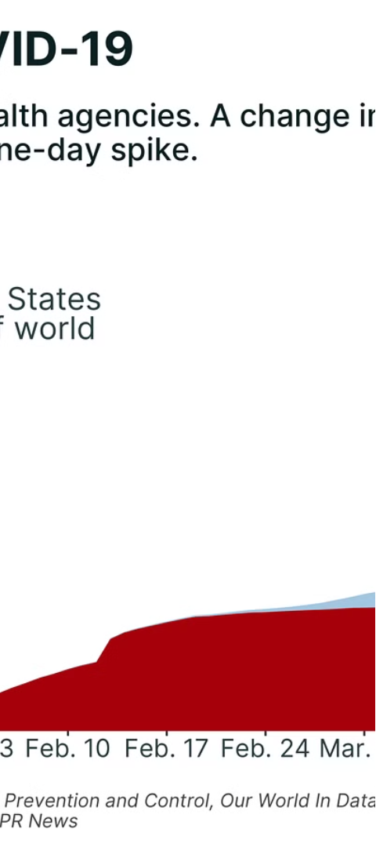



Trend and Pattern Identification
Case Trajectory
Analyze the evolution of COVID-19 cases over time, identifying peaks, declines, and patterns in the data.
Mortality Rates
Examine the trends in COVID-19 mortality rates and how they change across different regions and demographics.
Hospitalization Dynamics
Understand the fluctuations in COVID-19 hospitalizations and the strain on healthcare systems over time.

Slide 6
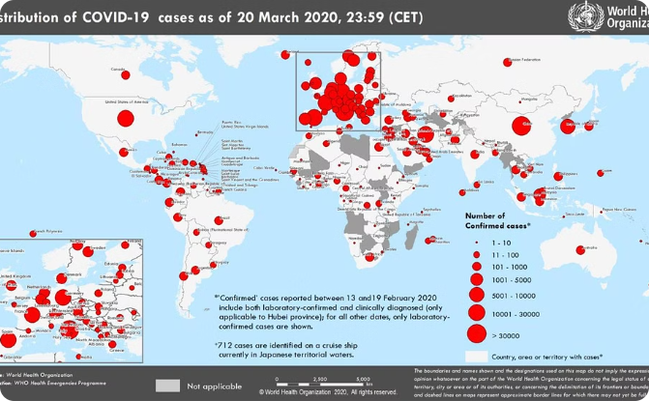
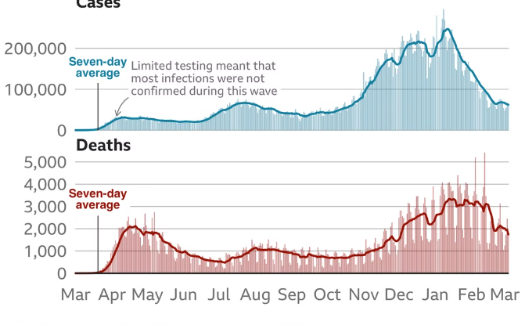
Geographical Analysis
Spatial Patterns
Cross-Regional Comparisons
Visualize the geographic distribution of COVID-19 cases, hospitalizations, and deaths to identify hotspots and regional disparities.
Analyze how COVID-19 metrics vary across different countries, states, or provinces to understand the impact of local policies and interventions.

Slide 7



Risk Factor Identification
Age
Underlying Conditions
Socioeconomic Factors
Investigate the relationship between age and COVID-19 severity, including hospitalization and mortality rates.
Determine the impact of pre-existing medical conditions on COVID-19 outcomes, such as comorbidities like obesity and diabetes.
Analyze how social determinants of health, such as income, education, and access to healthcare, influence COVID-19 risk and outcomes.

Slide 8

Conclusion and Recommendations
Key Insights
Policy Implications
Summarize the critical findings from the data analysis, highlighting the most significant trends, patterns, and risk factors.
Provide recommendations for data-driven public health interventions, resource allocation, and policy decisions to mitigate the impact of COVID-19.
Future Research
Identify areas for further investigation and data collection to continuously improve our understanding of the COVID-19 pandemic.

