Slide 1



Logistic Regression Analysis
Predict whether the patient has 10-year risk of future coronary heart disease (CHD)
The dataset is from an ongoing cardiovascular study on residents of the town of Framingham, Massachusetts. The dataset provides the patients’ information. It includes over 4,000 records and 15 attributes

Slide 2
Dataset Overview
The dataset comprises various health metrics of patients. Our goal is to predict the likelihood of a heart disease event in ten years.
Dataset Size: We had 4118 observations, spanning various metrics like age, gender, glucose levels, smoking habits, and more.
Target Variable: TenYearCHD is a binary outcome “- 1” indicating the onset of CHD in ten years and 0 otherwise. Given that our outcome was skewed, we had many more zeros (no CHD) than ones (CHD).
Predictor Variables:male, age, education, currentSmoker, cigsPerDay BPMeds prevalentStroke prevalentHyp,diabetes, totChol, sysBP, diaBP, BMI, heartRate, glucose.
We've followed a structured and stepwise approach to model creation, starting from understanding the dataset, performing exploratory data analysis, creating a logistic regression model, evaluating its performance, and interpreting its coefficients.

Slide 3
Dataset Preparation
Through observation we have noticed that our dataset had missing values. To address this, we have performed the following actions:
Number of observations (rows) with missing data values = 582 (13.73%)
Total number of missing data values = 645 (0.95% of total data values)
education: 105 missing values (2.48%)
I have performed a quick analysis using GRETL and determine which is highest frequently occurring value (1). I then updated N/A values in the original set with 1
cigsPerDay: 29 missing values (0.68%)
I have performed a MEAN calculation on the cigsPerDay values in the original dataset (rounded value of 9). Then I have updated all the N/A values with the value 9
BPMeds: 53 missing values (1.25%) - I have chosen to delete the records which had missing values from this variable.
totChol: 50 missing values (1.18- I have chosen to delete the records which had missing values from this variable.
BMI: 19 missing values (0.45%) - I have chosen to delete the records which had missing values from this variable. heartRate: 1 missing values (0.02%) - I have chosen to delete the records which had missing values from this variable.
glucose: 388 missing values (9.16%)
I have performed a MEAN calculation on the cigsPerDay values in the original dataset (rounded value of 82). Then I have updated all the N/A values with the value 82

Slide 4
Exploratory Data Analysis
On the cleaned-up data set, I have performed a full Summary statistics report on all variables to have better view of the data we have available.
Then performed a Correlation Matrix analysis to be able to identify the variable or variables to be used in the regression model.
Given the nature of some of the variables the following transformation and normalizations actions were applied:
For the following variables I have used the log transform for the skwed values identified with the Statistics Summary report. I have used the series log_variable = log(variable + 1) in the GRETL console and generated a new variable (Log_variable):
cigsPerDay (highly skewed)
totChol (moderately skewed)
sysBP (highly skewed)
diaBP (moderately skewed)
BMI (highly skewed)
heartRate (moderately skewed)
For the following variables I have opted to normalize the values using Min-Max scaling following this formula: (variable - min(variable)) / (max(variable) - min(variable))
age
log_cigsPerDay
totChol
sysBP
diaBP
BMI
heartRate
glucose

Slide 5
Model Creation
As the outcome of the dependent variable “TenYearCHD” is binary, logistic regression model was the most appropriate choice.
I have initially included all available variables in the model and then iterated with the most significant variables based on the Collinearity report from GRETL. And finally decided on the the predictors: male, norm_age, norm_log_cigsPerDay, and norm_log_glucose, as the predictors with the most statistical significance impact.
After a few sampling tests, I have decided to separate the dataset into a training set and a validation set based on a 80/20 ratio (80% training, 20% validation).
The best model was selected based on its performance on the validation dataset and the statistical significance of predictor variables. The model had a McFadden R-squared of 0.066569, indicating a decent fit. Furthermore, 84.6% of cases were correctly predicted.

Slide 6
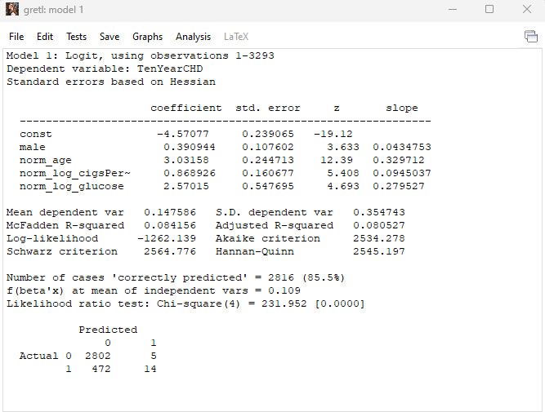
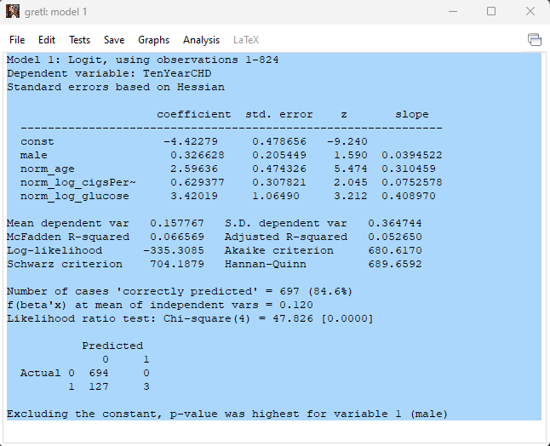
Model Calibration
Training Dataset (80%)
Validation Dataset (20%)

Slide 7
Model Performance
For performance metrics, I have selected Accuracy (to measure overall correctness), Precision & Recall scores (for determining false positives and false negatives) and ROC-AUC (This value indicates a model's ability to distinguish between the positive and negative classes).
These are highly used metrics in models based on medical scenarios. I have assessed the model with these performance metrics, by using a Python script (with Pandas and Sklearn libraries):
- With an ROC-AUC of 0.645, the model can reasonably differentiate between those who will and won't experience TenYearCHD in the next decade.
- The accuracy of 0.628 signifies that the model correctly predicts the TenYearCHD status in about 63% of the cases.
- Precision of 0.251 indicates that out of all predicted positive TenYearCHD cases, only 25.1% actually had the disease. This is highly impacted by our skewed dataset values for the TenYearCHD.
- A recall of 0.671 suggests that the model was able to capture 67.1% of actual positive TenYearCHD cases.

Slide 8
Coefficient and Odds Ratios Interpretation
Coefficients provide direction and magnitude of the relationship between predictors and the outcome. Odds Ratios further allow us to interpret the change in odds given a one unit change in the predictor.
The coefficient values represent the log odds change for a one-unit increase in the predictor, while holding other predictors constant:
male: A positive coefficient (0.326628) indicates that males have higher odds of having TenYearCHD compared to females.
norm_age: With a coefficient of 2.59636, as age increases, the odds of having TenYearCHD increase considerably.
norm_log_cigsPerDay: The positive coefficient (0.629377) indicates that as the number of cigarettes smoked per day increases, so does the odds of having TenYearCHD.
norm_log_glucose: The coefficient of 3.42019 implies a strong positive relationship between glucose levels and the odds of TenYearCHD.

Slide 9
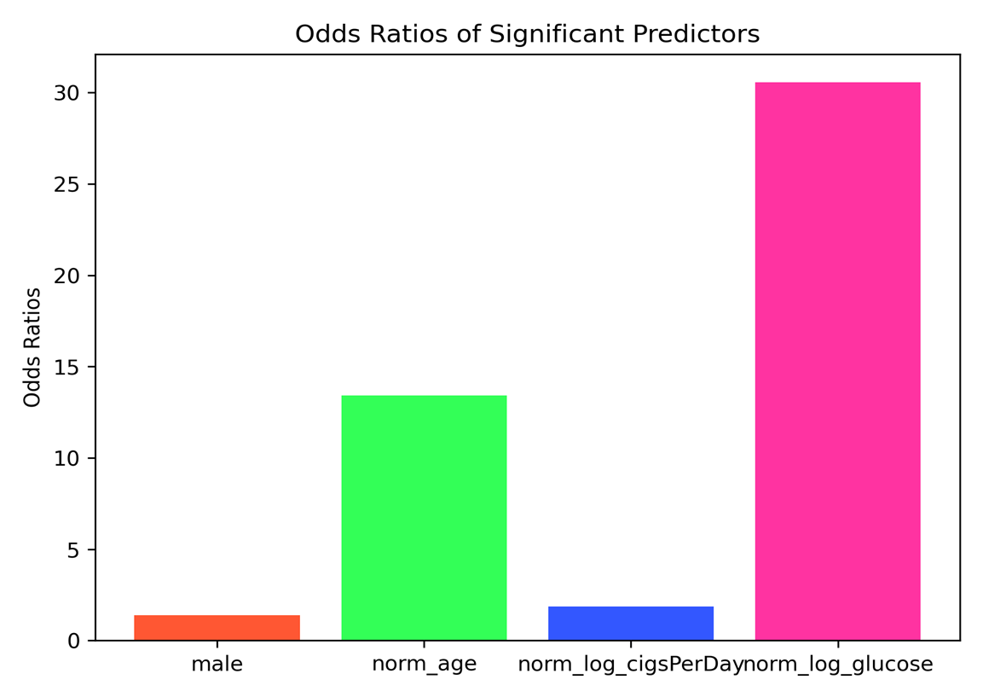
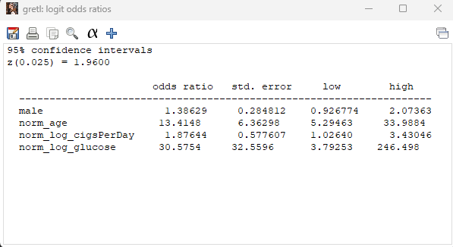
Coefficient and Odds Ratios Interpretation

