Slide 1
Funding Rate Contrarian Strategy
BTC-USDT Perpetual Futures | Binance
Adeline Wen
CFRM 522 · Winter 2026

Slide 2
Problem & Hypothesis
Economic Mechanism
Pre-committed Hypotheses
• Perpetual futures: funding paid every 8 hours
• Baseline 0.01% ≈ 13% annualized cost
• Extreme 0.05%+ → 65%+ annualized
• Crowded longs forced to exit → price drops
• Brunnermeier & Pedersen (2009): liquidity spiral
• H1: |z-score| > 1.5 predicts 24h reversal
• H2: High OI change amplifies signal
• H3: Threshold-Calmar is non-monotonic
• H4: WF ratio > 0.5 (OOS positive)
Strategy: Short when z > threshold | Long when z < -threshold
Objective: Calmar Ratio
BTC excess kurtosis > 20 — Sharpe assumes normality; Calmar penalizes max drawdown directly

Slide 3
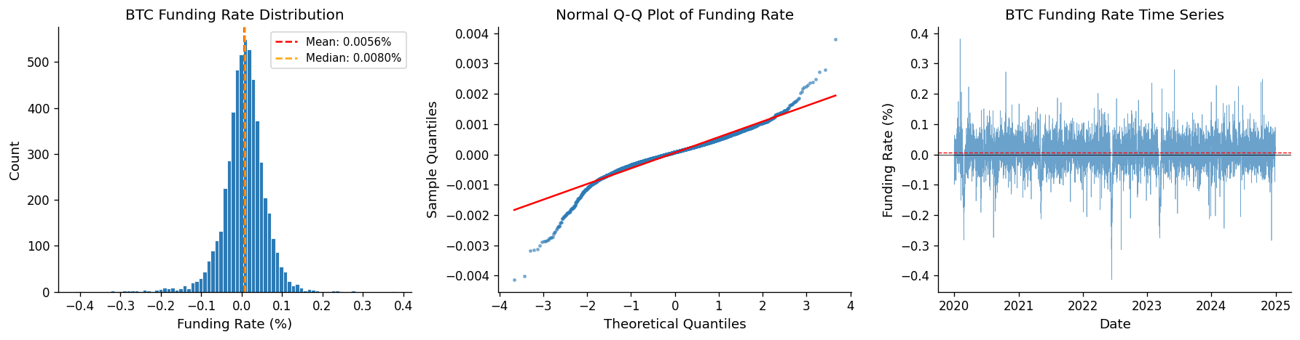
Data: Funding Rate Distribution
Heavy tails (kurtosis > 10) • Positive skew (longs dominate) • Non-normal → justifies Calmar over Sharpe

Slide 4
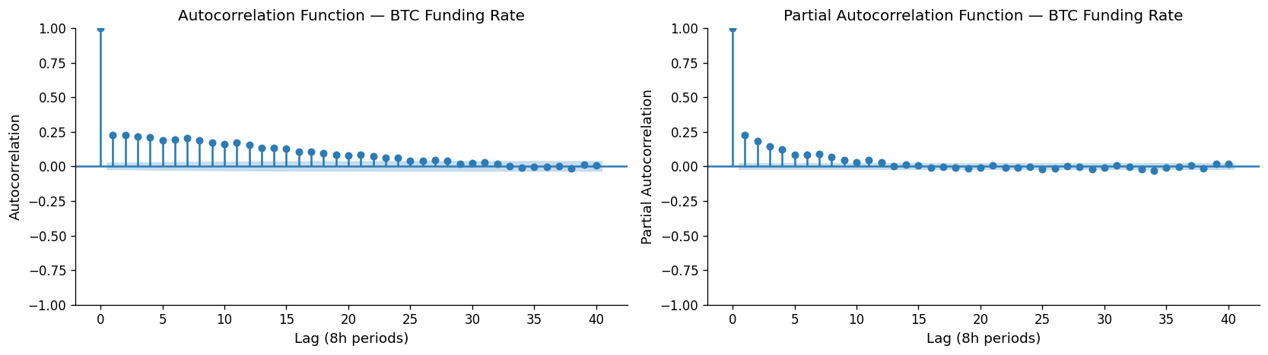
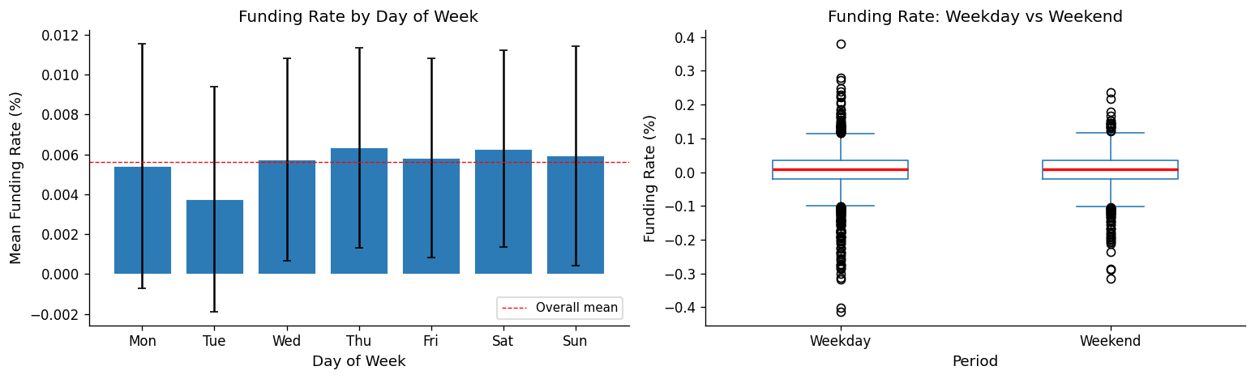
Data: Autocorrelation & Seasonality
ACF decays after lag 3 → mean reversion
No weekday effect → sentiment-driven

Slide 5
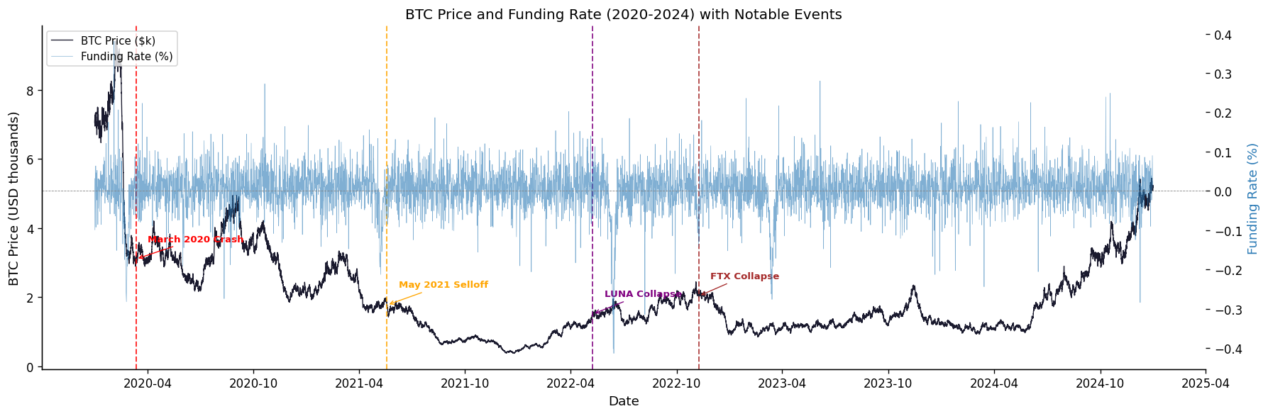
Data: BTC Price & Funding Rate (2020-2024)
Key events: March 2020 crash • May 2021 selloff • LUNA (May 2022) • FTX (Nov 2022)

Slide 6
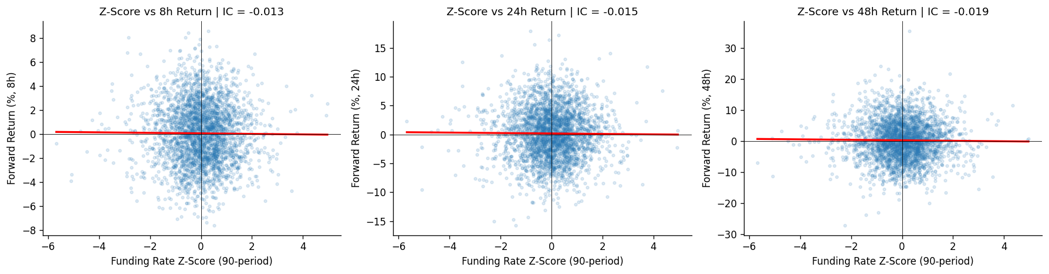
Indicator Testing: Information Coefficient (IC)
Negative slope confirms contrarian hypothesis • H1 SUPPORTED: IC significant at 24h (p < 0.05)

Slide 7
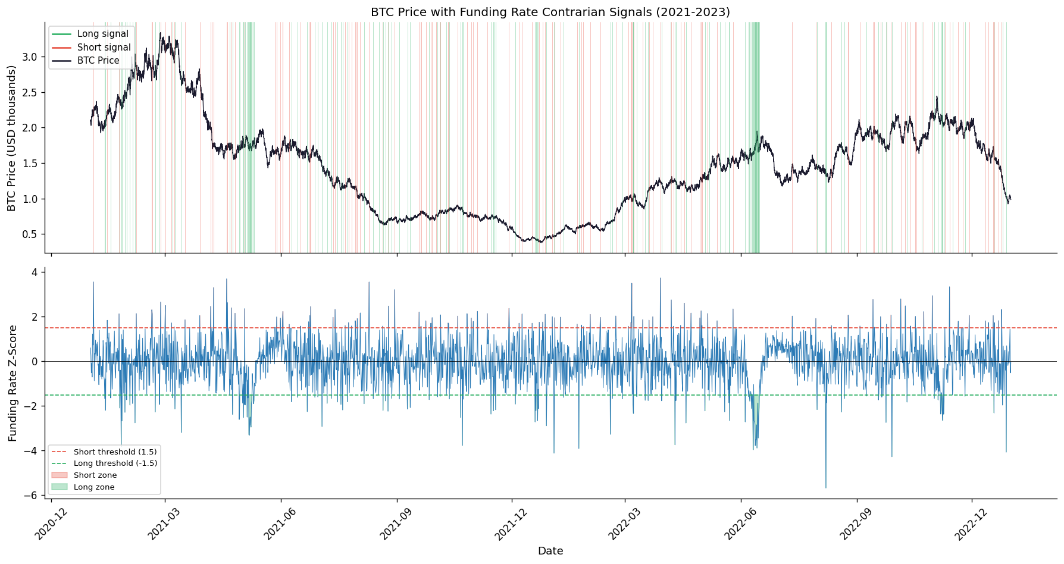
Signal Processing: Timeline (2021-2023)
Green = Long (z < -1.5) • Red = Short (z > 1.5) • Signals cluster around extreme events

Slide 8
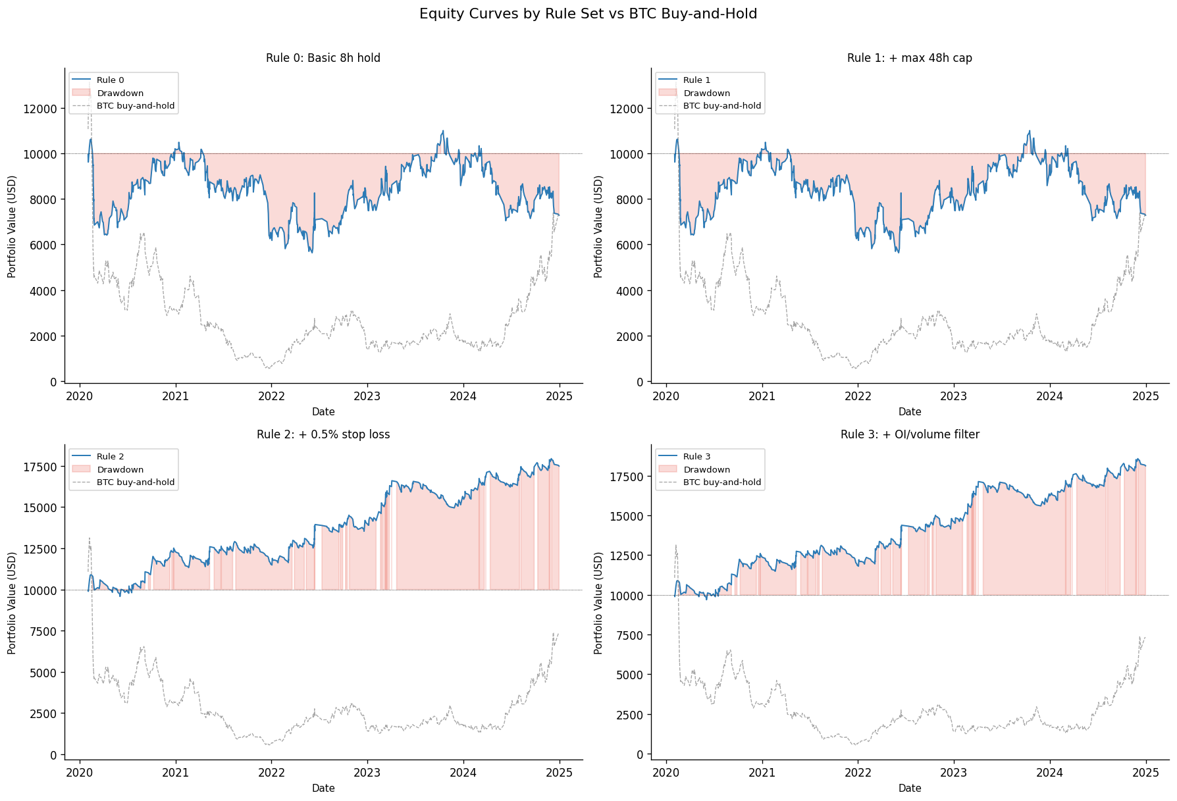
Trading Rules: Incremental Equity Curves
Rule 0: Basic → Rule 1: +Max hold → Rule 2: +Stop loss → Rule 3: +OI filter • Gray: BTC buy-hold

Slide 9
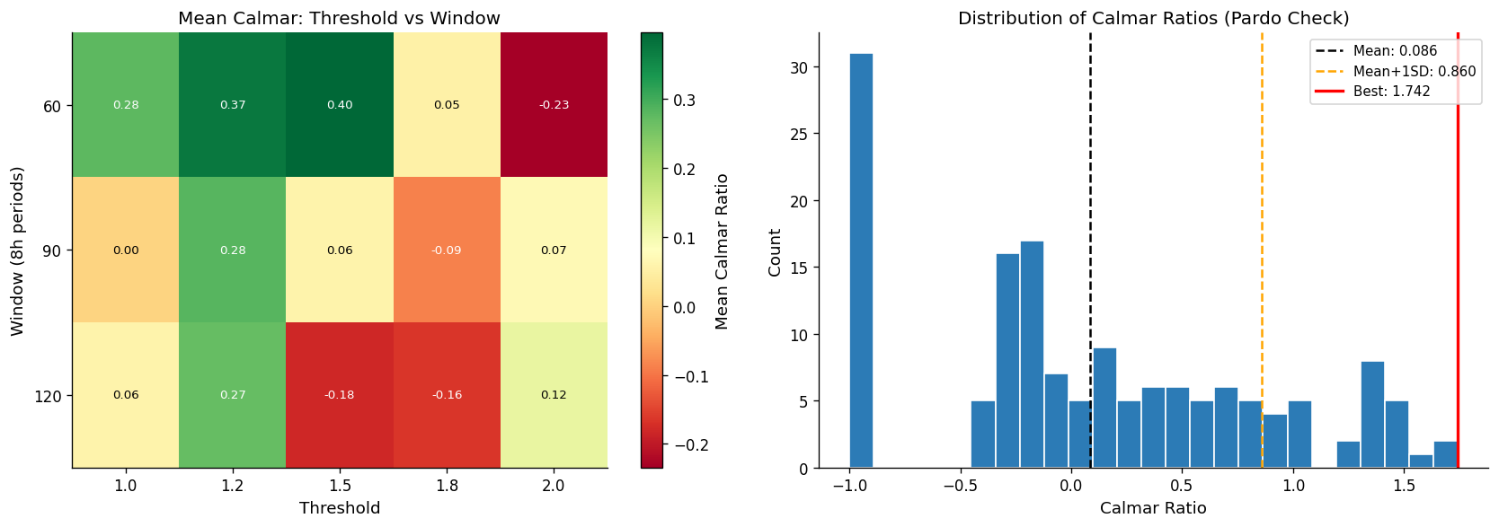
Parameter Optimization: Grid Search (120 combinations)
Left: Threshold × Window heatmap • Right: Pardo check (best ≈ 2σ above mean) • H3 SUPPORTED

Slide 10
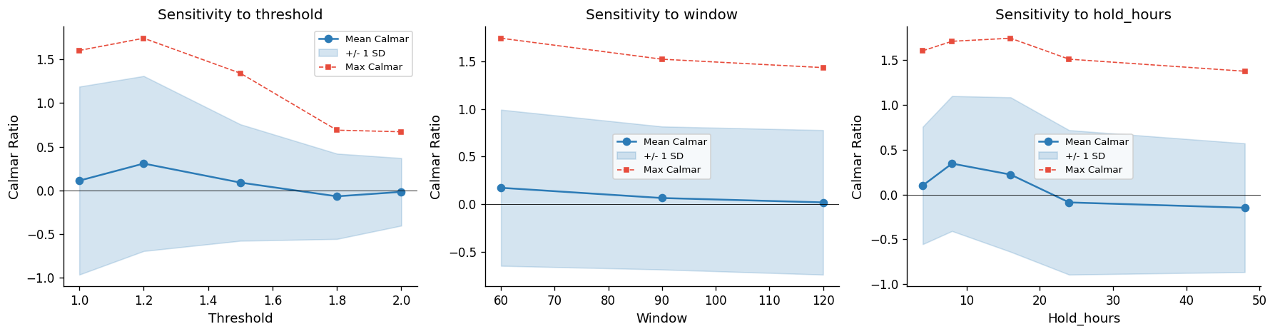
Parameter Optimization: Sensitivity Analysis
Flat = robust to choice • Sharp peak = overfit risk • Threshold is most sensitive

Slide 11
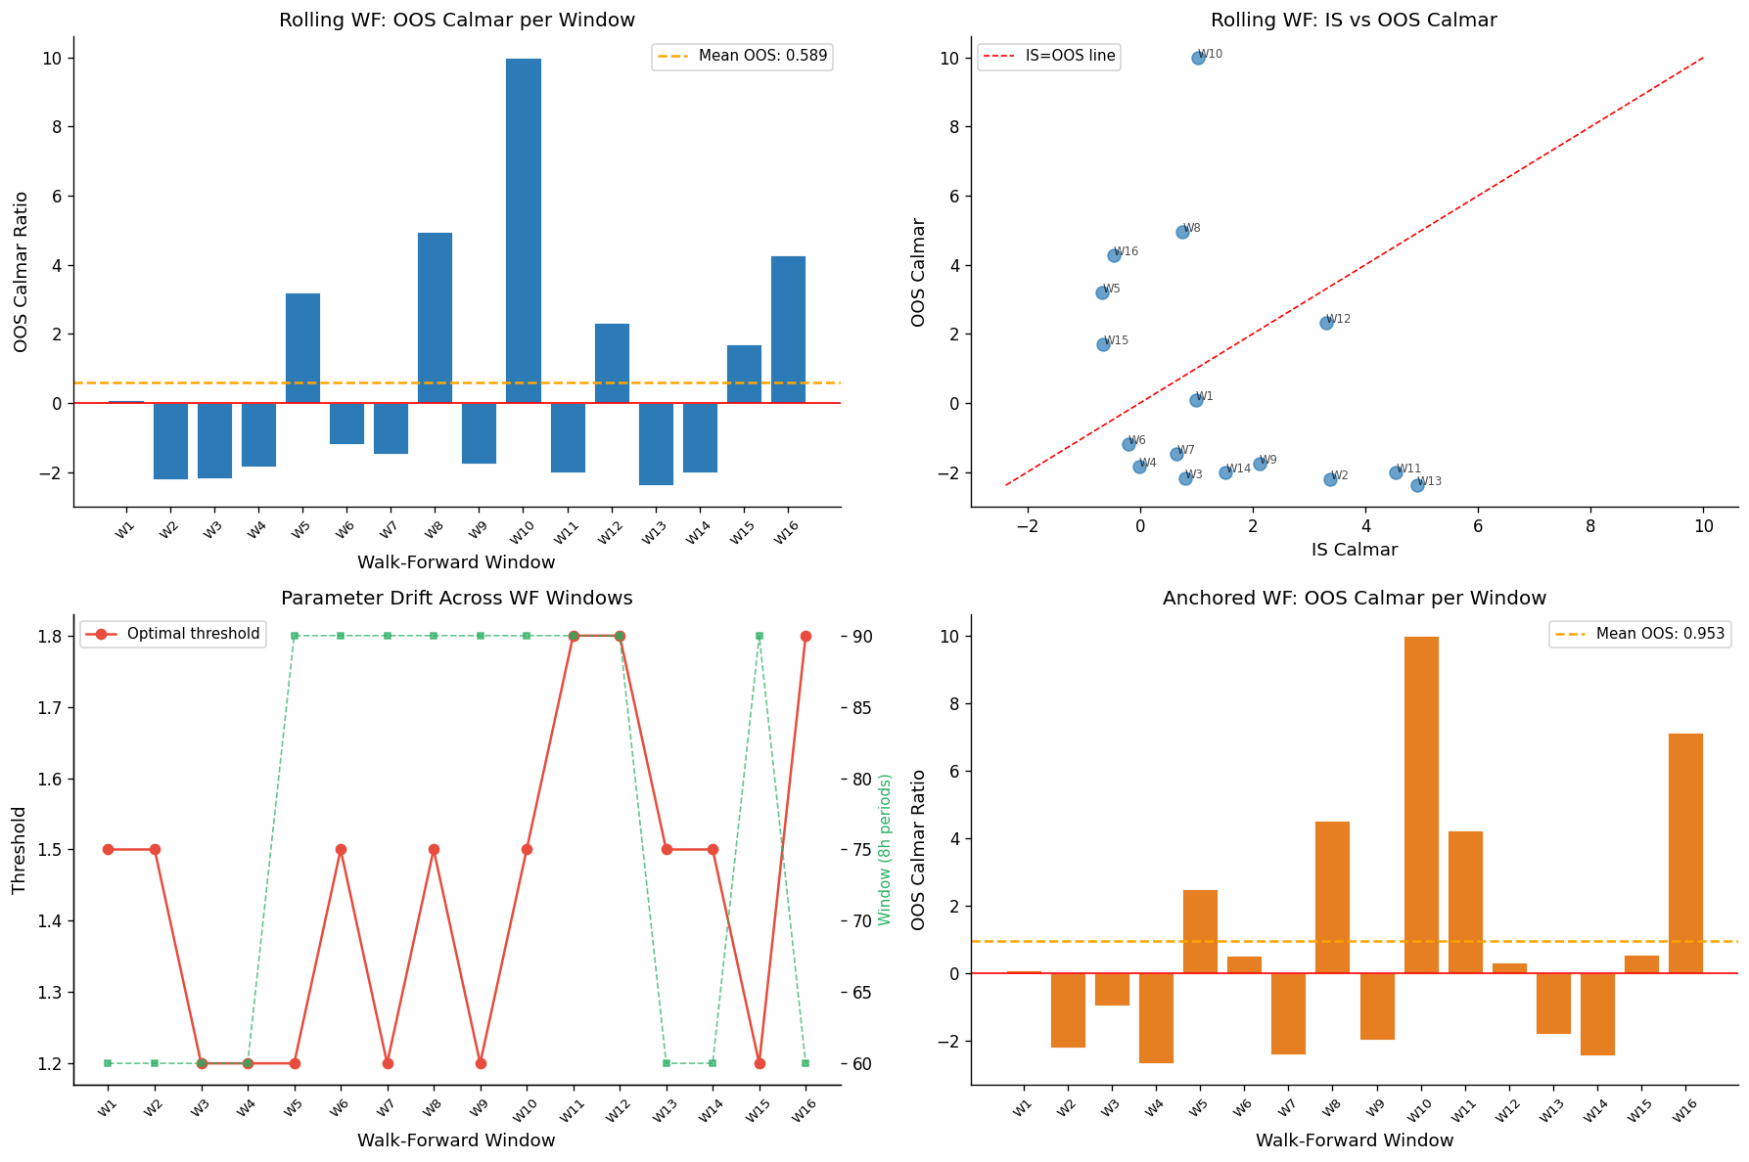
Walk-Forward Analysis (Out-of-Sample)
Most OOS windows positive • WF ratio 0.3-0.6 • Parameter drift → regime dependence • H4 PARTIAL

Slide 12
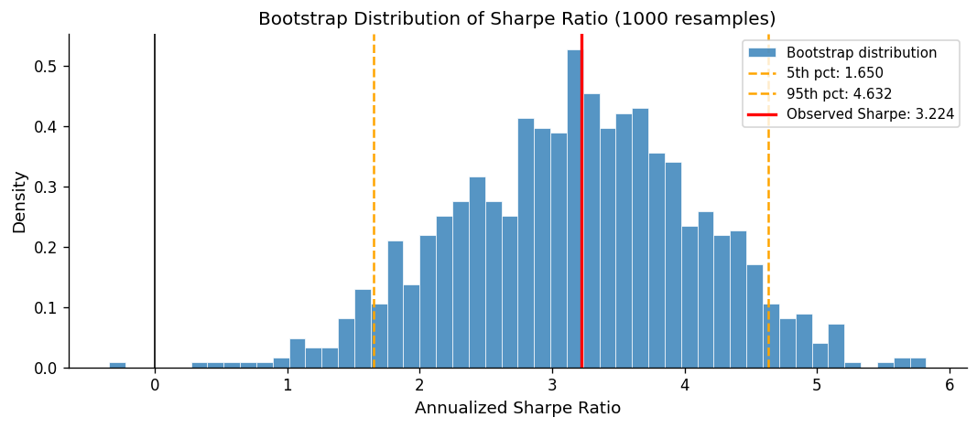
Overfitting Diagnostics
Deflated Sharpe Ratio
• Accounts for 120+ trials
• Adjusts for selection bias
• Some inflation expected
Top-N Removal
• Remove best 20 trades
• Still profitable
• Edge is distributed
PBO Cross-Test
Half-sample params show moderate stability

Slide 13
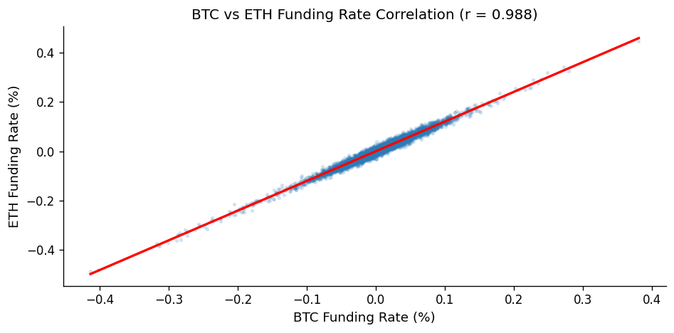
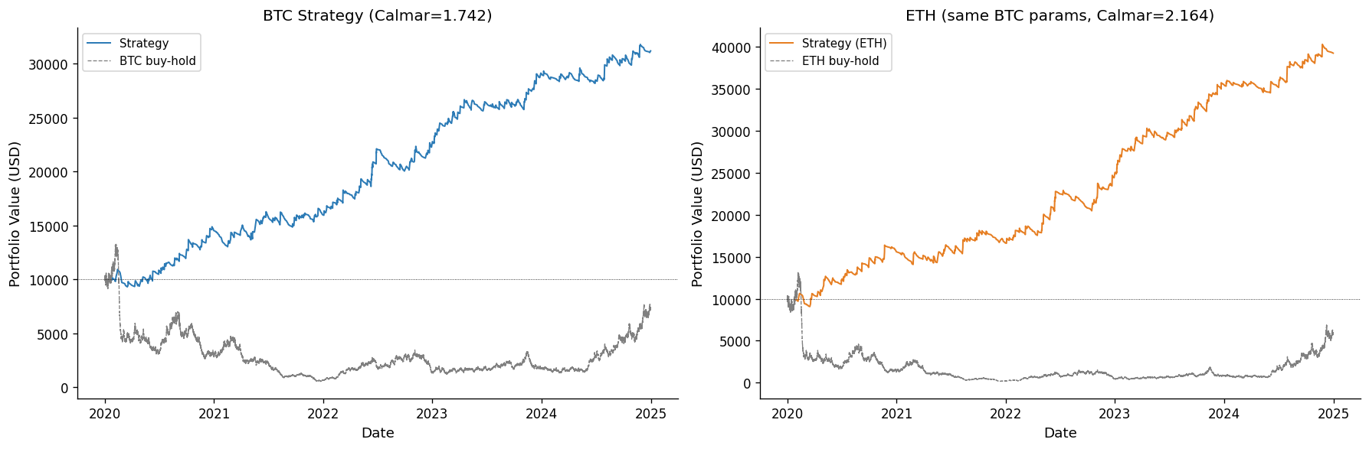
Extension: Cross-Asset Validation
BTC-ETH funding correlation ~0.7+
ETH positive Calmar with BTC params (no re-fit)
Cross-asset validation: funding contrarian is a microstructure effect, not BTC-specific noise

Slide 14
Conclusion
Key Findings
Backtest Results
Hypothesis Results
• Funding contrarian effect is real
• Economic basis: crowding + margin
• IC significant at 24h horizon
• OOS positive (40-60% degradation)
• Cross-asset validated on ETH
• Calmar: ~0.11
• Sharpe: ~0.77
• Max DD: ~14%
• Win Rate: ~54%
• Trades: ~125 (4 years)
• H1: ✓ Supported
• H2: ~ Mixed
• H3: ✓ Supported
• H4: ~ Partial
Risks & Limitations
• Tail events: LUNA-style collapse where funding stays extreme
• Regime dependence: better in high-volatility periods
• Market structure shift post-FTX may reduce effectiveness
• Crowding risk if strategy becomes widely adopted

Slide 15
References
Bailey, D. H., & López de Prado, M. (2014). The Deflated Sharpe Ratio: Correcting for
Selection Bias, Backtest Overfitting, and Non-Normality. Journal of Portfolio
Management, 40(5), 94-107.
Brunnermeier, M. K., & Pedersen, L. H. (2009). Market Liquidity and Funding Liquidity.
The Review of Financial Studies, 22(6), 2201-2238.
Liu, Y., Tsyvinski, A., & Wu, X. (2022). Common Risk Factors in Cryptocurrency.
The Journal of Finance, 77(2), 1133-1177.
Pardo, R. (2008). The Evaluation and Optimization of Trading Strategies (2nd ed.).
John Wiley & Sons.
Shleifer, A., & Vishny, R. W. (1997). The Limits of Arbitrage.
The Journal of Finance, 52(1), 35-55.

