Slide 1
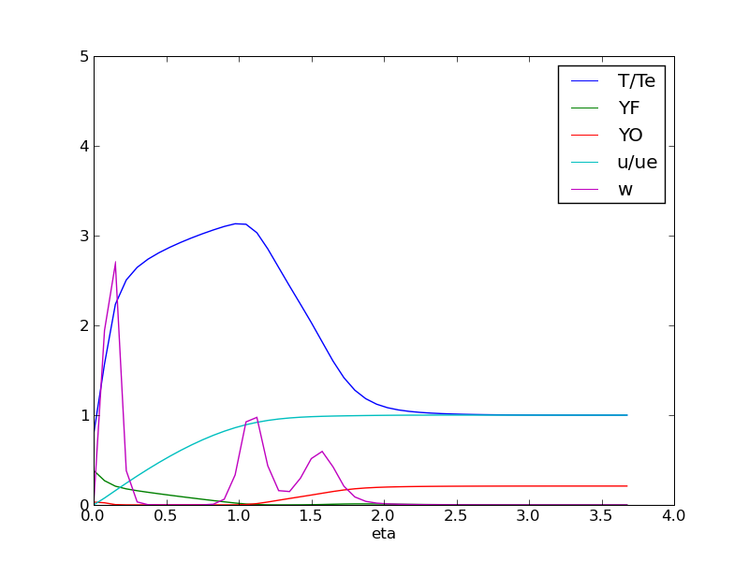
Combustion of PMMA
Ignition in a hot convective stream
Phoebe Stierhoff

Slide 2
Non-dimensional Equations
solid heat up equations:
Heat loses from radiation, convection, and latent heat
Burning rate calculated from wall temperature and activation energy of solid

Slide 3
Gas heat up equations:
Initial conditions:
U=1
θ=1
YO=YOE
YF=0
f_{w}=0
Flow properties taken NIST and non-dimensional properties taken from Tien et al. 1978 (after multiplying by a factor of T_{e,old}/T_{e,new}=.3333

Slide 4
Methodology
Used method from Tien et al. (1978) modified to include solid
Computed in python
Non-dimensional time stepping
Usually the non dimensional time step for gas phase should be much smaller than the time step for gas phase
However, this takes an unmanageable number of iterations to reach steady state
Use large solid time step after checking for discrepancies

Slide 5
Results
a=30, YOE=.21
Steady state peaks at 3
Begins with large peak, diverges into 2
Peak closest to the solid burns away oxygen
Second peak splits, and the peak furthest from the solid burns away fuel not in the premixed zone
The middle peak becomes the steady state reaction

Slide 6
Ignition limits for a, YOE
When the stretch rate is increased, the reaction is wider and occurs later. Small stretch rates react very quickly over a very narrow η
There does not appear to be a lower limit on the stretch rate (assuming YOE is high enough)
At high stretch rates, blowout occurs
Increasing YOE causes the reaction to occur sooner
No apparent upper limit
Lower limit ~0.06

Slide 7
Reaction at extinction limit
Small reaction similar to ignition reaction, but reaction ends by the time steady state is reached

Slide 8
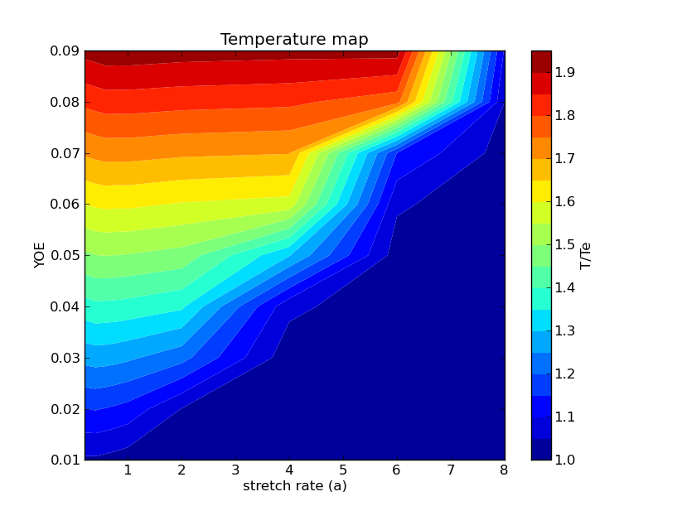

Slide 9
References
Çengel, Yunus A., Robert H. Turner, and John M. Cimbala. Fundamentals of Thermal-fluid Sciences. Boston: McGraw-Hill, 2008. Print.Used NIST database CD to find certain air property values
Tien, J., S. Singhal, D. Harrold, and J. Prahl. "Combustion and Extinction in the Stagnation-point Boundary Layer of a Condensed Fuel." Combustion and Flame 33 (1978): 55-68. Print.
Tien, James S. "Diffusion Flame Extinction at Small Stretch Rates: The Mechanism of Radiative Loss." Combustion and Flame 65 (1986): 31-34. Print.
Niioka, T. "Gas-phase Ignition of a Solid Fuel in a Hot Stagnation-point Flow." Symposium (International) on Combustion 18.1 (1981): 741-47. Print.

Slide 10
Questions?

