Slide 1

My Rent & Investment Estimator
End-to-End ML Pipeline, MLflow Tracking & Deployment with AWS SageMaker
ITI113 — Model Building and Machine Learning with AWS Sagemaker Studio
Team 08 • Presented by Terence Tye, Student ID 4697566D

Slide 2






Agenda
Problem & Dataset Preprocessing
Deployment
Prediction and Data Used
The real-time inference endpoint
System Architecture
Web Application & Live Demo
How the different processes fit together end to end
The Streamlit rent web application & Ngrok provide external excess
SageMaker Pipeline
Processing, training, evaluation, registration
Model & Experiment Tracking
Algorithm selection and the MLflow App
My Rent & Investment Estimator | ITI113 Team 08
2

Slide 3

Objective & Dataset at a Glance
Objective
~367,000
27
Predict monthly rental price for non-landed private residential units in Singapore, and translate that into an indicative investment value — to support rental and investment decisions across all 27 valid postal districts.
Rental Transactions
Valid Postal Districts
2021–2025
31
Transaction Period
Model Input Features
Source Data
Historical private-residential rental transactions across Singapore, 2021–2025. Feature engineering distilled this into 31 model inputs: 4 numeric fields plus 27 one-hot encoded districts (district 24 is not a valid postal district and is excluded).
My Rent & Investment Estimator | ITI113 Team 08
3

Slide 4

System Architecture
From raw data to a publicly accessible prediction app
→
→
→
→
Rental Data
SageMaker Pipeline
Real-Time Endpoint
Streamlit App
Public URL
S3 / CSV
Process → Train → Evaluate → Register
XGBoost model
Rent & investment estimator
via ngrok tunnel
Tracked in MLflow App
My Rent & Investment Estimator | ITI113 Team 08
4

Slide 5




SageMaker Pipeline: 4 Steps
1. Process
2. Train
3. Evaluate
4. Conditional Register
→
→
→
Clean raw transactions and build the 31 model features, including one-hot district encoding.
Fit an XGBoost regressor via a SageMaker Training Job; log parameters & metrics to the MLflow App.
Score the trained model against a test dataset and produce an evaluation report.
Register to the Model Registry only if the model clears a defined threshold of >0.8 for R2 score
My Rent & Investment Estimator | ITI113 Team 08
5

Slide 6
Model Selection
Several regression approaches were experiment before select the model
Random Forest Regressor as base model
Random Forest with hyperparameters tuning
Baseline linear approach is fast and interpretable, reduces overfitting,less sensitive to outliers and handles nonlinear relationships well
Find combination of settings that gives the best prediction performance with tuning on n_estimators(number of trees),max_depth(Max depth of each tree)
XGBoost — Selected
Comparison of 3 Models on MAE RMSE R2 Score
Model | MAE | RMSE | R2
RF Baseline | 0.660 | 1.05 | 0.795
RF Tuned | 0.675 | 1.05 | 0.795
XGBoost | 0.642 | 1.032 | 0.810
Gradient-boosted trees; selected for production based on regression performance with lowest MAE,RMSE and R2 score
My Rent & Investment Estimator | ITI113 Team 08
6

Slide 7


Experiment Tracking: MLflow App
Why a SageMaker MLflow App
No server to provision, patch, or keep alive — fully managed and serverless
Pipeline Run
logs params, metrics, tags
Addressed directly by ARN, found by name rather than assumed
↓
Every pipeline run logs parameters, metrics, and tags automatically
MLflow App
central experiment store, addressed by ARN
Model artifacts link directly to the corresponding Model Package
↓
Presigned URL
authenticated link to view runs in the UI
Jupyter Notebook: 4697566D_ITI113_experiment_SageMaker_mlflow_app_arn.ipynb
My Rent & Investment Estimator | ITI113 Team 08
7

Slide 8


Model Deployment: Real-Time Endpoint
Flexible Input
Validated Inputs
Accepts application/json or text/csv; JSON supports a compact single “district” field, expanded internally to the full one-hot form.
Bedroom count and floor area are checked to be whole numbers before scoring.
Versioned Naming
Dollar-Scaled Output
Endpoints follow sgp-rental-price-endpoint-v2-{model_package_version}, so each approved model gets its own named endpoint.
The model predicts on a thousands scale internally; the inference script rescales the response back to plain dollar amounts.
Jupyter Notebook:4697566D_ITI113_My_Rental_Pipeline__MLflow_App_Web_R1.ipynb
My Rent & Investment Estimator | ITI113 Team 08
8

Slide 9
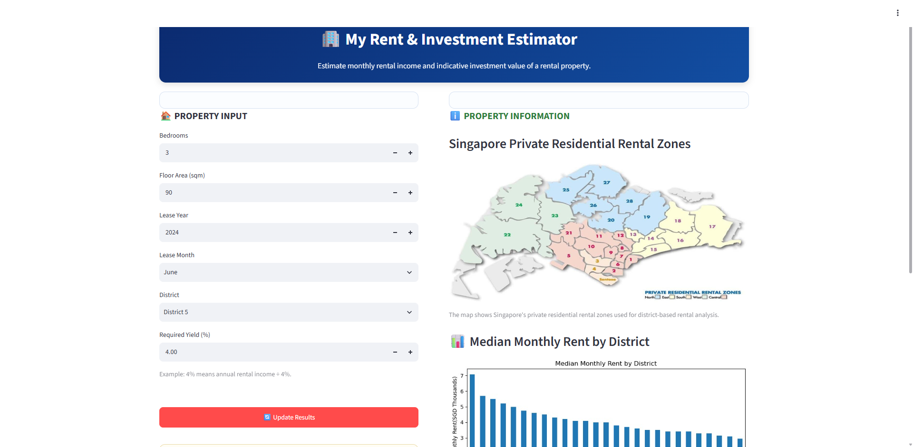
The Web Application
“My Rent & Investment Estimator” — built with Streamlit
Bedrooms, floor area, lease date, district, and required yield as inputs
Calls the SageMaker endpoint directly via boto3
Auto-discovers the live endpoint — no hardcoded, stale endpoint names
Reference map & median-rent-by-district chart to guide district selection
Converts predicted rent into an indicative investment value
My Rent & Investment Estimator | ITI113 Team 08
9

Slide 10

Public Access via ngrok
SageMaker Studio has no public HTTP endpoint of its own — ngrok tunnels the app out
→
→
→
→
Browser
ngrok Edge
ngrok Agent
Streamlit :8501
SageMaker Endpoint
anywhere on the internet
public HTTPS URL
running inside Studio
local web server
via boto3 + Studio IAM role
ngrok only relays HTTP traffic — it never talks to AWS. Predictions still run through the Studio instance's own IAM role, exactly as they would locally.
My Rent & Investment Estimator | ITI113 Team 08
10

Slide 11

Conclusion & Future Work
A complete MLOps workflow on AWS SageMaker — automated training, managed experiment tracking, conditional registration, real-time serving, and a public-facing application — with each layer able to evolve independently.
Where this could go next:
Add authentication to the public-facing application
Move from ngrok to persistent hosting (EC2 / App Runner) for production availability
Incorporate clustering-based features explored earlier as candidate model inputs
Add automated monitoring and drift detection on the deployed endpoint
Thank you
My Rent & Investment Estimator | ITI113 Team 08
12

