Slide 1
Web design, CSS basics
By Tyler Farrell class of 2027

Slide 2
Definition of CSS
CSS or cascading style sheets is as the name implies a way to style html and JS pages with different colors, fonts, and etc.

Slide 3
Key Terms
Color: this changes the color of the specified element text background etc.
ID: identifies a specific element
Font style: changes the font style

Slide 4
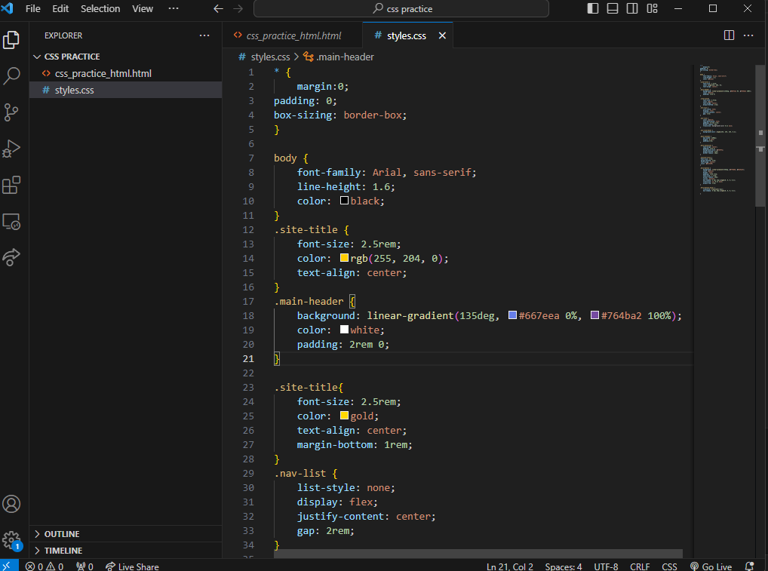
Visual example

Slide 5
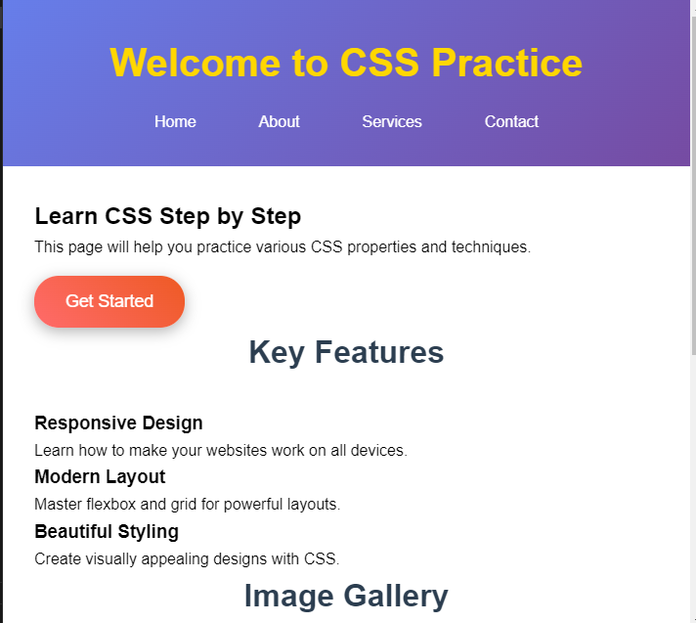
Applied example

Slide 6
Common mistakes
TIPS
Always ensure that your text is spelled correctly
Always check the website to know if that’s what you want it to look like

Slide 7
Key takeaways
This is an important topic as CSS is a vital part of building and designing a website and is an extremely valuable skill no matter what you do.

