Slide 1
Matlab Tutorials Part 1: Data Analysis
By: Tyler Montcalm

Slide 2
Glossary
Function: Something we create in programming that has a job, example “tell me if the number is greater then 5 and send me back “true” if true.”
For Loop: A programming statement that says to do something for x amount of tries
If Statement: A programming statement that asks IF something is true or false
Matrix: A rectangular array
Column: Vertical line in a matrix
Row: Horizontal line in a matrix
Latitude: Horizontal lines
Longitude: Vertical lines
GPS: Latitude/Longitude measurements (Where we are on earth)
SAS: Steering Angle Sensor

Slide 3
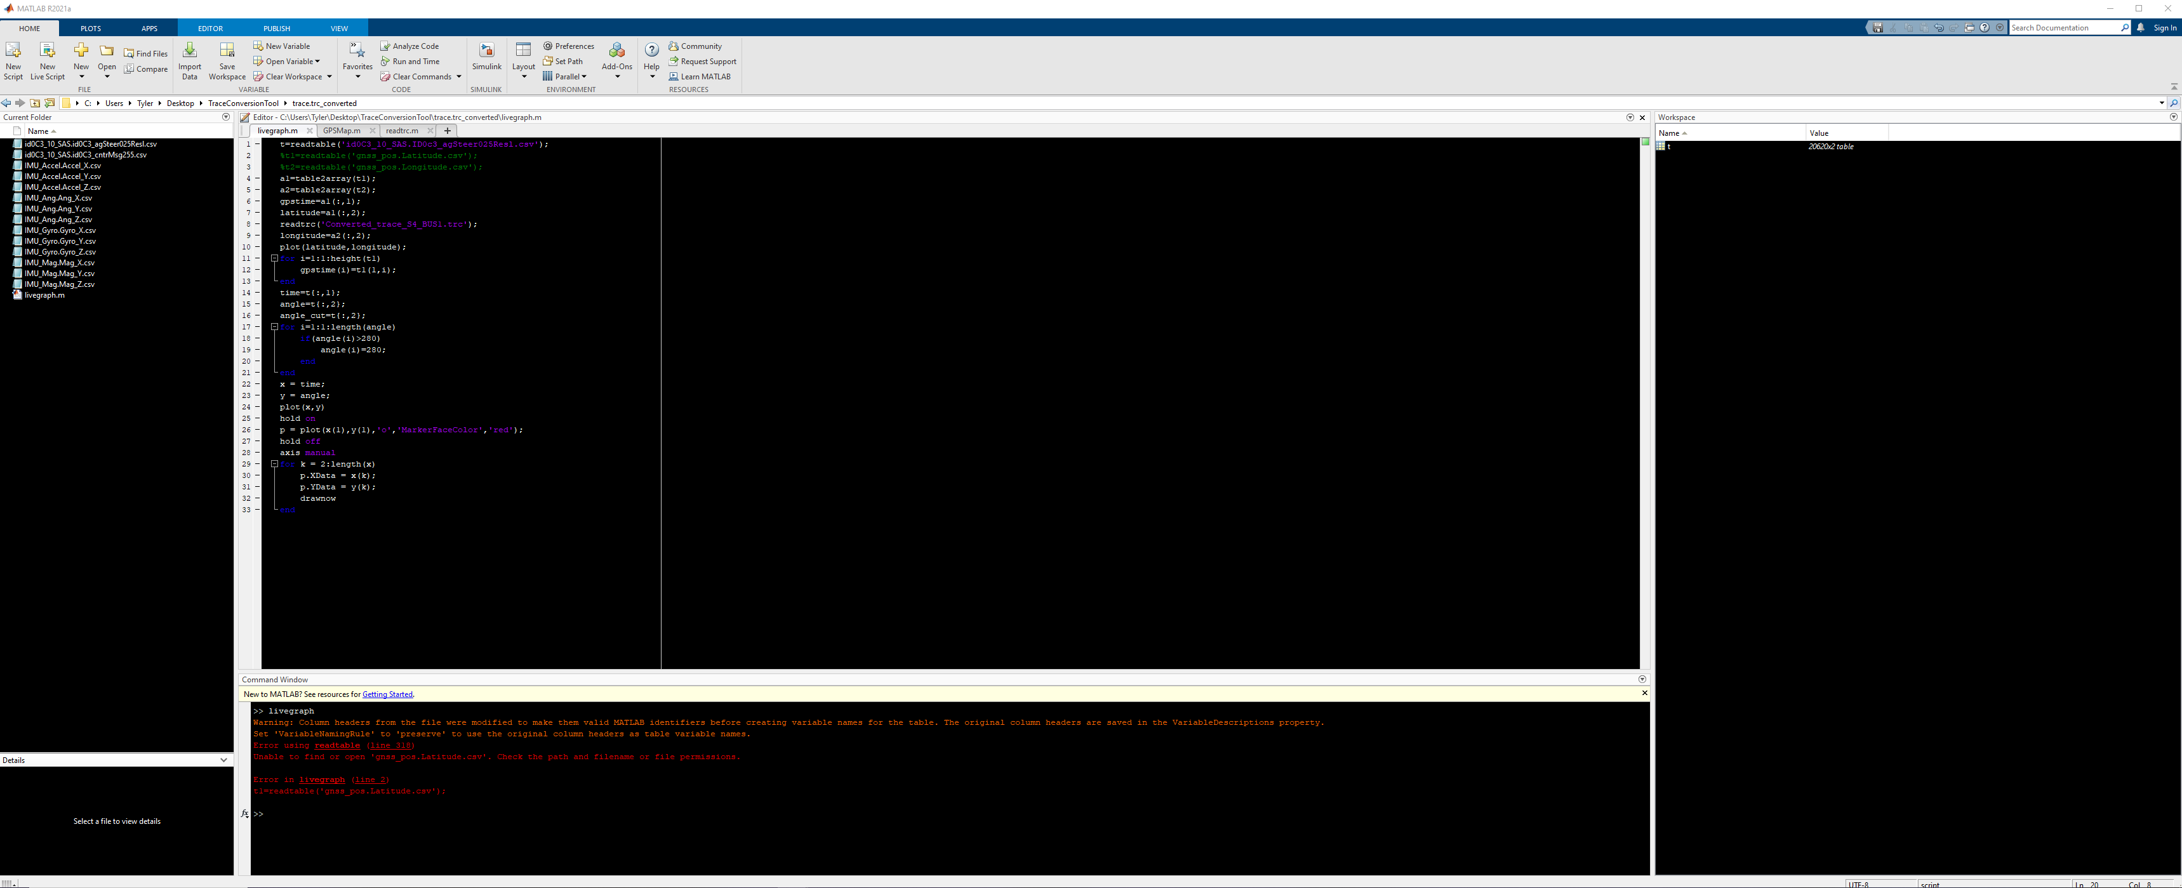
Basics (Environment setup)
Toolstrip
Editor
Workspace
Working Folder
Console

Slide 4
Basics (Environment setup)
1. We can adjust the size of these zones
2. We can change background colors
3. We can hide zones and restore them
4. We can have multiple “windows” of editor

Slide 5
Basics
What is Matlab used for?
Data Analysis
Control systems code
Control system simulation
There are:
Scripts
Functions
Code Blocks
Basic “Script” uses in the console/code:
1. clc
(Clears all text from your console)
2. clear all
(Clears all data from your workspace

Slide 6

Importing Data
Importing data is bringing data in from wherever you have it to the workspace (Data storage) for analysis
1. Manual:
Manually works well but won’t be automatic when you run a script or give that script to someone to re-use
2. Automatic:
Automatic allows you to create a script that can be used by anyone after.
Ex: I made a script that draws a map with gps coordinates, if you want to use it manually: You have to tell the next person to use your script to “import the latitude/longitude as a table” before running the script

Slide 7
Useful functions
Readtable()
Table2array()
Plot()
Drawnow
linspace()
Max() min()
Disp()
Fit()

Slide 8

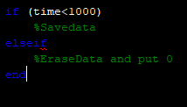
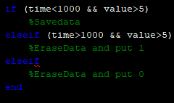



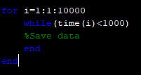
Basic Programming (For/If/While)
1. If statement
2. For Loop
3. While Loop

Slide 9
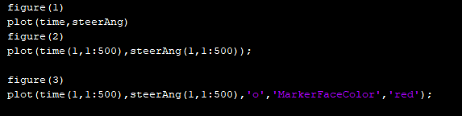
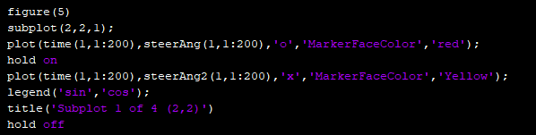
Plotting

Slide 10
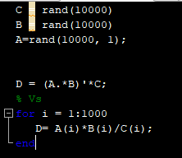
Best Practices
My script is running slow!
A: The most common mistake is to use for loops in Matlab but to NOT use matrix multiplication operators.
Example:

Slide 11
Example 1: Live Graph

Slide 12
Example 2: Animations

Slide 13
Matlab Tutorials Part 2: Simulink & Control Systems
By: Tyler Montcalm

Slide 14
What is Simulink
It’s a visual to code that uses blocks and pre-defined functions instead of statements etc. Pure code functions still exist but are often ignored. It has some benefits and some downsides.

Slide 15
Simulink vs C++ compiler
Positives
Much easier to pick up as a newbie
Easier to “simulate” and debug then with hardware.
A lot of available libraries that already exist
Negatives
Requires time to make the code look “clean”
Costs money
There are limitations to what you can do
Sometimes simple math takes more time to code then in c++ for example.

Slide 16
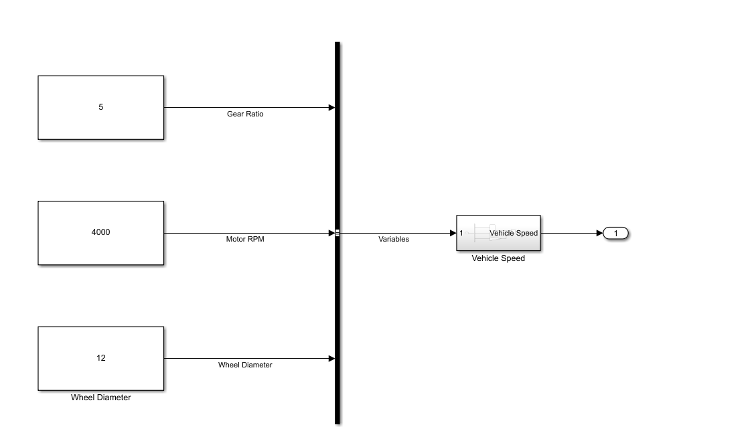
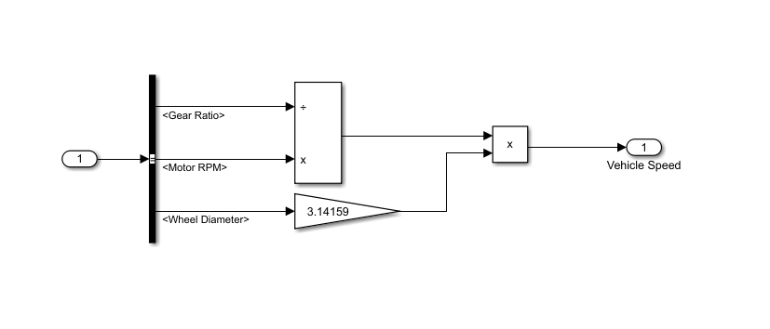
How does it work

Slide 17
Example 1: Simple Vehicle Speed

Slide 18
Example 2: Building OpenEcu Code
How does it build
Why do we need to build code this way
What is INP/FLT/CAS/CTR/OUT
Step By step explanation
Build a code from scratch for an example picked from someone

