Slide 1
Matlab Tutorials Part 1: Data Analysis
By: Tyler Montcalm

Slide 2
Glossary
Function: Something we create in programming that has a job, example “tell me if the number is greater then 5 and send me back “true” if true.”
For Loop: A programming statement that says to do something for x amount of tries
If Statement: A programming statement that asks IF something is true or false
Matrix: A rectangular array
Column: Vertical line in a matrix
Row: Horizontal line in a matrix
Latitude: Horizontal lines
Longitude: Vertical lines
GPS: Latitude/Longitude measurements (Where we are on earth)
SAS: Steering Angle Sensor

Slide 3
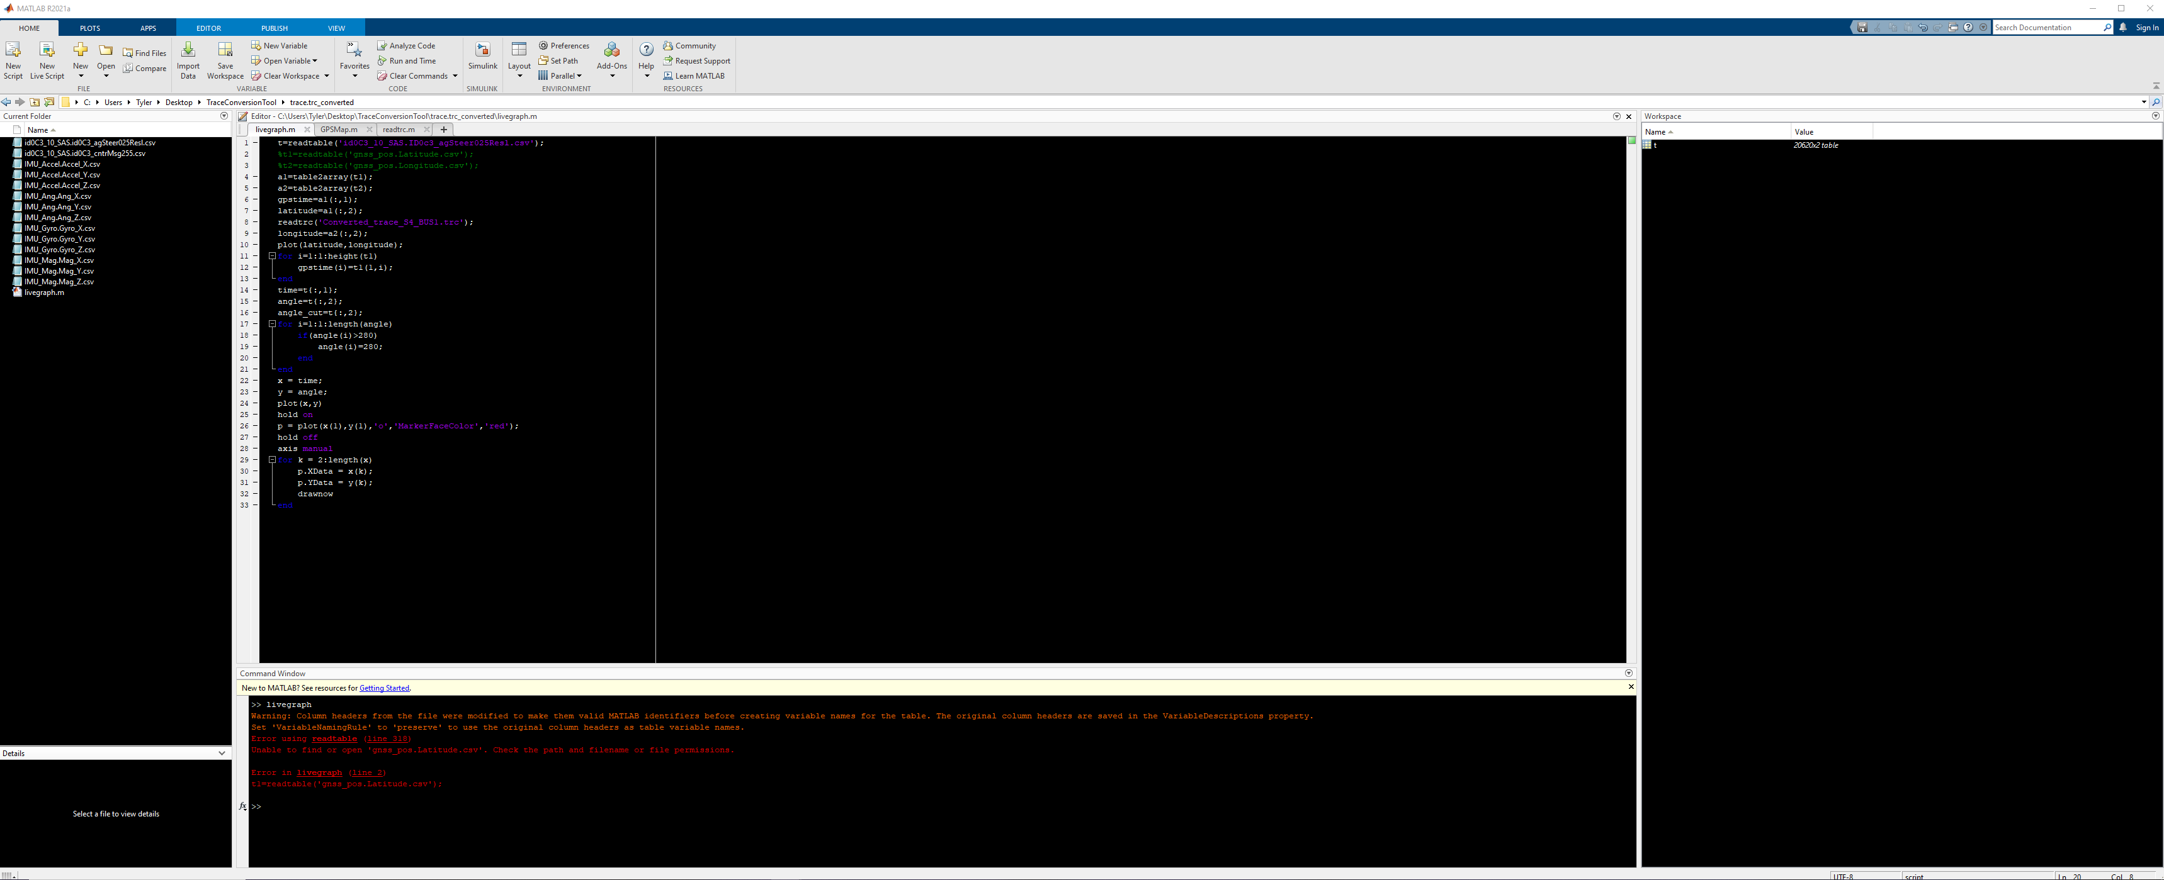
Basics (Environment setup)
Toolstrip
Editor
Workspace
Working Folder
Console

Slide 4
Basics (Environment setup)
1. We can adjust the size of these zones
2. We can change background colors
3. We can hide zones and restore them
4. We can have multiple “windows” of editor

Slide 5
Basics
What is Matlab used for?
Data Analysis
Control systems code
Control system simulation
There are:
Scripts
Functions
Code Blocks
Basic “Script” uses in the console/code:
1. clc
(Clears all text from your console)
2. clear all
(Clears all data from your workspace

Slide 6

Importing Data
Importing data is bringing data in from wherever you have it to the workspace (Data storage) for analysis
1. Manual:
Manually works well but won’t be automatic when you run a script or give that script to someone to re-use
2. Automatic:
Automatic allows you to create a script that can be used by anyone after.
Ex: I made a script that draws a map with gps coordinates, if you want to use it manually: You have to tell the next person to use your script to “import the latitude/longitude as a table” before running the script

Slide 7
Useful functions
Readtable()
Table2array()
Plot()
Drawnow
linspace()
Max() min()
Disp()
Fit()

Slide 8

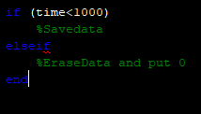
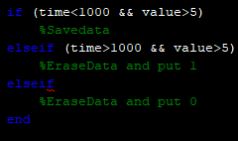



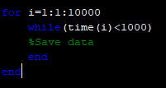
Basic Programming (For/If/While)
1. If statement
2. For Loop
3. While Loop

Slide 9
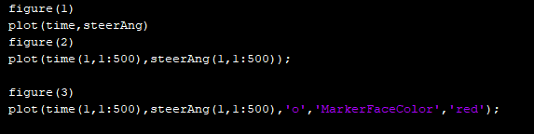
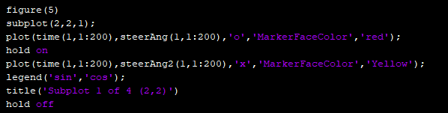
Plotting

Slide 10
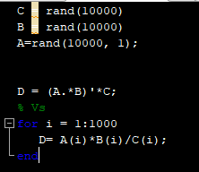
Best Practices
My script is running slow!
A: The most common mistake is to use for loops in Matlab but to NOT use matrix multiplication operators.
Example:

Slide 11
Example 1: Live Graph

Slide 12
Example 2: Animations

Slide 13
Matlab Tutorials Part 2: Simulink & Control Systems
By: Tyler Montcalm

