Slide 1
WIGWAM Introduction
Workspace for Image Generation, Workflows, and Artifact Management

Slide 2
Desired features
Full-stack image creation
Configurable, cross-platform builds, easy interface with additional options for those who need them
Artifact management with minimal network usage
Online binaries can be cached to a local system for given tests or by other search terms
Binaries already cached will not be re-downloaded
Easy workflow testing
Workflows tests can be performed and updated simply and flexibly

Slide 3
Building the isce3 stack
In 3 commands (soon to be 1?)

Slide 4
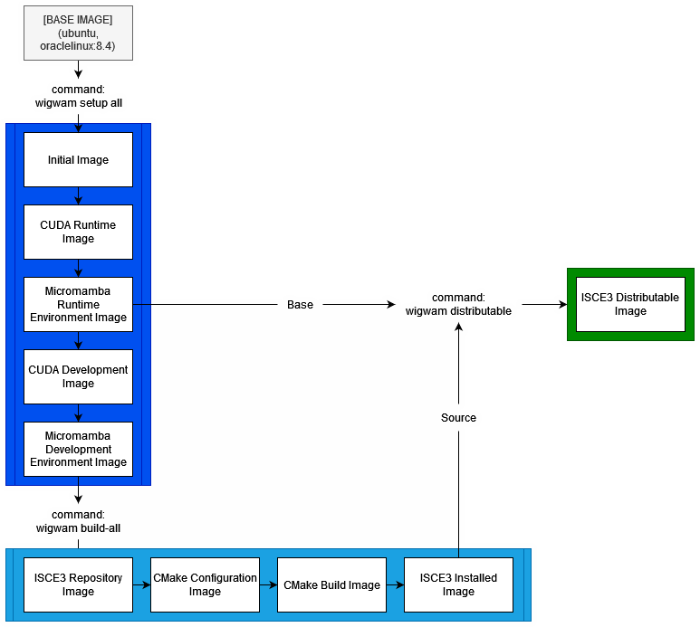

Slide 5
Setup all: build the isce3 environment Images

