Slide 1
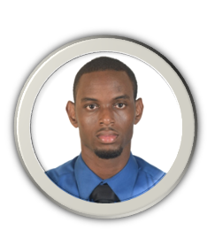
Tyler Foster
EXPERIENCE
PROJECTS
WISYNCO GROUP Brand Ambassador
Pets Eating Timing System (P.E.T.S.) Team Lead and Database Developer Fall 2018
This system permits the user to monitor and feed their pets remotely. Reduced expenditure by 25% from $80,000 to $60,000.
Differentiated P.E.T.S from competitors by gaining buy-in for suggestion to incorporate Wi-Fi functionality.
October 2017-Present
Increased brand awareness with target market by enthusiastically educating prospective customers about the suite of products offered by the company.
Enhanced customer service by accurate and timely responses to customers queries and recommendations to supervisors based on high-level product knowledge.
Delivered accurate Promotional Report documentation of daily activities such as opening and closing stock of featured products.
SKILLS
LIME JAMAICA LIMITED, MANDEVILLE
Card Sales Representative
MICROSOFT OFFICE
UNITY GAME DEV
[2012-2014
PHOTOSHOP
Generated card sales of up to $150,000 per day.
Awarded the Most Outstanding Sales Representative, 2013.
Responded to customer queries with quality information and timeliness, based on strong product knowledge.
TEAM MANAGEMENT
SOCIAL MEDIA MARKETING
PROGRAMMING LANGUAGES
C++
PHP
PYTHON
EDUCATION
Northern Caribbean University
3.62
Date August 2014-August 2019
Computer Information Systems BSc
GPA
ABILITIES
YEARS OF EXPERIENCE
www. http://www.tylerfoster.xyz/
SOCIAL MEDIA MARKETING
8
tyler.a.foster@gmail.com
PROJECT MANAGEMENT
10
WEBSITE DEVELOPMENT
7
1-(876)-798-2976
GRAPHIC DESIGN
3.5

